Slide 1
Longitudinal diagnostic models
for small sample size contexts
Pablo Nájera, Miguel A. Sorrel, Hyunjee Oh, & Chia-Yi Chiu

Slide 2
Cognitive diagnosis modelling
Cognitive diagnosis modelling (CDM) is a family of confirmatory statistical models that can be understood either as:
restricted latent class models, or
multidimensional item response theory (IRT) models with discrete latent variables
These models have been primarily employed in educational assessments, where the detailed feedback they provide can help identify students’ strengths and weaknesses objectively and in a timely manner (de la Torre & Minchen, 2014; Paulsen & Svetina, 2022)

Slide 3
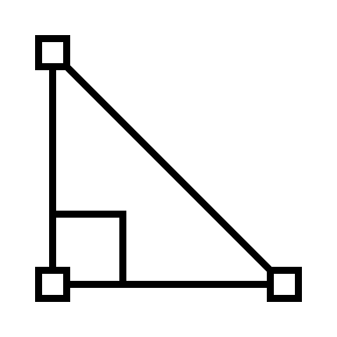


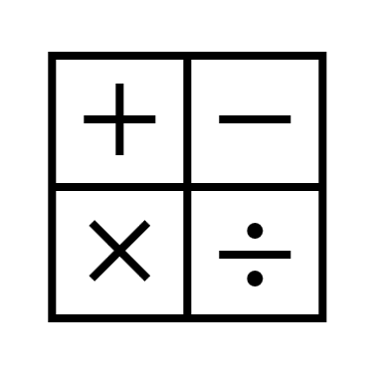







Cognitive diagnosis modelling
Summative assessments
Diagnostic assessments

Slide 4











Cognitive diagnosis modelling
Inputs
Responses
Q-matrix
Probability / Classification
Outputs
…
…
…
…
…
…
…
…
…
Reliability
…
Estimation of the
% of correct classifications
Response process
Item parameters
P ( | )
P ( | )
Fit
Relative and absolute fit

Slide 5
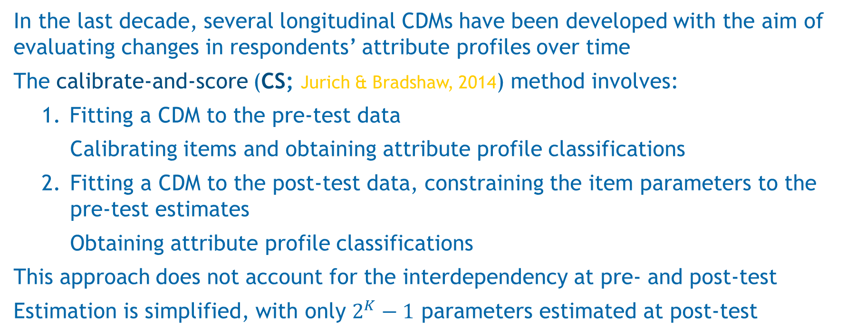
Longitudinal CDM
In the last decade, several longitudinal CDMs have been developed with the aim of evaluating changes in respondents’ attribute profiles over time
The calibrate-and-score (CS; Jurich & Bradshaw, 2014) method involves:
Fitting a CDM to the pre-test data
Calibrating items and obtaining attribute profile classifications
Fitting a CDM to the post-test data, constraining the item parameters to the pre-test estimates
Obtaining attribute profile classifications
This approach does not account for the interdependency at pre- and post-test
Estimation is simplified, with only $2^{K}−1$ parameters estimated at post-test

Slide 6
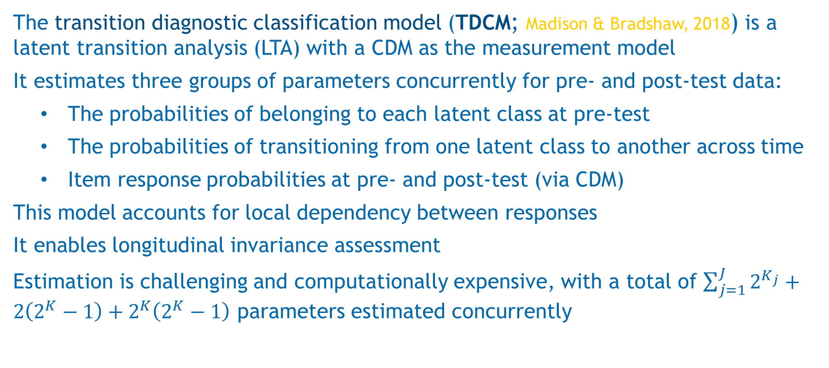
Longitudinal CDM
The transition diagnostic classification model (TDCM; Madison & Bradshaw, 2018) is a latent transition analysis (LTA) with a CDM as the measurement model
It estimates three groups of parameters concurrently for pre- and post-test data:
The probabilities of belonging to each latent class at pre-test
The probabilities of transitioning from one latent class to another across time
Item response probabilities at pre- and post-test (via CDM)
This model accounts for local dependency between responses
It enables longitudinal invariance assessment
Estimation is challenging and computationally expensive, with a total of $\sum_{j=1}^{J}{2^{K_{j}}}+2\left(2^{K}−1\right)+2^{K}\left(2^{K}−1\right)$ parameters estimated concurrently

Slide 7
Model complexity and sample size
CDM is a family of models with different item response functions and complexities
In order to provide accurate parameter estimates, traditional CDMs require:
Large sample sizes (N > 500; Sen & Cohen, 2021)
Simple Q-matrices, high-quality items, low dimensionality… (Sorrel et al., 2021)
Under suboptimal conditions, a more parsimonious model might provide more accurate parameter estimates and attribute classifications than a more complex one, even when the latter is the generating model (Nájera et al., 2023)

Slide 8
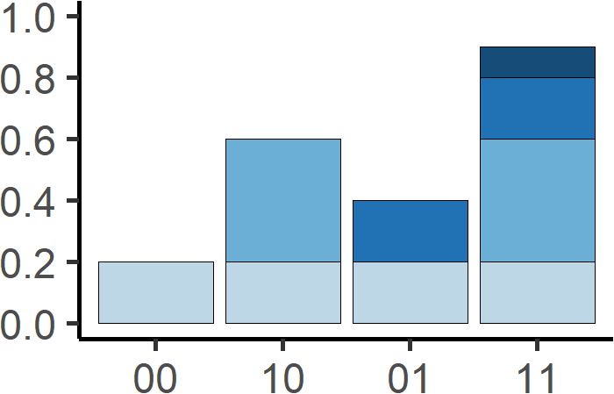
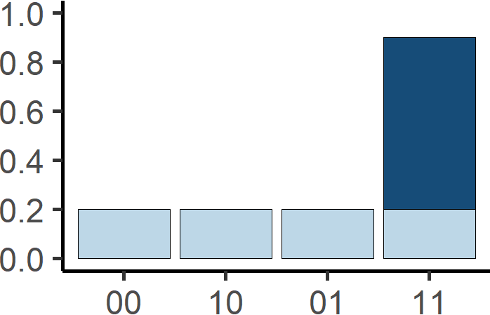
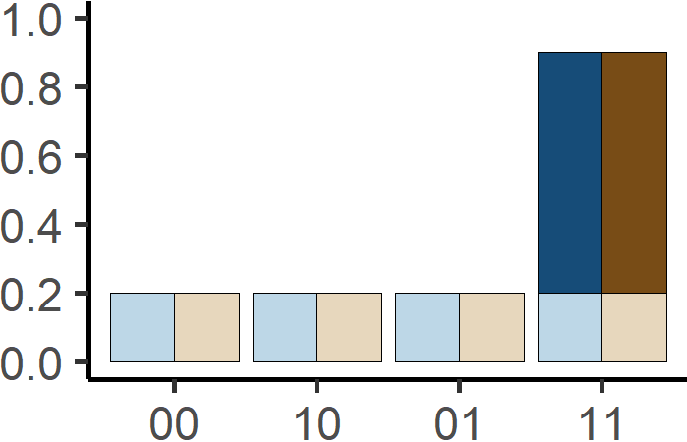
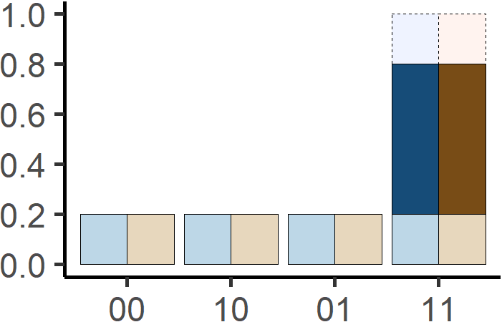


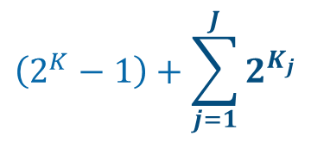

Model complexity and sample size
CDM is a family of models with different item response functions and complexities
G-DINA
(de la Torre, 2011)
DINA
(Junker & Sijtsma, 2001)
S-DINA
R-DINA
(Nájera et al., 2023)
$$\left(2^{K}−1\right)+\sum_{j=1}^{J}{2^{K_{j}}}$$
$$\left(2^{K}−1\right)+2J$$
$$\left(2^{K}−1\right)+2$$
$$\left(2^{K}−1\right)+1$$

Slide 9
The present study
Up to date, studies about longitudinal CDM have worked with relatively optimal contexts (e.g., simple Q-matrices) and large sample sizes (N > 1000)
The main objective of the present study is to elucidate the most optimal way of estimating longitudinal CDM in small sample size scenarios
Is the simplicity of the CS method enough to overcome its limitations and outperform the TDCM?
Can simpler models (e.g., R-DINA) provide more accurate parameter estimates and attribute classifications than the G-DINA model, even when the G-DINA is the true, generating model?

Slide 10

Simulation study design
Simulation factors
Methods
Generating model = G-DINA
Sample size = 25, 50, 100
Number of attributes = 3, 5
Q-matrix complexity = simple, complex (.45, .35, .20)
Item discrimination = 0.1, 0.2, 0.3
Probability of attribute mastery growth = 0.20
Probability of attribute mastery loss = 0.10
Item parameter drift = none, random
6 items per attribute, attribute correlations of 0.5
TDCM CS
$$×$$
G-DINA DINA S-DINA R-DINA
Dependent variables
Item parameter recovery
Transition probs. Recovery
Classification accuracy
Model fit

Slide 11
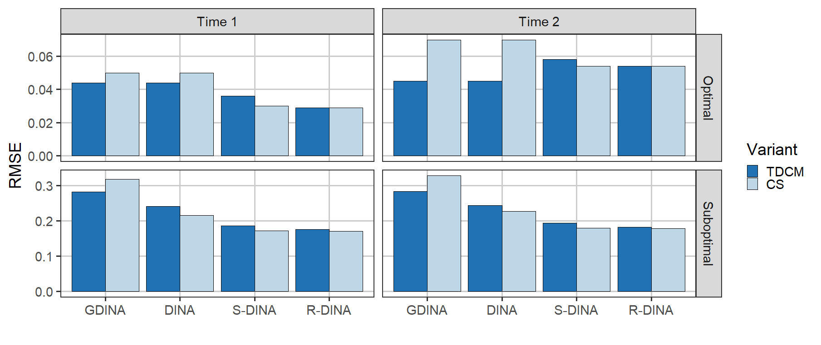
Results (I): Item parameter recovery

Slide 12
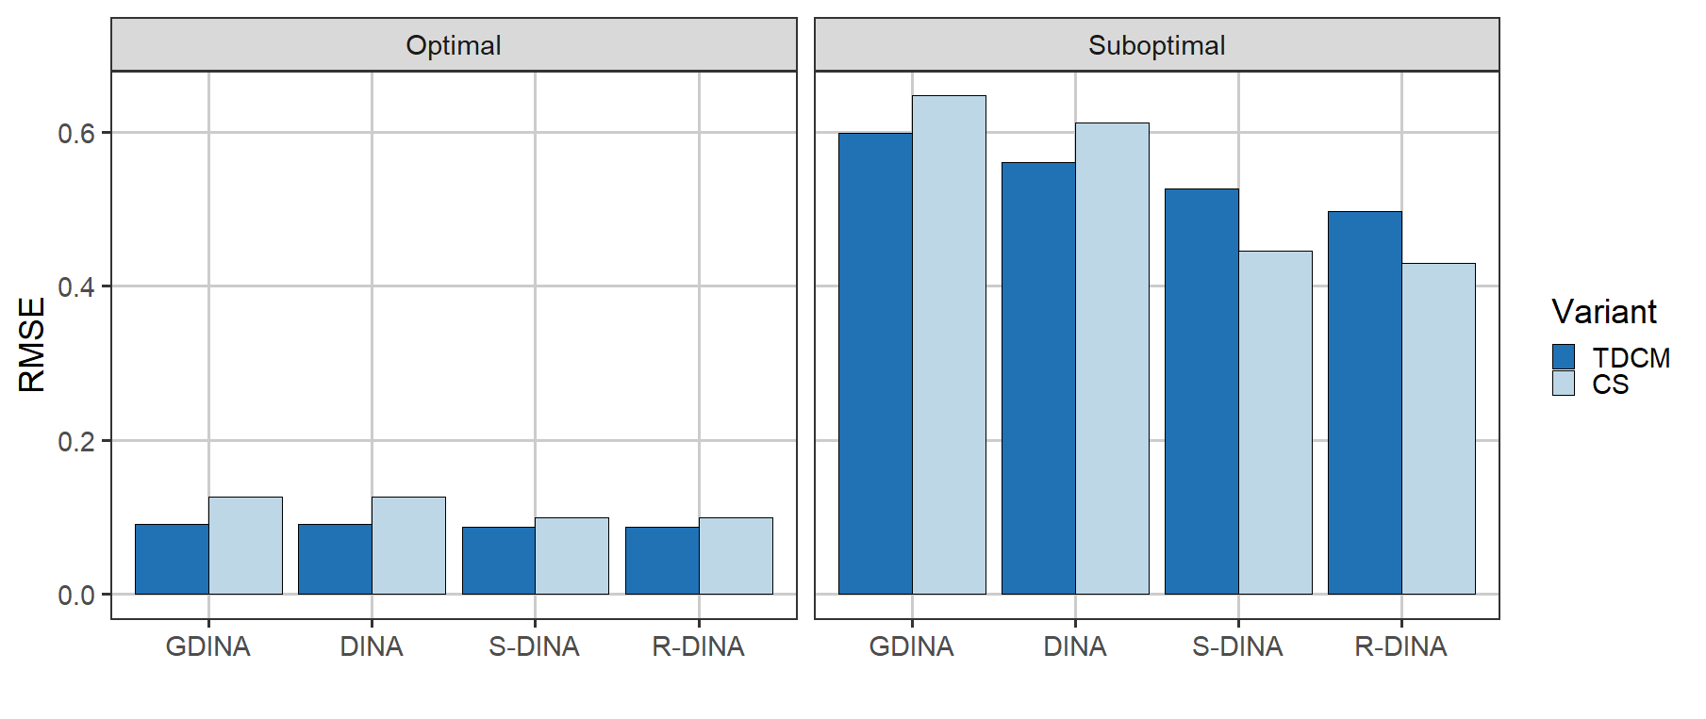
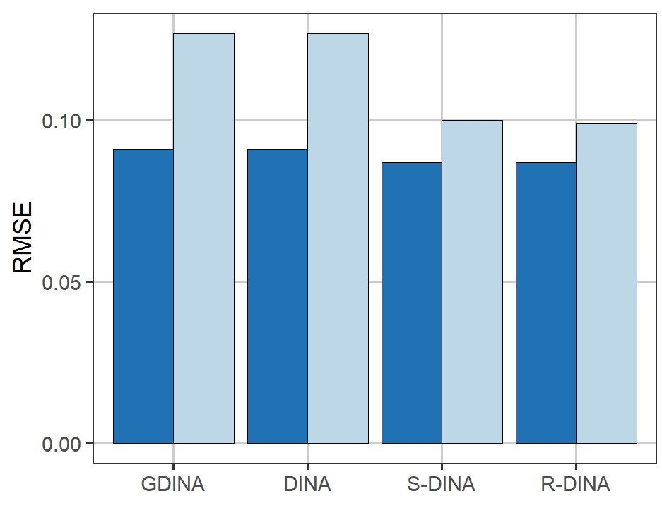
Results (II): Transition probabilities recovery

Slide 13
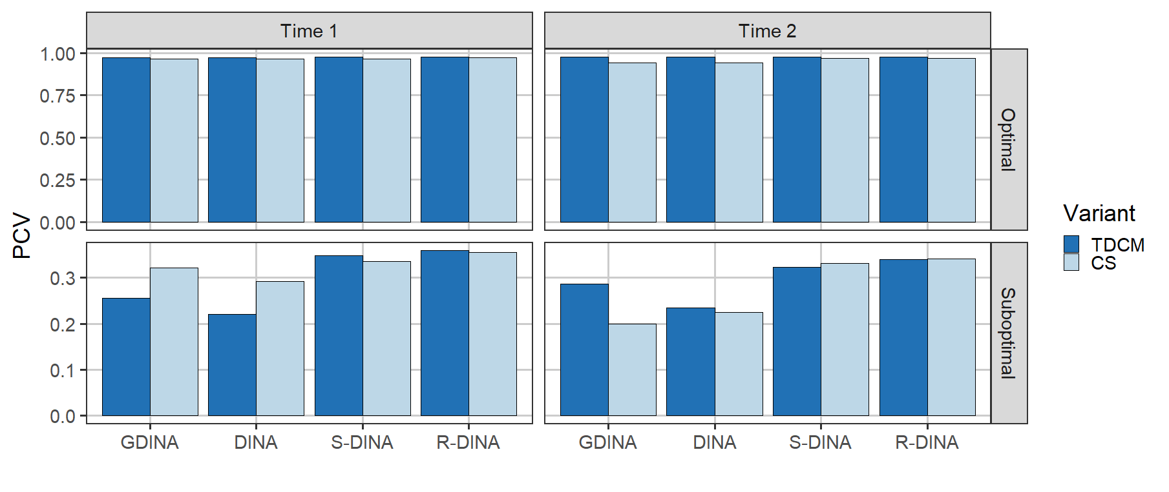
Results (III): Attribute classification accuracy

Slide 14
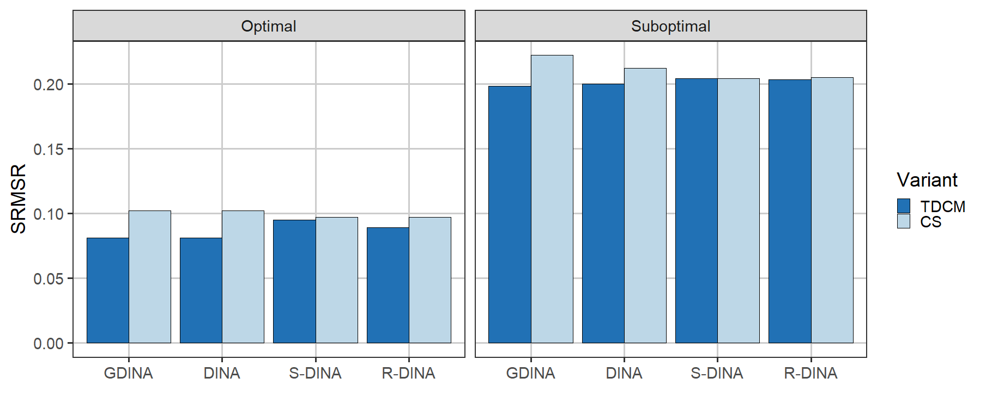
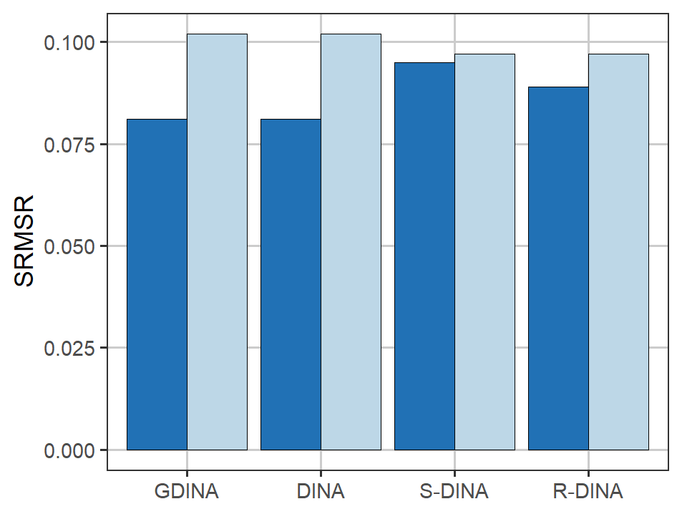
Results (IV): Absolute fit

Slide 15
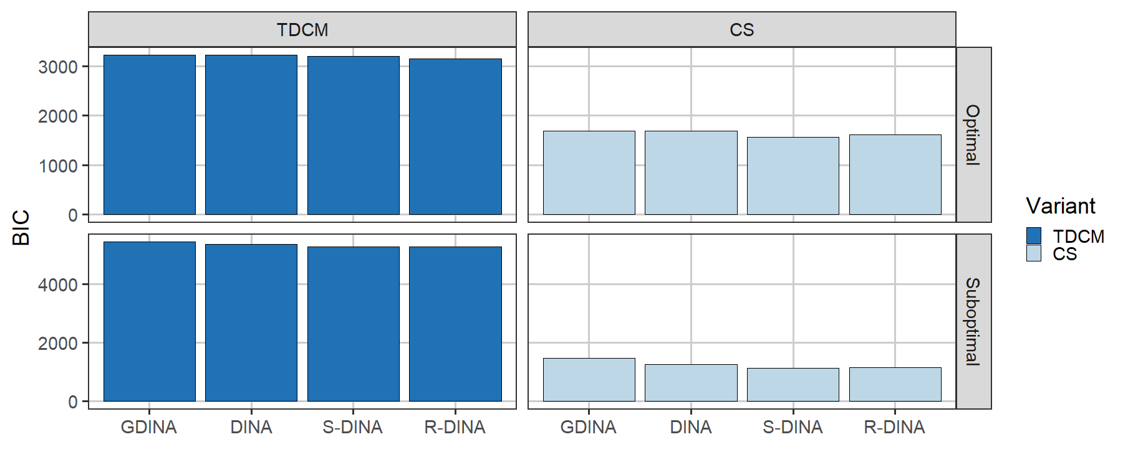
Results (V): Relative fit

Slide 16
Conclusions
More accurate parameter estimates and attribute profile classifications are provided by simple CDMs (S-DINA and R-DINA), especially under suboptimal conditions
Model fit is similar for all CDMs
The TDCM provides slightly better results with complex CDMs (G-DINA and DINA), especially under optimal conditions
The CS method provides slightly better results with simple CDMs (S-DINA and R-DINA), especially under suboptimal conditions
Overall…
1. S-DINA + CS 2. R-DINA + CS/TDCM 3. G-DINA + TDCM

Slide 17
Conclusions
Future extensions:
Anchor item design (e.g., different items on pre- and post-test)
  CDM classification invariance (Madison & Bradshaw, 2018)
Different modelling approaches of latent class transition
  Multilevel CDM (Huang, 2017)
  Hidden Markov models (Wang et al., 2018)
  Bayesian networks (Lee & Gu, 2024)

Slide 18

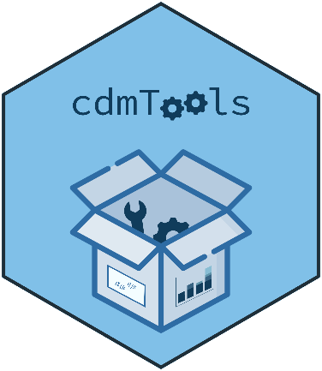
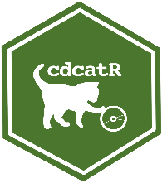








Conclusions
Research on CDM for small sample sizes
Model comparison to reduce complexity (Sorrel et al., 2021)
Reliability estimation via multiple imputation (Kreitchmann et al., 2023)
Estimation approaches for small samples (Sorrel et al., 2023; Nájera et al., 2023)
Computerized adaptive testing with no calibration sample (Nájera et al., 2025)
Miguel A. Sorrel
UAM, Spain
Francisco J. Abad
UAM, Spain
Rodrigo S. Kreitchmann
UNED, Spain
Jimmy de la Torre
HKU, Hong Kong
Scarlett Escudero
UMN, USA
Chia-Yi Chiu
CU, USA
Hyunjee Oh
CU, USA

Slide 19

Longitudinal diagnostic models
for small sample size contexts
Pablo Nájera, Miguel A. Sorrel, Hyunjee Oh, & Chia-Yi Chiu
Thank you!
pnajera@comillas.edu
This work was supported by the 2024 Call for Funding of Research Projects of Universidad Pontificia Comillas under the project
“Advancements in Cognitive Diagnosis Models for Formative Assessments”

Slide 20
References
de la Torre, J. (2011). The generalized DINA model framework. Psychometrika, 76(2), 179–199. https://doi.org/10.1007/s11336-011-9207-7
de la Torre, J., & Minchen, N. (2014). Cognitively Diagnostic Assessments and the Cognitive Diagnosis Model Framework. Psicología Educativa, 20(2), 89–97.
Huang, H. Y. (2017). Multilevel cognitive diagnosis models for assessing changes in latent attributes. Journal of Educational Measurement, 54(4), 440–480.
Junker, B. W., & Sijtsma, K. (2001). Cognitive assessment models with few assumptions, and connections with nonparametric item response theory. Applied Psychological Measurement, 25(3), 258–272. https://doi.org/10.1177/01466210122032064
Jurich, D. P., & Bradshaw, L. P. (2014). An illustration of diagnostic classification modeling in student learning outcomes assessment. International Journal of Testing, 14, 49–72.
Kreitchmann, R. S., de la Torre, J., Sorrel, M. A., Nájera, P., & Abad, F. J. (2022). Improving reliability estimation in cognitive diagnosis modeling. Behavior Research Methods, 55, 3446–3460.
Lee, S., & Gu, Y. (2024). Latent conjunctive Bayesian network: Unify attribute hierarchy and Bayesian network for cognitive diagnosis. The Annals of Applied Statisics, 18(3), 1988-2011.
Madison, M. J., & Bradshaw, L. P. (2018). Assessing growth in a diagnostic classification model framework. Psychometrika, 83(4), 963-990.
Nájera, P., Abad, F. J., Chiu, C.-Y., & Sorrel, M. A. (2023). The restricted DINA model: A comprehensive cognitive diagnostic model for classroom-level assessment. Journal of Educational and Behavioral Statistics, 48(6), 719-749.
Nájera, P., Sorrel, M. A., Chiu, C.-Y., & Abad, F. J. (2025). Variable-Length Cognitive Diagnostic Computerized Adaptive Testing in Small-Scale Assessments. [Manuscript submitted for publication].
Paulsen, J., & Svetina, D. (2022). Examining cognitive diagnostic modeling in classroom assessment conditions. The Journal of Experimental Education, 90(4), 916–933.
Sen, S., & Cohen, A. S. (2021). Sample Size Requirements for Applying Diagnostic Classification Models. Frontiers in Psychology, 11, 621251.
Sorrel, M. A., Abad, F. J., & Nájera, P. (2021). Improving Accuracy and Usage by Correctly Selecting: The Effects of Model Selection in Cognitive Diagnosis Computerized Adaptive Testing. Applied Psychological Measurement, 45(2), 112–129.
Sorrel, M. A., Escudero, S., Nájera, P., Kreitchmann, R. S., & Vázquez-Lira, R. (2023). Exploring Approaches for Estimating Parameters in Cognitive Diagnosis Models with Small Sample Sizes. Psych, 5, 336-349.
Wang, S., Yang, Y., Culpepper, S. A., & Douglas, J. (2018) Tracking Skill Acquisition with cognitive diagnosis models: a higher-order, hidden Markov model with covariates. Journal of Educational and Behavioral Statistics, 43(1), 57–87.

