Slide 1


Methodological Quality Profiles in Basketball: A Systematic Review of Studies based on Observational Methodology
Daniel López-Arenas, Susana Sanduvete-Chaves, M. Teresa Anguera & Salvador Chacón-Moscoso

Slide 2
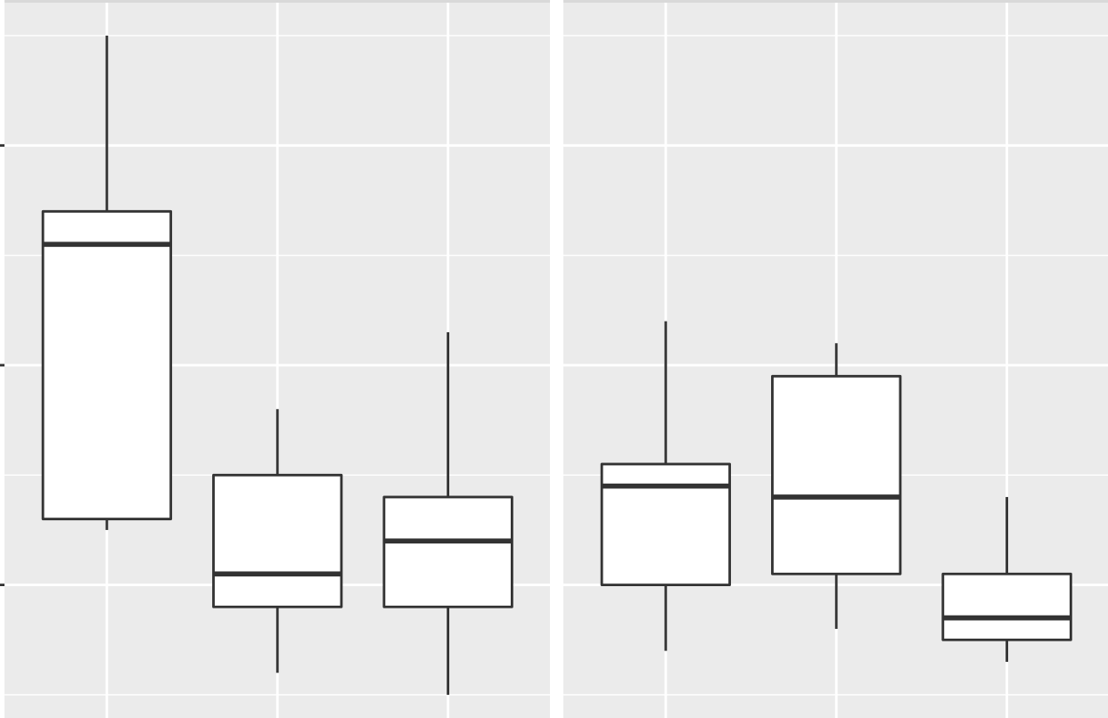
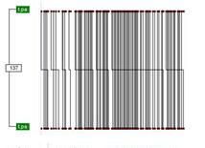
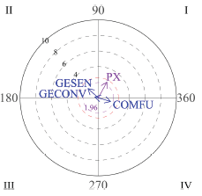
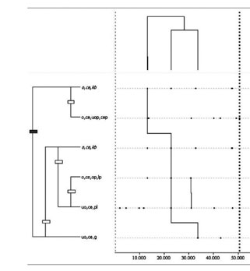
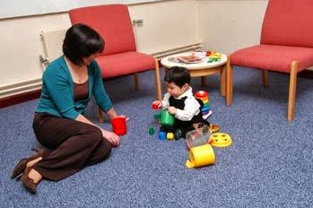
Observational Methodology
Observational methodology as a Mixed Methods approach
Natural Context
Ad hoc observational Instrument
Data Quality Control
Observational Design
Register
Data Analysis
Interpretation of results
QUALITATIVE STEP
QUANTITATIVE STEP
QUALITATIVE STEP
2

Slide 3
Observational Methodology
Work line of the research group
INNOEVALUA
2015
2018
2019
2025
Methodological Quality Checklist for studies based on Observational Methodology
(MQCOM)
(Chacón-Moscoso et al., 2019)
Guidelines for Reporting Experiments based on Observational Methodology
(GREOM)
(Portell et al., 2015)
Preliminary checklist for reporting observational studies
(Chacón-Moscoso et al., 2018)
Methodological Quality Scale for Observational Methodology
(MQSOM)
(Sanduvete-Chaves et al., 2025)
3

Slide 4
Methodological Quality Scale for Observational Methodology (MQSOM) (Sanduvete-Chaves et al., 2025)
Observational Methodology employment
ω = .87
D = .55
Observational Unit
Quality of Design
Temporality
Factor 1
Dimensionality
Codification Manual
Methodological Quality Overall
General Factor
Data Type
Observational Instrument
Software de Recording, Quality Control & Analysis Softwares
Factor 2
Quality of Measurement & Analysis
Type of Parameter
Data Quality Control
4
Data Analysis

Slide 5
Objectives
Significant differences between procedural characteristics
Obtention methodological quality profiles
5

Slide 6
Method
Participants
Instrument
Differences between characteristics
Methodological Quality Profiles
236 studies
  OM employed
  Applied on basketball
  Original empirical works
  Written in English or Spanish
  Following the standard publication format
Methodological Quality Scale for Observational Methodology
(MQSOM)
(Sanduvete-Chaves et al., 2025)
Proportion Analysis
  Ho = Proportion of 55 : 45
Two-Step Cluster Analysis
  Dimension reduction through PCA
  Cluster determination through BIC
6

Slide 7
Results (I): Proportion Analysis
Ratios to compare |  | Estimate | SE | 95% CI |  | Z_{Estimate} | p
 |  |  |  | LL | UL
Observational methodology specified | No observational methodology specified
104/220 = 0.47 | 116/220 = 0.53 | .527 | 7.42 | .459 | .595 | .74 | .458
Observational design | No observational design
37/220 = 0.17 | 183/220 = 0.83 | .832 | 7.42 | .776 | .879 | 9.78 | .000
Codification manual | No codification manual
138/220 = 0.63 | 82/220 = 0.37 | .627 | 7.42 | .560 | .691 | 3.71 | .000
Data type specified | No data type specified
46/220 = 0.21 | 174/220 = 0.79 | .791 | 7.42 | .731 | .843 | 8.56 | .000
Observational instrument | No observational instrument
89/220 = 0.40 | 131/220 = 0.60 | .595 | 7.42 | .527 | .661 | 2.76 | .006
Recording software | No recording software
105/220 = 0.48 | 115/220 = 0.52 | .477 | 7.42 | .410 | .545 | -.61 | .544
Quality control software | No quality control software
30/220 = 0.14 | 190/220 = 0.86 | .864 | 7.42 | .811 | .906 | 10.72 | .000
Analysis software | No analysis software
145/220 = 0.66 | 75/220 = 0.34 | .341 | 7.42 | .279 | .408 | -4.65 | .000
Sequency parameter | Frequency parameter
29/220 = 0.13 | 191/220 = 0.87 | .868 | 7.42 | .816 | .910 | 10.86 | .000
Data quality control | No data quality control
116/220 = 0.53 | 104/220 = 0.47 | .473 | 7.42 | .405 | .541 | -.742 | .458
Regularity detection | Inferential analysis
21/220 = 0.09 | 176/220 = 0.80 | .893 | 7.42 | .842 | .933 | 10.97 | .000
Inferential analysis | Descriptive/Qualitative analysis
176/220 = 0.80 | 23/220 = 0.11 | .884 | 7.42 | .832 | .925 | 10.78 | .000
Regularity detection | Descriptive/Qualitative analysis
21/220 = 0.09 | 23/220 = 0.11 | .523 | 7.42 | .367 | .675 | .151 | .880
Note. CI = confidence interval; LL = lower limit; UL = upper limit
7

Slide 8
Results (II): Methodological Quality Profiles
8
Profiles | Frequency | General Dimension | Dimension 1 Quality of Design | Dimension 2 Quality of Measurement & Analysis |  | Dimension 1: Quality of design |  |  |  |  | Dimension 2: Quality of measurement & analysis
 |  |  |  |  |  | Observational methodology | Observational design | Codification manual | Data Type |  | Observation instrument | Software |  |  | Parameter | Data quality | Data analysis
 |  |  |  |  |  |  |  |  |  |  |  | Recording | Quality control | Analysis
1 | 20 | 0,88 | 0,87 | 0,89 |  | Specified | Mostly specified | Specified | Frequently Type IV/ Rarely Type II |  | Specified | Specified | Frequently employed | Employed | Sometimes duration/ Occasionally order | Quantitative | Usually regularity detection
2 | 86 | 0,47 | 0,30 | 0,67 |  | Sometimes specified | Rarely specified | Often specified | Occasionally Type II/ Rarely Type IV |  | Sometimes specified | Sometimes specified | Rarely employed | Sometimes employed | Mostly frequency | Usually quantitative | Often inferential analysis
3 | 114 | 0,24 | 0,08 | 0,41 |  | Rarely specified | Not specified | Occasionally specified | Occasionally Type II/ Rarely Type I |  | Rarely specified | Rarely specified | Not employed | Occasionaly employed | Mostly frequency | Usually not employed | Usually inferential analysis

Slide 9
Discussion (I)
Only 47% of papers included are identified as observational methodology studies.
  Consequently, key observational-methodology elements are mainly ignored, such as observational design (83% of papers), observational instrument (60%) or data type (79%).
Observational Design
Observational Instrument
Qualitative Data
Data Quality Control
Quantitative Parameter
Data Analysis
Interpretation of results
Register
QUALITATIVE STEP
QUANTITATIVE STEP
QUALITATIVE STEP
9

Slide 10
Discussion (II)
Proportion analysis in basketball matched some of the procedural positioning in football (e.g. coding manual or analysis software mainly specified, data type or quality control software mainly ignored, etc.), but represent a methodological quality setback in others:
  Observational design and observational instrument are mainly ignored in basketball, while in football no significant differences were found
  No significant differences were found in basketball in terms of recording software or data quality control, while in football both elements were mainly specified
10

Slide 11
Discussion (III)
Cluster analysis allowed to distinguish between three procedural profiles in decreasing order of methodological quality:
  Profile 1: High methodological quality level (for both Design and Measurement & Analysis)
  Profile 2: Low methodological quality (low for Design and moderate for Measurement & Analysis)
  Profile 3. Low methodological quality (for both Design and Measurement & Analysis)
11

Slide 12
Conclusion
The best MQ profile in basketball matched the best MQ profile in football, but the 2nd and 3rd profiles matched the lowest profiles in football (4th and 5th)
    Methodological Quality seems to be polarized in basketball research based on observational methodology
90.91% of studies scored low (below 0.5) on the MQSOM scale
It is essential to disseminate the scale among applied basketball researchers and editorial boards
12

Slide 13
References
Anguera, M. T. (1993). Observational Methods (General). In R. Fernández-Ballesteros (Ed.), Encyclopedia of Psychological Assessment, Vol. 2 (pp. 632-637). Sage.
Chacón-Moscoso, S., Anguera, M. T., Sanduvete-Chaves, S., Losada, J. L. y Portell, M. (2019). Methodological quality checklist for studies based on observational methodology (MQCOM). Psicothema, 31 (4), 458-464. https://doi.org/10.7334/ psicothema2019.116
Chacón-Moscoso, S., Sanduvete-Chaves, S., Anguera, M. T., Losada, J. L., Portell, M. y Lozano-Lozano, J. A. (2018). Preliminary checklist for reporting observational studies in sports areas: Content validity. Frontiers in Psychology, 9, 291. https://doi.org/10.3389/fpsyg.2018.00291
Portell, M., Anguera, M. T., Chacón-Moscoso, S. y Sanduvete-Chaves, S. (2015). Guidelines for reporting evaluations based on observational methodology. Psicothema, 27 (3), 283-289. https://doi.org/10.7334/psicothema2014.276
Sanduvete-Chaves, D., López-Arenas, D., Anguera, M. T., & Chacón-Moscoso, S. (2025). A Scale for Evaluating the Methodological Quality of studies based on Observational Methodology. Psicothema, 37(1), 1-10. https://doi.org/10.70478/psicothema.2025.37.01
13

Slide 14
Methodological Quality Profiles in Basketball: A Systematic Review of Studies based on Observational Methodology
Thank you for your attention
This work was supported by the research project PID2020-115486GB-I00 funded by the Ministerio de Ciencia, Innovación y Universidades, MICIU/AEI/10.13039/501100011033, Government of Spain. We gratefully acknowledge the support of the Chilean government project FONDECYT Regular 1250316 funded by the National Fund for Scientific and Technological Development, ANID; the Julio Olea Grant for Young Researchers from the Spanish Association for Methodology of Behavioral Sciences (AEMCCO); the Research Group of the Generalitat de Catalunya (Grup de Recerca e Innovació en Dissenys [GRID] “Tecnología i aplicació multimedia i digital als dissenys observacionals” [grant number 2021 SGR 00718] (2022-2024); and the support of the Project funded by the Spanish government “Integration between observational data and data from external sensors: Evolution of the LINCE PLUS software and development of the mobile application for the optimization of sport and physical activity beneficial to health” [EXP_74847] (2023), Ministry of Culture and Sport, Higher Council of Sport and the European Union.
14

