Slide 1

Instruments for measuring Mathematical Anxiety in the last 10 years: what we know and what we can do.
Laura Barrera Romero

Slide 2
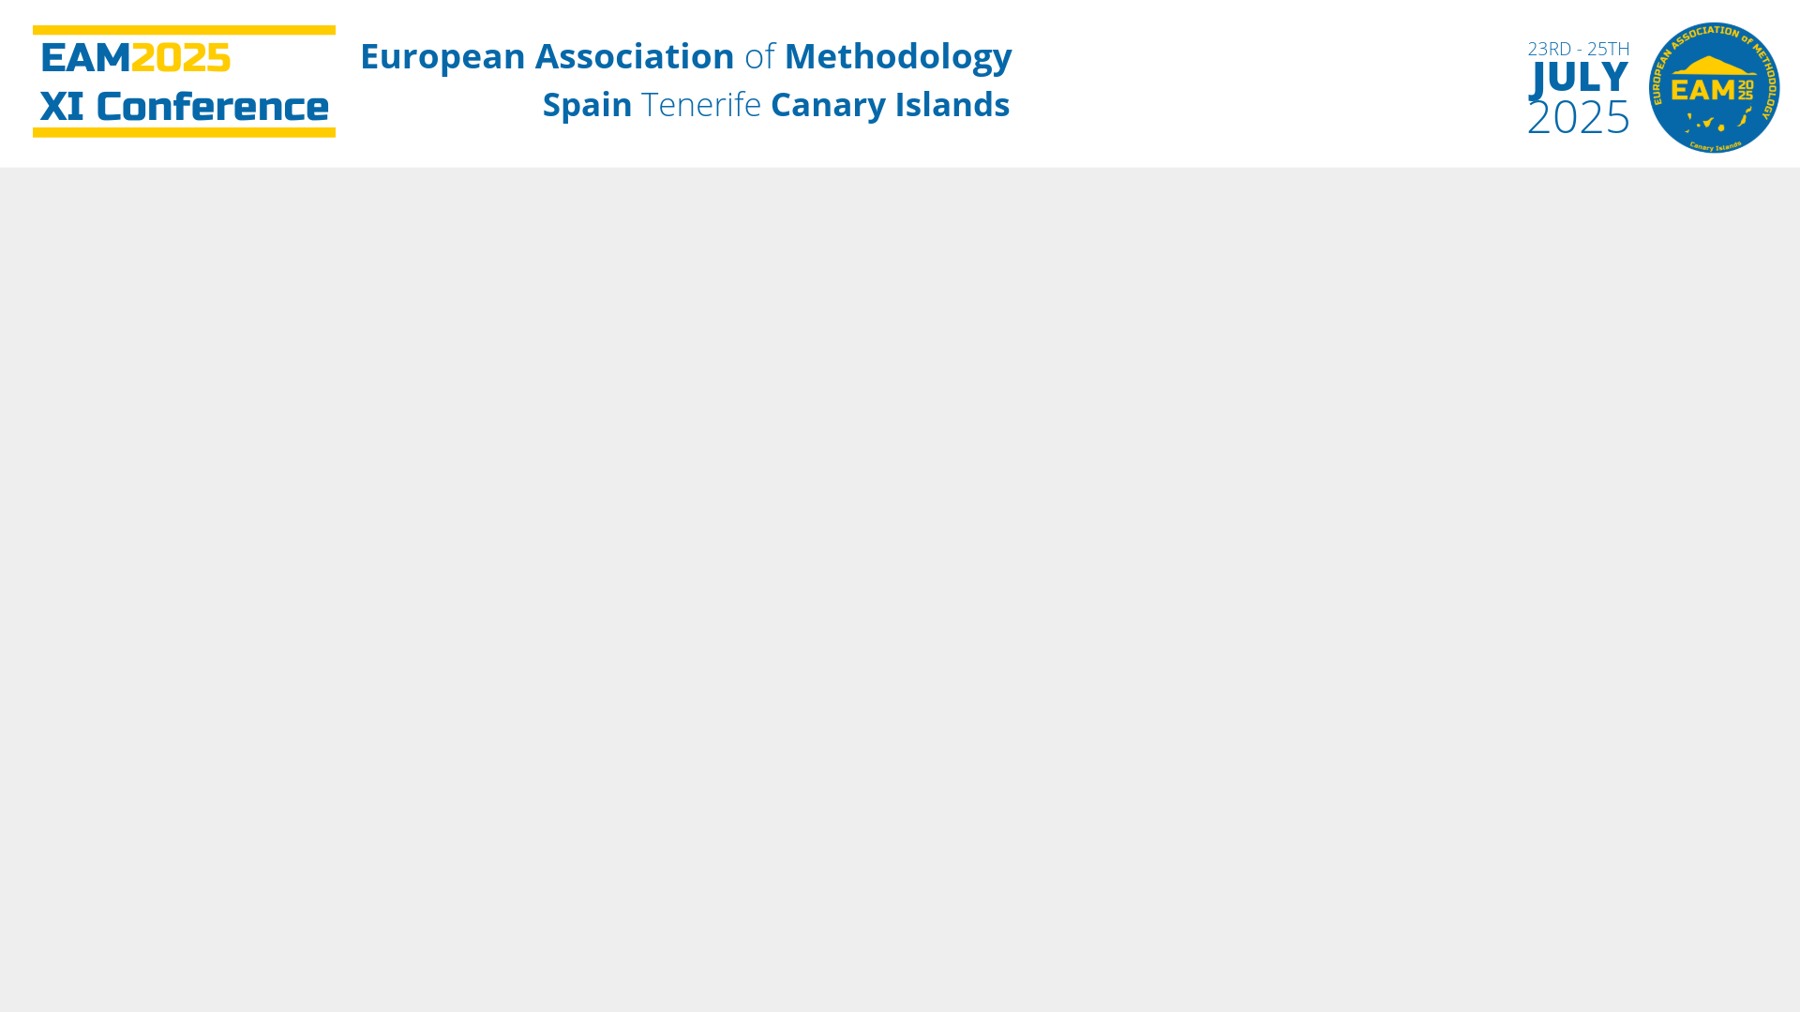
1.
WHO AM I?
2. MATHEMATICS ANXIETY
3. SYSTEMATIC REVIEW
3.1. Inclusion and Exclusion Criteria
3.2. Search String
3.3. Screening Results
4. RESULTS
4.1. Some Information
4.2. Instruments
5. CONCLUSIONS

Slide 3


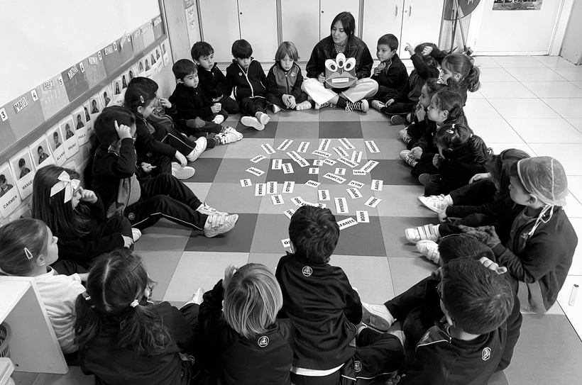
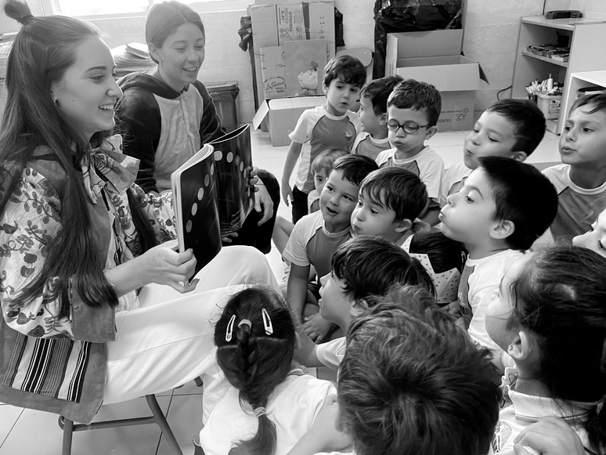



Laura Barrera Romero
  Loyola University
  Data Science
  1st grade
  TEACHER
lbarrera@uloyola.es
Laura Barrera Romero
Carlos Fresneda Portillo
Salvador Reyes de Cózar

Slide 4
1.
WHO AM I?
2. MATHEMATICS ANXIETY
3. SYSTEMATIC REVIEW
3.1. Inclusion and Exclusion Criteria
3.2. Search String
3.3. Screening Results
4. RESULTS
4.1. Some Information
4.2. Instruments
5. CONCLUSIONS

Slide 5

It is a variant of anxiety
MATH
ANXIETY
It was defined as an independen concept in 1972
It can have negative repercussions for years, even a lifetime
Until 1972, various authors developed very specific instruments
Since 1972, few instruments have been designed, but modified according to needs
Sagasti-Escalona, M. (2019). La ansiedad matemática. Matemáticas, Educación y Sociedad, 2(2), 1-18.

Slide 6
1.
WHO AM I?
2. MATHEMATICS ANXIETY
3. SYSTEMATIC REVIEW
3.1. Inclusion and Exclusion Criteria
3.2. Search String
3.3. Screening Results
4. RESULTS
4.1. Some Information
4.2. Instruments
5. CONCLUSIONS

Slide 7
1.
WHO AM I?
2. MATHEMATICS ANXIETY
3. SYSTEMATIC REVIEW
3.1. Inclusion and Exclusion Criteria
3.2. Search String
3.3. Screening Results
4. RESULTS
4.1. Some Information
4.2. Instruments
5. CONCLUSIONS

Slide 8
 | INCLUSION CRITERIA | EXCLUSION CRITERIA
PARTICIPANTS | Regulatory development, at school age | Non-normative development, special needs, population outside of school age
INTERVENTION | Any intervention | None
CONTEXT | 2015-2024 Articles Math Anxiety as a cause | Prior to 2015 Chapters, lectures, and more Math Anxiety as a consequence
OUTCOMES | Provide information about their causes Specify key elements | Focused on interventions Does not specify causative elements
Reyes-de-Cózar, S., Pérez-Escolar, M., & Navazo-Ostúa, P. (2022). Digital Competencies for New Journalistic Work in Media Outlets: A Systematic Review. Media and Communication, 10(1), 27–42. https://doi.org/10.17645/mac.v10i1.4439

Slide 9
1.
WHO AM I?
2. MATHEMATICS ANXIETY
3. SYSTEMATIC REVIEW
3.1. Inclusion and Exclusion Criteria
3.2. Search String
3.3. Screening Results
4. RESULTS
4.1. Some Information
4.2. Instruments
5. CONCLUSIONS

Slide 10


MATH
ANXIETY
INTERVENTION
STRATEGY
SCALE
QUESTIONNAIRE
MODEL
PROGRAM
TEST

Slide 11

MATH
ANXIETY
INTERVENTION
STRATEGY
SCALE
QUESTIONNAIRE
MODEL
PROGRAM
TEST

Slide 12
1.
WHO AM I?
2. MATHEMATICS ANXIETY
3. SYSTEMATIC REVIEW
3.1. Inclusion and Exclusion Criteria
3.2. Search String
3.3. Screening Results
4. RESULTS
4.1. Some Information
4.2. Instruments
5. CONCLUSIONS

Slide 13
PUBLICATIONS INDEXED IN DATABASES
n = 2.931
Scopus: n = 2.794
WOS: n = 137
IDENTIFICATION
Excluded publications: n = 32
3 articles were duplicated
29 articles were inaccessible
REMAINING PUBLICATIONS AFTER THE SCREENING PROCESS
n = 571
SCREENING PROCESS
Excluded publications after reading titles and asbtracts:
n = 2.328
ELIGIBLE LITERATURE
n = 108
Excluded full texts, since they do not meet the PICO model criteria
n = 75
SUITABILITY
PUBLICATIONS INCLUDED IN THE QUALITATIVE SYNTHESIS
n = 33
INCLUSION

Slide 14
1.
WHO AM I?
2. MATHEMATICS ANXIETY
3. SYSTEMATIC REVIEW
3.1. Inclusion and Exclusion Criteria
3.2. Search String
3.3. Screening Results
4. RESULTS
4.1. Some Information
4.2. Instruments
5. CONCLUSIONS

Slide 15
1.
WHO AM I?
2. MATHEMATICS ANXIETY
3. SYSTEMATIC REVIEW
3.1. Inclusion and Exclusion Criteria
3.2. Search String
3.3. Screening Results
4. RESULTS
4.1. Some Information
4.2. Instruments
5. CONCLUSIONS

Slide 16




ORIGIN OF THE POPULATION
3%
15%
24%
61%
AFRICA
AMERICA
ASIA
EUROPE

Slide 17





ORIGIN OF THE AUTHORS
6%
18%
24%
67%
3%
AFRICA
AMERICA
ASIA
EUROPE
OCEANIA

Slide 18


METHODOLOGY
88%
6%
6%
QUANTITATIVE
QUALITATIVE
MIXED

Slide 19
1.
WHO AM I?
2. MATHEMATICS ANXIETY
3. SYSTEMATIC REVIEW
3.1. Inclusion and Exclusion Criteria
3.2. Search String
3.3. Screening Results
4. RESULTS
4.1. Some Information
4.2. Instruments
5. CONCLUSIONS

Slide 20
1961
Mathematics Attitudes Scale (MAS)
2012
Revised Children’s Manifest Anxiety Scale: Second Edition (RCMAS-2)
1972
Mathematics Anxiety Rating Scale (MARS)
Scale for Early Mathematics Anxiety (SEMA)
1978
Revised Children’s Manifest Anxiety Scale (RCMAS)
2013
Mathematics Motivation Scale (MMS)
1989
Revised Mathematics Anxiety Rating Scale (RMARS)
Math Anxiety Questionnaire for Children (MAQC)
Math Anxiety Scale (MANX)
2015
Trends in International Mathematics and Science Study
2001
Calculation Subtests of the Woodcock-Johnson III tests
2016
Revised Child Math Anxiety Questionnaire (CMAQ-R)
2003
PISA 2003
Brief Mathematics Anxiety Rating Scale (MARS-30 brief)
Abbreviated Math Anxiety Scale (AMAS)
Calculation and Math Fluency Subtests of the WJ-III Achievement battery
Test of Early Mathematics Ability (TEMA-3)
2018
Children’s Mathematics Anxiety Scale-UK (CMAS-UK)
Students Motivation to Learn Mathematics Scale (SMOT)
Mathematics Anxiety Scale
2005
Math Anxiety Scale (MAS)
Math Anxiety Questionnaire
Curriculum-based Mathematics Assessment for Learning and Teaching (MaLT)
2019
Modified Abbreviated Math Anxiety Scale (m-AMAS)
2006
Escala de Ansiedad hacia las Matemáticas (MARS)
2020
Early Elementary School Abbreviated Math Anxiety Scale (EES-AMAS)
Differential and General Aptitude Test Battery (BADyG)
2021
Math Anxiety Scale
2009
Mathematics Self-fficacy and Anxiety Questionnaire (MSEAQ)
Mathematics Motivation Questionnaire (MMQ) for Secondary School Students
Mathematics Anxiety Scale
Questionnaire of factors influencing Mathematics Anxiety
2010
Mathematics Anxiety Scale for Elementary School Students (MASESS)
2022
Cognitive, Emotiona, Physical - Mathematics Anxiety Rating (CEP-MAR)
2011
Mathematics Anxiety Scale (MAS-UK)
Mathematics Content Scale
Mathematics Anxiety Scale
Academic Motivation Scale
Science Motivation Questionnaire
Simplified version of RMARS
Career Motivation Subscale of the Science Motivation Questionnaire II
PISA 2022
2023
Arabic version of the Modified Abbreviated Math Anxiety Scale (m-AMAS)
Brief Math Anxiety Scale (BMAS)
1961
1972
1978
1989
2001
2003
2005
2006
2009
2010
2011
2012
2013
2015
2016
2018
2019
2020
2021
2022
2023
A10
A31
A33
A07
A08
A20
A21
A23
A22
A09
A03
A10
A28
A22
A28
A14
A22
A17
A13
A01
A05
A32
A18
A15
A12
A12
A03
A29
A32
A33
A12
A22
A30
A25
A29
A24
A26
A28
A33
A22
A04
A04
A26
A11
A16
A16
A16
A27
A19
A21

Slide 21










AGES SERVED BY THE INSTRUMENTS
6%
6%
9%
12%
15%
15%
18%
24%
4
5
6
7
8
9
10
11
21%
21%
36%
39%
36%
27%
36%
27%
12
13
14
15
16
17
18
+18

Slide 22


AGES SERVED BY THE INSTRUMENTS
6%
6%
9%
12%
15%
15%
18%
24%
4
5
6
7
8
9
10
11
21%
21%
36%
39%
36%
27%
36%
27%
12
13
14
15
16
17
18
+18

Slide 23
COMPARISON BETWEEN SOME INSTRUMENTS
Student´s Mathematics Anxiety assessed through some items from the Science Motivation Questionnaire
(Glynn & Kobana, 2006)
Abbreviated Math Anxiety Scale (AMAS)
Semi-structured interview
Math Learning Anxiety (MLA):
  Having to use the diagrams and multiplication tables in the back of a math textbook (item 1).
  Watching the teacher break down a complex problem on the blackboard (item 3).
  Carefully listening to the math lesson (item 6).
  Watching another student solve a math problem (item 7).
  Starting a new topic in mathematics (item 9).
Math Testing Anxiety (MTA):
  Thinking about the upcoming written math test you have tomorrow (item 2).
  Doing a written math/examination test (item 4).
  Having to solve many difficult math problems for homework due the next class lesson (item 5).
  Having an oral test on math without knowing in advance (item 8).
  What are the student-related factors that cause students to create fear and anxiety towards mathematics?
  What are the factors related with teachers that can cause students to create fear and anxiety towards mathematics?
  What are the factors related with parents that cause students to develop fear and anxiety towards math course?
  What are the other factors which may cause students to create fear and anxiety towards mathematics?
  Which strategies do the teachers use to reduce and eliminate the factors that cause students to develop fear and anxiety towards mathematics?
  I am nervous about how I will do on the mathematics tests.
  I become anxious when it is time to take a mathematics test.
  I worry about failing mathematics tests.
  I am concerned that the other students are better in methematics.
  I hate taking mathematics tests.
Likert: 1 - 5
Likert: 1 - 5
Likert: 1 - 5
Open part of the interview: how, why

Slide 24
COMPARISON BETWEEN SOME INSTRUMENTS
Student´s Mathematics Anxiety assessed through some items from the Science Motivation Questionnaire
(Glynn & Kobana, 2006)
Abbreviated Math Anxiety Scale (AMAS)
Semi-structured interview
Math Learning Anxiety (MLA):
  Having to use the diagrams and multiplication tables in the back of a math textbook (item 1).
  Watching the teacher break down a complex problem on the blackboard (item 3).
  Carefully listening to the math lesson (item 6).
  Watching another student solve a math problem (item 7).
  Starting a new topic in mathematics (item 9).
Math Testing Anxiety (MTA):
  Thinking about the upcoming written math test you have tomorrow (item 2).
  Doing a written math/examination test (item 4).
  Having to solve many difficult math problems for homework due the next class lesson (item 5).
  Having an oral test on math without knowing in advance (item 8).
  What are the student-related factors that cause students to create fear and anxiety towards mathematics?
  What are the factors related with teachers that can cause students to create fear and anxiety towards mathematics?
  What are the factors related with parents that cause students to develop fear and anxiety towards math course?
  What are the other factors which may cause students to create fear and anxiety towards mathematics?
  Which strategies do the teachers use to reduce and eliminate the factors that cause students to develop fear and anxiety towards mathematics?
  I am nervous about how I will do on the mathematics tests.
  I become anxious when it is time to take a mathematics test.
  I worry about failing mathematics tests.
  I am concerned that the other students are better in methematics.
  I hate taking mathematics tests.
Likert: 1 - 5
Likert: 1 - 5
Likert: 1 - 5
Open part of the interview: how, why

Slide 25
1.
WHO AM I?
2. MATHEMATICS ANXIETY
3. SYSTEMATIC REVIEW
3.1. Inclusion and Exclusion Criteria
3.2. Search String
3.3. Screening Results
4. RESULTS
4.1. Some Information
4.2. Instruments
5. CONCLUSIONS

Slide 26
WHAT DO WE KNOW?
The studies focus mainly on students in higher education stages
Most studies follow a quantitative methodology (the opinions are not given much consideration)
The instruments used in the last decade are mainly modifications of existing ones
There is no theoretical model of Mathematical Anxiety that defines all the possible indicators

Slide 27
WHAT CAN WE DO?
Developing a theoretical model of Mathematics Anxiety that includes the indicators involved in it
Designing an instrument based on the theoretical model, which evaluates these indicators
Establishing profiles (from high risk to low risk) of Math Anxiety by age and stage of cognitive development
Designing interventions tailored to the needs of each individual, prioritizing risk profiles

Slide 28
REFERENCES
Arteaga, J. C. C. (2021). Conociendo la ansiedad matemática. El rol del docente: Knowing math anxiety. The role of the teacher. Franz Tamayo-Revista de Educación, 3(7), 260-276.
Barranco, V. T., Ruiz, J. G. S., & Furlong, A. D. (2024). Ansiedad matemática y engagement académico en estudiantes de educación media superior en México. Educatio Siglo XXI, 42(2), 97-120.
Fennema, E., & Sherman, J. A. (1976). Fennema-Sherman Mathematics Attitudes Scales: Instruments Designed to Measure Attitudes toward the Learning of Mathematics by Females and Males. Journal for Research in Mathematics Education, 7(5), 324. https://doi.org/10.2307/748467
Lukowski, S. L., DiTrapani, J., Jeon, M., Wang, Z., Schenker, V. J., Doran, M. M., ... & Petrill, S. A. (2019). Multidimensionality in the measurement of math-specific anxiety and its relationship with mathematical performance. Learning and individual differences, 70, 228-235.
Luttenberger, S., Wimmer, S., & Paechter, M. (2018). Spotlight on math anxiety. Psychology Research and Behavior Management, 11, 311–322. https://doi.org/10.2147/PRBM.S141421
Maldonado, M., & Sotomayor, V. (2021). Análisis de la ansiedad matemática en futuros emprendedores - [Analysis of math anxiety in future entrepreneurs]. Innovaciones docentes en tiempos de pandemia.
Nerio Delgado, O. G., & Ramírez Puente, T. E. (2024). Ansiedad matemática. CIENMS, 2(2), 135-155.
Reyes-de-Cózar, S., Pérez-Escolar, M., & Navazo-Ostúa, P. (2022). Digital Competencies for New Journalistic Work in Media Outlets: A Systematic Review. Media and Communication, 10(1), 27–42. https://doi.org/10.17645/mac.v10i1.4439
Sagasti-Escalona, M. (2019). La ansiedad matemática. Matemáticas, Educación y Sociedad, 2(2), 1-18.

Slide 29






Laura Barrera Romero
Laura Barrera Romero
lbarrera@uloyola.es
0009-0007-1246-4653
Loyola University
Laura Barrera-Romero
ORAL COMMUNICATION:
“Instruments for measuring Mathematical Anxiety in the last 10 years: what we know and what we can do.”
Laura Barrera-Romero Carlos Fresneda-Portillo Salvador Reyes-de-Cózar
lbarrera@uloyola.es
cfresneda@uloyola.es
sreyes@uloyola.es

