Slide 1


Evaluating Methodological Quality in Football Studies: An Application of the MQSOM
Daniel López-Arenas, Susana Sanduvete-Chaves, Salvador Chacón-Moscoso
& M. Teresa Anguera

Slide 2
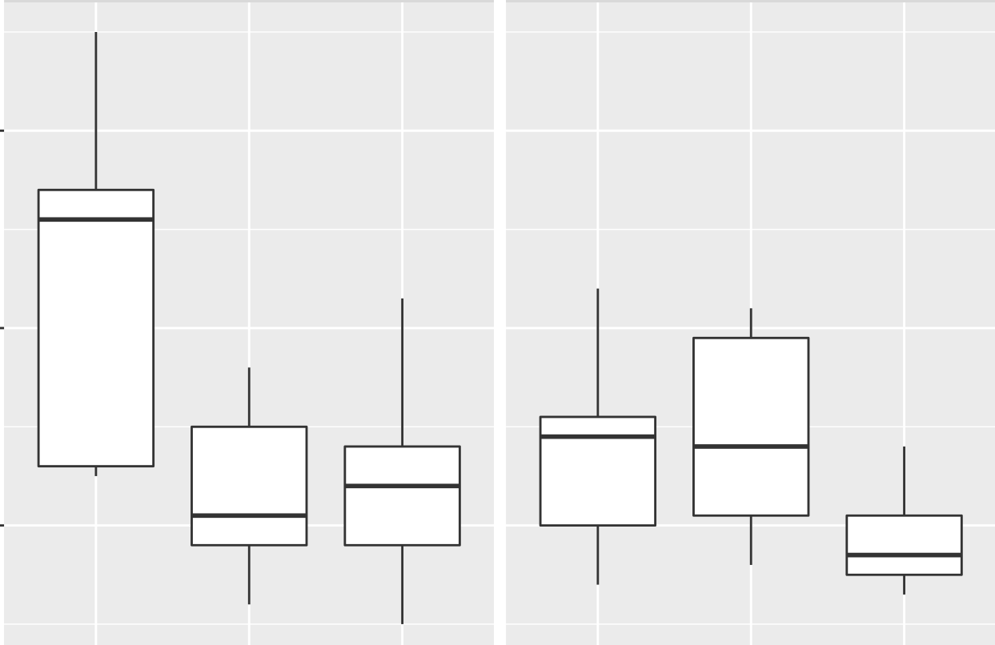
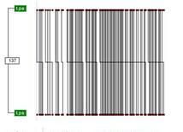
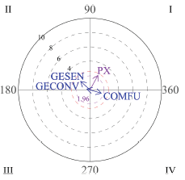
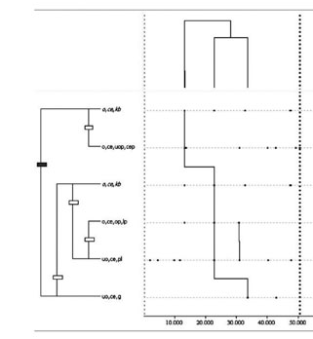
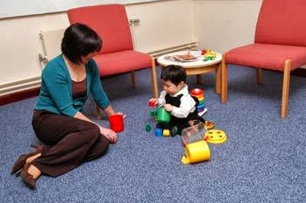
Observational Methodology
Observational methodology as a Mixed Methods approach
Natural Context
Ad hoc observational Instrument
Data Quality Control
Observational Design
Register
Data Analysis
Interpretation of results
QUALITATIVE STEP
QUANTITATIVE STEP
QUALITATIVE STEP
2

Slide 3
Observational Methodology
Work line of the research group
INNOEVALUA
2015
2018
2019
2025
Methodological Quality Checklist for studies based on Observational Methodology
(MQCOM)
(Chacón-Moscoso et al., 2019)
Guidelines for Reporting Experiments based on Observational Methodology
(GREOM)
(Portell et al., 2015)
Preliminary checklist for reporting observational studies
(Chacón-Moscoso et al., 2018)
Methodological Quality Scale for Observational Methodology
(MQSOM)
(Sanduvete-Chaves et al., 2025)
3

Slide 4
Methodological Quality Scale for Observational Methodology (MQSOM) (Sanduvete-Chaves et al., 2025)
Observational Methodology employment
ω = .87
D = .55
Observational Unit
Quality of Design
Temporality
Factor 1
Dimensionality
Codification Manual
Methodological Quality Overall
General Factor
Data Type
Observational Instrument
Recording, Quality Control & Analysis Software
Factor 2
Quality of Measurement & Analysis
Type of Parameter
Data Quality Control
4
Data Analysis

Slide 5
Objectives
Significant differences between procedural characteristics
Obtention of methodological quality profiles
5

Slide 6
Method
Participants
Instrument
Differences between characteristics
Methodological Quality Profiles
236 studies
  OM employed
  Applied on football
  Original empirical works
  Written in English or Spanish
  Following the standard publication format
Methodological Quality Scale for Observational Methodology
(MQSOM)
(Sanduvete-Chaves et al., 2025)
Proportion Analysis
  Ho = Proportion of 55 : 45
Two-Step Cluster Analysis
  Dimension reduction through PCA
  Cluster determination through BIC
6

Slide 7
Results (I): Proportion Analysis
Ratios to compare |  |  |  | Sig.
Direct observation 201/236 = 0.85 |  | Indirect Observation 35/236 = 0.15 |  | .000
Observational Design specified 113/236 = 0.48 |  | No observational design 123/236 = 0.52 |  | .558
Coding manual 170/236 = 0.72 |  | No coding manual 66/236 = 0.28 |  | .000
Data type specified 32/236 = 0.14 |  | No data type specified 204/236 = 0.86 |  | .000
Observational instrument specified 199/236 = 0.84 |  | No observational instrument 37/236 = 0.16 |  | .000
Recording instrument specified 165/236 = 0.70 |  | No recording instrument 71/236 = 0.30 |  | .000
Quality control software specified 98/236 = 0.42 |  | No quality control software 138/236 = 0.59 |  | .011
Analysis software specified 186/236 = 0.79 |  | No analysis software 50/236 = 0.21 |  | .000
Sequency parameter 55/236 = 0.23 |  | Frequency parameter 181/236 = 0.77 |  | .000
Data quality control 187/236 = 0.79 |  | No data quality control 49/236 = 0.21 |  | .000
Descriptive statistics | Inferential analysis |  | Regularity detection | .000
15/236 = 0.06 | 162/236 = 0.69 |  | 59/236 = 0.25
7

Slide 8
Results (II): Methodological Quality Profiles
8
Profiles | N | General Dimension | Dimension 1 Quality of Design | Dimension 2 Quality of Measurement & Analysis | F1. Quality of Design |  |  |  |  | F2. Quality of Measurement & Analysis
 |  |  |  |  | Observation | Observational Design | Coding Manual | Data Type |  | Observational Instrument | Software |  |  | Parameter | Data Quality Control | Data Analysis
 |  |  |  |  |  |  |  |  |  |  | Recording | Quality Control | Analysis
1 | 49 | 0.81 | 0.78 | 0.89 | Direct | Mostly specified | Mostly specified | Frequently not specified/ Sometimes Type IV/ Rarely Types I & II |  | Specified | Specified | Employed | Mostly Employed | Mostly duration | Quantitative | Regularity detection/inferential analysis and rarely descriptive
2 | 54 | 0.76 | 0.70 | 0.83 | Mostly Direct | Specified | Mostly specified | Not specified/ Rarely Type IV |  | Specified | Mostly Specified | Sometimes employed | Mostly Employed | Mostly Frequency | Mostly quantitative | Mostly Inferential analysis
3 | 38 | 0.56 | 0.37 | 0.79 | Direct | Sometimes specified | Frequently specified | Not specified/ Rarely Type II |  | Mostly specified | Sometimes specified | Occasionally employed | Mostly Employed | Duration/ Order | Mostly quantitative | Mostly regularity detection and occasionally inferential
4 | 59 | 0.46 | 0.26 | 0.70 | Frequently direct | Rarely specified | Mostly specified | Not specified |  | Frequently specified | Sometimes specified | Rarely employed | Frequently employed | Frequency | Quantitative, but sometimes absent or qualitative | Mostly inferential and rarely descriptive
5 | 36 | 0.24 | 0.06 | 0.45 | Sometimes direct | Not specified | Not specified | Not specified |  | Rarely specified | Sometimes specified | Not employed | Sometimes employed | Frequency | Frequently absent/ rarely quantitative | Mostly inferential and rarely descriptive or regularity detection

Slide 9
Discussion
Inaugural application of the MQSOM scale in primary studies based on observational methodology.
Cluster analysis allowed the five procedural profiles to be graded in decreasing order of methodological quality:
  Profile 1: High level for both dimensions
  Profile 2: Moderate level for Design and high for Measurement & Analysis
  Profile 3: Low level for Design and high for Measurement & Analysis
  Profile 4: Low level for Design and moderate for Measurement & Analysis
  Profile 5: Low level for both dimensions
9

Slide 10
Conclusions
34.32% of studies scored below 0.50 on the MQSOM scale
It is essential to disseminate the scale among applied researchers and editorial boards. This work should be complemented by applying the MQSOM scale in other fields that employ observational methodology.
10

Slide 11
References
Anguera, M. T. (1993). Observational Methods (General). In R. Fernández-Ballesteros (Ed.), Encyclopedia of Psychological Assessment, Vol. 2 (pp. 632-637). Sage.
Chacón-Moscoso, S., Anguera, M. T., Sanduvete-Chaves, S., Losada, J. L. y Portell, M. (2019). Methodological quality checklist for studies based on observational methodology (MQCOM). Psicothema, 31 (4), 458-464. https://doi.org/10.7334/ psicothema2019.116
Chacón-Moscoso, S., Sanduvete-Chaves, S., Anguera, M. T., Losada, J. L., Portell, M. y Lozano-Lozano, J. A. (2018). Preliminary checklist for reporting observational studies in sports areas: Content validity. Frontiers in Psychology, 9, 291. https://doi.org/10.3389/fpsyg.2018.00291
Portell, M., Anguera, M. T., Chacón-Moscoso, S. y Sanduvete-Chaves, S. (2015). Guidelines for reporting evaluations based on observational methodology. Psicothema, 27 (3), 283-289. https://doi.org/10.7334/psicothema2014.276
Sanduvete-Chaves, D., López-Arenas, D., Anguera, M. T., & Chacón-Moscoso, S. (2025). A Scale for Evaluating the Methodological Quality of studies based on Observational Methodology. Psicothema, 37(1), 1-10. https://doi.org/10.70478/psicothema.2025.37.01
11

Slide 12
Evaluating Methodological Quality in Football Studies: An Application of the MQSOM
Thank you for your attention
This work was supported by the research project PID2020-115486GB-I00 funded by the Ministerio de Ciencia, Innovación y Universidades, MICIU/AEI/10.13039/501100011033, Government of Spain. We gratefully acknowledge the support of the Chilean government project FONDECYT Regular 1250316 funded by the National Fund for Scientific and Technological Development, ANID; the Julio Olea Grant for Young Researchers from the Spanish Association for Methodology of Behavioral Sciences (AEMCCO); the Research Group of the Generalitat de Catalunya (Grup de Recerca e Innovació en Dissenys [GRID] “Tecnología i aplicació multimedia i digital als dissenys observacionals” [grant number 2021 SGR 00718] (2022-2024); and the support of the Project funded by the Spanish government “Integration between observational data and data from external sensors: Evolution of the LINCE PLUS software and development of the mobile application for the optimization of sport and physical activity beneficial to health” [EXP_74847] (2023), Ministry of Culture and Sport, Higher Council of Sport and the European Union.
12

