Slide 1
Comparing nested multilevel models with the Vuong test
José María Santa Olalla Tovar, José Ángel Martínez-Huertas, Belén Fernández Castilla

Slide 2
Vuong, Q. H. (1989). Likelihood ratio tests for model selection and non-nested hypotheses.
Econometrica: Journal of the Econometric Society, 307-333. DOI:10.2307/1912557
Vuong determine the p.d.f. of the Likelihood Ratio statistic for nested, non nested, fully specified and misspecified models
There is no difference between
Vuong test and Likelihood Ratio Test (LRT) for nested lineal models
Vuong test is implemented for SEM and MIXED MODELS in nonnest2 R package by Merkle and You

Slide 3
EMPIRICAL EXAMPLE
Teacher Support
CASTILLA
Y LEÓN
STUDENTS
(PREDICTORS)
Mathematics Anxiety
(DEPENDENT VARIABLE)
If student ASKs when
he/she does not understand
PISA 2022
DATABASE

Slide 4

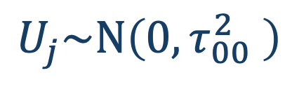
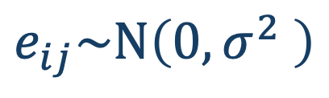
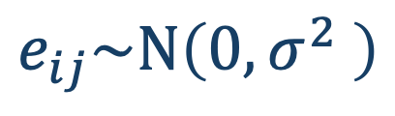


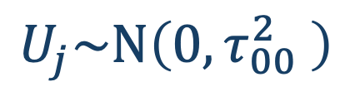


NESTED MODELS
$$β_{2}=0$$
$$β_{1}=0$$
$$β_{2}=0$$
$${ANXMAT}_{ij}= β_{00}+ U_{j}+e_{ij}$$
MODEL 0
$$U_{j}\sim N\left(0,τ_{00}^{2} \right)$$
$$e_{ij}\sim N\left(0,σ^{2} \right)$$
$${ANXMAT}_{ij}= β_{00}+ β_{1}·{TEACHSUP}_{ij}+U_{j}+e_{ij}$$
$$U_{j}\sim N\left(0,τ_{00}^{2} \right)$$
$$e_{ij}\sim N\left(0,σ^{2} \right)$$
MODEL 1
$${ANXMAT}_{ij}= β_{00}+ β_{1}·{TEACHSUP}_{ij}+β_{2}·{ASK}_{ij}+U_{j}+e_{ij}$$
$$U_{j}\sim N\left(0,τ_{00}^{2} \right)$$
$$e_{ij}\sim N\left(0,σ^{2} \right)$$
MODEL 2

Slide 5
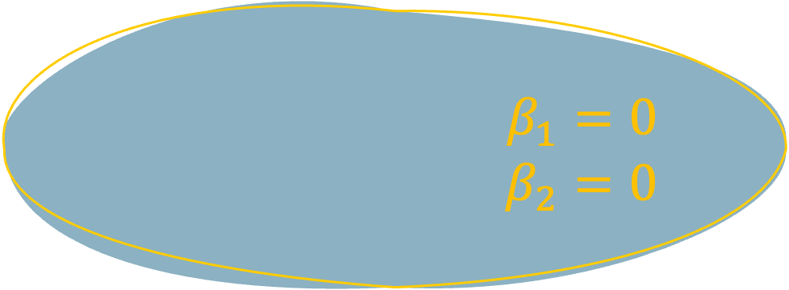
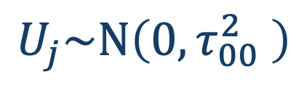
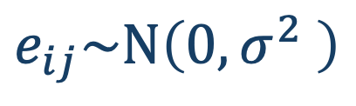


OVERLAPPING MODEL (NON NESTED)
$${ANXMAT}_{ij}= β_{00}+ β_{1}·{TEACHSUP}_{ij}+U_{j}+e_{ij}$$
$$U_{j}\sim N\left(0,τ_{00}^{2} \right)$$
$$e_{ij}\sim N\left(0,σ^{2} \right)$$
MODEL 1
$$β_{1}=0$$
$$β_{2}=0$$
MODEL 3
$${ANXMAT}_{ij}= β_{00}+ β_{2}·{ASK}_{IJ}+U_{j}+e_{ij}$$
$$U_{j}\sim N\left(0,τ_{00}^{2} \right)$$
$$e_{ij}\sim N\left(0,σ^{2} \right)$$
OVERLAPING MODEL (NON NESTED)

Slide 6
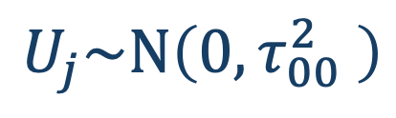

1) First, A test is applied to check if the models are distinguishable.
2) If they are, another test is applied to select the best model.
$${ANXMAT}_{ij}= β_{00}+ β_{1}·{TEACHSUP}_{ij}+U_{j}+e_{ij}$$
MODEL 1
$$U_{j}\sim N\left(0,τ_{00}^{2} \right)$$
$$e_{ij}\sim N\left(0,σ^{2} \right)$$
VUONG TEST RESULTS,
MODELS ARE DISTINGUISHABLE, p = 0.002
MODEL 1 FITS BETTER THAN MODEL 3, p = 0.037
MODEL 3
$${ANXMAT}_{ij}= β_{00}+ β_{2}·{ASK}_{IJ}+U_{j}+e_{ij}$$
$$U_{j}\sim N\left(0,τ_{00}^{2} \right)$$
$$e_{ij}\sim N\left(0,σ^{2} \right)$$
OVERLAPPING MODEL (NON NESTED)

Slide 7
A prerequisite for Vuong test is sample independence.
In nonnest2, Vuong test is applied to level 2 units, because those are independent.
Vuong test allows comparing nested and non nested models, but in the case of nested mixed models, could the Merkle and You implementation in nonnest2 R package outperform LRT?

Slide 8

Level 1
Units
N1
Level 2
Units
N2
Total
Variance
ICC
Standardized size effect.
$$β$$
.1
0.47
Simulation MLM
15
50
0
.05
.25
1.41
.15
.25
30
150
.50

Slide 9
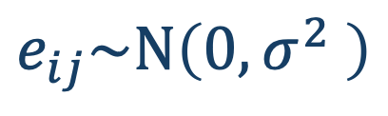





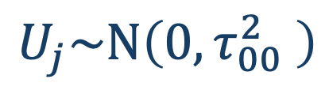

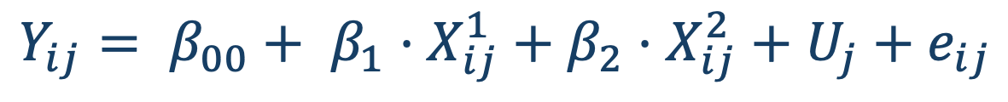
$$Y_{ij}= β_{00}+ U_{j}+e_{ij}$$
MODEL 0
$$U_{j}\sim N\left(0,τ_{00}^{2} \right)$$
$$e_{ij}\sim N\left(0,σ^{2} \right)$$
$$Y_{ij}= β_{00}+ β_{1}·X_{ij}^{1}+U_{j}+e_{ij}$$
Simulation MLM
MODEL 1
$$U_{j}\sim N\left(0,τ_{00}^{2} \right)$$
$$e_{ij}\sim N\left(0,σ^{2} \right)$$
$$Y_{ij}= β_{00}+ β_{1}·X_{ij}^{1}+β_{2}·X_{ij}^{2}+U_{j}+e_{ij}$$
MODEL 2
$$U_{j}\sim N\left(0,τ_{00}^{2} \right)$$
$$e_{ij}\sim N\left(0,σ^{2} \right)$$
$X_{ij}^{2}$ is a variable which is not included in the data

Slide 10
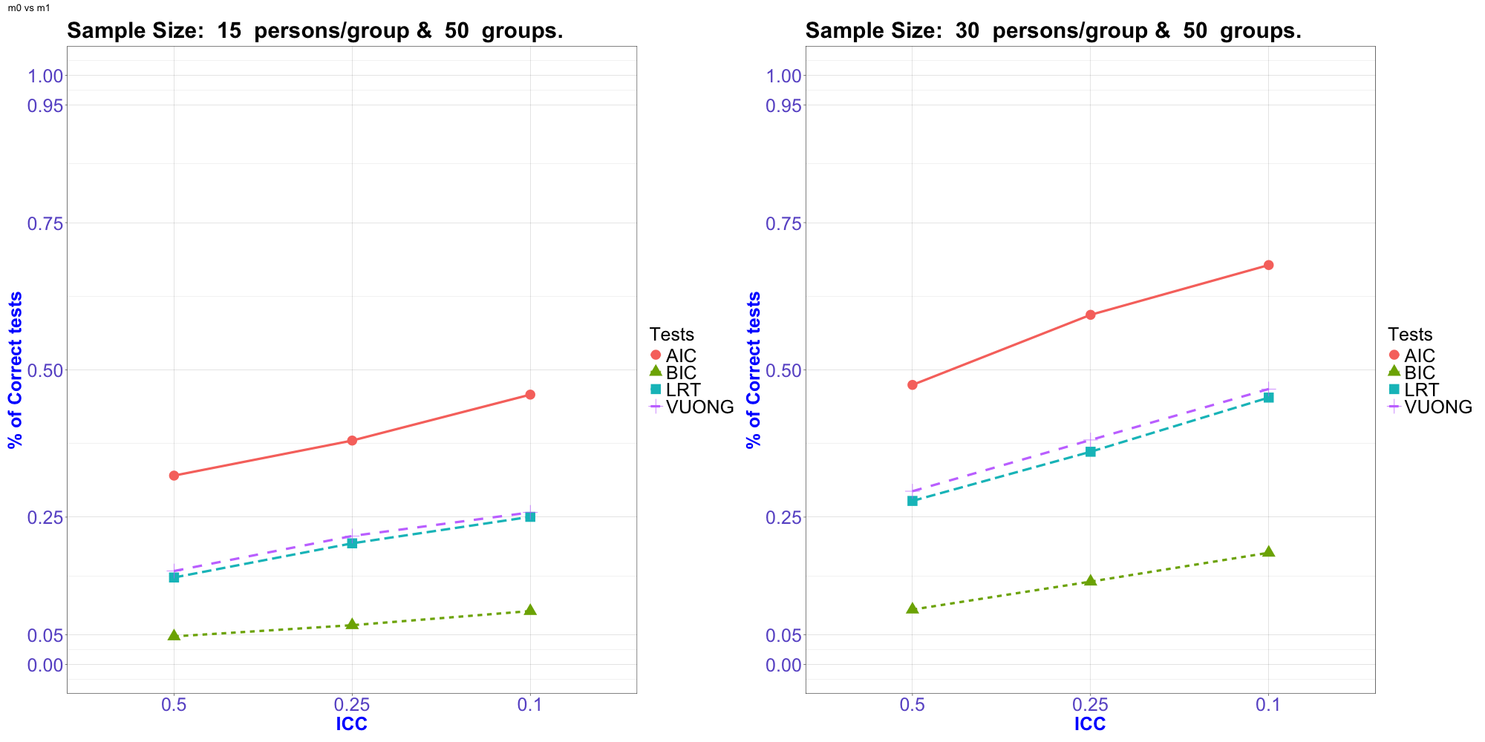
MODEL 0 VS MODEL 1
Standardized
Effect of X¹
^{0.05}

Slide 11
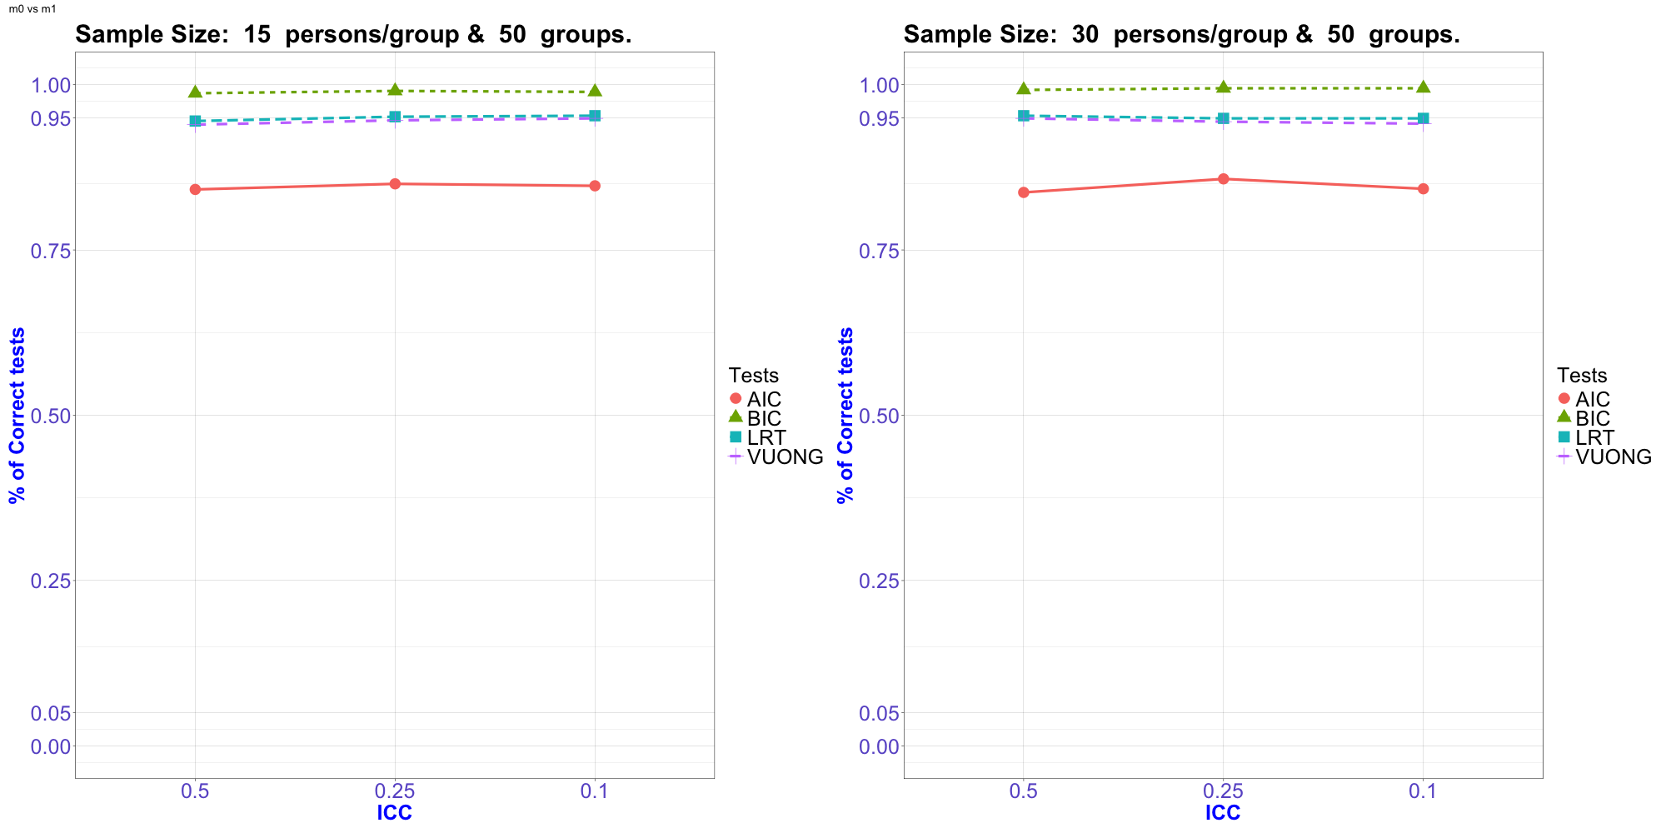
MODEL 0 VS MODEL 1
Standardized
Effect of X¹
⁰

Slide 12
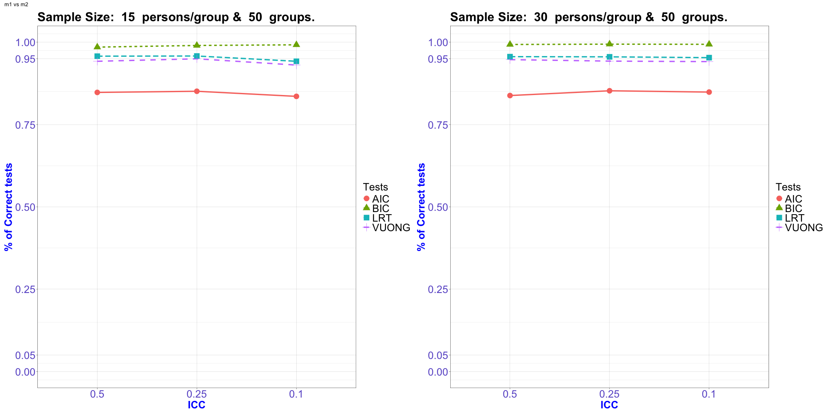
MODEL 1 VS MODEL 2
Standardized
Effect of X¹
^{0.25}

Slide 13
Level 1
Time
N1
Level 2
Persons
N2
Time
effect
Variance
Inter
Residual error
5
7
25
81
9
11
0
Simulation MLM with random slopes
50
5
Variance
Slopes
13
15
1
75
0
25
50
2
100
36
75

Slide 14
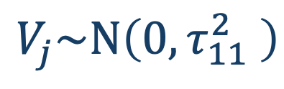

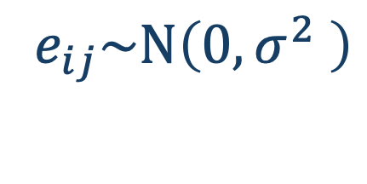
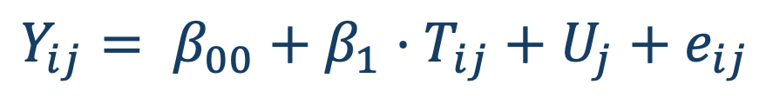


$$Y_{ij}= β_{00}+β_{1}·T_{ij}+U_{j}+e_{ij}$$
MODEL 1
$$U_{j}\sim N\left(0,τ_{00}^{2} \right)$$
$$e_{ij}\sim N\left(0,σ^{2} \right)$$
Simulation MLM with random slopes
$$Y_{ij}= β_{00}+ β_{1}·T_{ij}+·V_{j}·T_{ij}+U_{j}{+e}_{ij}$$
MODEL 2
$$U_{j}\sim N\left(0,τ_{00}^{2} \right)$$
$$V_{j}\sim N\left(0,τ_{11}^{2} \right)$$
$e_{ij}\sim N\left(0,σ^{2} \right)$a

Slide 15
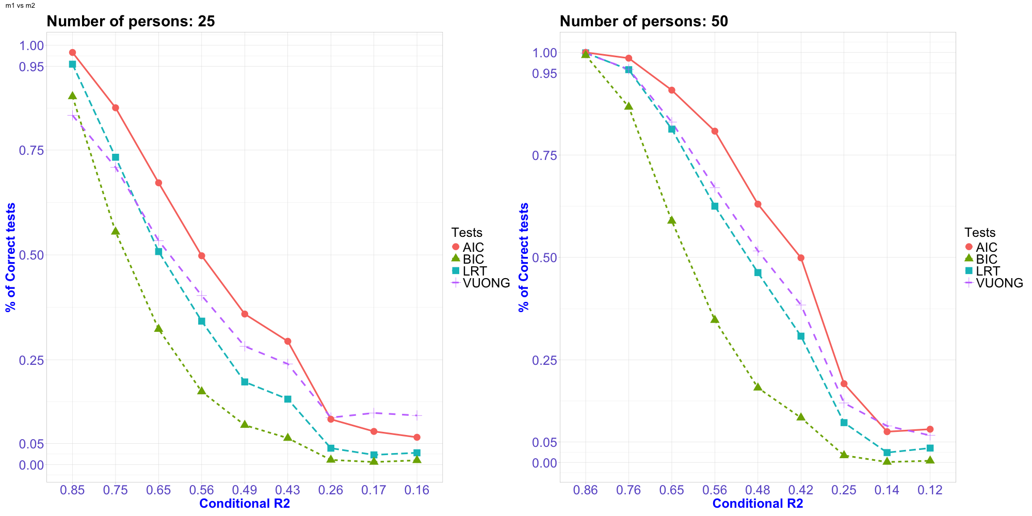
Variance
Slopes 36

Slide 16
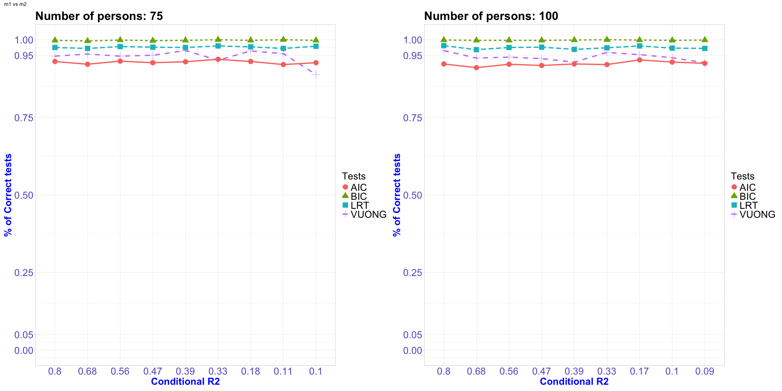
Variance
Slopes 0

Slide 17
In nested MLM, if we set the total variance, Vuong test as implemented in nonnest2 perform like LRT, slightly more liberal, it performs a Little bit better when there is lack of power,(N small).
In nested MLM with random slopes, if we set intercept and slopes variances, Vuong test perform as LRT, slightly more liberal and it performs a little bit better than LRT when both loose power, this means Conditional R² decreases.

Slide 18
Vuong test can be applied in nested MLM as LRT with similar performance.
Besides, Vuong test can be used to compare non nested models

Slide 19
Thanks for your attention
jsantaola8@alumno.uned.es
jamartinez@psi.uned.es
bfcastilla@psi.uned.es

