Slide 1
Bayesian Sample Size Determination for Longitudinal Trials with Attrition
Ulrich Lösener & Mirjam Moerbeek

Slide 2




The Problem
Methodologists
Applied Researchers

Slide 3

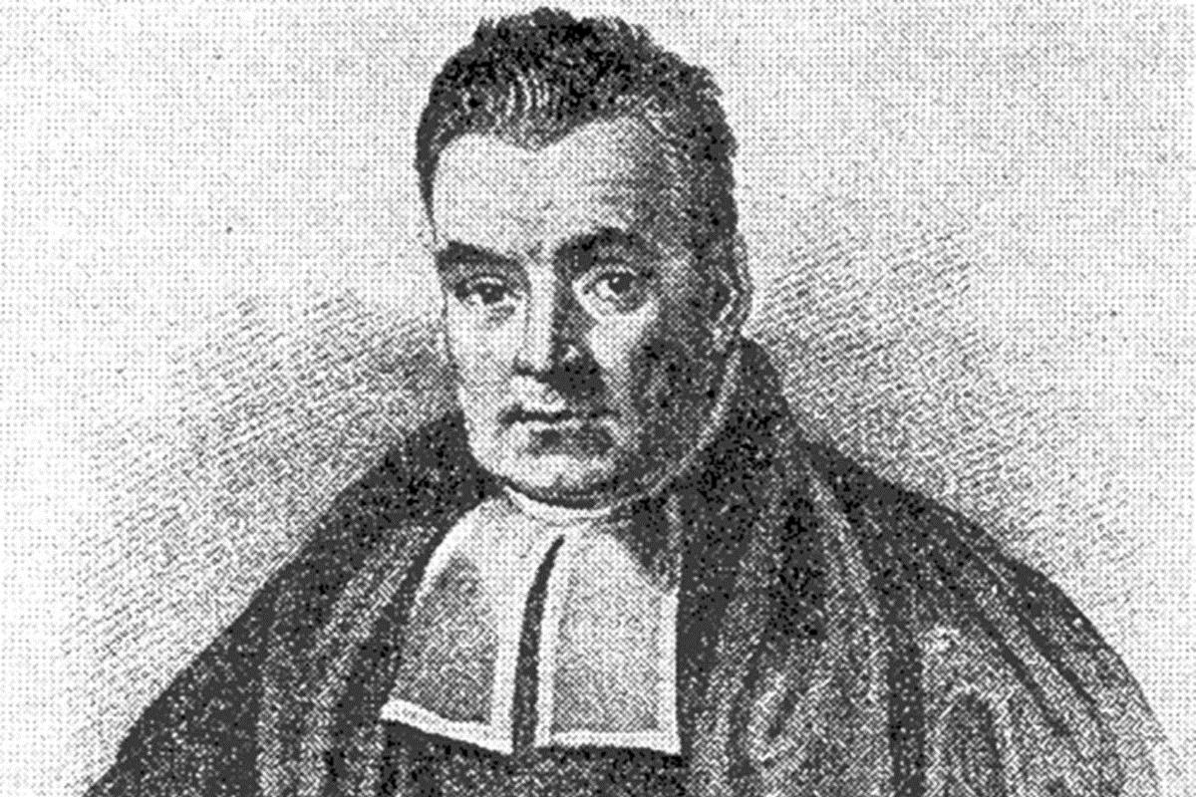



$$P(H|D)=\frac{P\left(D | H\right)P(H)}{P(D)}$$
Sample Size Determination?!

Slide 4
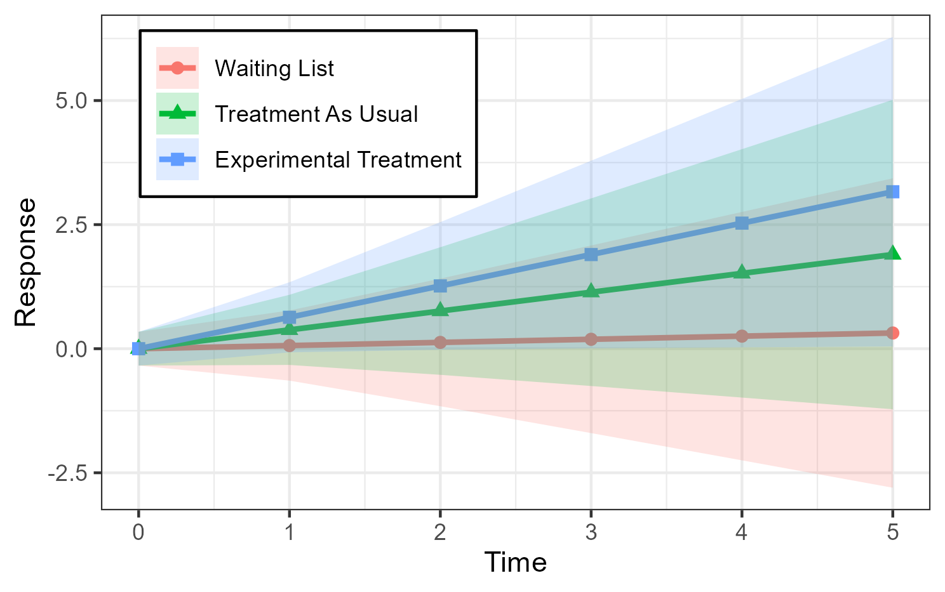
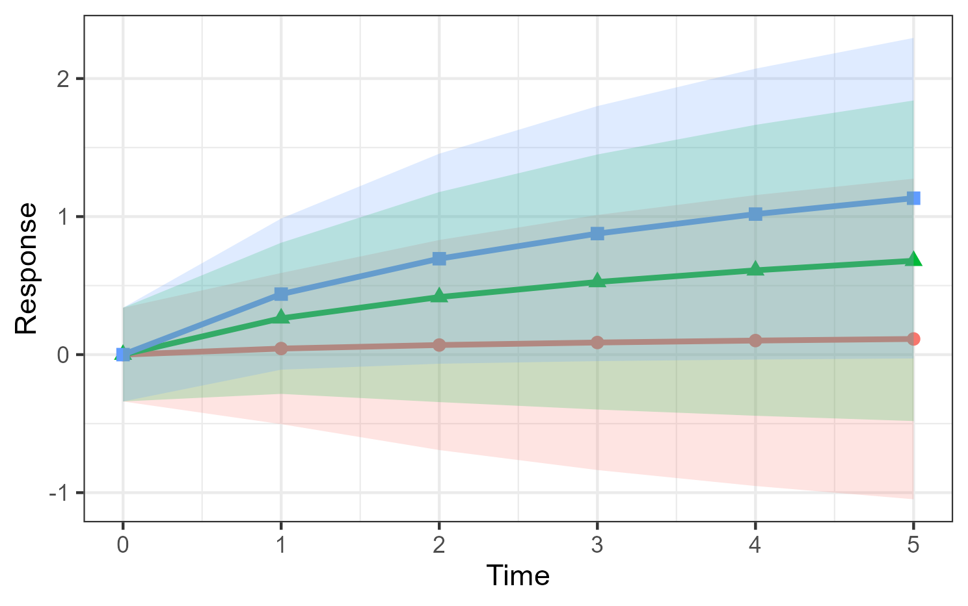
The Multilevel Model for Longitudinal Data
n observations nested within N individuals
Random allocation to treatment conditions
Coefficient of interest: interaction between time and condition
H₀: β₁ = β₂ = β₃
H₁: β₁ < β₂ < β₃
H_{u}: β₁, β₂, β₃
individual 1
individual 2
individual N
. . .
measurement 1
measurement 2
. . .
measurement n

Slide 5
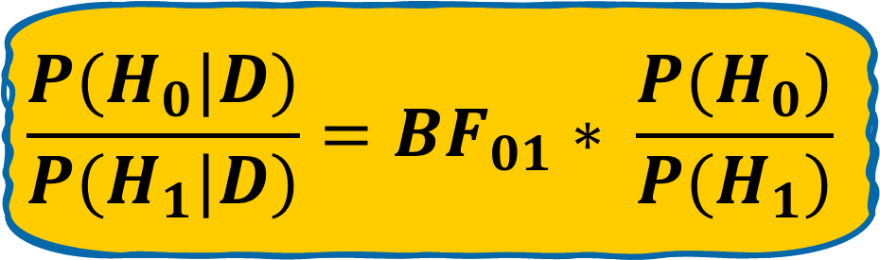
The Bayes Factor (BF)
Prior
Posterior
Change in belief before vs. after inspecting the data
Quantifies relative evidence between two competing hypotheses
Easy interpretation:
  BF₀₁ = 2 means that data supports H₀ twice as much as H₁
  BF₀₁ = 0.5, means that data supports H₁ twice as much as H₀
BF
$$\frac{P(H_{0}|D)}{P(H_{1}|D)}={BF}_{01}∗ \frac{P(H_{0})}{P(H_{1})}$$
Notes:
Michael Lavine & Mark Schervish (1999) Bayes Factors: What they are and what they are not

Slide 6
Posterior Model Probabilities (PMPs)
Quantify the relative support in the data for a set of hypotheses
Always sum to 1
Hypothesis with highest PMP is most supported by the data
Caveat: “true” hypothesis may not be included in set
Notes:
Michael Lavine & Mark Schervish (1999) Bayes Factors: What they are and what they are not

Slide 7
The Approximate Adjusted Fractional Bayes Factor
Ratio between fit and complexity
Prior is constructed from part of the data
Implemented in R packages such as bain and BFpack
No Bayesian estimation needed!
Complexity
Fit
BF_{iu}
Notes:
AAFBF stands out for its easy computation and accesibility

Slide 8
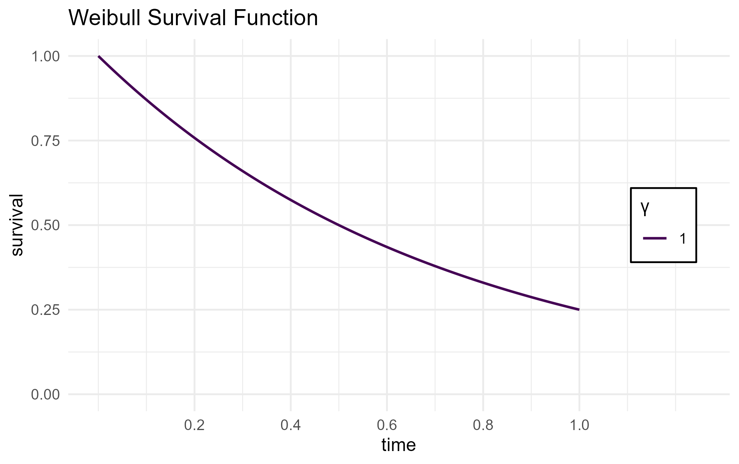
Modeling Attrition with Survival Functions
Example: the Weibull survival function
Survival function models the proportion of subjects remaining in study
ω [0,1]: proportion of subjects to drop out at some point, here fixed at .75
γ [0, inf]: timing of drop-out within the study,
if γ < 1, at beginning
if γ > 1, towards the end

Slide 9
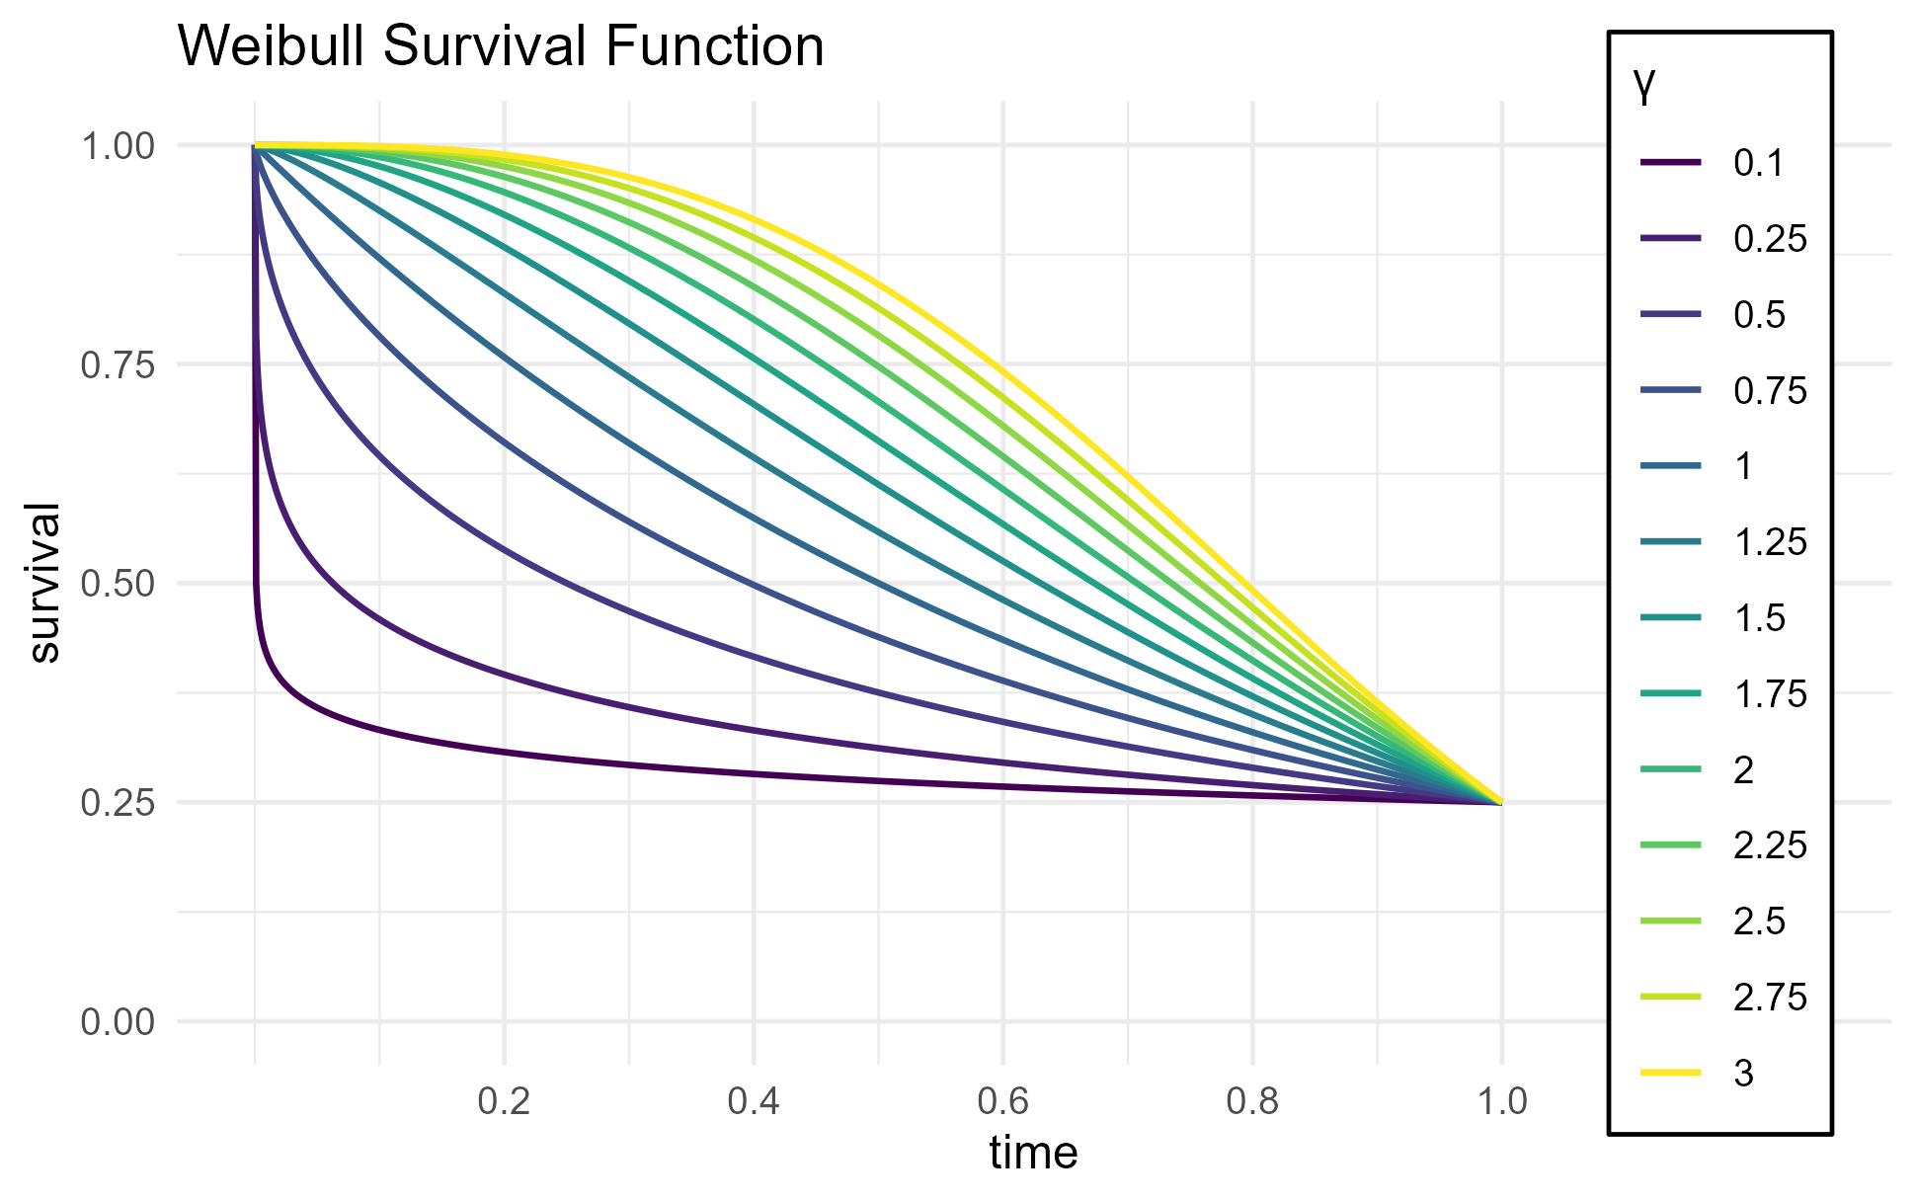
Modeling Attrition with Survival Functions
Example: the Weibull survival function
Survival function models the proportion of subjects remaining in study
ω [0,1]: proportion of subjects to drop out at some point, here fixed at .75
γ [0, inf]: timing of drop-out within the study,
if γ < 1, at beginning
if γ > 1, towards the end

Slide 10
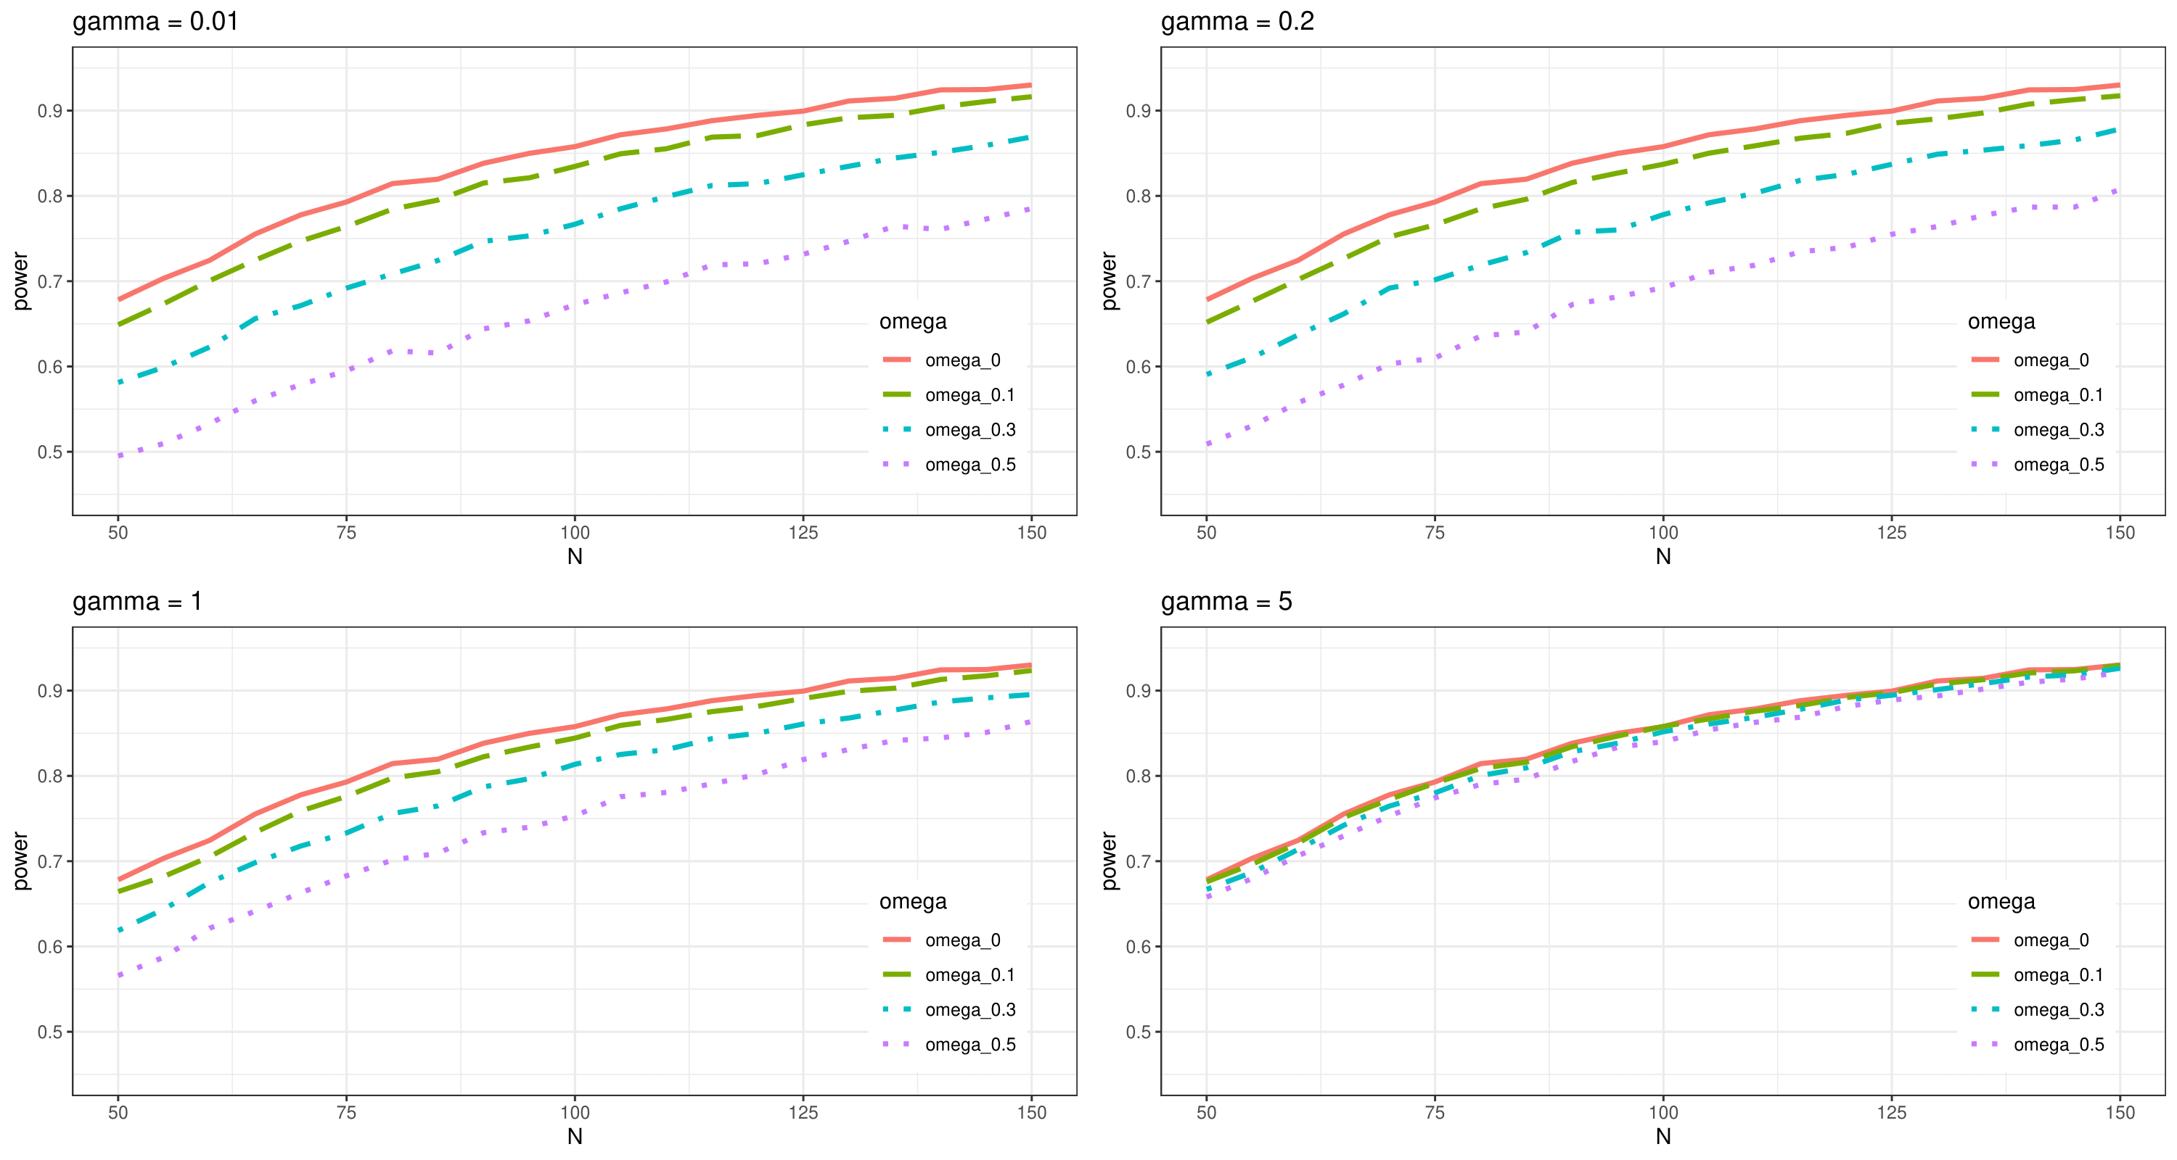
Simulation – Attrition and Power

Slide 11
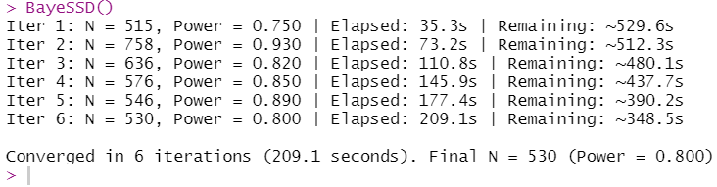
Ingredients and Example Output
Desired power level
Threshold of convincing evidence (BF, PMPs)
Effect size(s)
(Co-) variance components of the model
Hypothesis of interest

Slide 12


Let’s get in touch!
Contact
GitHub

Slide 13
Thank you for your attention!
Notes:
AAFBF stands out for its easy computation and accesibility

Slide 14
References
Lösener, U. C., & Moerbeek, M. (in press). Bayesian Sample Size Determination for Longitudinal Intervention Studies with Linear and Log-linear Growth. Behavior Research Methods.
ar.inspiredpencil.com
metode.es
Lavine, M., & Schervish, M. J. (1999). Bayes factors: What they are and what they are not. The American Statistician, 53(2), 119-122.

