Slide 1
Labour market participation and Unpaid Care Work in the UK: An Intersectional Analysis of the Understanding Society Dataset
Christie Butcher, The University of Sheffield

Slide 2
Unpaid care in this paper is defined as ‘looking after or giving help to someone who is sick, disabled or elderly, such as a friend, relative or partner’ (U Essex, 2024)

Slide 3
What is the issue?
Caring negatively impacts an individual's ability to participate in the labour market (Brimblecombe et al., 2020; Carers UK, 2019; King and Pickard, 2013): Many reduce working hours or leave the labour market entirely (Carers UK, 2019).
4 in 10 carers do not work as much as they would like to (Peytrignet et al., 2023).
Reduction in earnings (Brimblecombe et al., 2020; Cartagena-Farias and Brimblecombe, 2023; Petrillo et al., 2024)

Slide 4
Research aims
To explore the relationship between care intensity and paid employment.
To explore intersectional differences in this relationship

Slide 5
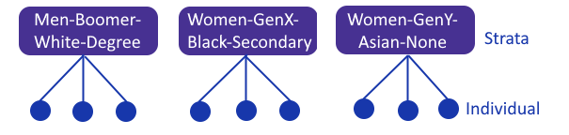
A Quantitative Intersectional Approach
Wave 13 (2022/23) of the Understanding Society dataset (U Essex, 2023).
Multilevel analysis of individual heterogeneity and discriminatory accuracy (MAIHDA) regression: individuals are nested in intersectional strata.
Accounting for the multiplicative effects of belonging to multiple identities at the same time (Crenshaw, 1991, Bell et al., 2019).

Slide 6
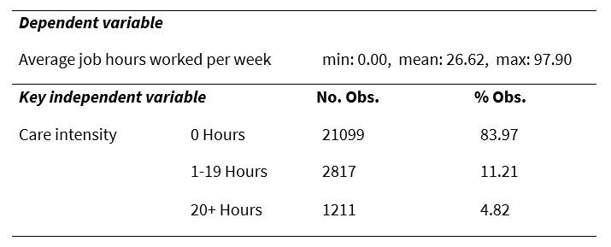
Variables

Slide 7
Defining the “strata” variable
2 sexes: Male, Female
4 age groups (generation): Boomer, Gen X, Gen Y, Gen Z
5 ethnicity groups: White, Mixed, Asian, Black, Other
4 education groups: Degree, A-Levels or GCSEs, Other, None
Min | Q1 | Median | Q2 | Max | Mean | SD | n | missing
1 | 5 | 26 | 89 | 2118 | 169 | 387.35 | 160 | 10

Slide 8
RQ1: What is the relationship between caring intensity and labour market participation?
Once sociodemographic variables were controlled for:
Caring for 1-19 hours is associated with working just over 1 hour fewer per week (63 minutes) in comparison to non-carers.
caring for 20 or more hours is associated with working over 9 and a half hours fewer (9 hours 41 minutes) in comparison to non-carers.
Negative relationship between the average hours of care provided per week and the average hours worked in paid employment per week, which is most pronounced for higher intensity caring.

Slide 9
RQ2: How does the relationship between care intensity and labour market participation vary across intersectional strata?
Once strata variables are controlled for as additive effects (in the fixed/level 1 part of the model), approximately 6% of the variance in job hours occurs across intersectional strata, suggesting there is some variation across intersectional strata (evidence of multiplicative effects) however…

Slide 10
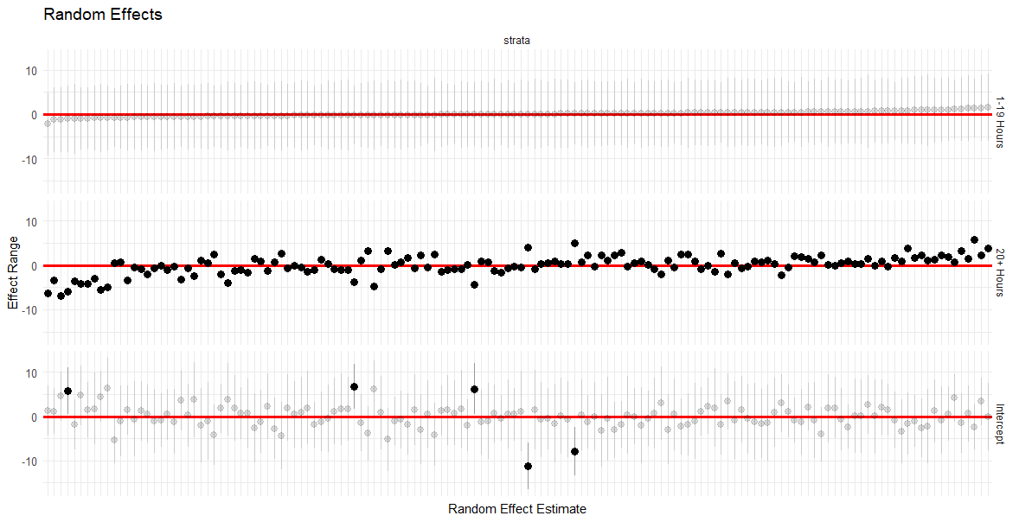

Slide 11
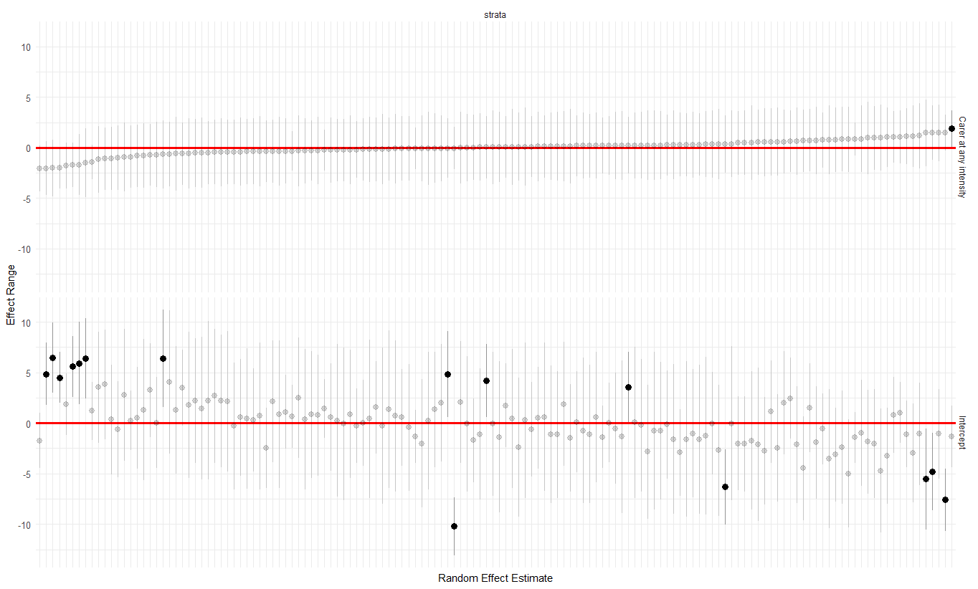
Woman - White - Boomer - GCSEs/A-LEVEL

Slide 12
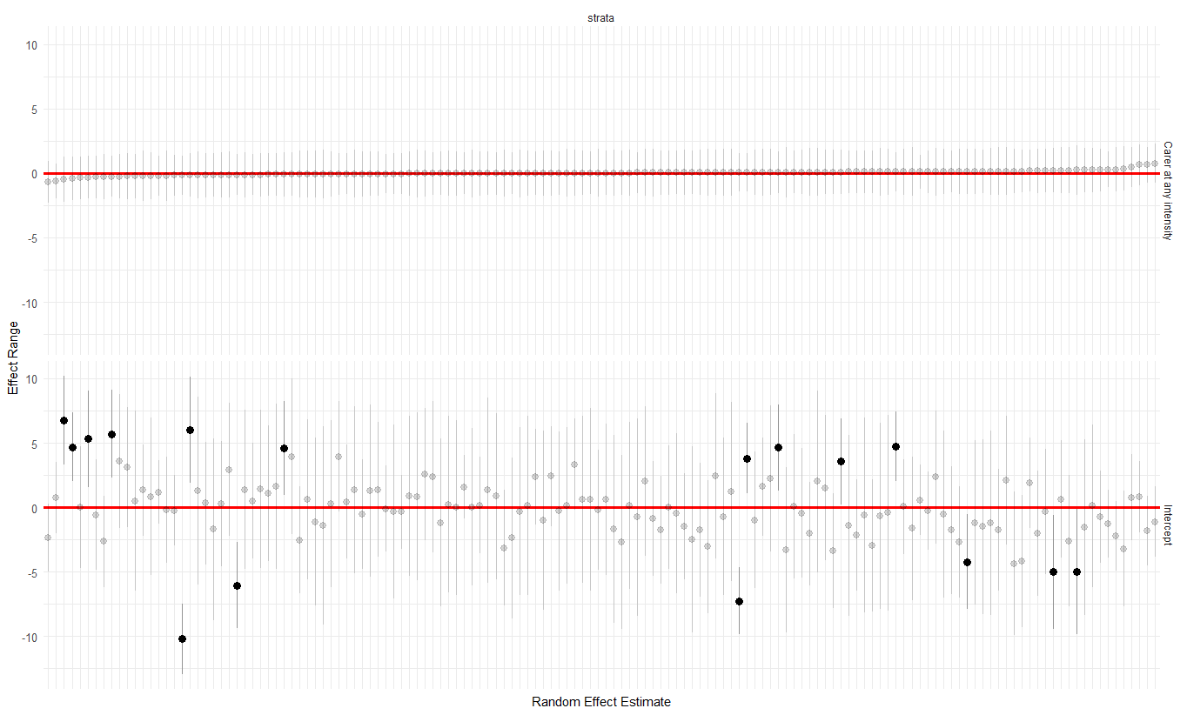

Slide 13

RQ3: To what extent is the variation in the care-employment relationship explained by two-way, care-by-demographic-variable interactions, as opposed to higher-order interactions?
In other words… Does the effect of care intensity on job hours differ depending on the socio-demographic group someone belongs to?
75.86% of the intersectional variance is explained by controlling for socio-demographic interactions with caring.
Significant interactions between care and socio-demographic variables (sex, ethnicity, generation and highest educational qualification)

Slide 14
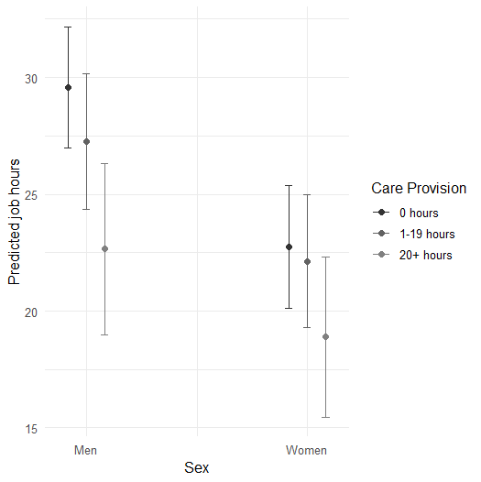
Care*Sex

Slide 15
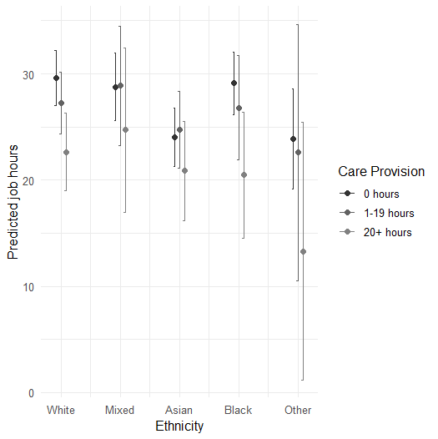
Care*
Ethnicity

Slide 16
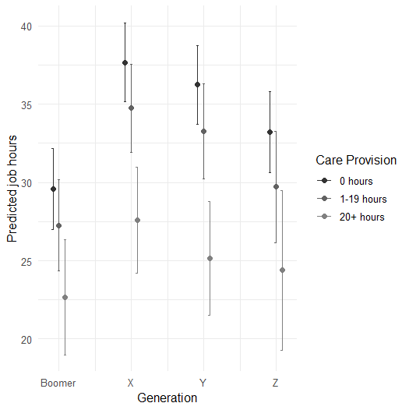
Care*
Generation

Slide 17
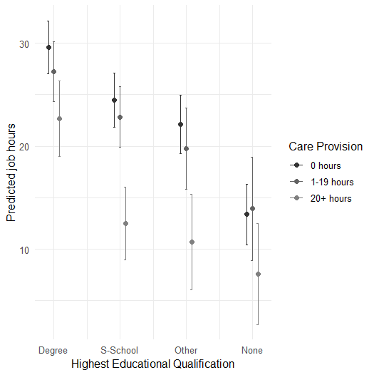
Care*
Education

Slide 18
Limitations
USING RIGID GROUPINGS
Carers are not a homogenous group (Gallagher, 2020) and care intensity is difficult to quantify.
Does not take into account the individual experiences of providing care
→ Emotional/physical demands differ
→ The relationship between care provider & receiver
Rigid categories when defining strata may overlook the differences within categories
→ For example, categorising ethnicity into 5 categories misses key detail, such as differences between Black Caribbean and Black African ethnic groups.
This research should be considered alongside qualitative research to understand individual experiences.

Slide 19
References
Bell, A., Holman, D., Jones, K. (2019) ‘Using Shrinkage in Multilevel Models to Understand Intersectionality: A Simulation Study and a Guide for Best Practice’, Methodology: European Journal of Research Methods for the Behavioral and Social Sciences, 15(2), pp. 88–96.
Brimblecombe, N., Knapp, M., King, D., Stevens, M. and Farias, J. C. (2020) ‘The high cost of unpaid care by young people:health and economic impacts of providing unpaid care’, BMC Public Health, 20(1), 1115. DOI: 10.1186/s12889-020-09166-7
Carers UK (2019) Juggling Work and Unpaid Care: A Growing Issue. Available at: https://www.carersuk.org/media/no2lwyxl/juggling-work-and-unpaid-care-report-final-web.pdf (Accessed 15 November 2024).
Cartagena-Farias, J. and Brimblecombe, N. (2023) ‘The Economic Cost of Unpaid Care to the Public Finances: Inequalities in Welfare Benefits, Forgone Earnings-related Tax Revenue, and Health Service Utilisation’, Social Policy and Society, pp. 1–15.
Crenshaw, K. (1991) ‘Mapping the Margins: Intersectionality, Identity Politics, and Violence against Women of Color’, Stanford Law Review, 46(3), pp. 1241-1299.
Gallagher, A. (2020) Slow Ethics and the Art of Care. Bingley: Emerald Publishing Limited.
King, D. and Pickard, L. (2013) ‘When is a carer's employment at risk? Longitudinal analysis of unpaid care and employment in midlife in England’, Health and Social Care in the Community, 21(3), pp. 303-314. DOI: 10.1111/hsc.12018
Petrillo, M., Valdenegro, D., Rahal, C., Zhang, Y., Pryce, G., & Bennett, M. R. (2024) ‘Estimating the cost of informal care with a novel two-stage approach to individual synthetic control’ [Preprint]. arXiv:2411.10314v2. https://arxiv.org/abs/2411.10314v2
Peytrignet, S., Grimm, F. and Tallack, C. (2024) Understanding unpaid carers and their access to support. Available at: https://www.health.org.uk/publications/long-reads/understanding-unpaid-carers-and-their-access-to-support (Accessed 15 November 2024).
University of Essex, Institute for Social and Economic Research [U Essex]. (2023) Understanding Society: Waves 1-13, 2009-2022 and Harmonised BHPS: Waves 1-18, 1991-2009. [data collection]. 18th Edition. UK Data Service. SN: 6614, http://doi.org/10.5255/UKDA-SN-6614-19.

