Slide 1



Assessing Professionalism in Spanish Healthcare Contexts: Cultural Adaptation and Validation of the Professionalism Mini-Evaluation Exercise (P-MEX)
Raúl Castañeda-Vozmediano, Diana Monge, Niels Smits, Emilio Cervera-Barba, Valle Coronado-Vázquez, Santiago Álvarez-Montero, Cristina Cisterna, Miguel A. Sorrel

Slide 2


INTRODUCTION
MEDICAL PROFESSIONALISM: commitment of physicians to the health of patients and society, the profession, and themselves (Medical Professionalism Project, 2002)
“Professionalism” requires knowledge and technical competence, but, more importantly, necessitates the application of virtue ethics (Brody & Doukas, 2014)
3 core values: patient welfare, patient autonomy, and social justice
    Key responsibilities and professional commitments:
    professional competence,
    honesty with patients,
    patient confidentiality,
    maintaining appropriate relationships with patients,
    improving the quality of care,
    enhancing access to care,
    ensuring just distribution of finite resources,
    …
          - Heterogenous construct -

Slide 3
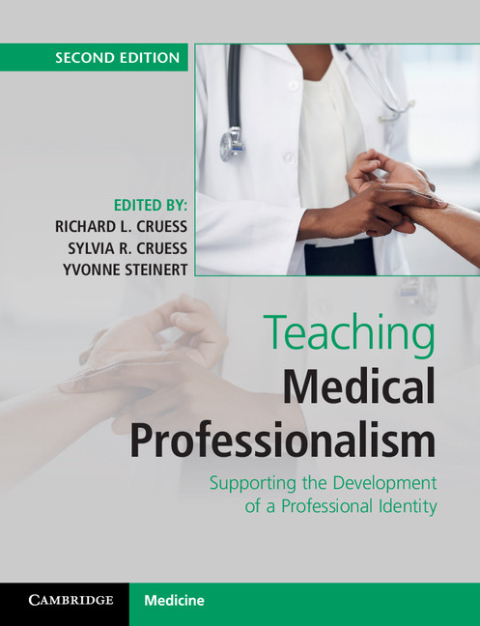
INTRODUCTION
Large collection of existing questionnaires to measure students' and professionals' knowledge of :
what professionalism is (level "know") (e.g. Barry Challenges to Professionalism questionnaire, Test of Residents’ Ethics Knowledge for Pediatrics (TREK-P))
what respondents say they would do (level "know how") in a hypothetical situation that tests their professionalism (e.g. Moral Judgment Interview (MJI), Defining Issues Test (DIT), Jefferson scales, Situational Judgment Test (SJT), Groningen Reflection Ability Scales (GRAS))
what participants do when observed (level "show how") in a specific situation (e.g. Standardized Patients (SPs), Mini-CEX, and Professionalism-Mini Clinical Evaluation Exercise (P-MEX))
what the signs of professional behavior are (level "does") when they are not being observed (e.g. Records of incidents of unprofessional behavior, 360º evaluations – collated views of coworkers, peers, supervisors, or patients, Conscientiousness index)
Cruess et al. (2016, pp 156-164)

Slide 4

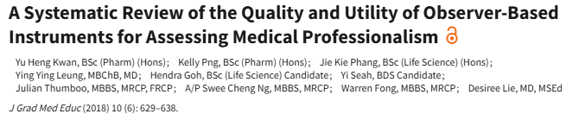
INTRODUCTION
“We don´t need many more tools. It is time to stop developing aditional methods and focus our efforts on refining those we have and tailoring them for different purposes…” (Cruess et al., 2016)
3 main issues in the assessment of MP:
there is no single definition that is generally agreed upon;
when asking the professional directly to rate their MP response biases such as social desirability may play a role;
MP is a multifaceted construct; it requires a mapping under many different circumstances (e.g. medical students / medical residents / senior doctors ; standardized pateints/ real patients ; center patient specialties / technological-procedure specialties; east cultures / west cultures etc.)
recommended 360-degree evaluations (observational tools)
P-MEX questionnaire demonstrated the strongest measurement properties

Slide 5
INTRODUCTION
Professionalism Mini-Evaluation Exercise (P-MEX) (Cruess, et al., 2006):
    Reported by supervisors or observers about residents or students' performance
    21 items; Likert Scale 1-4 (1= Unacceptable; 4= Exceeded expectations)
    4 factor theorical dimensionality: Doctor patient relation skills; Reflexive skills; Time Management; Interprofessional relation skills
    Instruction: “Please rate the student’s/resident’s performance…”
    (e.g. Item 1: “Listened actively to patient")
7 international adapted versions: US, Japan, Finland, Iran, India, Brazil and Turkey
  Main methodological limitations:
    Several rating for each rater – dependency between observations not contempled
    CFA with small samples were applied (convergence issues not reported)
    Cronbach Alpha used in this multidimensional test
    Kaiser Criterion (eigenvalues >1) used for factor extraction

Slide 6
METHODS
Sample
N raters = 186 Spanish resident’s supervisors (Mean Age = 47.58; SD=8.72; 63.7% women)
N ratee = 262 Spanish resident’s
N ratings = 268 Observations
Dependent observations
63 supervisors completed the P-MEX questionnaire for more than one resident
5 residents were evaluated by more than one supervisor
25 (9.33%) surveys were collected in a retest
Variables
21 P-MEX translated items
1 global question: “Please rate this student’s/resident’s overall professional performance”
2 criterions measures:
Number of official and unofficial complaints received from patients regarding the residents’ performance in the past year
Translation and cultural adaption process
Translation and backtranslation
Experts panel
Pilot sample
Statistical analysis
Item analysis
Internal structure
Check of consequences about dependent observations and EFA convergence problems
Internal consistency and test-retest reliability
Convergent and criterion validity

Slide 7
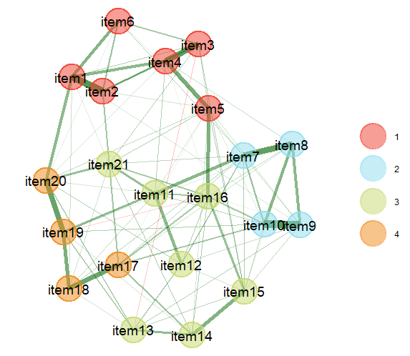
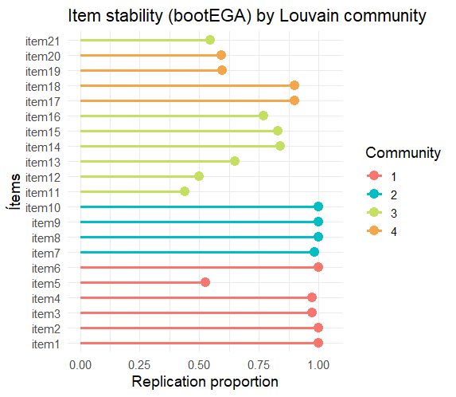
RESULTS
Exploratory Graph Analysis (EGA) Solution
Stability of the BootEGA solution with Louvain Algorithm:
4 F (60.8% of the 500 replic.) 5 F (37.0%)

Slide 8
RESULTS
Check of consequences about:
Dependency between observations
2 linear mixed models (randome effect: supervisors):
Only the observations from supervisors who evaluated more than one resident (ICC=0.313)
All responses (ICC=0.277)→ not negligible
2 Exploratory Factor Analysis (EFA) - oblimin rotation and WLSMV estimator
  the initial sample, which included all responses (dependency between observations)
  100 randomized subsamples one observation per rater (no intra-supervisor dependency)
Tucker’s coefficient of loadings congruence (Lorenzo-Seva & Ten Berge, 2006)
F1-F1 = 0.99; F2- F2 = 0.99; F3- F3 = 0.98; F4- F4 = 0.99
EFA convergence problems
N observations = 268 /
N parameters =142
3 EFA models (all observations)
    WLSW
    MINRES
    ML
Tucker’s coefficient of loadings congruence >0.97

Slide 9
RESULTS
Internal consistency:
Test-retest:
ICC=0.86
r = 0.874
 | Total Scale | Doctor patient relation | Reflexive skills | Time Management | Interprofessional relation skills
α | 0.920 | 0.852 | 0.852 | 0.619 | 0.775
ω | 0.935 | 0.86 | 0.85 | 0.76 | 0.72
ω H | 0.720
Criterion validity:
P-MEX Total score was negatively correlated with patients’ unofficial complaints (r = -0.607, p < 0.001)
  and official complaints (r = -0.163, p < 0.001)

Slide 10
DISCUSSION
The internal structure identified through the EFA model closely resembled the original validation
7 “unexpected” cross-loadings :
Some of them were also identified in the original validation study (11, p.76), although they were not explicitly discussed (e.g., items 5 and 12).
Others showed loadings above 0.30 on all four factors in the original study, suggesting a possible lack of conceptual precision (e.g. item 16)
In most previous adaptations of the P-MEX, the use of confirmatory strategies (e.g., CFA) prevented the detection of cross-loadings, as these parameters were fixed to zero.
    Moreover, some of the CFA models estimated in those studies showed unsatisfactory GOF indices such as RMSEA values > 0.08 and/or CFI < 0.90

Slide 11
DISCUSSION
Dependency between observations:
Factor estimation remained consistent despite a potential dependency among observations.
EFA convergence issues:
    Results were identical when comparing several estimators of different types, suggesting that convergence issues did not lead to discrepant outcomes in this case
Criterion and predictive validity:
P-MEX score could be a good predictor of low professionalism although:
      Cut of points should be consider with caution specially because of the small sample size
      Patient complaints were relied by the rater (supervisor) - recall bias
      Future studies: invariance measurement between technological and person-center medical specialties

Slide 12
REFERENCES
Brody, H., & Doukas, D. (2014). Professionalism: A framework to guide medical education. Medical Education, 48(10), 980–987. https://doi.org/10.1111/medu.12520
Cruess, R. L., Cruess, S. R., & Steinert, Y. (2016). Teaching Medical Professionalism (2nd Edition). Cambridge University Press. https://doi.org/10.1017/CBO9781316178485
Cruess, R., Mcilroy, J. H., Cruess, S., Ginsburg, S., & Steinert, Y. (2006). Addressing Medical Student Professionalism The Professionalism Mini-Evaluation Exercise: A Preliminary Investigation.
Kwan, Y. H., Png, K., Phang, J. K., Leung, Y. Y., Goh, H., Seah, Y., Thumboo, J., Ng, A. S. C., Fong, W., & Lie, D. (2018). A Systematic Review of the Quality and Utility of Observer-Based Instruments for Assessing Medical Professionalism. Journal of Graduate Medical Education, 10(6), 629–638. https://doi.org/10.4300/JGME-D-18-00086.1
Lorenzo-Seva, U., & Ten Berge, J. M. F. (2006). Tucker’s Congruence Coefficient as a Meaningful Index of Factor Similarity. Hogrefe & Huber Publishers Methodology, 2(2), 57–64. https://doi.org/10.1027/1614-1881.2.2.57
Medical Professionalism Project. (2002). Medical professionalism in the new millennium:a physicians’ charter. TheLancet, 359(9305), 520–522. https://doi.org/10.1016/S0140-6736(02)07684-5

