Slide 1

Preliminary Convergent-Discriminant Validity Evidence of the Methodological Quality Scale for Observational Methodology (MQSOM): A Confirmatory Factor Analysis
Daniel López-Arenas, Susana Sanduvete-Chaves, José Mena-Raposo, & Salvador Chacón-Moscoso

Slide 2
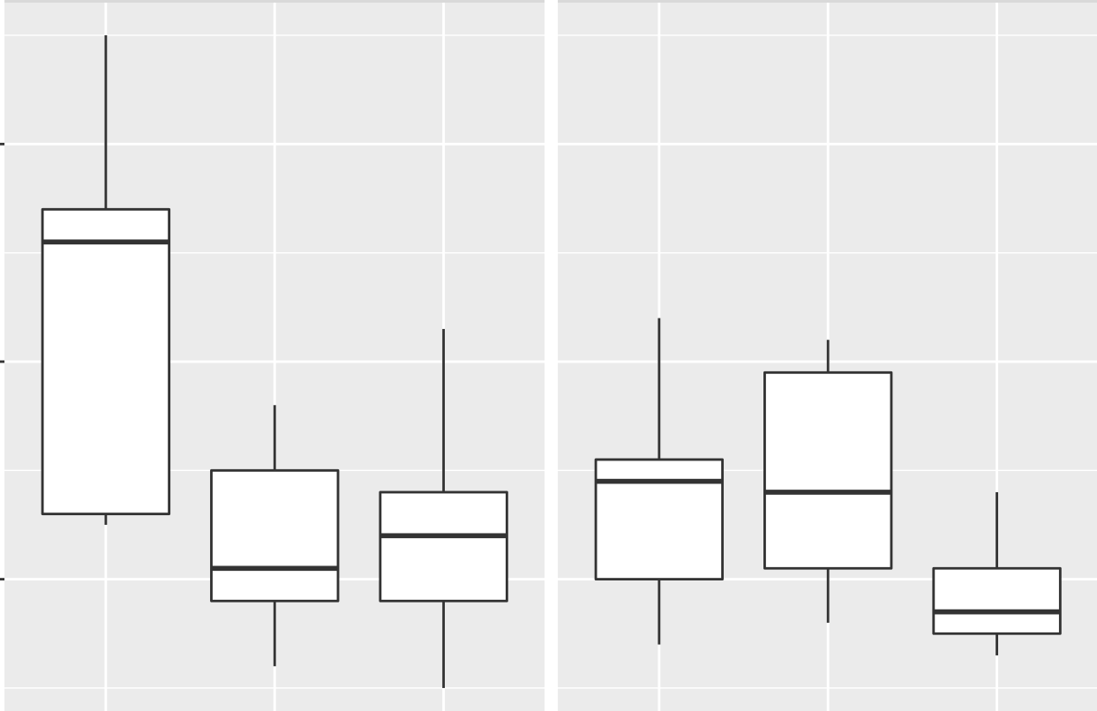
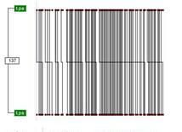
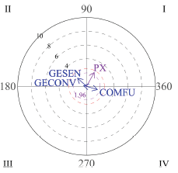
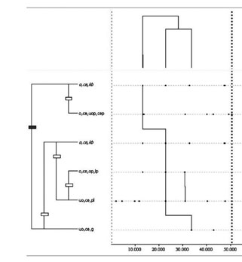

Observational Methodology
2
Observational methodology as a Mixed Methods approach
Natural Context
Ad hoc observational Instrument
Data Quality Control
Observational Design
Register
Data Analysis
Interpretation of results
QUALITATIVE STEP
QUANTITATIVE STEP
QUALITATIVE STEP

Slide 3
Observational Methodology
“Observational Methods”
(MT Anguera, 1993)
3

Slide 4
Observational Methodology
A long-time need
2015
2018
2019
2025
Methodological Quality Checklist for studies based on Observational Methodology
(MQCOM)
(Chacón-Moscoso et al., 2019)
Guidelines for Reporting Experiments based on Observational Methodology
(GREOM)
(Portell et al., 2015)
Preliminary checklist for reporting observational studies
(Chacón-Moscoso et al., 2018)
Methodological Quality Scale for Observational Methodology
(MQSOM)
(Sanduvete-Chaves et al., 2025)
MQSOM is the first scale with evidence of reliability and validity to evaluate the methodological quality of studies based on observational methodology
4

Slide 5
Mixed Methods
5
Observational Methodology
2015
2018
2019
2025
Methodological Quality Checklist for studies based on Observational Methodology
(MQCOM)
(Chacón-Moscoso et al., 2019)
Guidelines for Reporting Experiments based on Observational Methodology (GREOM)
(Portell et al., 2015)
Preliminary checklist for reporting observational studies
(Chacón-Moscoso et al., 2018)
Methodological Quality Scale for Observational Methodology
(MQSOM)
(Sanduvete-Chaves et al., 2025)
2018
2025
Mixed Methods Appraisal Tool (MMAT)
(Hong et al., 2018)

Slide 6
Objectives
Obtain evidence of convergent and discriminant validity of MQSOM with contrast instruments
MQSOM
GREOM
MMAT
6

Slide 7
Method
Participants
Instruments
Multitrait-Multimethod Analysis
307 studies
  - OM employed
  -Original works
  -Following the standard publication format
Guidelines for Reporting Experiments based on Observational Methodology
(GREOM; Portell et al., 2015)
Mixed Methods Appraisal Tool (MMAT; Hong et al., 2018)
Methodological Quality Scale for Observational Methodology
(MQSOM; Sanduvete-Chaves et al., 2025)
through Structural Equation Modelling (Kenny & Kashy, 1992) using JASP 0.19.3
7

Slide 8
Instruments: MQSOM
Observational Methodology employment
ω = .86
D = .61
Observational Unit
Quality of Design
Temporality
Factor 1
Dimensionality
Codificacion Manual
Methodological Quality Overall
General Factor
Data Type
Observational Instrument
Recording, Quality Control & Analysis Softwares
Factor 2
Quality of Measurement & Analysis
Type of Parameter
Data Quality Control
Data Analysis
8

Slide 9
Instruments for comparison
GREOM
MMAT
14 items
ω = .75
D = .43
15 items
ω = .87
D = .45
Intervention & Expected Outcomes
Qualitative
Component
Design
Quantitative Component
Samples
Instruments
Mixed Methods
Data Quality Control
Results
9

Slide 10
Results (I) Model 1: Trait & Method parameters freely estimated
Planification
.79
Implementation
.15
.24
1
.6
.96
.8
.06
-.14
.94
.45
.04
GREOM 1
Intervention & Expected Outcomes
GREOM 2
Design
GREOM 3
Samples
GREOM 4
Instruments
GREOM 5
Data Quality Control
GREOM 6
Results
MMAT 1
Qualitative component
MMAT 2
Quantitative component
MMAT 3
Mixed Methods
MQSOM 1
Quality of Design
MQSOM 2
Quality of Measurement & Analysis
.91
.82
-.01
.51
.85
-.03
.93
-.04
.46
.87
.25
GREOM
MMAT
MQSOM
-.36
-.36
.99

Slide 11
Results (II) Model 2: Only Method parameters considered
GREOM 1
Intervention & Expected Outcomes
GREOM 2
Design
GREOM 3
Samples
GREOM 4
Instruments
GREOM 5
Data Quality Control
GREOM 6
Results
MMAT 1
Qualitative Component
MMAT 2
Qunatitative Component
MMAT 3
Mixed Methods
MQSOM 1
Quality of Design
MQSOM 2
Quality of Measurement & Analysis
.96
.74
.85
.94
.9
.84
.97
.94
.99
.87
.96
GREOM
MMAT
MQSOM
1.02
1.02
1.03

Slide 12
Results (III) Model 3: Only Trait parameters considered
.99
Planification
Implementation
.98
.9
.94
.99
.88
.97
.97
.74
.89
.96
.88
GREOM 1
Intervention & Expected Outcomes
GREOM 2
Design
GREOM 3
Samples
GREOM 4
Instruments
GREOM 5
Data Quality Control
GREOM 6
Results
MMAT 1
Qualitative Component
MMAT 2
Quantitative Component
MMAT 3
Mixed Methods
MQSOM 1
Quality of Design
MQSOM 2
Quality of Measurement & Analysis

Slide 13
Results (IV) Model 4: Method parameters freely estimated & general trait
Quality
.93
.93
.93
.84
.94
.85
.99
.91
1
.58
.99
GREOM 1
Intervention & Expected Outcomes
GREOM 2
Design
GREOM 3
Samples
GREOM 4
Instruments
GREOM 5
Data Quality Control
GREOM 6
Results
MMAT 1
Qualitative component
MMAT 2
Quantitative component
MMAT 3
Mixed Methods
MQSOM 1
Quality of Design
MQSOM 2
Quality of Measurement & Analysis
.37
.59
.05
.31
.43
.02
.48
.06
.37
.61
.33
GREOM
MMAT
MQSOM
1.09
.93
1.07

Slide 14
Results (V) Model 5: Trait parameters freely estimated & general method
Planification
Implementation
-.51
.09
.28
.4
.06
.4
.11
-.02
.66
.36
.08
-.01
GREOM 1
Intervention & Expected Outcomes
GREOM 2
Design
GREOM 3
Samples
GREOM 4
Instruments
GREOM 5
Data Quality Control
GREOM 6
Results
MMAT 1
Qualitative component
MMAT 2
Quantitative component
MMAT 3
Mixed Methods
MQSOM 1
Quality of Design
MQSOM 2
Quality of Measurement & Analysis
.97
.88
.79
.94
.88
.76
1
.83
.98
.96
.94
Instruments

Slide 15
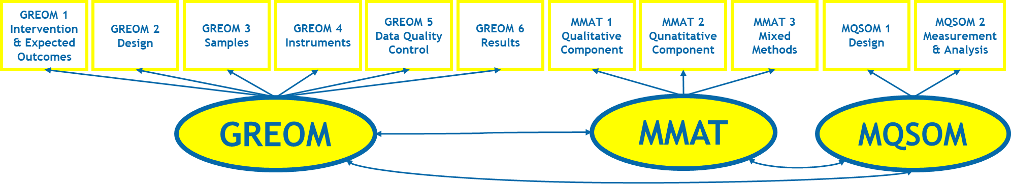
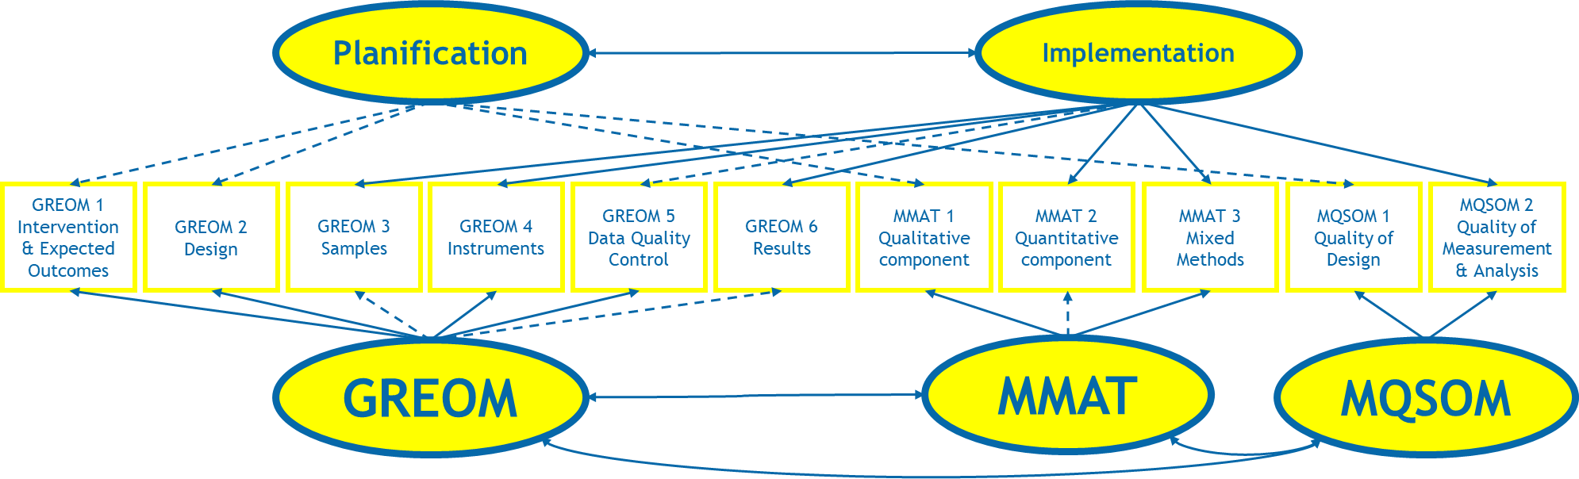
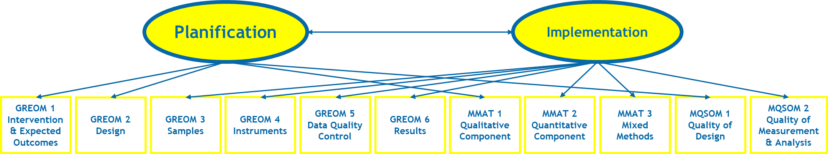
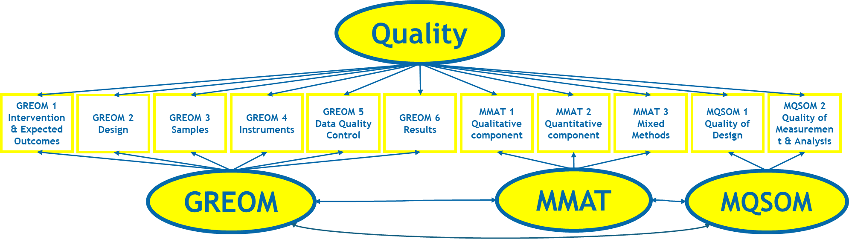
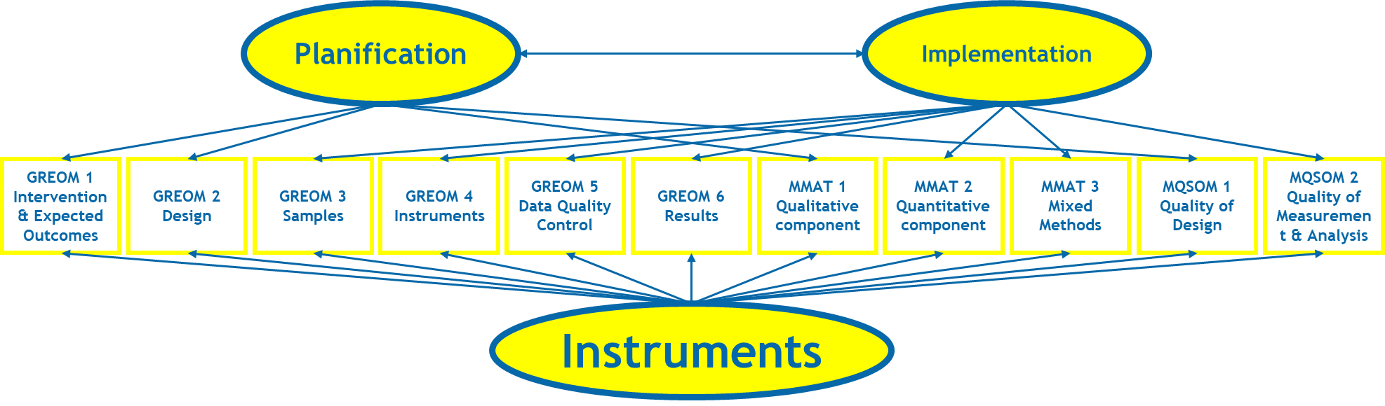
Results (VI)
2
3
1
4
Model | Fit Indexes
 | NFI | CFI | RMSEA | NNFI | IFI | RFI | GFI
1 | .57 | .57 | .359 | .30 | .57 | .30 | .66
2 | .31 | .31 | .367 | .27 | .31 | .27 | .46
3 | .28 | .28 | .368 | .27 | .28 | .26 | .45
4 | .50 | .50 | .365 | .28 | .51 | .28 | .61
5 | .48 | .49 | .360 | .31 | .49 | .31 | .58
Note. NFI = Bentler-Bonett Normed Fit Index; CFI = Comparative Fit Index; RMSEA = Root Mean Square Error of Approximation; NNFI = Bentler-Bonett Non-normed Fit Index; IFI = Bollen's Incremental Fit Index; RFI = Bollen's Relative Fit Index; GFI = Goodness of Fit Index.
5

Slide 16
Discussion
The multitrait-multimethod model fits the data slightly better than the proposed alternatives
Multitrait
DATA
Multimethod
Multitrait
Monotrait
Multitrait
DATA
DATA
DATA
DATA
Multimethod
Multimethod
Monomethod

Slide 17
Discussion
Compared to the multitrait-multimethod model, when estimating a multitrait-monomethod model the traits covariation decrease from 0.79 to -0.51
.79
-.51
Planification
Implementation
Planification
Implementation
DATA
DATA
GREOM
MMAT
MQSOM
Monomethod
This might suggest a potential influence of methods on the variability explained by traits → Acknowledging the uniqueness of each method (a guideline, a checklist and a validated scale), the trait covariation becomes theory-aligned (quality of planification and implementation is expected to be positively correlated)

Slide 18
Discussion
When estimating the multitrait-multimethod model, GREOM and MQSOM shows a clear differential nature respect to MMAT, but when estimating a monotrait-multimethod model the three methods shows almost perfect or out-of-range coefficients
Planification
Implementation
Monotrait
DATA
DATA
GREOM
MMAT
MQSOM
GREOM
MMAT
MQSOM
-.36
-.36
1.09
.93
.99
1.07
This might suggest a potential influence of traits on the variability explained by methods → Considering two traits allows to acknowledge the similarities of MQSOM with GREOM (a guideline tailored for observational methodology) and its differences with MMAT (a checklist to appraise Mixed Methods overall)

Slide 19
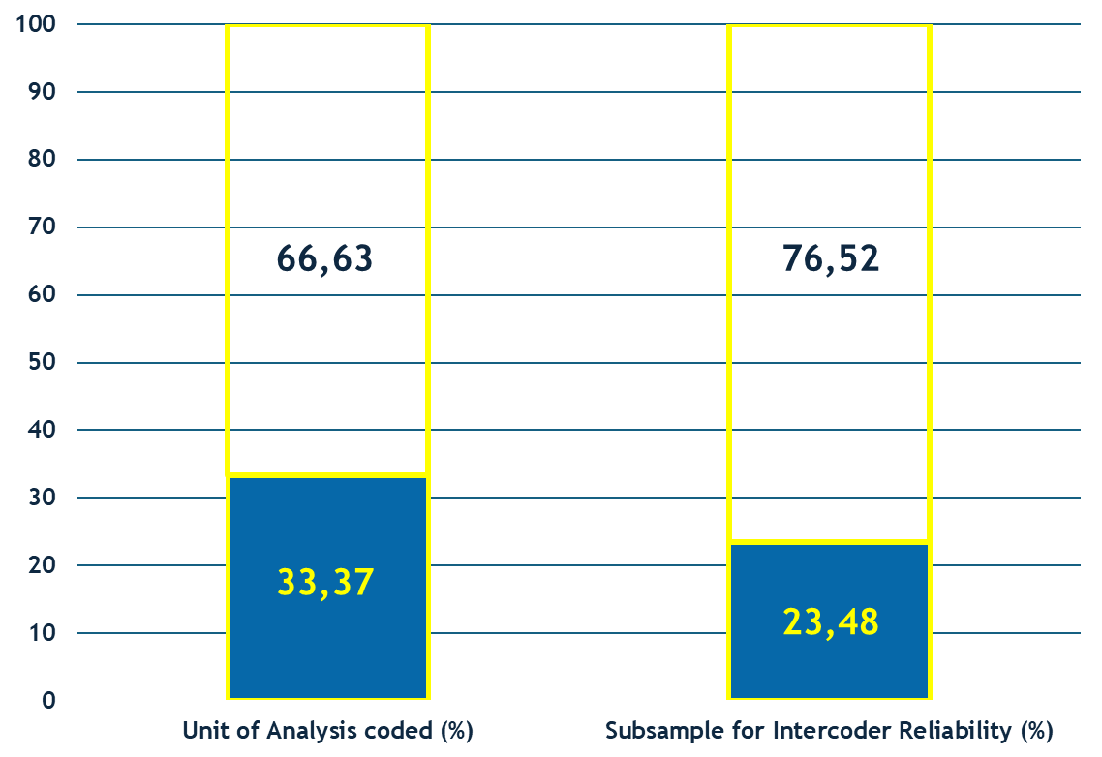
Conclusion
Weak, preliminary and inconclusive, but promising results
Intercoder reliability remains unstudied
After reliability exploration, MQSOM and the contrast instruments still need to be applied at least on twice the size of the sample considered in this work to guarantee a robust parameter estimation

Slide 20
References
Anguera, M. T. (1993). Observational Methods (General). In R. Fernández-Ballesteros (Ed.), Encyclopedia of Psychological Assessment, Vol. 2 (pp. 632-637). Sage.
Chacón-Moscoso, S., Anguera, M. T., Sanduvete-Chaves, S., Losada, J. L. y Portell, M. (2019). Methodological quality checklist for studies based on observational methodology (MQCOM). Psicothema, 31 (4), 458-464. https://doi.org/10.7334/ psicothema2019.116
Hong, Q. N. (2018). Revision of the Mixed Methods Appraisal Tool (MMAT): A mixed methods study. [PhD thesis, McGill University (Canada)]. ProQuest Dissertation & Theses. https://www.proquest.com/docview/2503422955/fulltextPDF/C42D3223B4294336PQ/1?accountid=14744&sourcetype=Dissertations%20&%20Theses
Kenny, D. A., & Kashy, D. A. (1992). Analysis of multitrait-multimethod matrix by confirmatory factor analysis. Psychological Bulletin, 112, 165–172. https://doi.org/10.1037/0033-2909.112.1.165
Portell, M., Anguera, M. T., Chacón-Moscoso, S. y Sanduvete-Chaves, S. (2015). Guidelines for reporting evaluations based on observational methodology. Psicothema, 27 (3), 283-289. https://doi.org/10.7334/psicothema2014.276
Sanduvete-Chaves, D., López-Arenas, D., Anguera, M. T., & Chacón-Moscoso, S. (2025). A Scale for Evaluating the Methodological Quality of studies based on Observational Methodology. Psicothema, 37(1), 1-10. https://doi.org/10.70478/psicothema.2025.37.01
20

Slide 21
Preliminary Convergent-Discriminant Validity Evidence of the Methodological Quality Scale for Observational Methodology (MQSOM):
A Confirmatory Factor Analysis
Thank you for your attention
This work was supported by the research project PID2020-115486GB-I00 funded by the Ministerio de Ciencia, Innovación y Universidades, MICIU/AEI/10.13039/501100011033, Government of Spain. We gratefully acknowledge the support of the Chilean government project FONDECYT Regular 1250316 funded by the National Fund for Scientific and Technological Development, ANID; the Julio Olea Grant for Young Researchers from the Spanish Association for Methodology of Behavioral Sciences (AEMCCO); the Research Group of the Generalitat de Catalunya (Grup de Recerca e Innovació en Dissenys [GRID] “Tecnología i aplicació multimedia i digital als dissenys observacionals” [grant number 2021 SGR 00718] (2022-2024); and the support of the Project funded by the Spanish government “Integration between observational data and data from external sensors: Evolution of the LINCE PLUS software and development of the mobile application for the optimization of sport and physical activity beneficial to health” [EXP_74847] (2023), Ministry of Culture and Sport, Higher Council of Sport and the European Union.
21

