Slide 1

The Invariance Partial Pruning Approach to The Network Comparison in Time-Series and Panel Data
Xinkai Du, Sverre Urnes Johnson, and Sacha Epskamp
July, EAM, Tenerife, Spain

Slide 2
Networks for longitudinal data
Different (groups of) individuals respond differently to the same type of treatment
  Treatment failure
A common goal of empirical network research is to compare the networks of different groups
  Temporal: predictive relations b/w waves
  Contemporaneous: associations at the same measurement
  Between (panel): association between person means

Slide 3
Network comparison
Observed difference are not all meaningful
  True difference
  Sample variability
  Estimation error
Solution:
  Multi-group model to estimate networks and differences at the same time
  Hold sample variability & estimation error constant
  INIT (Hoekstra et al., 2024) & Bayesian approach (Siepe et al., 2024)

Slide 4
Problems
Global tests
  Only know difference exists
  Still don’t know the mechanisms behind
IVPP
  Invariance test to determine presence
  Partial pruning to identify edge-level heterogeneity

Slide 5


The invariance partial pruning approach
1st step: full invariance test on both networks
  Global test on both networks: whether at least one edge is different in either temporal or contemporaneous
  Move on if M₁ fit better than M₀ (AIC, BIC, $χ2$)
Notes:
First we do a full invariance test try to establish full invariance of both temporal and contemporaneous networks by comparing a fully constrained and a fully unconstrained model

Slide 6

The invariance partial pruning approach
2nd step: partial invariance global test on temp/cont separately
  Compare with fully unconstrained (free) model: whether adding equality constraint lower fit
  Whether there is at least one edge difference in temporal network
  Whether there is at least one edge difference in contemporaneous network
Missing in INIT from Hoekstra et al; inspired from DIF test in IRT
  Compare with fully constrained model: whether releasing equality improves fit
  Whether there is at least one edge difference in temporal network
  Whether there is at least one edge difference in contemporaneous network

Slide 7
The invariance partial pruning approach
3rd step: Partial Pruning
  Starting from a fully-constrained model
  Iteratively releases equality constraint until it no longer improves fit
    BIC ensures conservatism
The method has been implemented as an open-source R package, IVPP
Applicable to panel data (small T large N; e.g., American National Election Studies)
  Precision treatment
  Cross-cultural comparison
  Meta-analysis ish
    Group edge & individual edge
Notes:
Therefore we set out to test these fit indices with a simulation study to see if they can really test the misfit in network models.

Slide 8
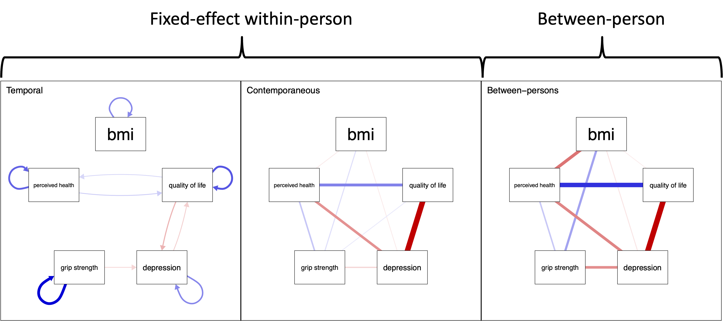
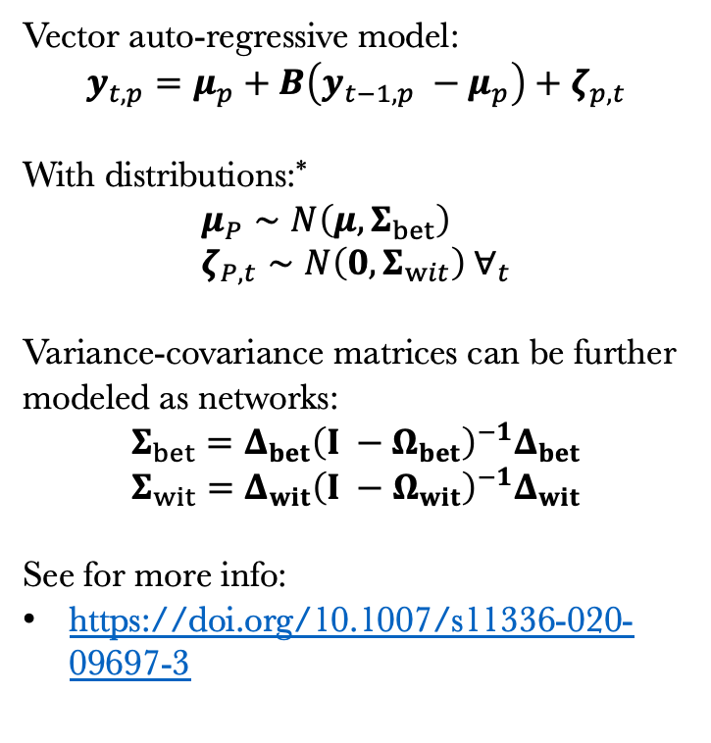
Panel graphical vector-autoregression
(panel-GVAR)
Vector auto-regressive model:
$$y_{t,p}=μ_{p}+B\left(y_{t−1,p} −μ_{p}\right)+ζ_{p,t}$$
With distributions:*
$$μ_{P}∼N\left(μ, Σ_{bet}\right) \\ ζ_{P,t}∼N\left(0, Σ_{wit}\right) ∀_{t}$$
Variance-covariance matrices can be further modeled as networks:
$$Σ_{bet}=Δ_{bet}{\left(I −Ω_{bet}\right)}^{−1}Δ_{bet}$$
$$Σ_{wit}=Δ_{wit}{\left(I −Ω_{wit}\right)}^{−1}Δ_{wit}$$
See for more info:
https://doi.org/10.1007/s11336-020-09697-3
Notes:
For the simulation we used the panelGVAR model. This is a type of vector autoregression model that estimate the temporal and contemporaneous relations among variables. It separates between- and within- variances and model them with Gaussian Graphical Models.
We chose this model because cross-sectional Gaussian Graphical Model and N = 1 GVAR models are its special case, and so we expect the results to generalize to these two cases as well.

Slide 9
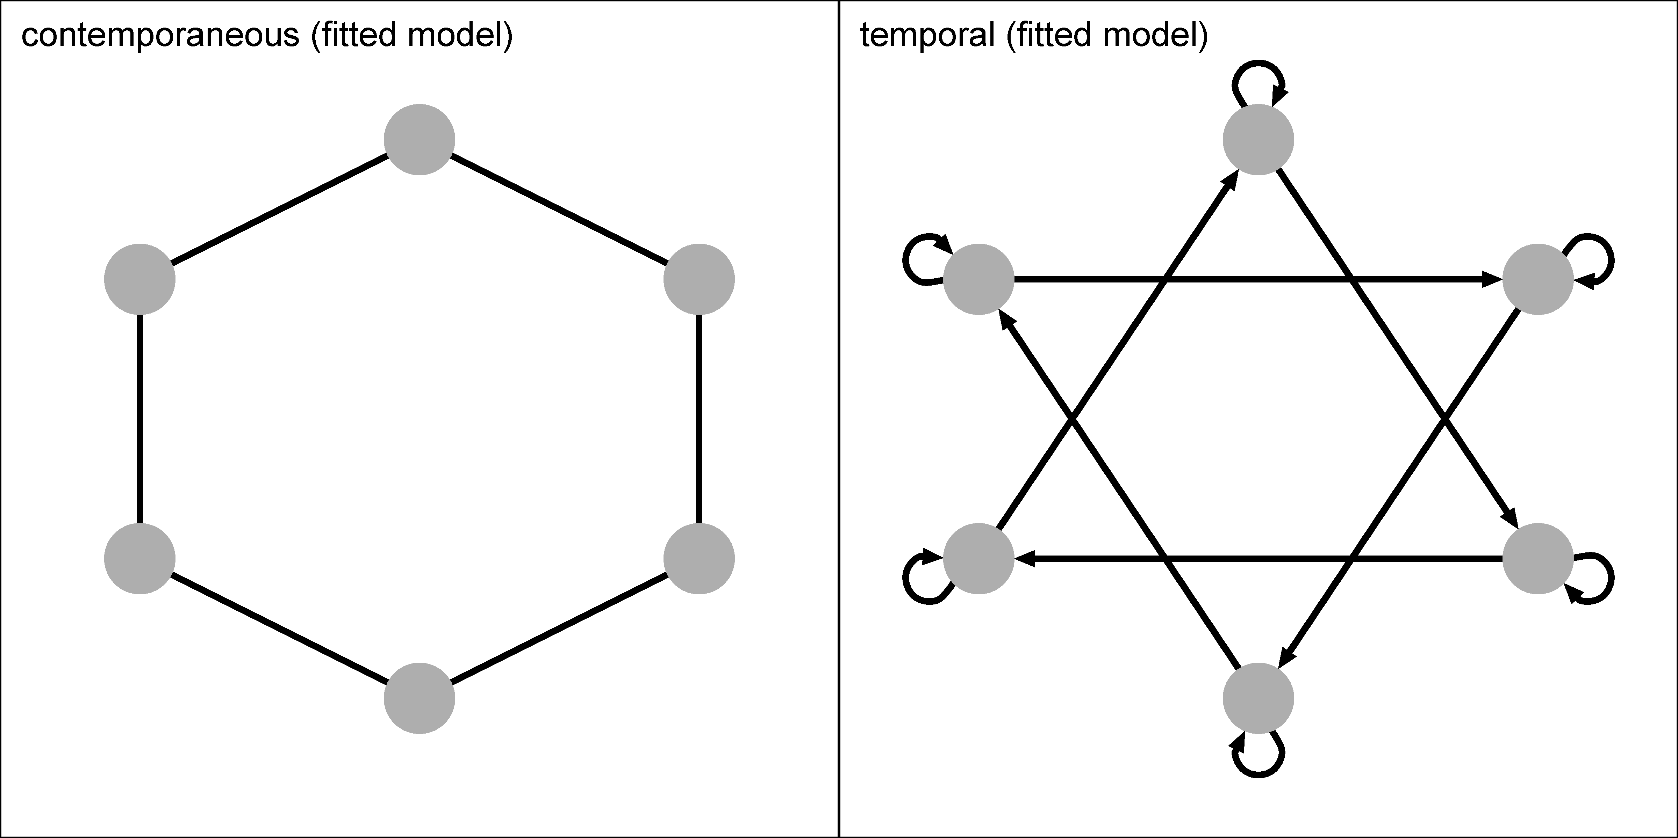
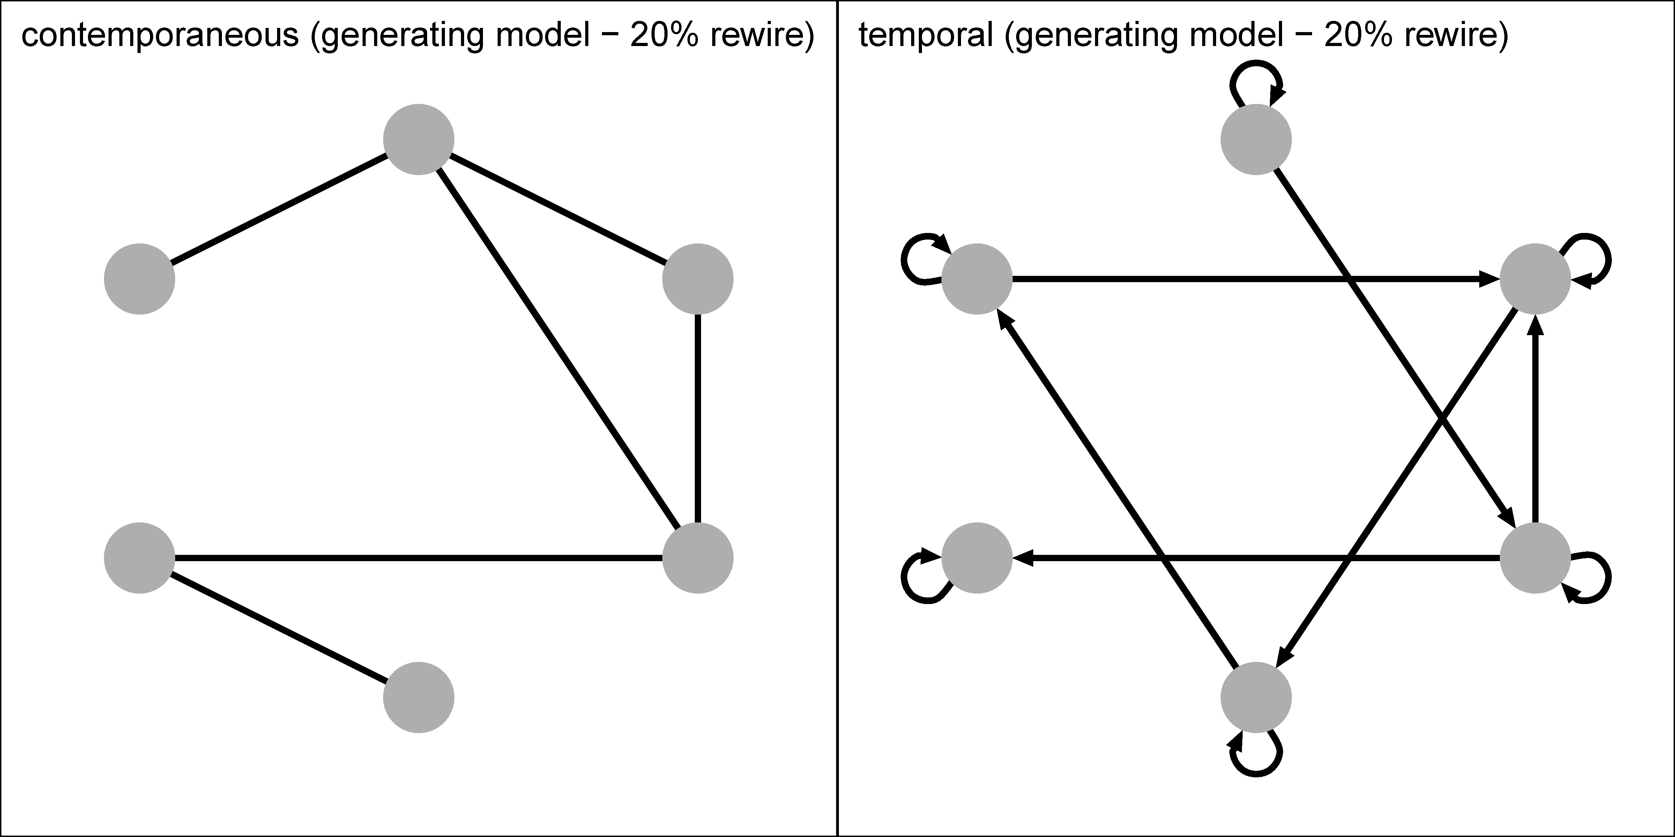
Create group differences
Create group differences
  Rewiring
  Rewire P=0: no difference
  Rewire P>0: there is difference
Notes:
For the sake of time I will only show the result for the hypothesis testing condition with 6 nodes and 3 waves of data. We have lots of other simulations and I recommend to check out the preprint.
In this condition we pre-specify network structures and see if the fit indices shows good fit when the pre-specified model matches the data-generating model and shows bad fit when there’s mismatch.
The specified contemporaneous model is a chain graph where each node is connected to its neighbor, and the temporal network is also a chain graph but each node is connected to the node next to its neighbor, so node 1 connects to node 3, and 3 to 5, and then 5 back to 1.
To create the mismatch between the pre-specified model and data-generating models, we used a technique called rewiring. Which means we relocate the edges with some probability and keep the original weight.
For example in this network rewiring with 20% probability, these edges were relocated to there, and their weights remains the same. If the probability is 0 then the network stays the same, and if probability is 1, all the edges are relocated.

Slide 10
Arbitrary choices & simulation study
Arbitrary choices involved
  Sparse networks vs. saturated
  AIC, BIC, vs. chi-square
  Start from fully constrained vs. free model
Performance in difference conditions
  Sample size
  Number of time points
  Extent of network difference

Slide 11
Rejection rates: The full invariance test (both)
Saturated networks
Sparse networks
Notes:
AIC are solid lines, BIC dash lines, and chi-squares are dotted lines
Main message:
Chi-square is the most liberal test, and it has some risk of false discovery, especially if you are testing equality in sparse networks;
BIC is the most conservative, and it has some risk of low power to detect small difference at small sample size and small number of waves
AIC is the best given the balance of power and sensitivity in testing global invariance of both networks

Slide 12
Rejection rates: The global partial invariance test (temporal)
Saturated networks
Sparse networks
Notes:
Here again, AIC straight line, BIC dash line, and chisquare dotted line
Blue line compares with the fully constrained model → both equal
Red lines compares with the free model, neither network constrained equal
Again chisquare is the most liberal and has highest risk of false positive especially for sparse
BIC has low power for small differences
Comparing with the fully constrained model has higher power to difference while demonstrating similar false discovery rates

Slide 13
Rejection rates: The global partial invariance test (contemporaneous)
Saturated networks
Sparse networks
Notes:
For contemporaneous, the benefit of comparing with the fully constrained model is more apparent
The bic with lowest power is better than the most sensitive chisquare in many conditions if we compare with the fully constrained model

Slide 14
Partial pruning (temporal)
Notes:
Dahsed lines mark 0.05 for bias, 0.5 for correlation, 0.8 for sensitivity, and 0.95 for specificity

Slide 15
Partial pruning (contemporaneous)
Notes:
For small sample the power is around 0.8

Slide 16
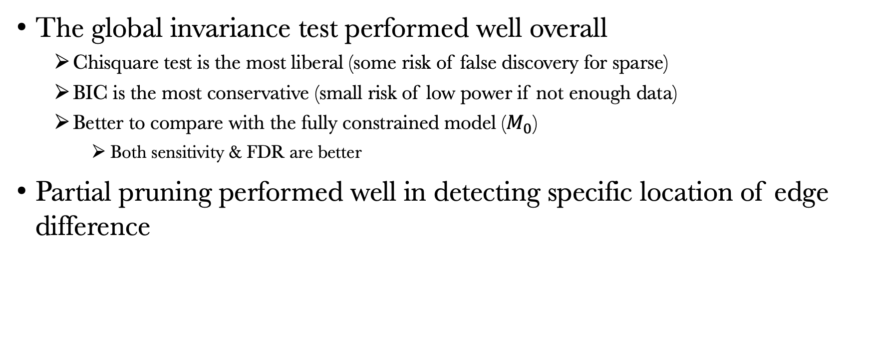
Summary
The global invariance test performed well overall
  Chisquare test is the most liberal (some risk of false discovery for sparse)
  BIC is the most conservative (small risk of low power if not enough data)
  Better to compare with the fully constrained model ($M_{0}$)
    Both sensitivity & FDR are better
Partial pruning performed well in detecting specific location of edge difference

Slide 17

Stay tuned for the preprint & package
Twitter: @XinkaiDu
Bluesky: @xinkaidu.bsky.social
GitHub: @xinkaidupsy

