Slide 1


When Should I Measure?
Finding the Best Sampling Schedule for Recovering Longitudinal Dynamics
in Panel Data Studies with Continuous-Time Models
Nuria Real-Brioso, Eduardo Estrada
PhD Funding contract by the Ministry of Universities - Ayudas para la Formación del Profesorado Universitario (FPU)
FPU22/03300

Slide 2
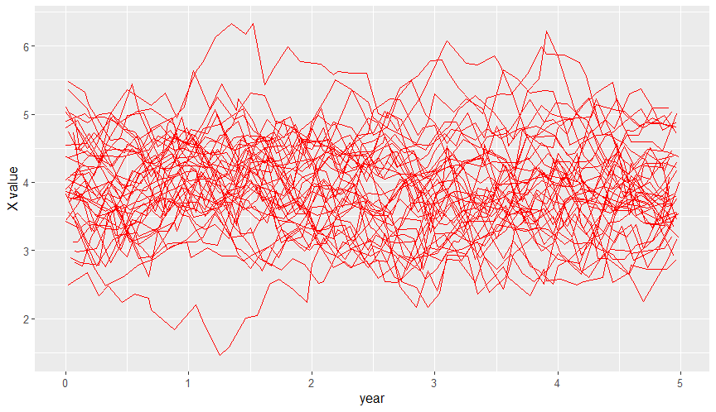
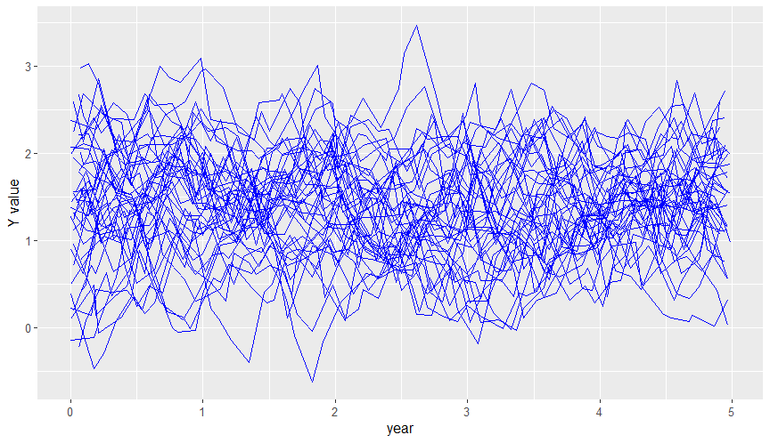




When Should I Measure?
Stable bivariate dynamic processes in Psychology
Autoregressive effects
Cross-lagged effects
Equilibrium points
Random shocks from external factors
Panel Designs (<10 measurements)
and Structural Equation Modeling
Random-Intercept Cross Lagged Panel Model (Hamaker, 2015)
Introduction – Present study – Method – Results – Discussion and Recommendations

Slide 3
When Should I Measure?
Stable bivariate dynamic processes in Psychology
Panel Designs (<10 measurements)
and Structural Equation Modeling
Constant time intervals (Δt) are required
Dynamic parameters depend on them
Introduction – Present study – Method – Results – Discussion and Recommendations

Slide 4
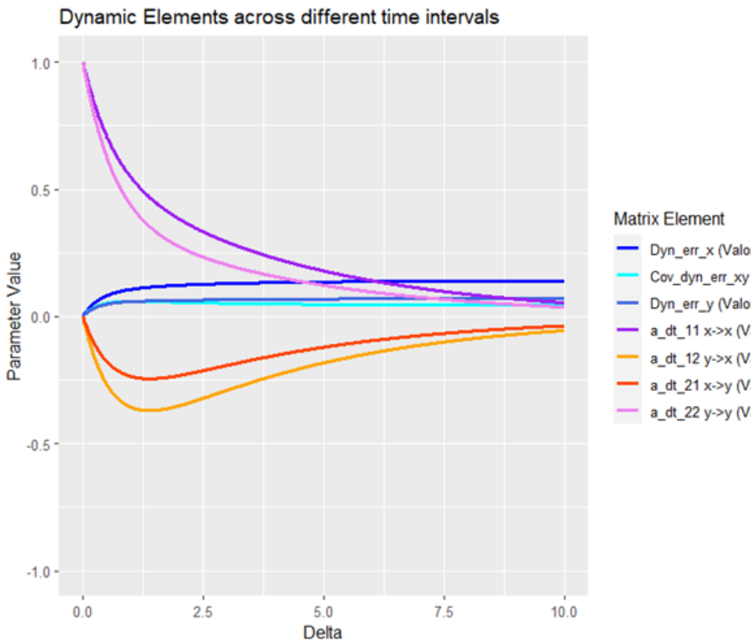
When Should I Measure?
Stable bivariate dynamic processes in Psychology
Panel Designs (<10 measurements)
and Structural Equation Modeling
Constant time intervals (Δt) are required
Dynamic parameters depend on them
Voelkle et al. (2012)
Introduction – Present study – Method – Results – Discussion and Recommendations

Slide 5
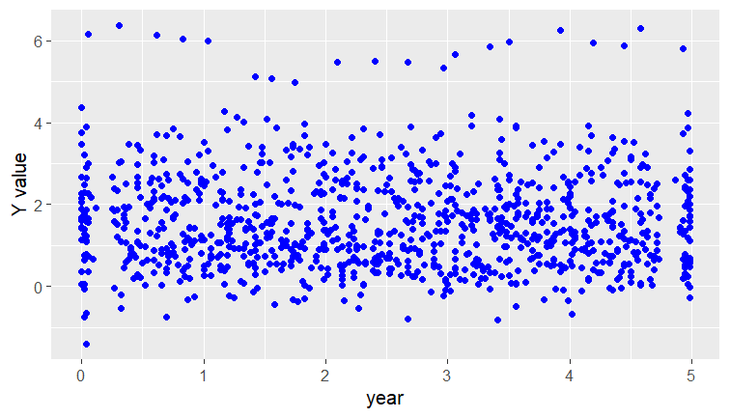
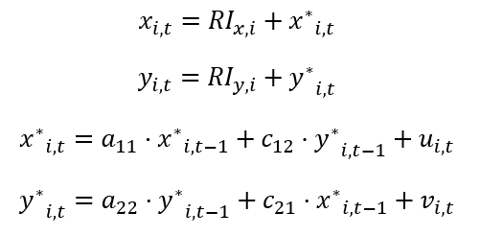
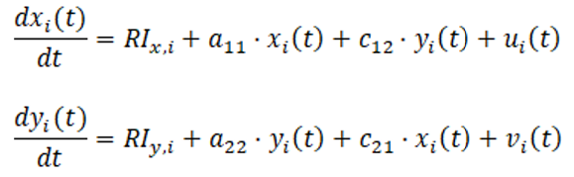
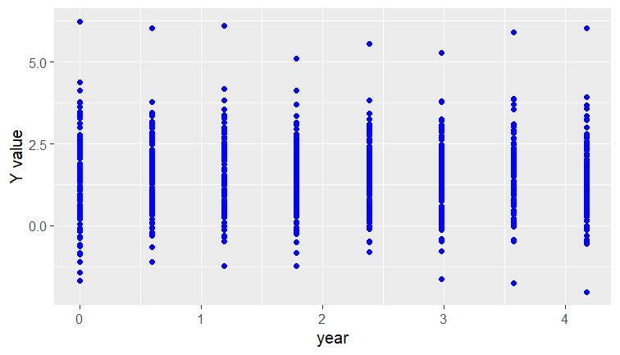
Constant time intervals (Δt) are required
Dynamic parameters depend on them
When Should I Measure?
Stable bivariate dynamic processes in Psychology
Panel Designs (<10 measurements)
and Structural Equation Modeling
Continuous Time (CT) Modeling has the solution!!
… but still, when should I measure? How much?
Ryan et al. (2018)
Hopwood et al. (2022)
Introduction – Present study – Method – Results – Discussion and Recommendations

Slide 6

When Should I Measure?
… but still, when should I measure? How much?
  Batra et al. (2024) for CT-AR(1) model
  Hals et al. (2024) different spacing methods to recover a change in one trajectory
Introduction – Present study – Method – Results – Discussion and Recommendations

Slide 7
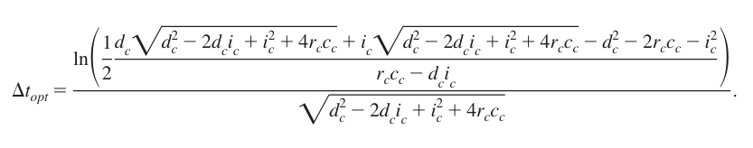
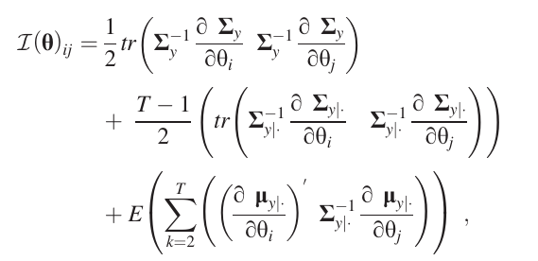
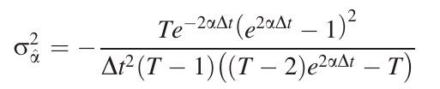


When Should I Measure?
  Dormann & Griffin (2015)
  Adolf et al. (2021)
… but still, when should I measure? How much?
For univariate processes and T > 100
getDtOptBVAR_v1.3
for multivariate settings
Introduction – Present study – Method – Results – Discussion and Recommendations

Slide 8

When Should I Measure?
Current limitations
  No comprehensive exploration of the use of CT in panel data to identify and estimate parameters (Mulder, 2025)
Intensive Longitudinal Data
Constant time intervals
Deterministic processes
(no attention to stochasticity)
Univariate process
Introduction – Present study – Method – Results – Discussion and Recommendations

Slide 9
When Should I Measure?
Our aims
  A comprehensive exploration of parameter estimation:
Panel Data
Different sampling schedules
Bivariate process
Stochasticity
Introduction – Present study – Method – Results – Discussion and Recommendations

Slide 10
When Should I Measure?
Method
Two bivariate processes: depression and self-esteem (Orth et al. 2021) across 5 years
Introduction – Present study – Method – Results – Discussion and Recommendations

Slide 11

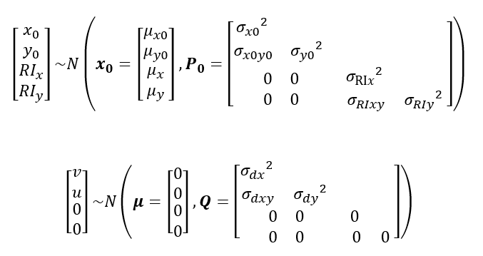
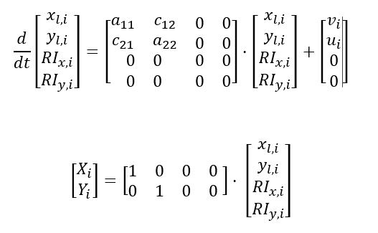

When Should I Measure?
Method
Two bivariate processes: depression and self-esteem (Orth et al. 2021) across 5 years
Model: RI-CLPM in Continuous Time (10 parameters) with State-Space Models (Hunter, 2018)
OpenMx
State equation
Boker et al. (2018)
Output equation
Introduction – Present study – Method – Results – Discussion and Recommendations

Slide 12
When Should I Measure?
Method
Two bivariate processes: depression and self-esteem (Orth et al. 2021) across 5 years
Model: RI-CLPM in Continuous Time (10 parameters) with State-Space Models (Hunter, 2018)
Monte Carlo simulation:
Sample size | 75, 100, 125, 250, 500
Amount of stochasticity | small, medium, high
Sampling Schedule | 1,2,3,4 (random intervals) 5,6,7,8 (constant intervals) 9,10,11 (Short And Long Lags)
Introduction – Present study – Method – Results – Discussion and Recommendations

Slide 13
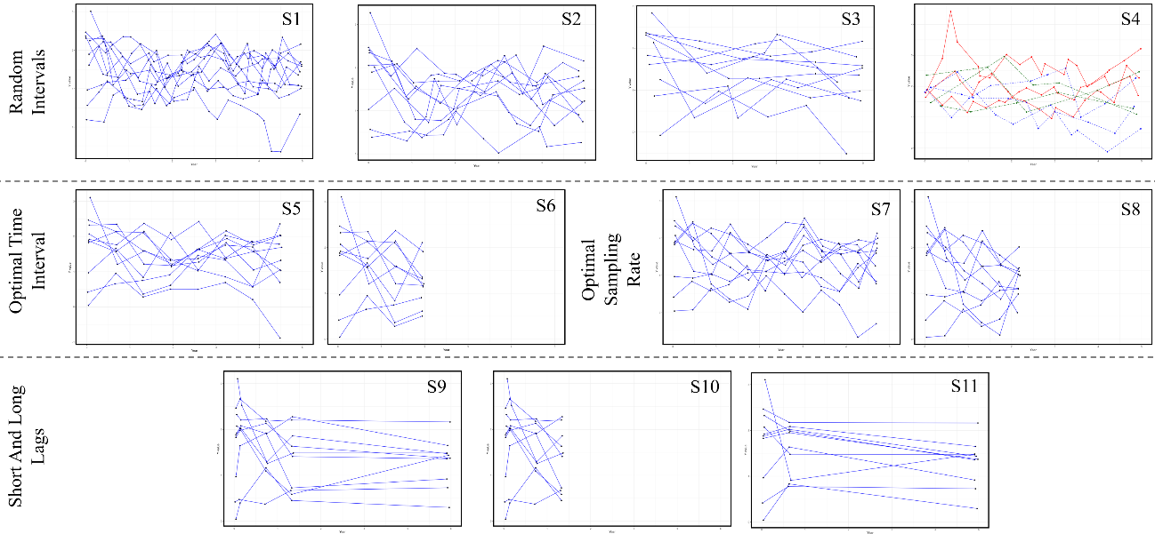
When Should I Measure?
Sampling Schedules
20 T
10 T
5 T
20, 10 and 5 T
8 T
4 T
12 T
6 T
5 T
4 T
3 T
Introduction – Present study – Method – Results – Discussion and Recommendations

Slide 14
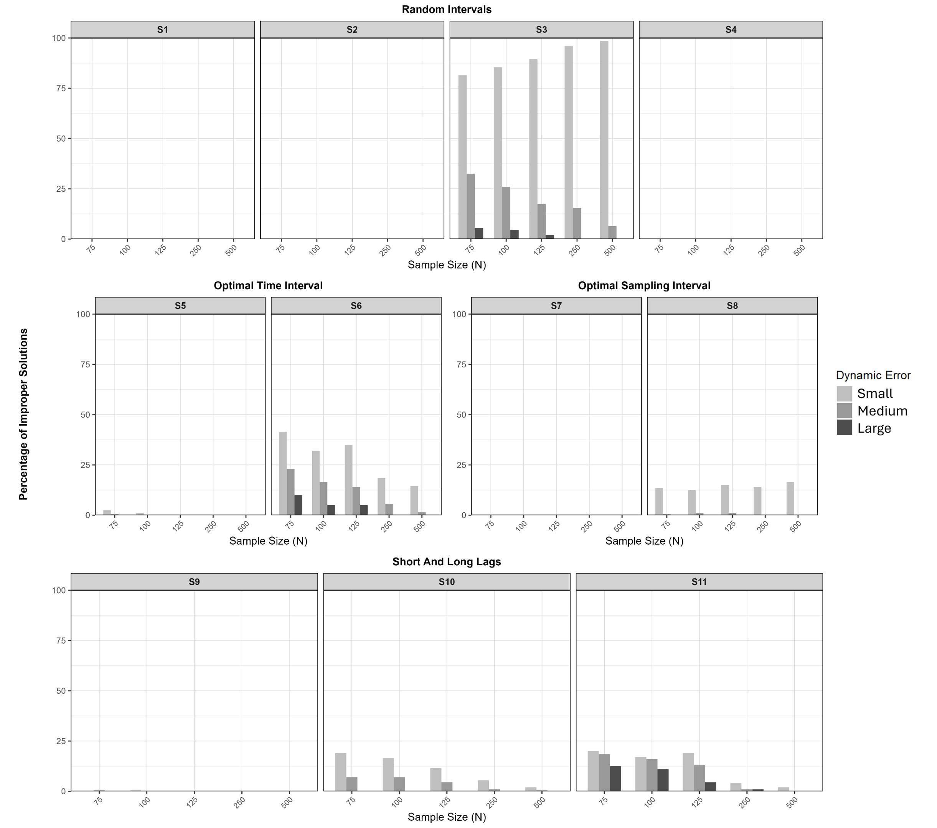
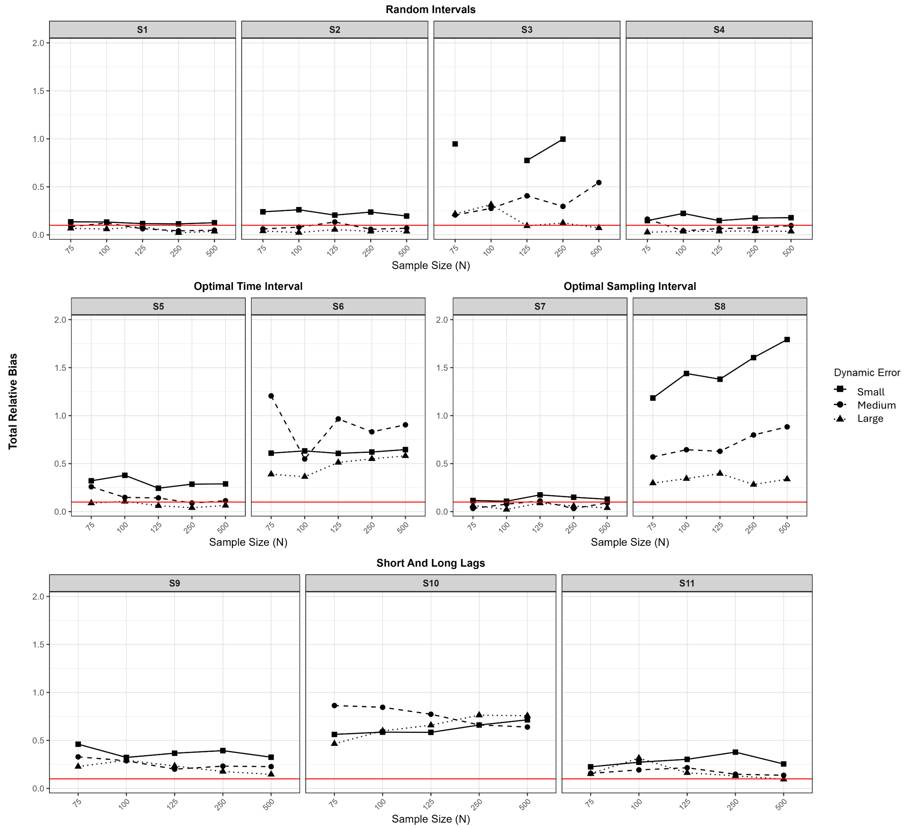
When Should I Measure?
Overall performance
% of improper solutions
Total Relative Bias
Introduction – Present study – Method – Results – Discussion and Recommendations

Slide 15
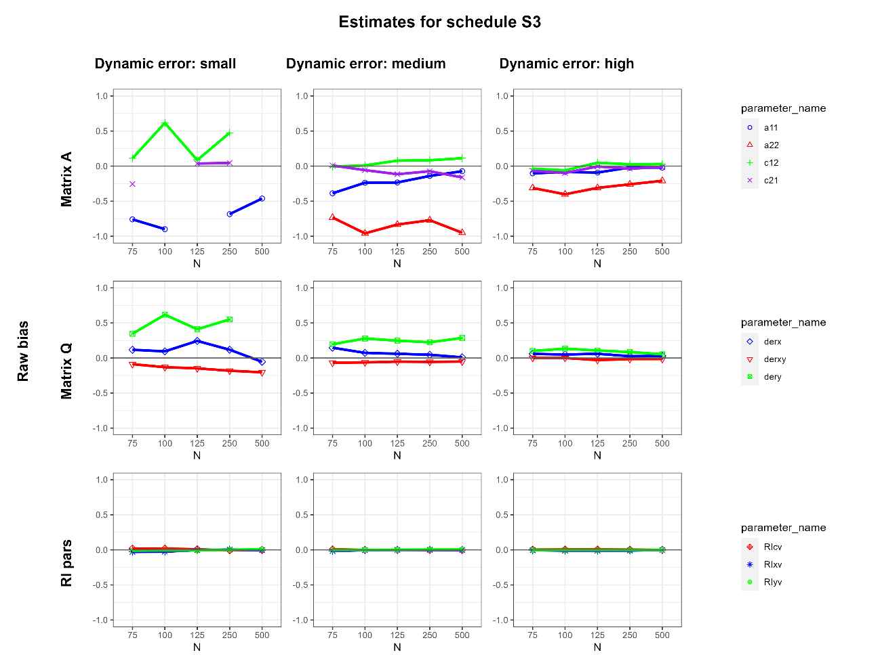
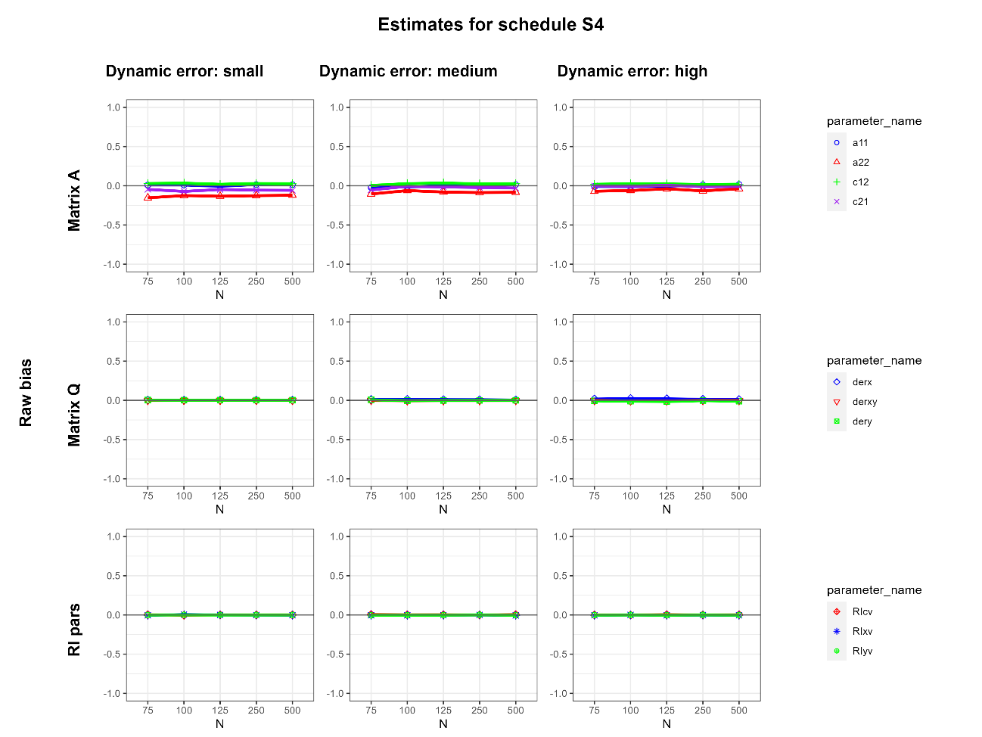
When Should I Measure?
Bias
Random Intervals
Autorregresive and cross effects
Dynamic error (stochasticity)
Random Intercepts variances
5 years, 5 T
5 years, 5, 10 and 20 T
Introduction – Present study – Method – Results – Discussion and Recommendations

Slide 16
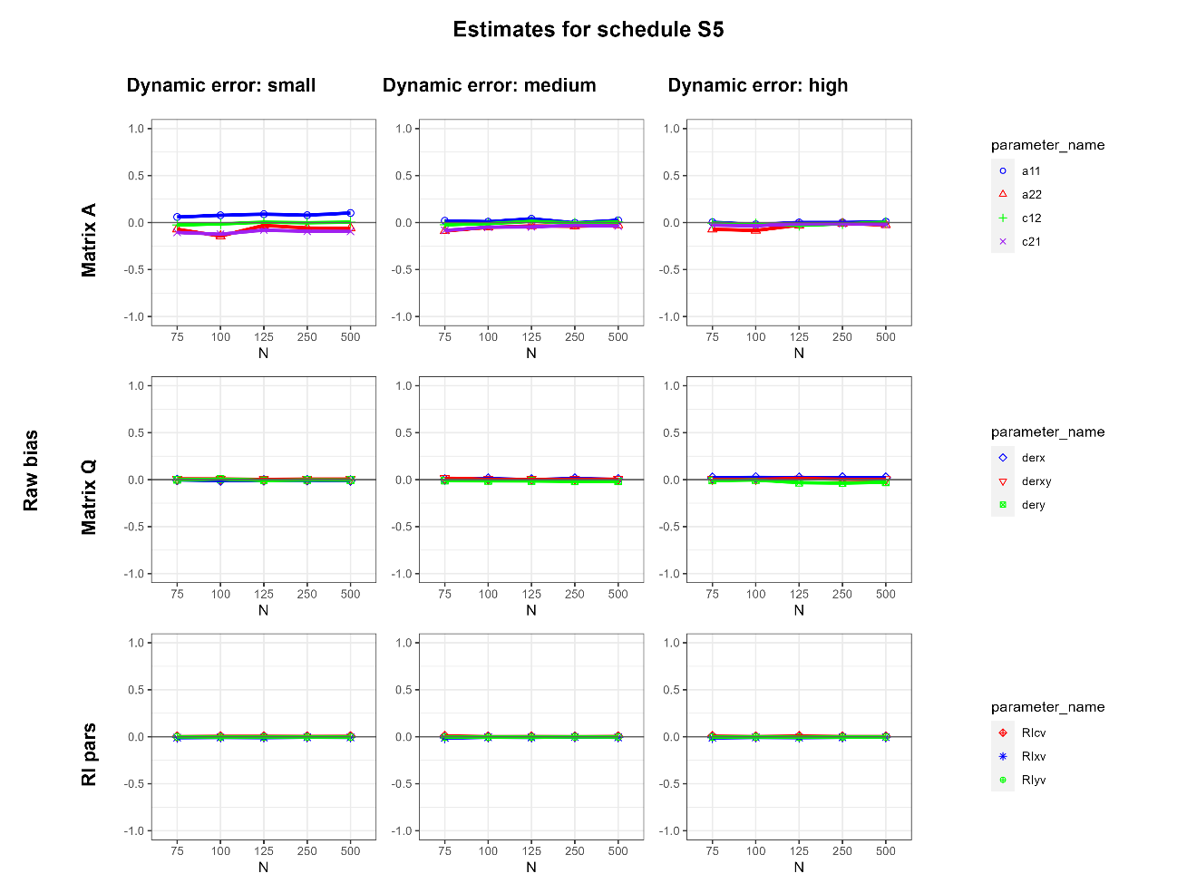
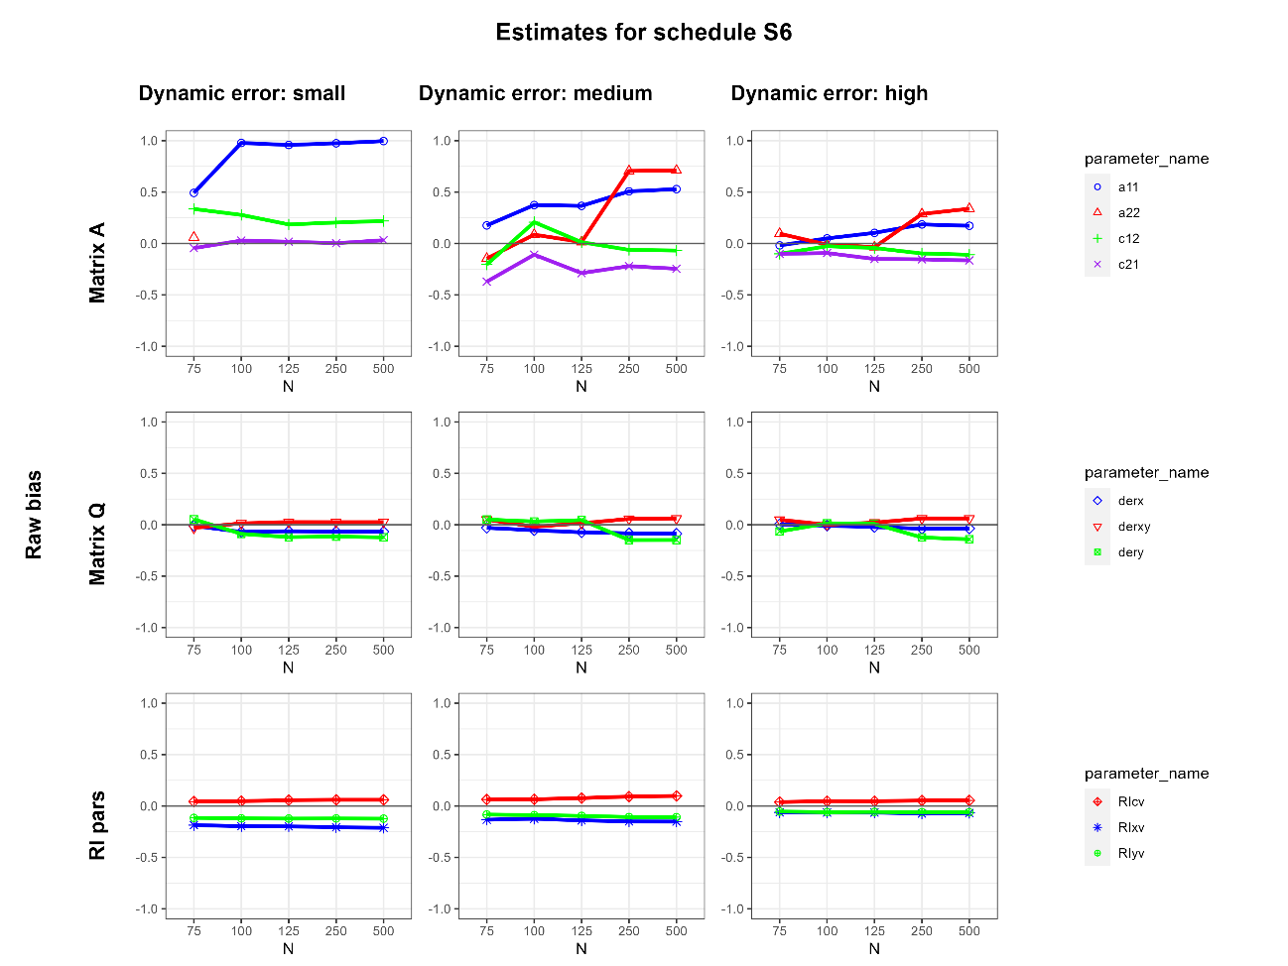
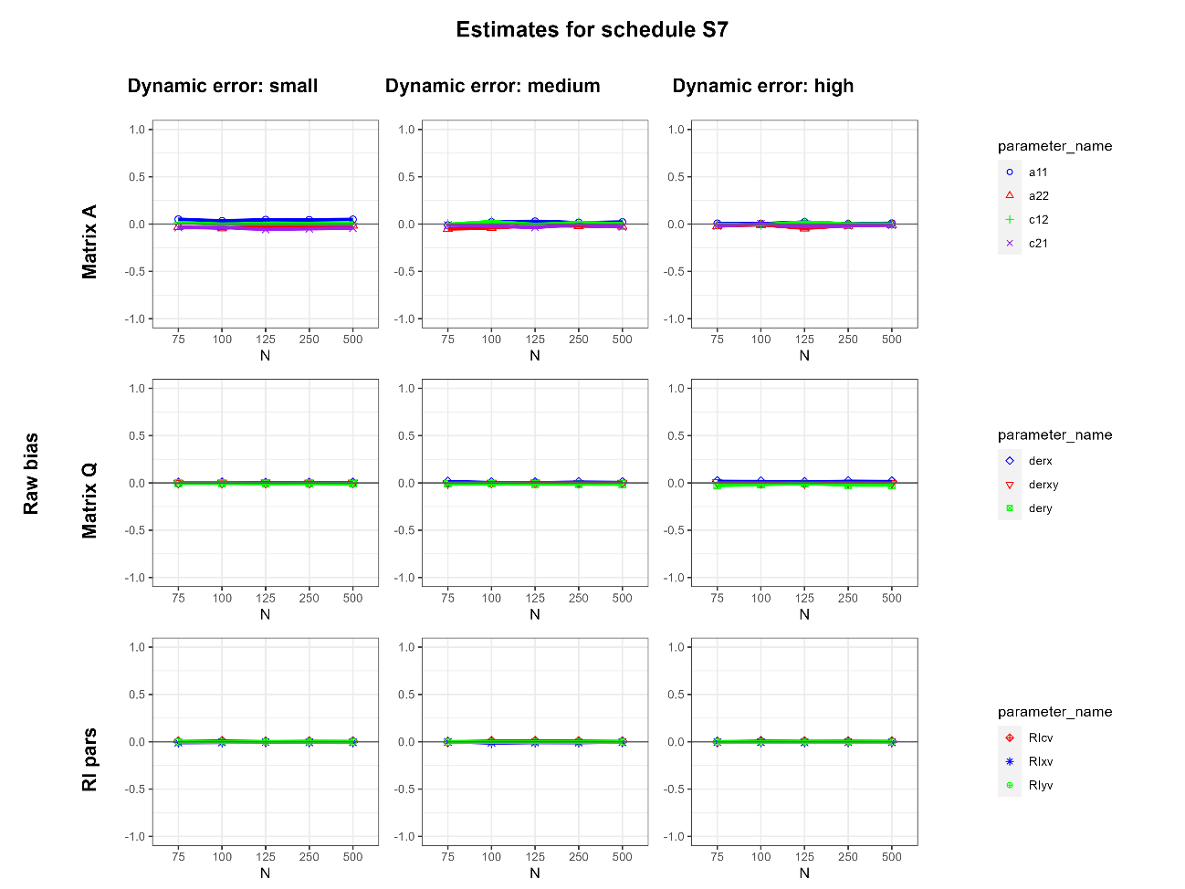
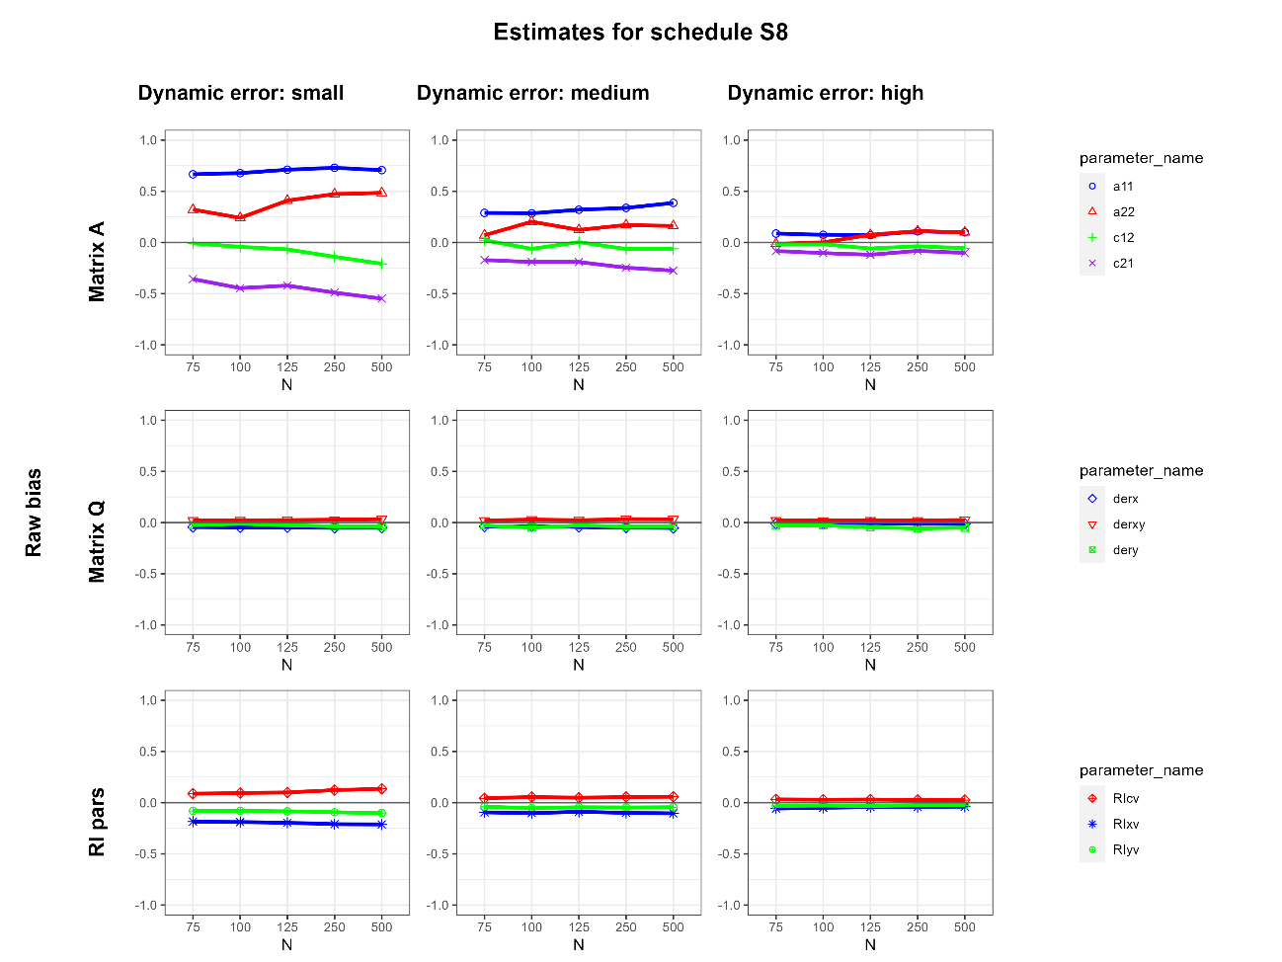
When Should I Measure?
Bias
Optimal Time Interval (Dormann & Griffin, 2015) Optimal Sampling Rate (Adolf et al., 2021)
5 years, 8 T
2.5 years, 4 T
5 years, 12 T
2.5 years, 6 T
Introduction – Present study – Method – Results – Discussion and Recommendations

Slide 17
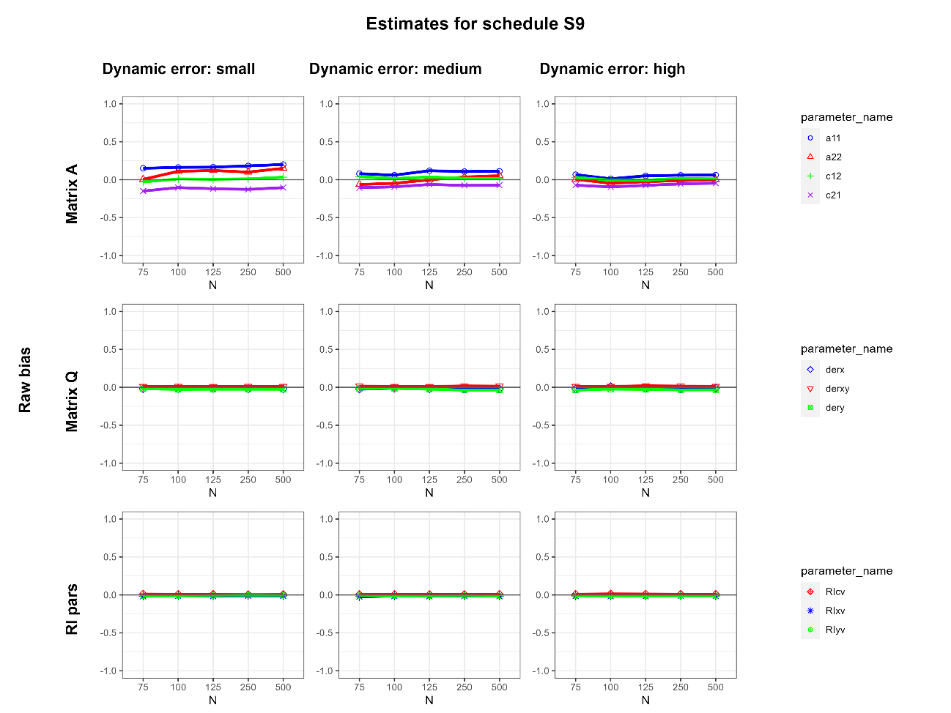
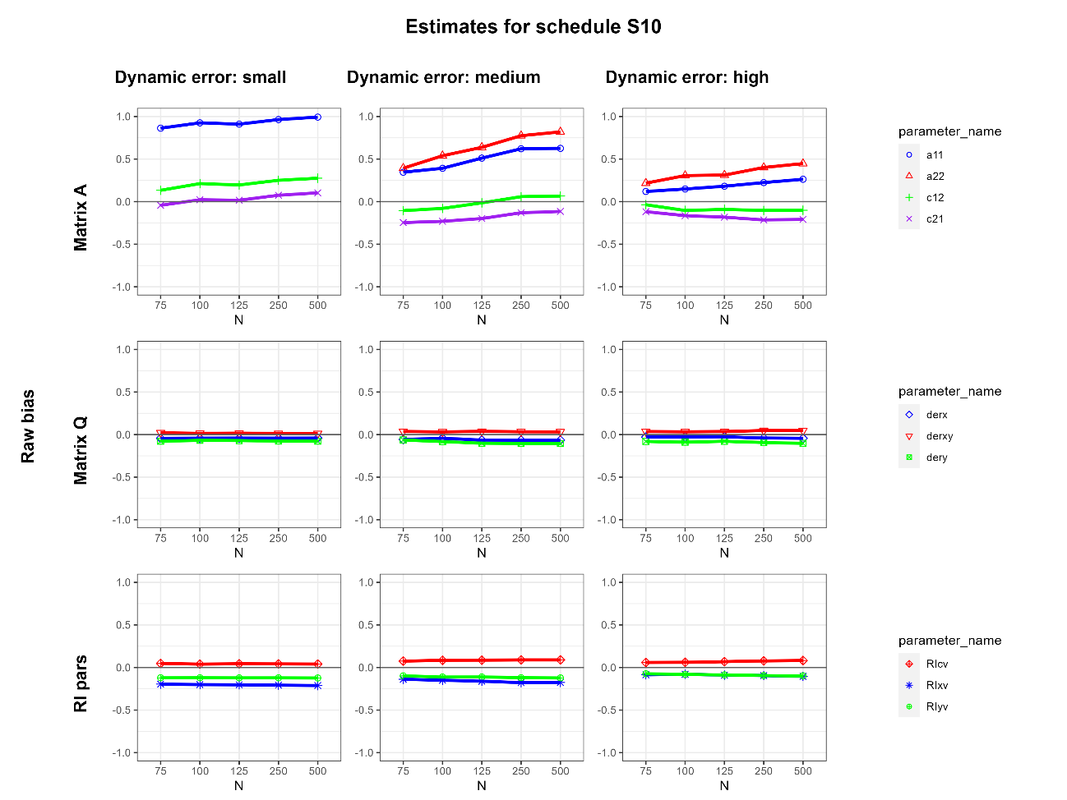
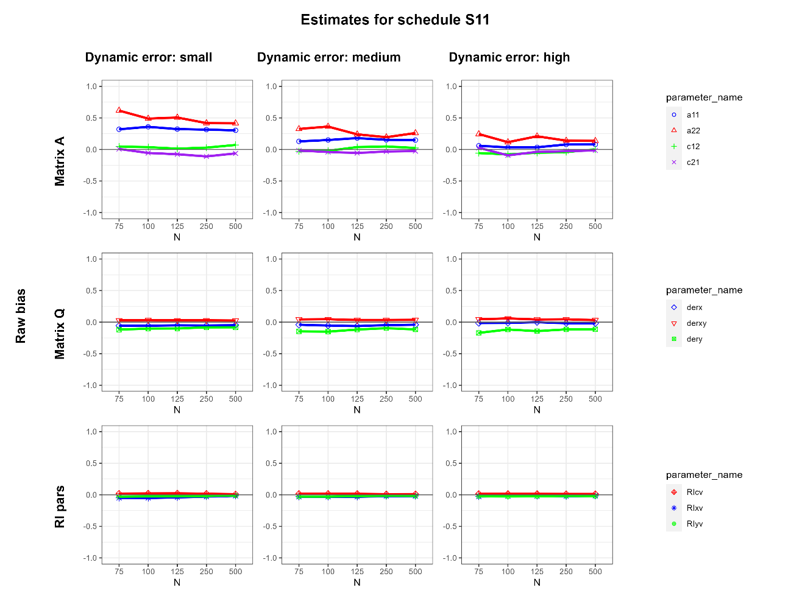
When Should I Measure?
Bias
Short and Long Lags
5 years, 5 T
2.5 years, 4 T
5 years, 3 T
Introduction – Present study – Method – Results – Discussion and Recommendations

Slide 18


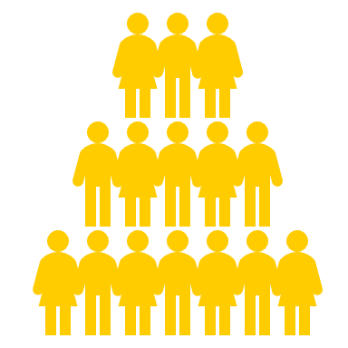




When Should I Measure?
N = 75 can be enough if there are enough T
Processes with higher levels of stochasticity were easier to recover
<8 time points
  If enough time is not covered:
  bad for stable, between-subjects component
  If short intervals are not included:
  bad for fluctuating, within-subjects process
Great when for >8 time points
Introduction – Present study – Method – Results – Discussion and Recommendations

Slide 19


When Should I Measure?
Work in progress…
What about missing data?
Test regime-switching
Which is the optimal total time span?
What about measurement error variance?
In conclusion…
Panel designs can benefit from CT models by including some short time intervals and longer ones
Introduction – Present study – Method – Results – Discussion and Recommendations

Slide 20
When Should I Measure?
Work in progress…
What about missing data?
Test regime-switching
Which is the optimal total time span?
What about measurement error variance?
In conclusion…
Panel designs can benefit from CT models by including some short time intervals and longer ones
Introduction – Present study – Method – Results – Discussion and Recommendations

Slide 21
When Should I Measure?
References
Adolf, J. K., Loossens, T., Tuerlinckx, F., & Ceulemans, E. (2021). Optimal sampling rates for reliable continuous-time first-order autoregressive and vector autoregressive modeling. Psychological Methods, 26(6), 701-718. https://doi.org/10.1037/met0000398
Batra, R., Johal, S. K., Chen, M., & Ferrer, E. (2023). Consequences of sampling frequency on the estimated dynamics of AR processes using continuous-time models. Psychological Methods. https://doi.org/10.1037/met0000595
Boker, S. M., Neale, M. C., Maes, H. H., Wilde, M. J., Spiegel, M., Brick, T. R., Estabrook, R., Bates, T. C., Mehta, P. D., von Oertzen, T., Gore, R. J., Hunter, M. D., & Hackett, D. C. (2018). OpenMx User Guide. https://openmx.ssri.psu.edu/documentation
Dormann, C., & Griffin, M. A. (2015). Optimal time lags in panel studies. Psychological Methods, 20(4), 489-505. https://doi.org/10.1037/met0000041
Hamaker, E. L., Kuiper, R. M., & Grasman, R. P. P. P. (2015). A critique of the cross-lagged panel model. Psychological Methods, 20(1), 102-116. https://doi.org/10.1037/a0038889
Hopwood, C. J., Bleidorn, W., & Wright, A. G. C. (2022). Connecting Theory to Methods in Longitudinal Research. Perspectives on Psychological Science, 17(3), 884-894. https://doi.org/10.1177/17456916211008407
Hasl, A., Voelkle ,Manuel, Driver ,Charles, Kretschmann ,Julia, & and Brunner, M. (2024). Leveraging Observation Timing Variability to Understand Intervention Effects in Panel Studies: An Empirical Illustration and Simulation Study. Structural Equation Modeling: A Multidisciplinary Journal, 31(1), 48-63. https://doi.org/10.1080/10705511.2023.2224515
Hunter, M. D. (2018). State Space Modeling in an Open Source, Modular, Structural Equation Modeling Environment. Structural Equation Modeling: A Multidisciplinary Journal, 25(2), 307-324. https://doi.org/10.1080/10705511.2017.1369354
Mulder, J., Voelkle, M., & Hamaker, E. (2025). Time Aggregation and Missing Time Frames in Causal Research With Panel Data. OSF. https://doi.org/10.31234/osf.io/chzb7_v1
Orth, U., Clark, D. A., Donnellan, M. B., & Robins, R. W. (2021). Testing prospective effects in longitudinal research: Comparing seven competing cross-lagged models. Journal of Personality and Social Psychology, 120(4), 1013-1034. https://doi.org/10.1037/pspp0000358
Ryan, O., Kuiper, R. M., & Hamaker, E. L. (2018). A Continuous-Time Approach to Intensive Longitudinal Data: What, Why, and How? In K. van Montfort, J. H. L. Oud, & M. C. Voelkle (Eds.), Continuous Time Modeling in the Behavioral and Related Sciences (pp. 27–54). Springer International Publishing. https://doi.org/10.1007/978-3-319-77219-6_2
Voelkle, M. C., Oud, J. H. L., Davidov, E., & Schmidt, P. (2012). An SEM approach to continuous time modeling of panel data: Relating authoritarianism and anomia. Psychological Methods, 17, 176–192. https://doi.org/10.1037/a0027543

Slide 22
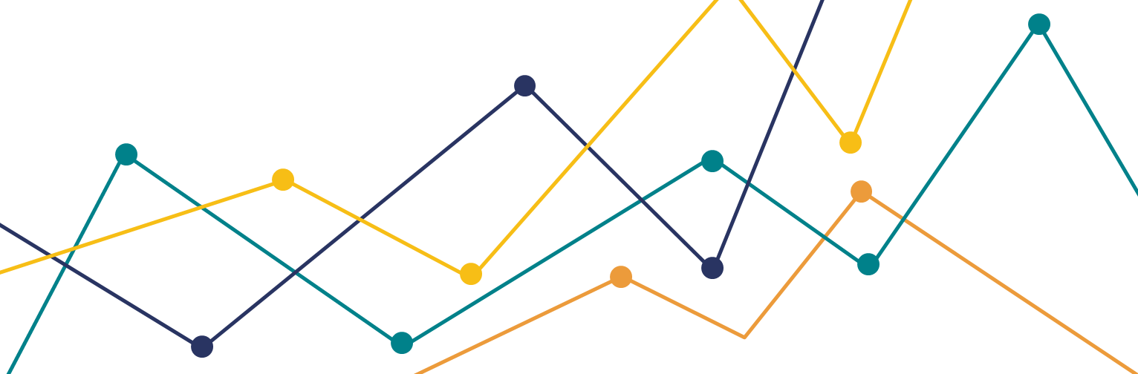

Thank you for your attention
When Should I Measure?
Finding the Best Sampling Schedule for Recovering Longitudinal Dynamics
in Panel Data Studies with Continuous-Time Models
Nuria Real-Brioso, Eduardo Estrada
PhD Funding contract by the Ministry of Universities - Ayudas para la Formación del Profesorado Universitario (FPU)
FPU22/03300

