Slide 1
State-Space Models for Identifying Abrupt Changes in Cognitive Development
Marcos Romero-Suárez
Pablo F. Cáncer
Eduardo Estrada
Notes:
Hello, my name is Marcos Romero-Suárez.
It’s a pleasure to be here today. You've already heard from my co-authors in their respective talks, so I’ll go straight to the point.
In this presentation, we’ll focus on the use of state-space models for identifying abrupt changes in cognitive development trajectories.

Slide 2
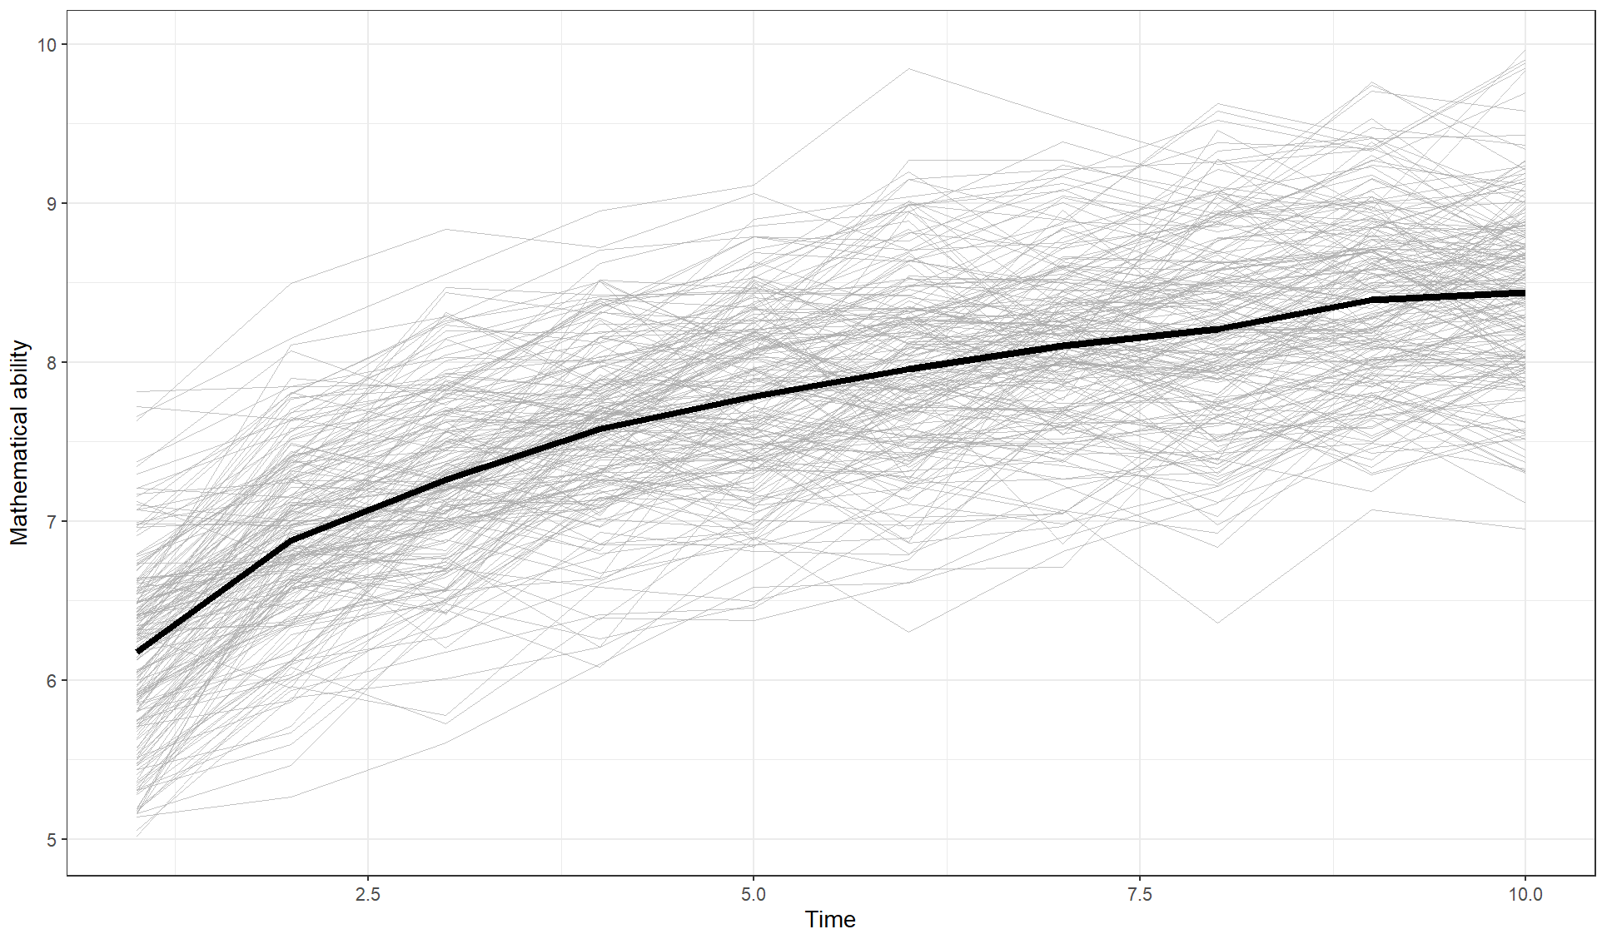
WHAT IS COGNITIVE DEVELOPMENT?
2
Notes:
Cognitive development refers to the growth and transformation of mental abilities over time — including thinking, reasoning, problem-solving, and understanding.
It also involves the acquisition of knowledge and skills, shaped by both maturation and experience.
In longitudinal research, we study how these abilities evolve, typically by tracking measurable outcomes such as mathematical ability across time.

Slide 3


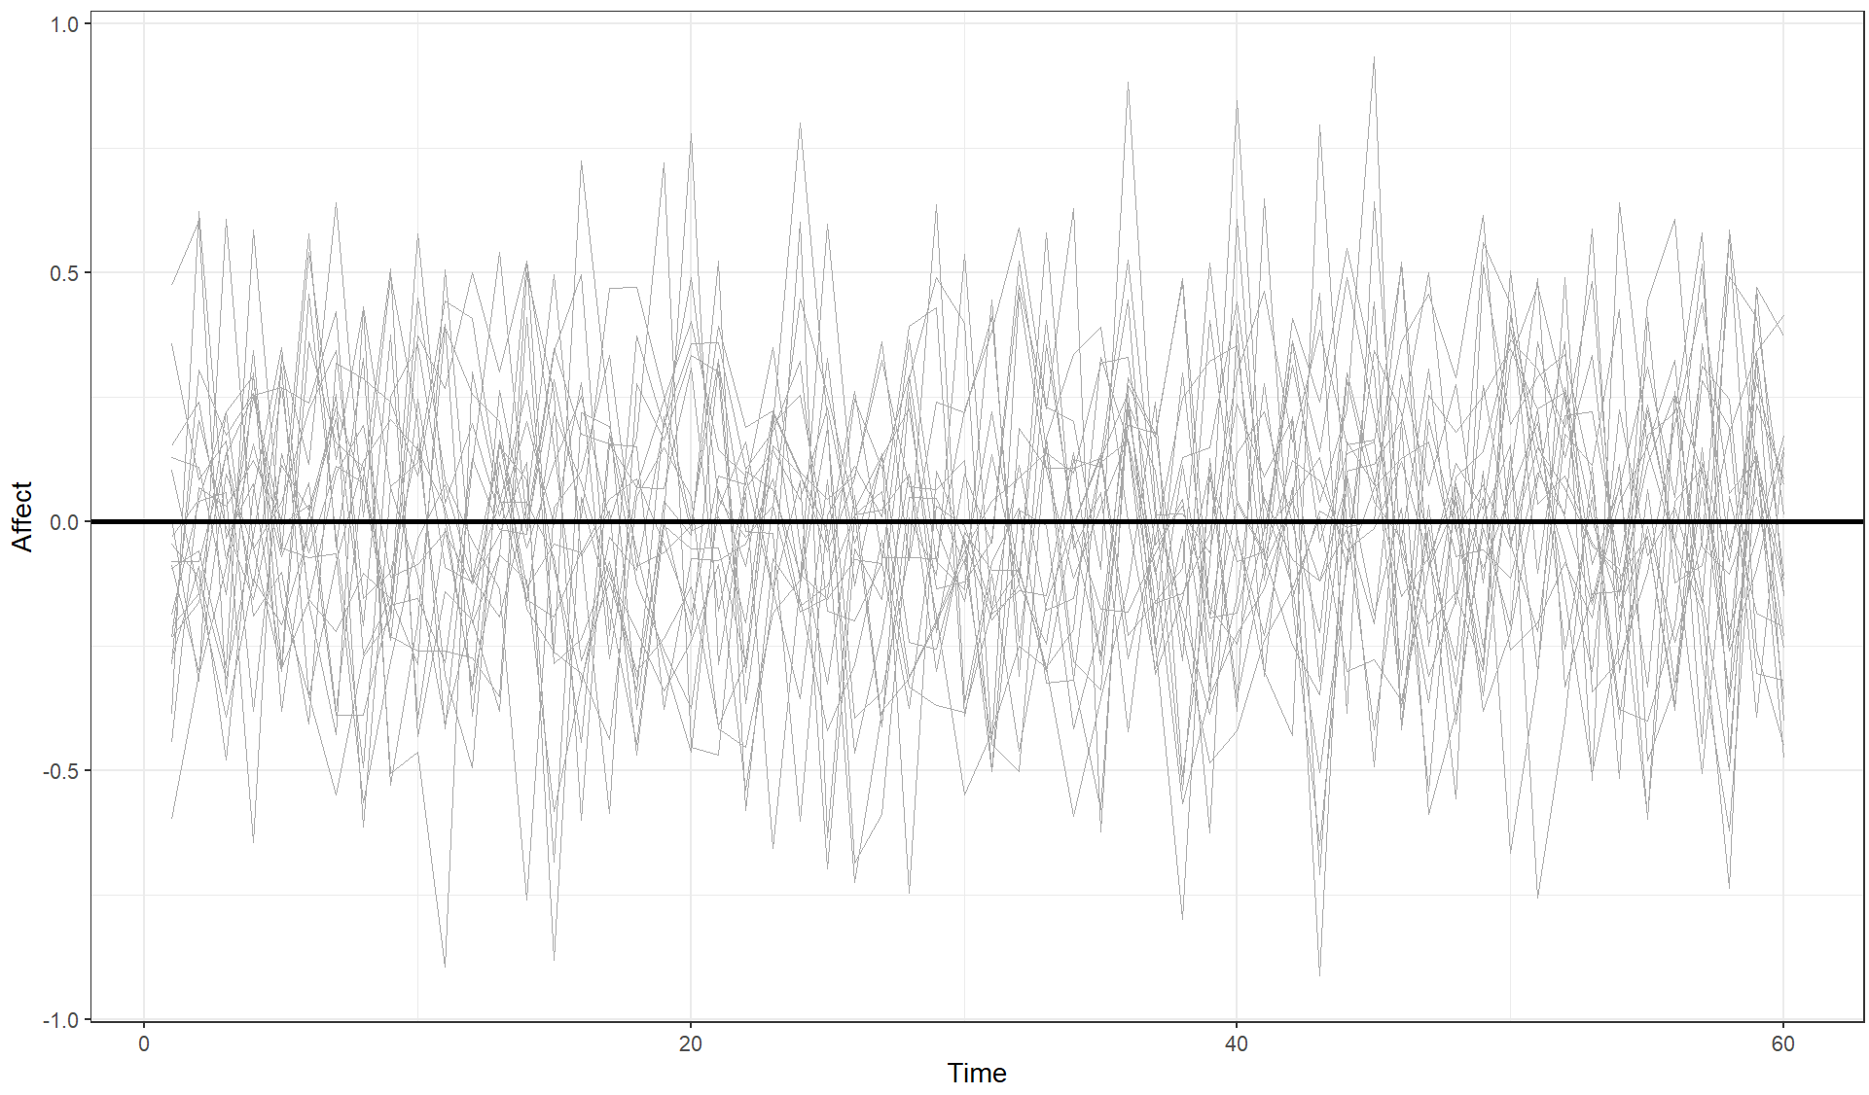
WHAT IS COGNITIVE DEVELOPMENT?
Growth process
Stable process
3
Notes:
On the left, we see a growth process — the trajectory reflects systematic change over time, typical of cognitive development, such as improvements in mathematical ability. These processes are usually studied with larger samples (e.g., n > 100) but fewer time points per individual (e.g., t < 20).
On the right, we see a stable process — it fluctuates but remains centered around an equilibrium point. This pattern is common in domains like affect or mood, and is typically studied with smaller samples (e.g., n < 60) and intensive longitudinal data (e.g., t > 50).

Slide 4
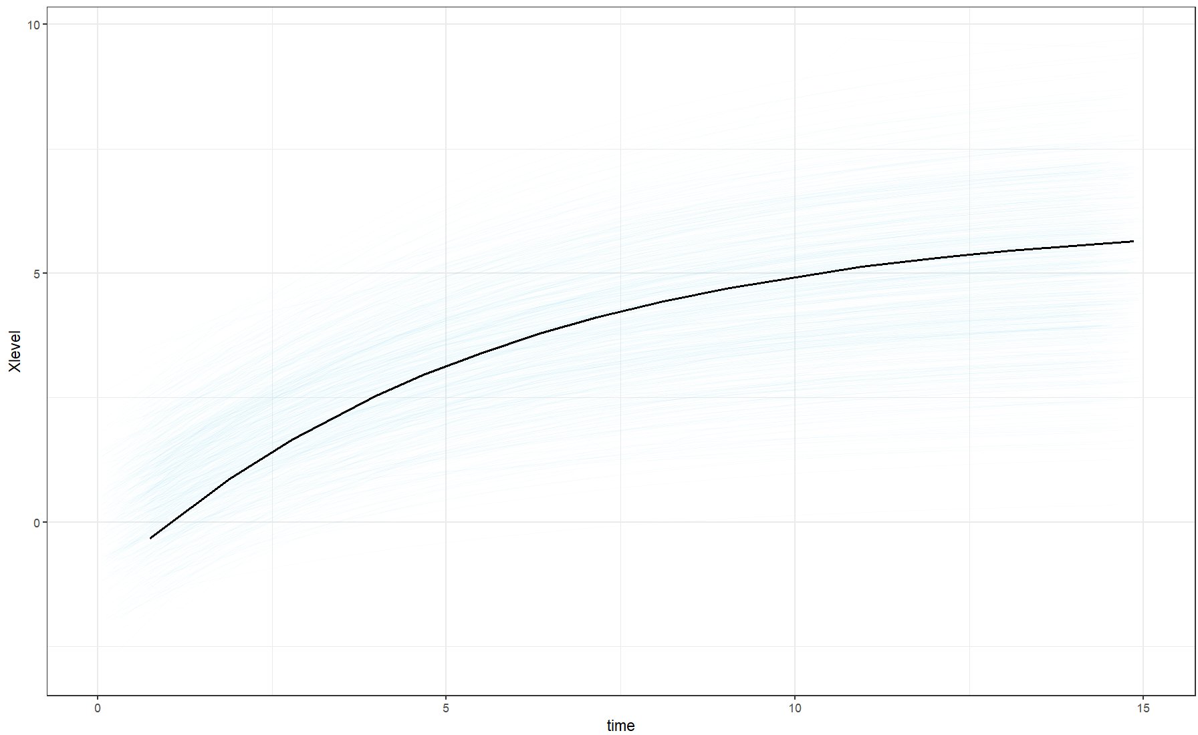
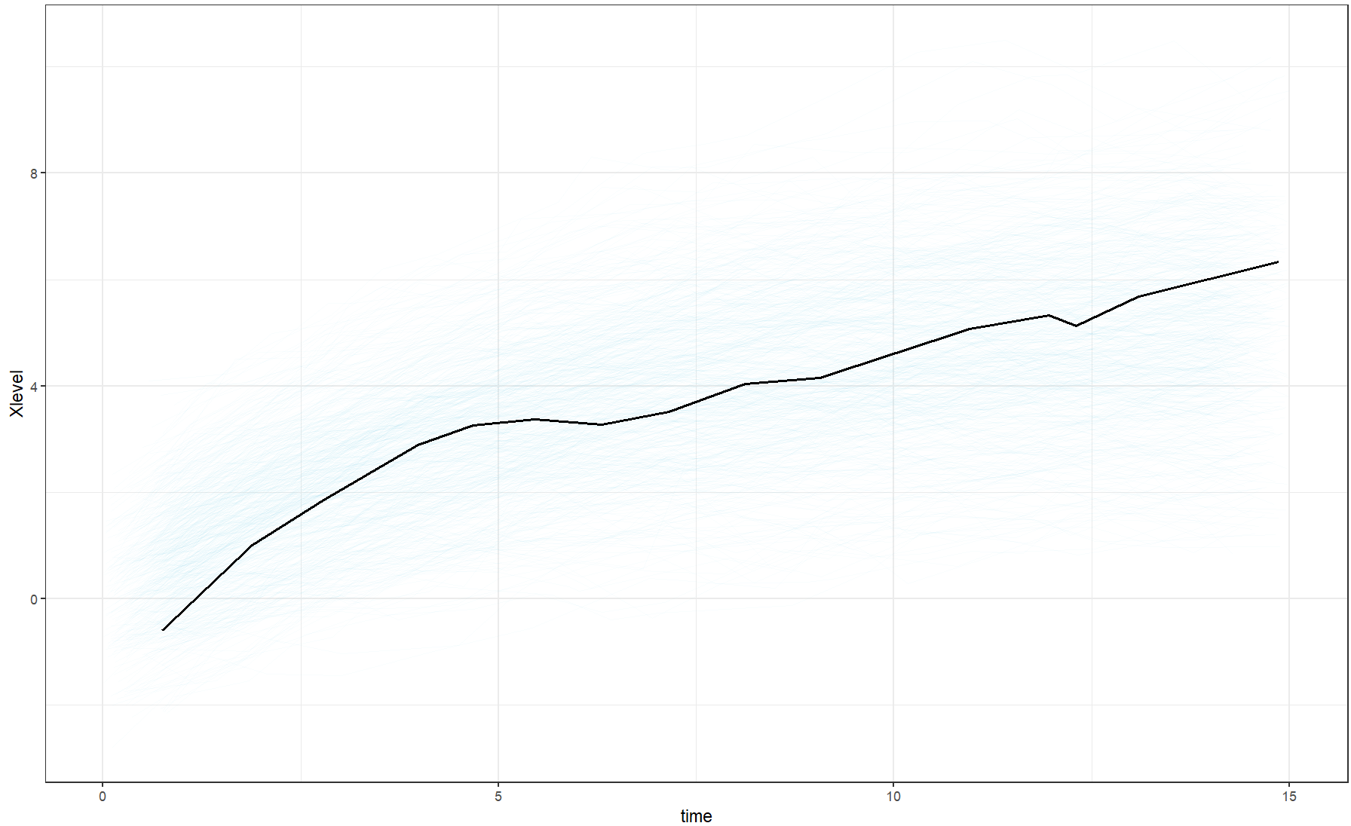
What is dynamic error or innovation variance?
ζ(t) = 0
ζ(t) = 0.1
4
Notes:
In this slide, ζ(t) represents the variance of the dynamic error in continuous time.
You can see two latent trajectories:
With ζ(t) =0, the system evolves smoothly — there is no latent noise, so the trajectory is fully deterministic.
With ζ(t) =0.1, the trajectory becomes irregular: small random perturbations continuously affect the latent state, resulting in a stochastic and more realistic pattern of individual development.
Although dynamic error introduces noise into the latent process, the resulting fluctuations are small, unsystematic, and not considered abrupt changes.

Slide 5
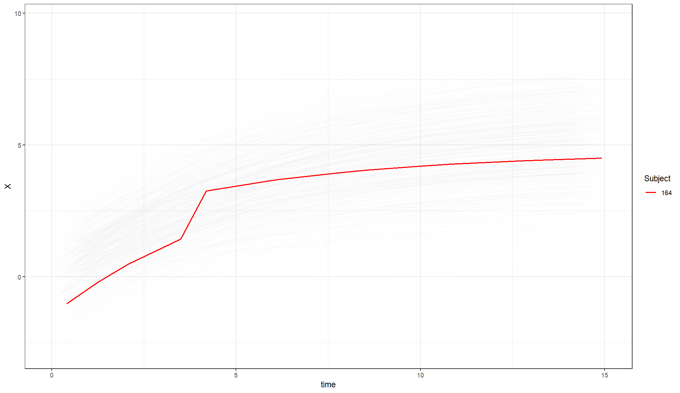
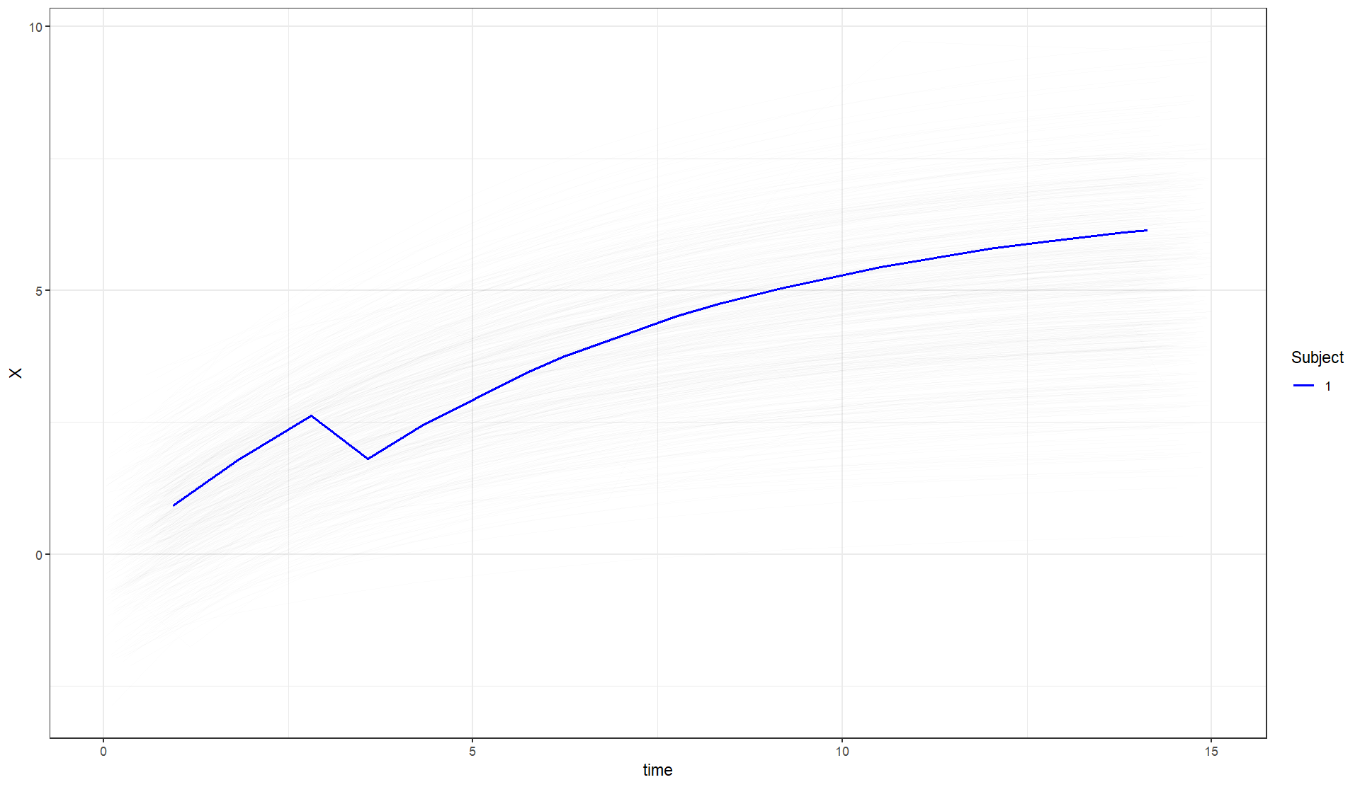
WHAT ARE ABRUPT CHANGES?
5
Notes:
In the left panel, we see a positive abrupt change, which could reflect periods of accelerated learning — for example, transitioning to a more stimulating school environment, beginning structured training, or participating in intensive tutoring programs.
In the right panel, we see a negative abrupt change, which could be caused by psychological trauma or medical illness.

Slide 6
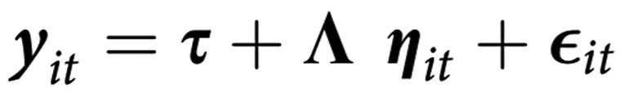
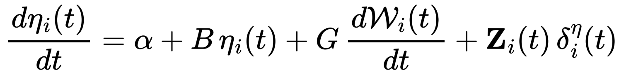
HOW CAN WE MODEL THESE ABRUPT CHANGES?
State-Space Models
Measurement equation
Innovative Outliers
State equation
(Chow et al., 2009; You et al., 2020)
6
Notes:
State-space models provide a flexible framework for modeling latent processes that may change abruptly over time.
They consist of two main equations:
Measurement Equation
Links the latent process (ηₜ) to the observed indicators
Includes: Intercept (τ) Factor loadings (Ληₜ) Measurement error (εₜ)
State Equation
Describes the temporal evolution of the latent process
Includes: Intercept (α) Autoregressive effect (Bηₜ) Dynamic error (ζₜ)
To model innovative outliers (shocks), we add the term
Zᵢ(t)δᵢ^η(t) to the state equation: Zᵢ(t): design matrix that activates the shock only at selected time points δᵢ^η(t): magnitude of the shock in the latent space for subject i at time t
However, before modeling shocks, we must detect their locations.

Slide 7

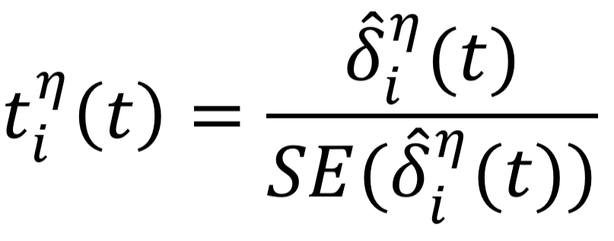
How can we detect these innovative outliers?
Chi-square statistic
Wald test t statistic
(Chow et al., 2009; You et al., 2020)
7
Notes:
We use two statistical procedures specifically designed to identify innovative outliers.
Chi-square statistic
ri​(t): smoother residuals from the continuous Kalman Filter
Ni​(t): covariance matrix of the latent process at time t
This statistic summarizes how much the latent process at time t deviates from model expectations.
If the chi-square-value exceeds a critical value, a shock is introduced into the state equation.
Wald t-statistic
Compares the estimated magnitude of a potential shock to its uncertainty.
A high t-value indicates a significant deviation in the latent state, suggesting an innovative outlier.
There is also an effect size measure derived from the t.

Slide 8
SIMULATION DESIGN: 90 Scenarios ➜ 200 Replicates per scenario ➜ 5% of subjects had one shock
Sample size (125 – 250 – 500)
Shock magnitude (0.75 – 1 – 1.25 – 1.5 – 1.75)
Dynamic error variance (0.001 - 0.005 - 0.1)
Measurements per year (1 - 2)
MODEL FITTING: 4 Methods for shock detection
Dynamic error parameter: Estimated – Fixed to 0
Shock detection method: Chi-square – T-statistic
N
shock
ζ(t)
MPY
✅
ζ(t)
8
Notes:
In this study, we simulated 90 different scenarios, each with 200 replicates per scenario and a 5% of subjects had one shock.
The scenarios vary by key factors: sample size ranging from 125 to 500 subjects; shock magnitude from 0.75 to 1.75; dynamic error variance set at low, medium, and relatively high levels; and measurement frequency, with one or two measurements per year.
From now on, we will use these abbreviations to refer to these simulation characteristics.
When fitting the models, we tested four methods for detecting shocks. A critical point is how we handle the dynamic error parameter — either estimating it freely or fixing it to zero.
It's important to differentiate between the simulated dynamic error in the trajectory and how it's modeled. You can have a simulated trajectory with dynamic error, but when modeling it, fix that parameter to 0.
This is important because when the dynamic error is estimated, we hypothesize that it can absorb unexpected variation in the latent trajectory, which may mask or reduce the detection of true shocks.
In contrast, fixing this parameter to zero may remove that “buffer,” making shocks more apparent to detection methods.
Finally, we apply both the chi-square and Wald t-statistics to detect shocks, comparing their effectiveness under these different model specifications.

Slide 9
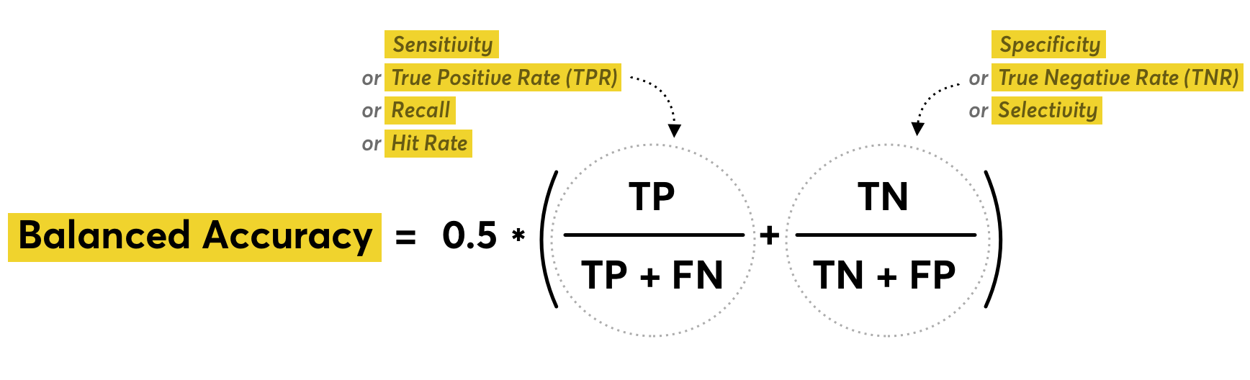
9
Notes:
Balanced accuracy will be used as the metric to evaluate detection performance in each simulation replicate, as it provides an average between the true positive rate and the true negative rate. This metric is particularly suitable in contexts with class imbalance, such as the present study. Its range goes from 0.5, indicating performance no better than chance, to 1, reflecting perfect detection of both shocks and non-shock trajectories.

Slide 10
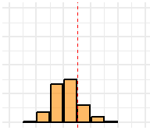
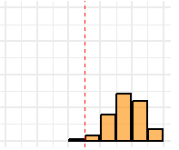
Chi-square statistic ζ(t) =
This is a BAD scenario for shock detection.
This is a GOOD scenario for shock detection.
N = 500 ; shock = 1 ; ζ(t) = 0.05 ; MPY = 2
N = 250 ; shock = 1.75 ; ζ(t) = 0.1 ; MPY = 2
Median = 0.71
Area = 0.20
Median = 0.89
Area = 0.98
0.00 0.5 1.00
0.00 0.5 1.00
Proportion of replicates
Proportion of replicates
0.5 0.75 1.00
0.5 0.75 1.00
Balanced Accuracy (BA)
Balanced Accuracy (BA)
10
Notes:
We can observe the chi-square detection method with the dynamic error parameter fixed to 0. Each histogram represents a scenario with 200 replicates. The x-axis shows balanced accuracy, and the y-axis shows the proportion of replicates with this balanced accuracy. The median is the median balanced accuracy in this scenario, and the area is the proportion of replicates above a balanced accuracy of 0.75

Slide 11

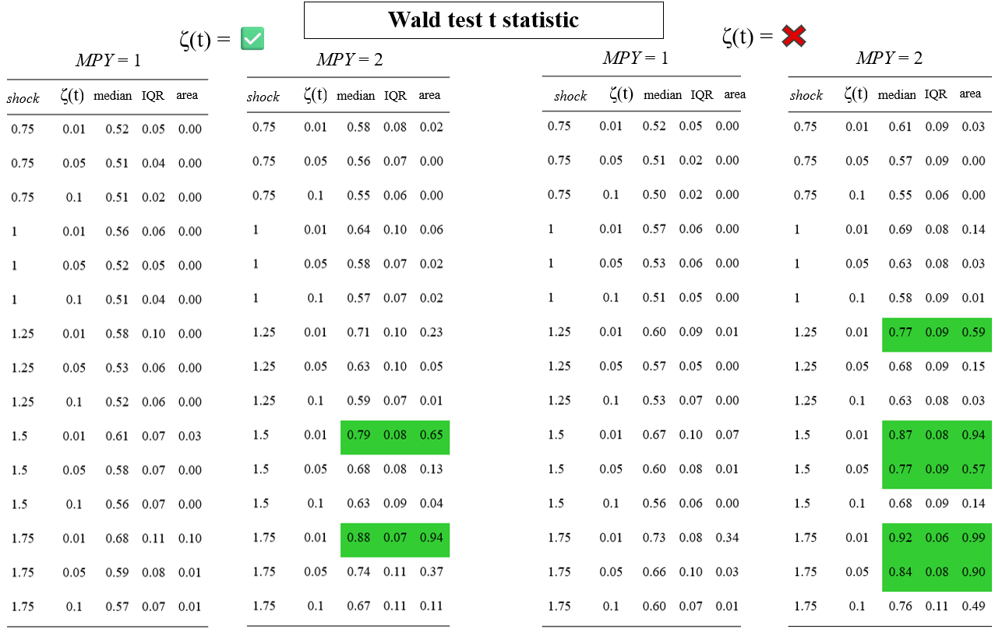
11
Notes:
Since sample size only affected the stability of the results but not detection accuracy, it was collapsed through averaging, thereby reducing the number of conditions and improving interpretability. In this table, we present the results based on the Wald test t-statistic. The columns show the shock size, dynamic error, the median balanced accuracy, the interquartile range (as a measure of dispersion around the median), and the area, defined as the proportion of replicates with balanced accuracy above 0.75. Scenarios in which more than half of the replicates achieved a balanced accuracy above 0.75 are highlighted in green.

Slide 12
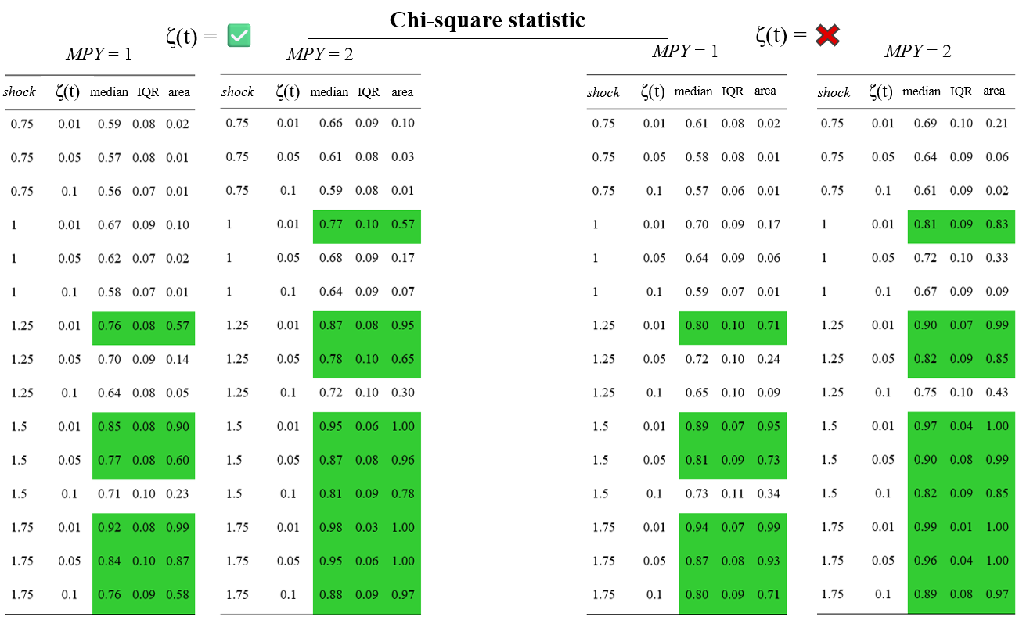
12
Notes:
We now observe that the chi-square statistic yields substantially better results, particularly when two measurements per year are taken instead of one, and when the dynamic error parameter is fixed to zero—even under conditions where high dynamic error was simulated.

Slide 13
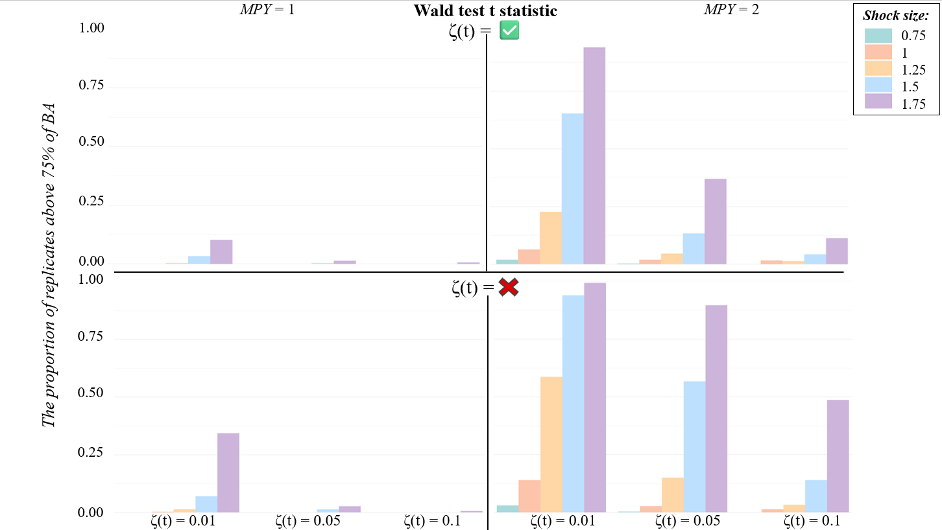
13
Notes:
This is an alternative way to visually present the results. On the y-axis is the area measure, and on the x-axis, grouped blocks represent the three levels of dynamic error. Different colors indicate the various shock sizes.

Slide 14
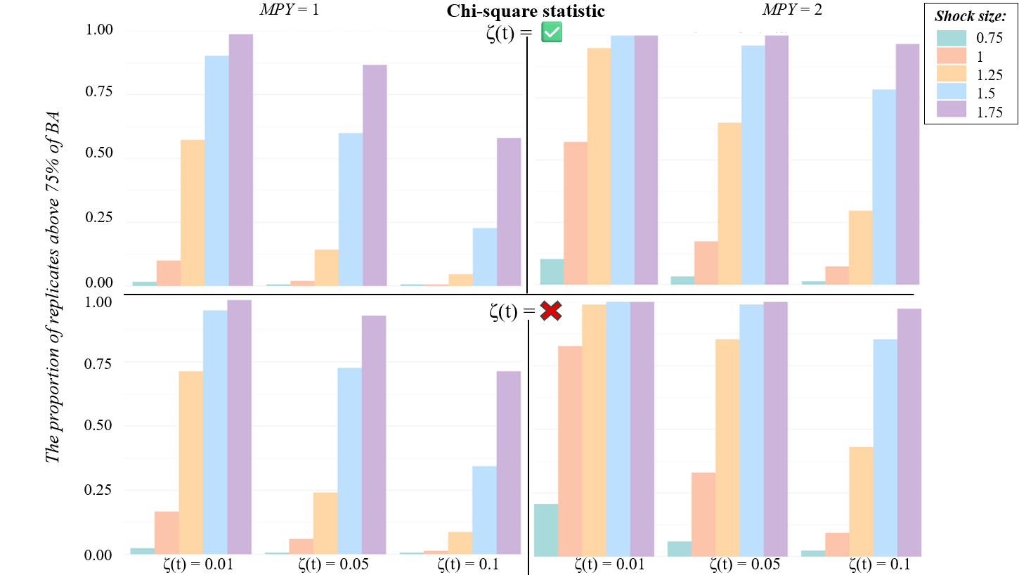
14
Notes:
Once again, we see the same pattern: the chi-square statistic performs overwhelmingly better, with improved detection when two measurements per year are taken and when the dynamic error parameter is fixed to zero.

Slide 15
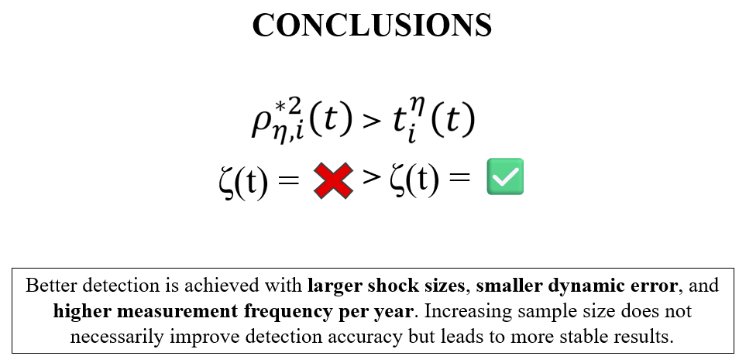
CONCLUSIONS
>
>
15
Notes:
The chi-square statistic is better than the Wald t-test for measures of cognitive development.
Fixing the dynamic error parameter to 0 improves the detection of innovative outliers.
This is interesting because the t statistic performs better in stable trajectories, whereas the chi-square statistic shows superior performance in developmental trajectories.

Slide 16
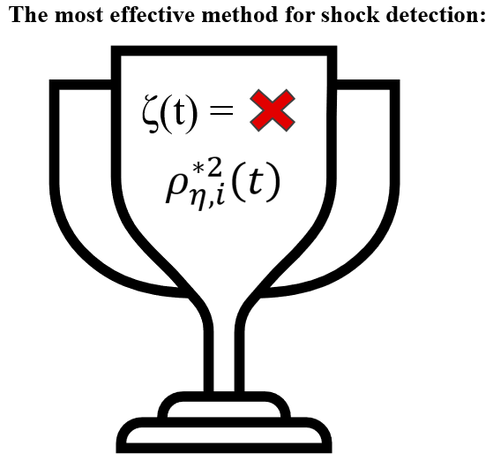
16
Notes:
To conclude, if the goal is to detect shocks in developmental trajectories, the most effective approach is to fix the dynamic error parameter to zero (even when the data contain dynamic error) and use the chi-square statistic for shock detection.

Slide 17
Detection of shocks in stable processes
Chow, S.-M., Hamaker, E. L., & Allaire, J. C. (2009). Using Innovative Outliers to Detect Discrete Shifts in Dynamics in Group-Based State-Space Models. Multivariate Behavioral Research, 44(4), 465-496.
You, D., Hunter, M., Chen, M., & Chow, S.-M. (2020). A Diagnostic Procedure for Detecting Outliers in Linear State–Space Models. Multivariate Behavioral Research, 55(2), 231-255.
17
Notes:
If you're interested in the precursors of this work and the main recommendations for stable processes, here are the two most important references.

Slide 18


marcos.romero@uam.es
marcosromerosuarez30@gmail.com
18
Notes:
And that’s all, thank you very much. Feel free to add me on LinkedIn or contact me by email if you want to get in touch. Stay tuned, because soon an article will be published where I will explain all of this in greater depth and detail. We will also address topics such as the optimal adjustment of the p-value in each scenario and the addition of an effect size measure to achieve better detection.

