Slide 1
The value of mixed methods research over the present decade in Psychology:
A critique study
Olatz Lopez-Fernandez

Slide 2

Outline
Introduction
Aim
Method
Results
Discussion
Conclusion

Slide 3
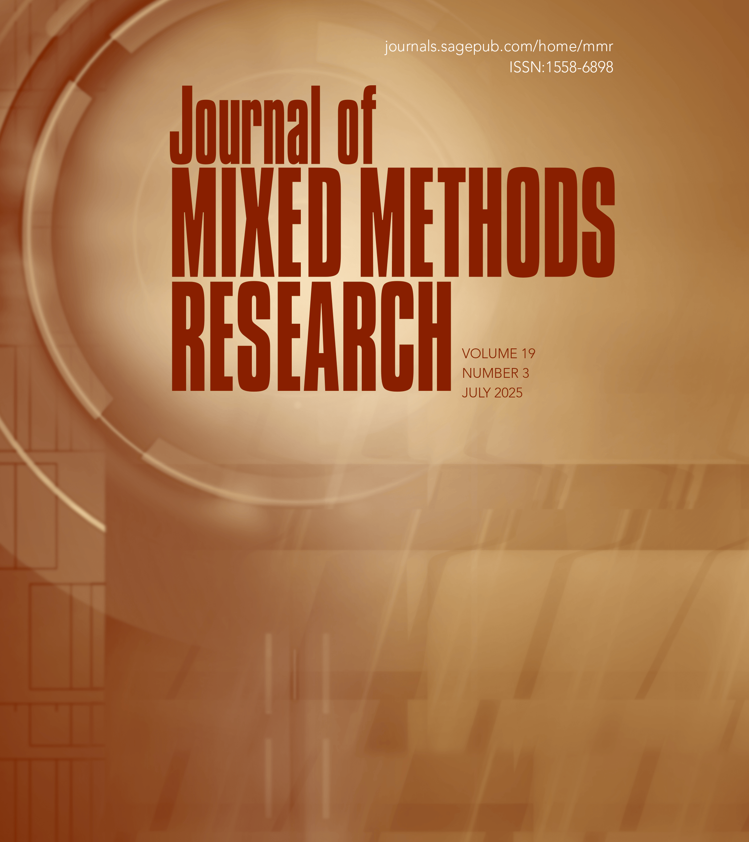
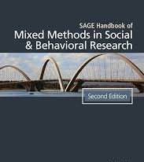
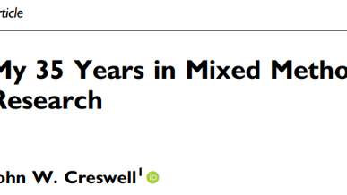
Introduction
MMR started around 90s
2003 Handbook
2009 JMMR
Based on a rapid review on the JMMR 2020-2025
One of the main conclusions was Psychology was scarce in the MMR publications.

Slide 4

Aim
To extract from a scoping review of the JMMR over the first half of the decade:
  The MMR features applied to the Psychology field
  What MMR-specific novelties could be useful for Psychology
  The MMR global implementation and report facets interdisciplinary applied
  A reflection about what measure to be taken to advance in MMR in Psychology

Slide 5
Method
Scoping review methodology
Rapid analysis of Psychology research articles
A qualitative analysis

Slide 6
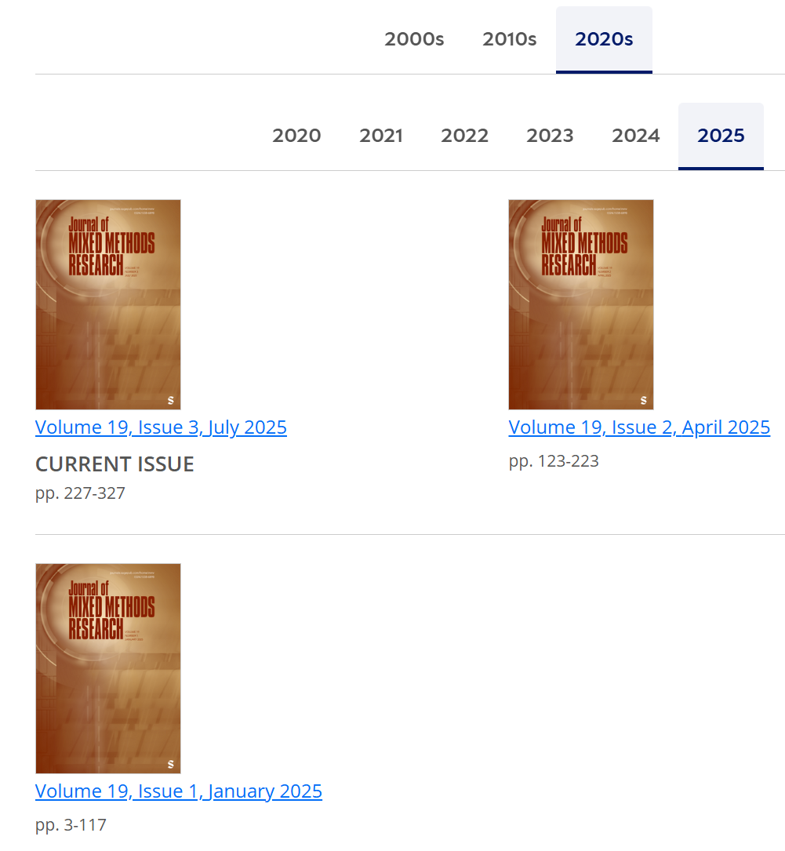
Editorials
Call for Papers
Methodoliogical/Theoretical Discussions
Research Articles
Media Reviews
Research Note
Erratum/Corrigendum
Thanks to reviewers
Main topics over time:
5 Vol. x 6 Issues -1:
n = 29
In each 3-19 articles (usually around 4-5)
2020: 23
2021: 23
2022: 20
2023: 17
2024: 31
2025: 11
Total: N=125

Slide 7
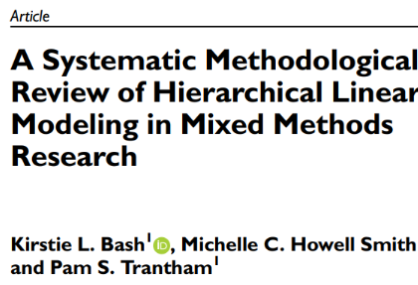
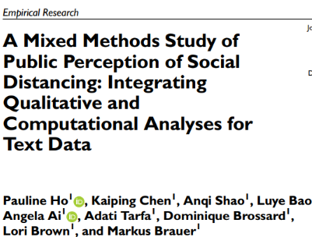
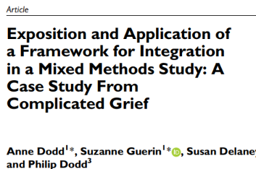
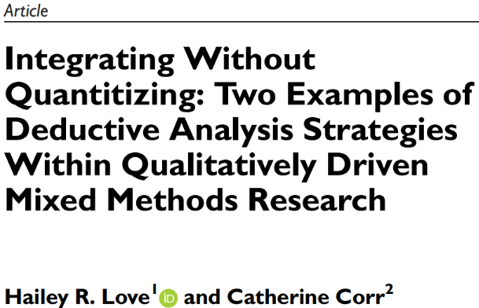
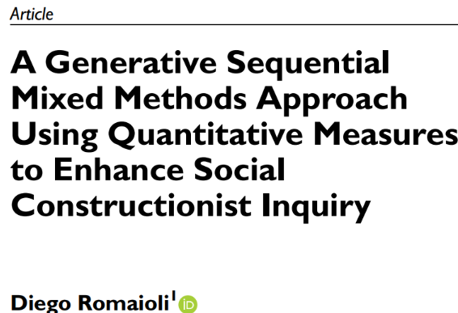
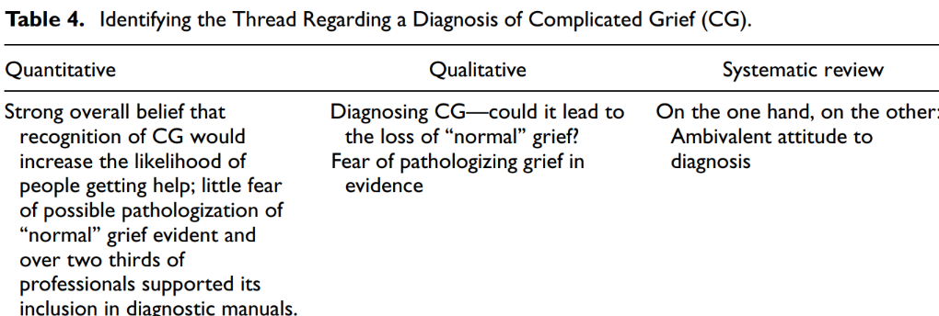
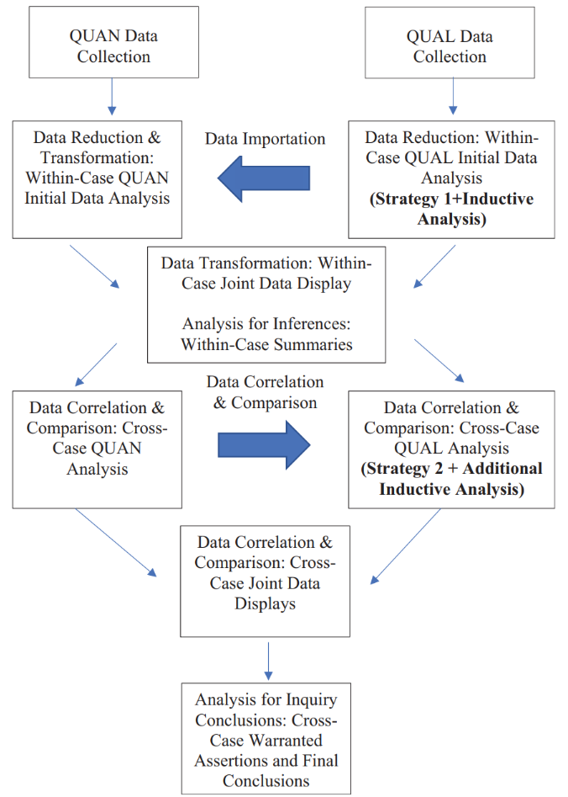
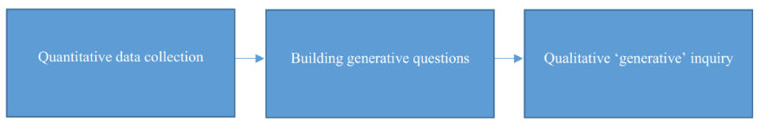
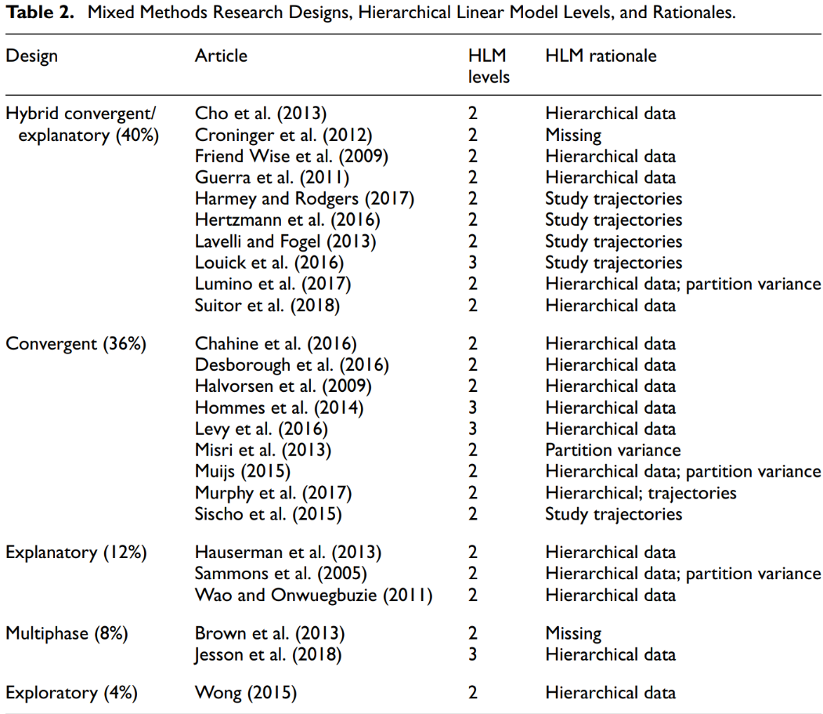
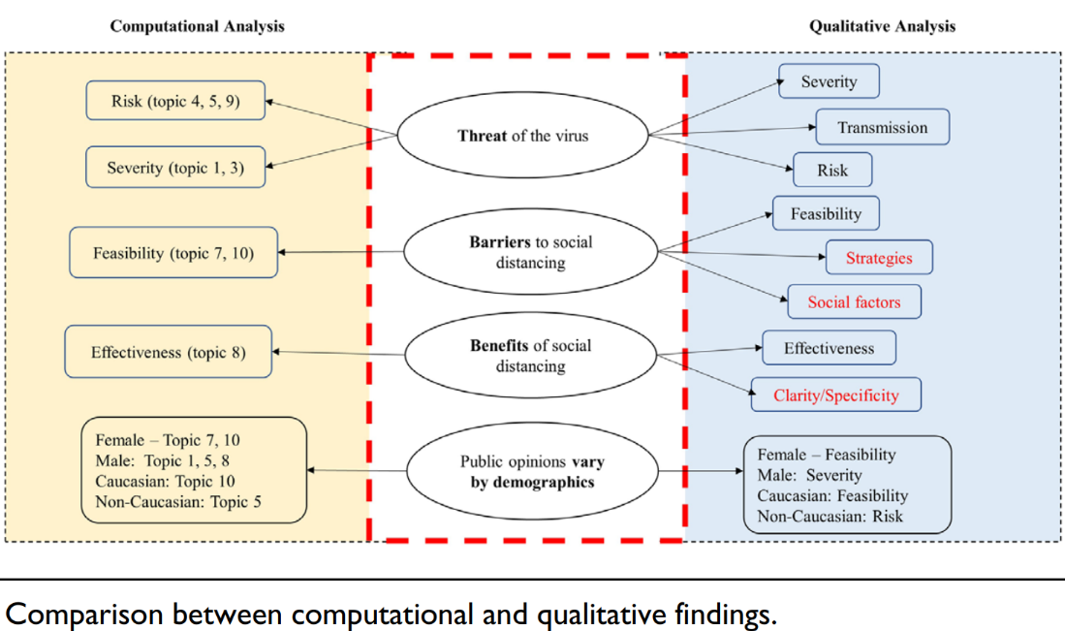
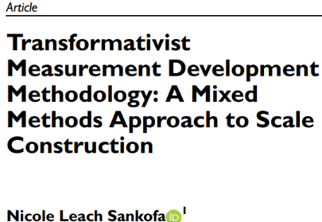
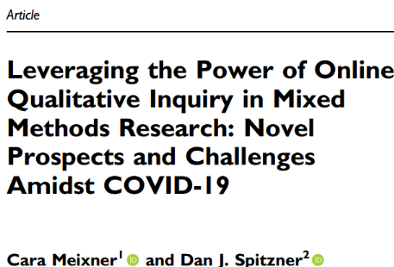
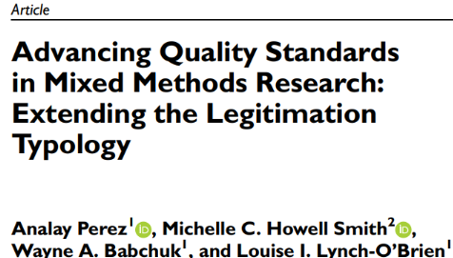
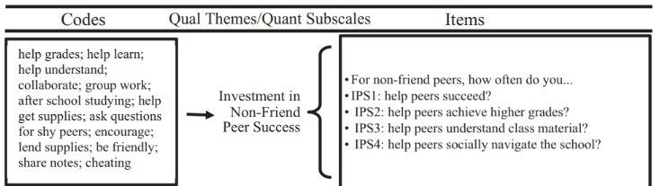
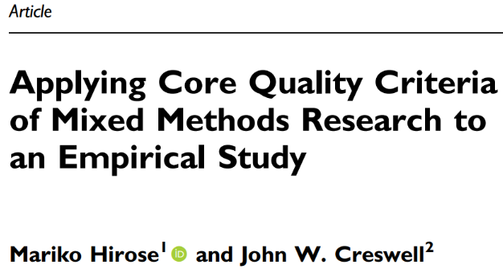
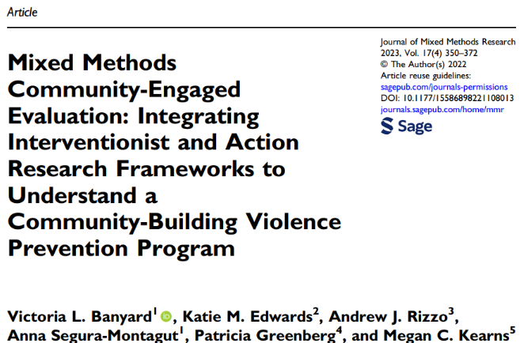
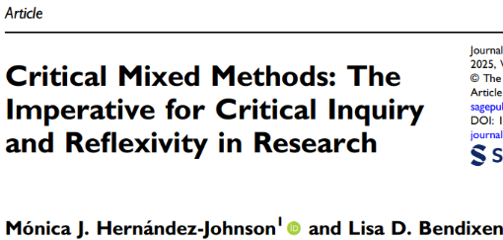
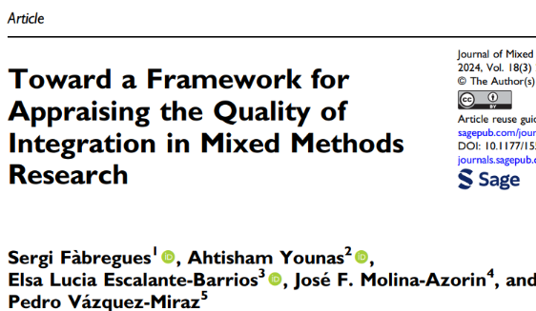
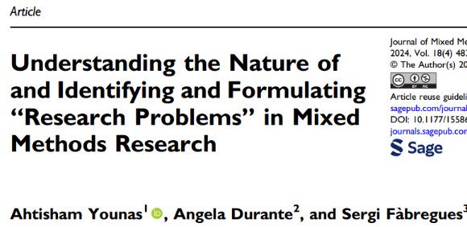
Psychology MMR advancements

Slide 8
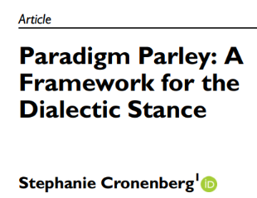
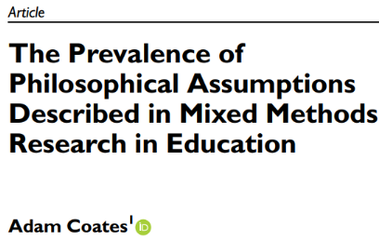
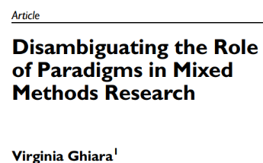
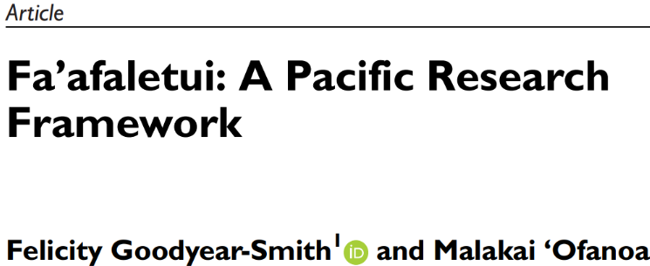
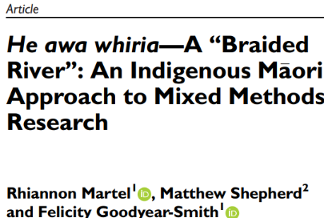
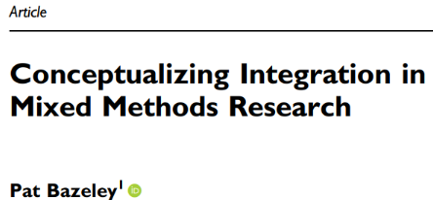
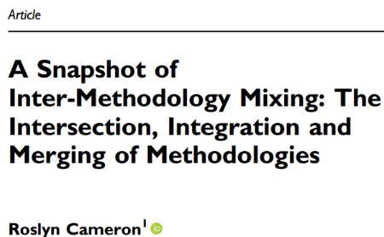
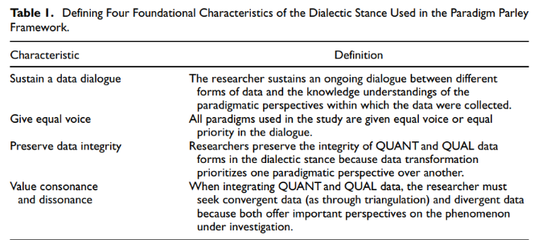
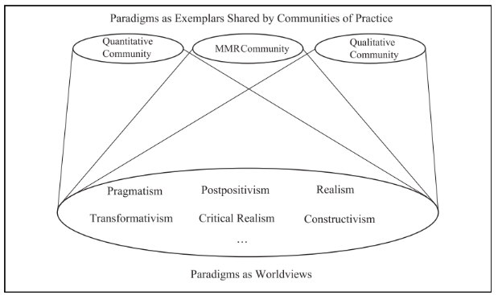
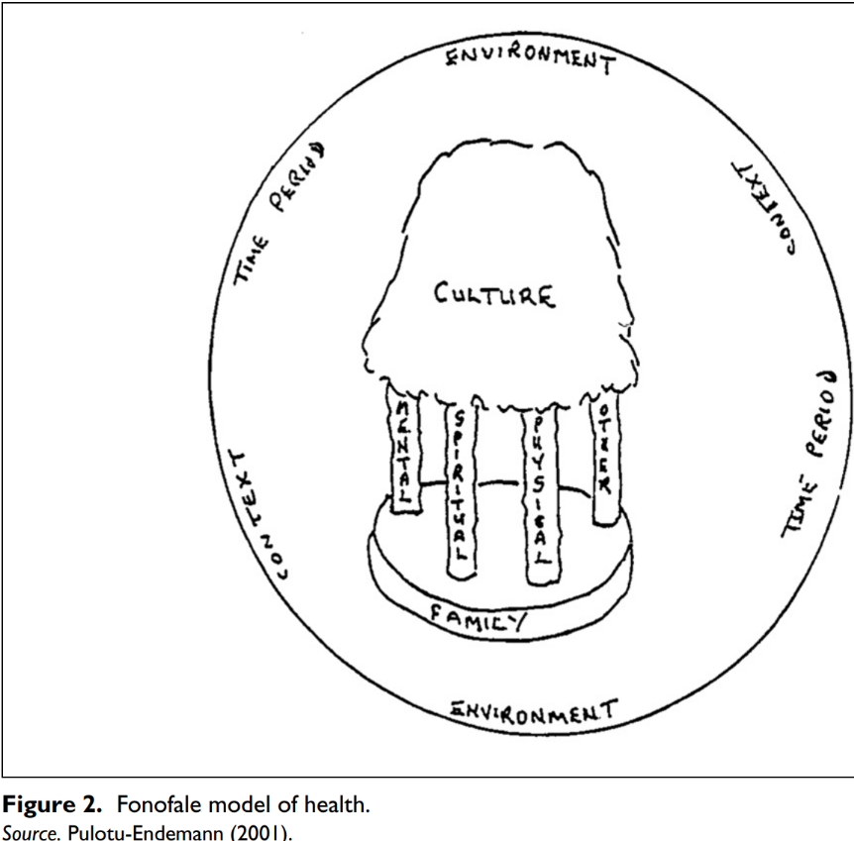
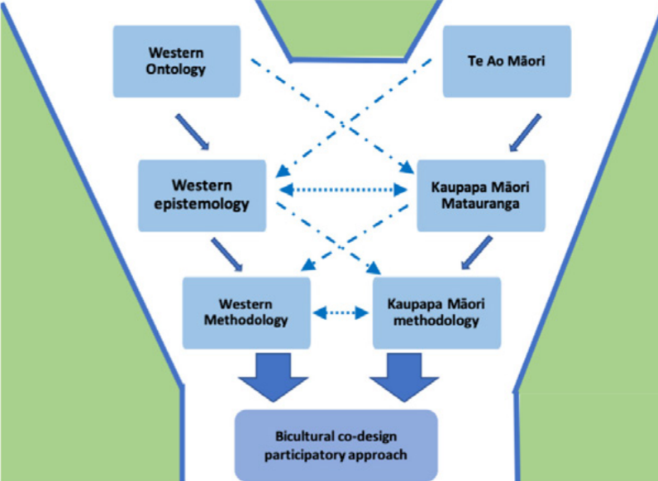
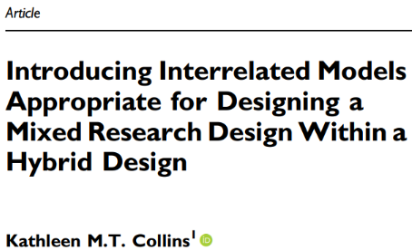
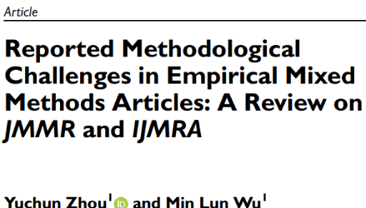
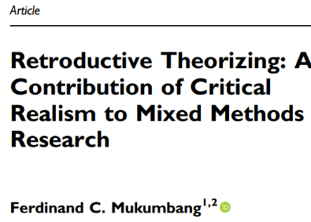
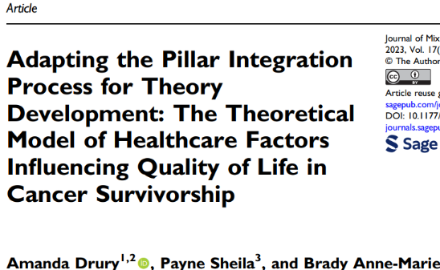
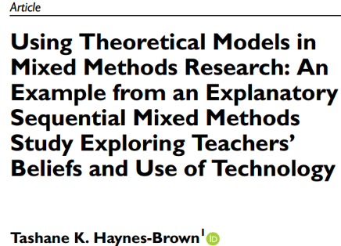
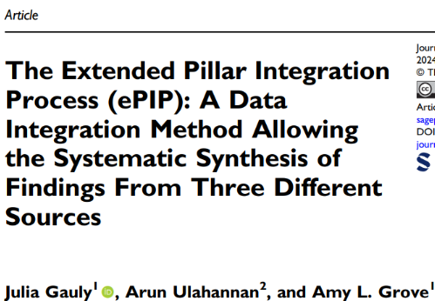
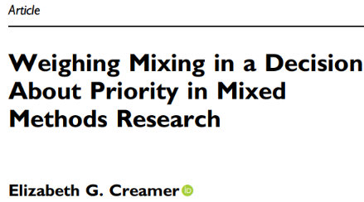
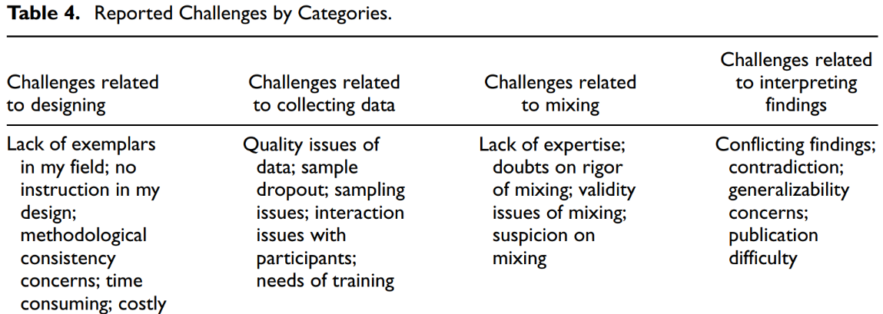
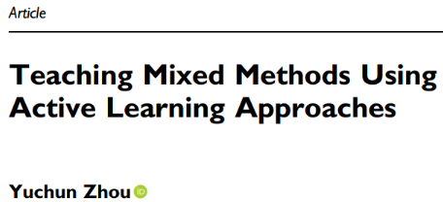
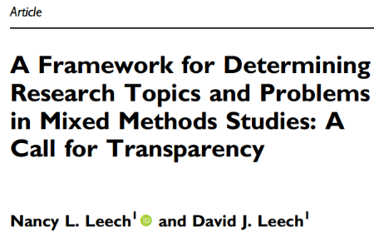
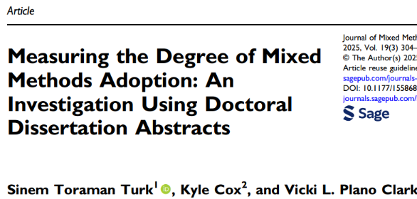
Theoretical advancements

Slide 9
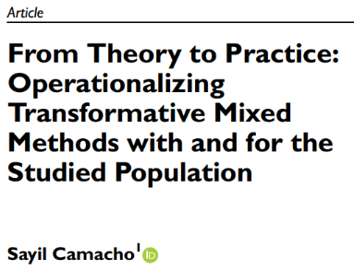
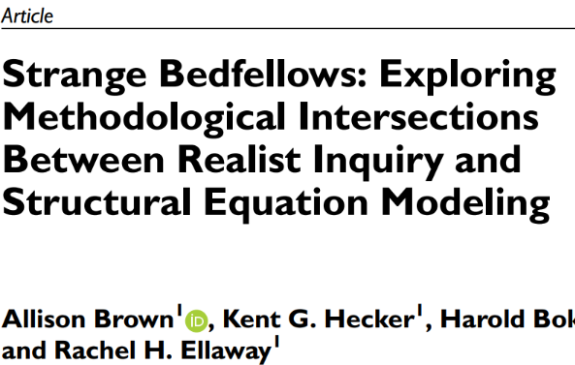
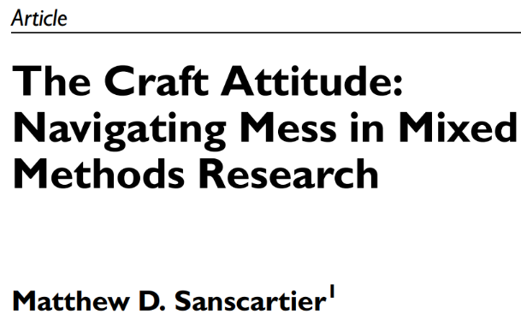
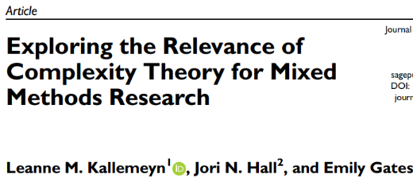
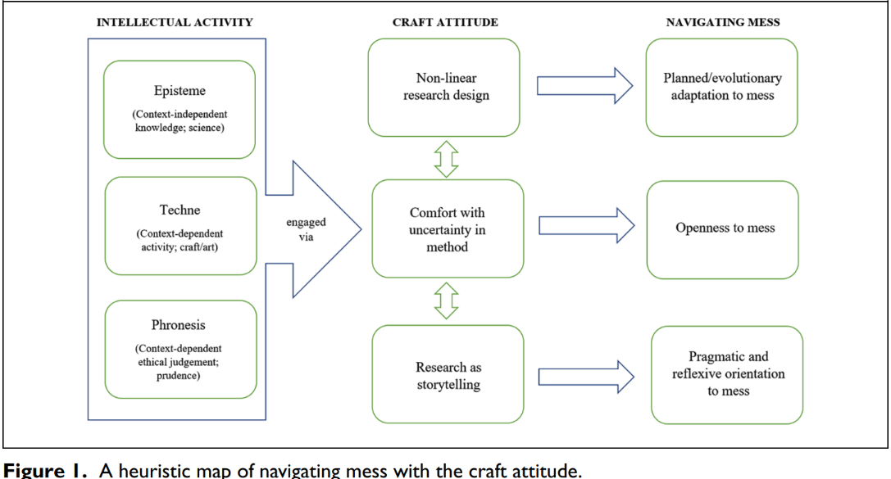





Theoretical advancements

Slide 10
















Technical advancements: MMR designs

Slide 11











Technical advancements: MMR designs

Slide 12

























Technical advancements: MMR tecniques

Slide 13


















Technical advancements: MMR data analysis

Slide 14
Results
Despite publishing four issues annually, the advancements observed in the JMMR reflect a significant positive academic evolution as a multidisciplinary journal (i.e., it is in the first decile of the interdisciplinary social sciences category)
Regarding the Psychological field, theoretical and conceptual foundations, these advancements relate to a set of paradigms (e.g., the transformative approaches).
Research designs are more complex, especially the qualitative approach (e.g., grounded theory with a relational design). However, most advancements come from other fields: health, social, and educational sciences.
There are many paradigmatical proposals (e.g., to avoid ambiguities, communicate better QUAL and QUAN integration, construct the study with an artisanal attitude, embrace complexity, and promote more social justice).

Slide 15
Results
Regarding the designs, while convergence is more prevalent, others, such as multilevel and case studies, are also present.
The major expansion has been on data analysis techniques (e.g., mixed cross-sectional analysis, network analysis, cost-effectiveness analysis, hybrid inductive/deductive thematic analysis)
There is a rise in the application of mixed-content digital techniques using visual elements (e.g., digital photographs, vignettes, Venn diagrams, mapping strategies).
The MMR global advancements include integrating QUAN and QUAL methods and pushing for a comprehensive review of terminology, quality standards, and reporting guidelines.

Slide 16
Conclusion
A recent examination reveals an encouraging trend in MMR, particularly in interdisciplinary areas where Psychology is underrepresented.
Psychology could benefit from the application of technological and data analysis techniques, especially with enhanced graphic support.
There appears to be increasing complexity in the theoretical assumptions surrounding MMR, along with multiple designs and some data analysis techniques with significant developments in technical advancements.
However, research designs and above all data analysis remain the least advanced technical-methodological aspects, especially in the qualitative domain, representing a weak area where Psychology excels and could contribute to progress.
The quality of research outputs and the dissemination of MMR within our field need to be addressed in this second decade of the 2020s.

Slide 17
Thank you!
Olatz.Lopez@psi.uned.es

