Slide 1

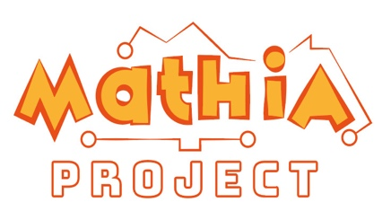

AI and students learning of Mathematics: A bibliometric study
Ana Pereira Antunes & Carlota Fernandes

Slide 2
Disclosure
But…
Yes, you heard something like this…
It is not the same…
despite the similar process…

Slide 3
- Does it matter in Mathematics?...
- Yes.
Mathematics is a
a national and a
international concern
as well as Artificial Intelligence
KA220-SCH - Cooperation partnerships in school education

Slide 4
Topics
Introduction
Method
Results
Conclusions

Slide 5
Introduction
Mathematics skills are essential for academic curricula despite the difficulties some students reveal on the topic.
To help the development of adolescents' mathematical skills is being implemented the Erasmus project: MathIA (Artificial Intelligence Model to enrich and improve mathematical skills in adolescent students).
This study is framed on that project.

Slide 6
Introduction
Again, no theoretical part will be presented…
This study is about the research that is being done on the topic…

Slide 7
Objective
to present the publications that are being made concerning artificial intelligence and Mathematics teaching and learning

Slide 8
However…
This is a work in progress...
A bibliometric study

Slide 9
A bibliometric study was conducted
A bibliometric study was conducted
Methods
An online search was made on b-On and Google platforms
publications from 2020 to 2025
descriptors such as:
Mathematics AND Artificial intelligence AND Teaching Learning
the four languages of the MathIA project were considered: Portuguese, English, Spanish and Italian.
31 articles were selected after title and abstract reading

Slide 10
Portuguese
B-on: 306→3
Google Scholar: 10.800*→7
Total: 10
English
B-on: 4→1
Google Scholar: 74.900*→18
Total: 19
39
Spanish
B-on: 477→4
Google Scholar:16.300*→6
Total: 10
Italian
B-on: 0→0
Google Scholar: 1.570*→0
Total: 0

Slide 11
Results
Categories
Themes
Methods

Slide 12
Results
Use of AI tools
Use of other techology
THEMES

Slide 13
Results
Qualitative
Quantitative
METHODS
Literature reviews

Slide 14
Conclusion
Learning
IA
Teaching
Students’ mathematic skills

Slide 15
Limitations (again)
Descriptors and data bases
Results cannot be generalized
Work in progress
Future work (as before…)
Exploratory work
Current publications

Slide 16
References*

Slide 17
Thank You!
Any questions?
aantunes@uma.pt

