Slide 1
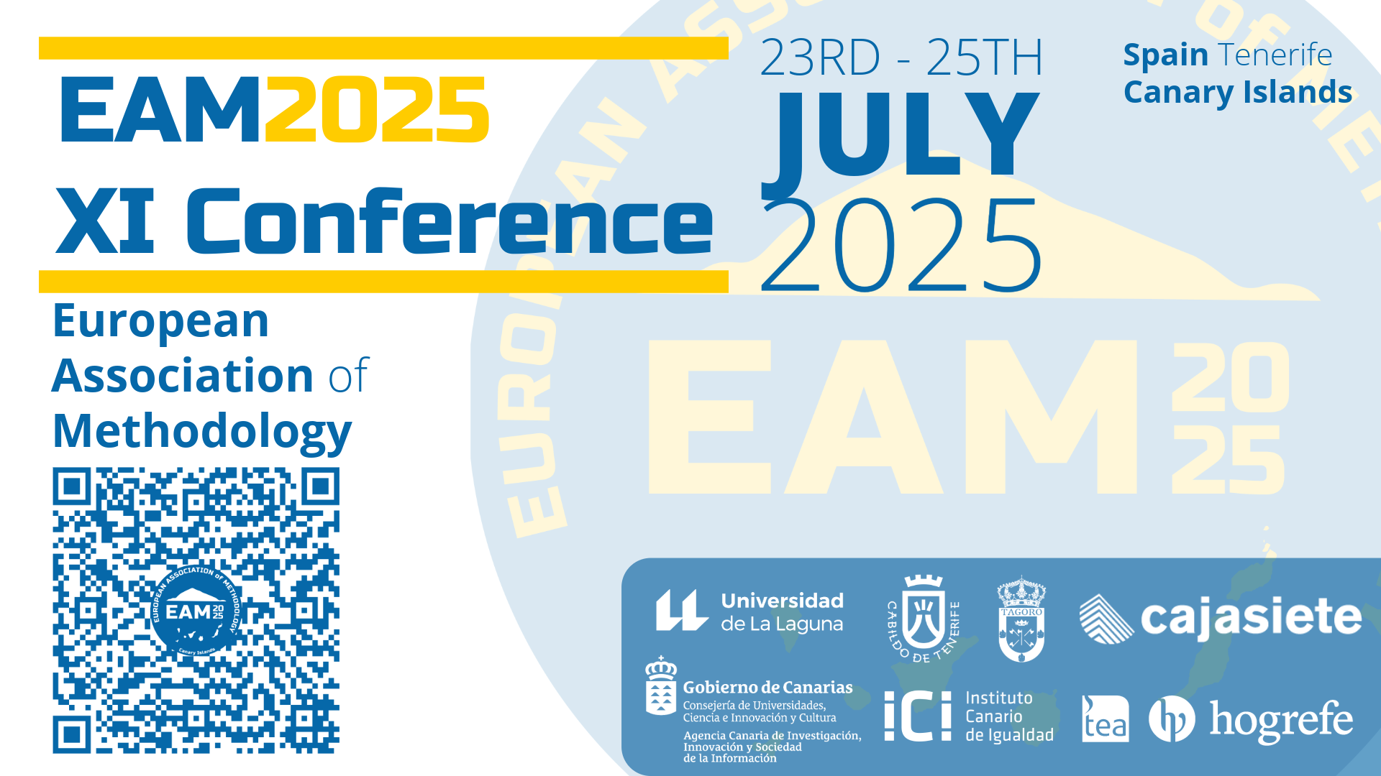


Project MathIA: Imbalanced Classication for Diagnosing Learning and
Cognitive Diferences in Mathematics Education
Ana F. Hernández; Andrej Franulic; Javier A. Salazar; José Palma; Fernando Jiménez
Dept. Developmental and Educational Psychology University of Murcia, Spain;Dept. Information and Communications Engineering University of Murcia, Spain; Comenius iDi SRL, Spain

Slide 2
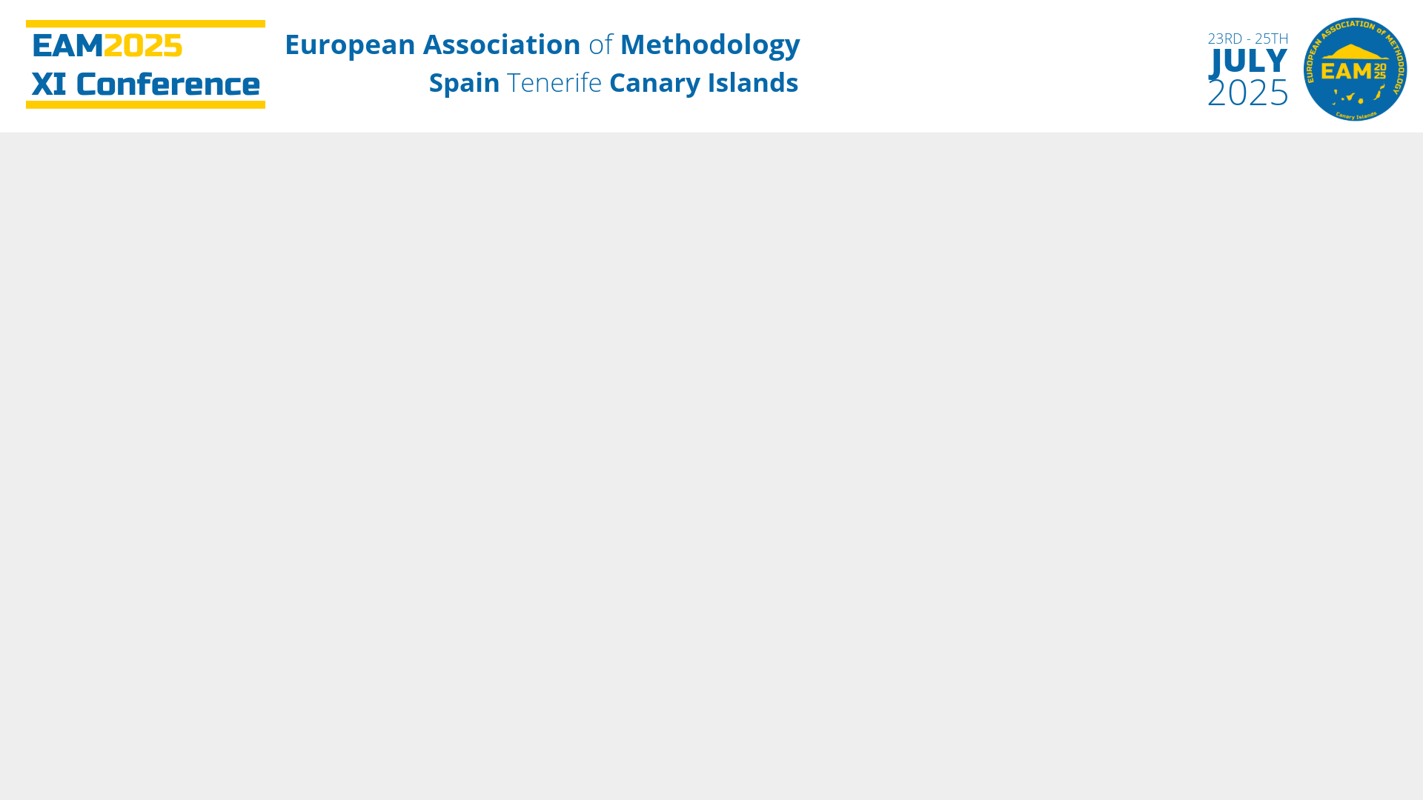
INTRODUCTION

Slide 3
Mathematics as the cornerstone of academic development
It enhances key cognitive skills:
      logical reasoning,
abstraction,
and problem-solving
Numerous students face barriers in acquiring these competencies within the secondary school curriculum.
Cognitive differences, specific learning disorders (such as dyslexia or dyscalculia), attentional difficulties (such as ADHD), or educational support needs associated with conditions on the autism spectrum or profiles of giftedness
To detect these profiles at an early stage
With the aim of promoting an appropriate educational response
By offering solutions capable of analyzing large volumes of educational data and generating predictive models that identify behavioral patterns associated with different learning trajectories.
The contribution of Artificial Intelligence and Machine Learning (ML)

Slide 4
Applying Machine Learning in education presents significant challenges
Class imbalance:
- The vast majority of students do not present diagnostic difficulties.
- This phenomenon can compromise the effectiveness of conventional algorithms, which tend to ignore or underrepresent minority classes

Slide 5

The present work proposes a comprehensive methodology for the collection, processing, analysis, and modeling of real educational data, with the aim of building an automatic diagnostic system for mathematical learning difficulties in secondary school students.

Slide 6
The main objective is to build a reliable and transferable model for real-world application:
Combining advanced strategies for imbalanced data,
Cross-validation techniques,
And comparative evaluation of multiple classification algorithms.

Slide 7
RELATED WORK

Slide 8
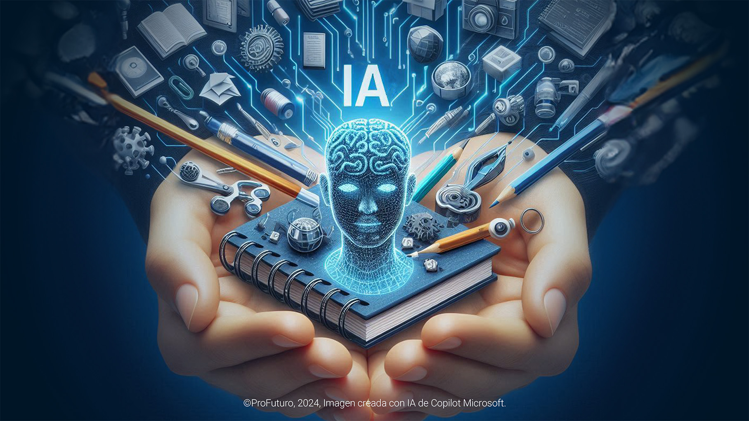
Growing interest in using Artificial Intelligence to detect Special Educational Needs
Recent studies highlight a variety of approaches:
- Machine Learning (ML) models
- Assistive technologies
- Systematic reviews
APPLICATION OF ARTIFICIAL INTELLIGENCE IN EDUCATIONAL DIAGNOSIS

Slide 9
Ravindran et al. compare six models (KNN, SVM, RF, CNN, LSTM...) to predict learning difficulties; KNN stands out with 90.33% accuracy.
Panjwani-Charania & Zhai review 16 studies, most of them focused on dyslexia, and highlight the use of adaptive learning technologies.
Aliu conducts an extensive review on the use of AI in Special Education (2001–2020), pointing out the lack of standardization and the challenges faced in developing countries.
Bhushan et al. apply AI to support students with dyscalculia, emphasizing the role of educational inclusion.
Apostolidou underlines the importance of individualized diagnostics and multidisciplinary collaboration.
Galeano et al. analyze SEN reports using cluster analysis; they identify inconsistencies in reporting and propose more personalized approaches

Slide 10
THE DISTINCTIVE CONTRIBUTION OF OUR AI MODEL
WHAT PROBLEM DO WE ADDRESS?
- In most educational contexts the number of students with specific learning difficulties is significantly lower than that of the general student population.
-This results in class imbalance, which negatively impacts the diagnostic accuracy of AI models.
OUR PROPOSAL
-Application of specific methodologies for imbalanced classification.
-Use of adapted evaluation metrics (such as F1-score, recall for the minority class, etc.).
-Improvement in the reliability of the predictive model.
-Accurate identification of minority classes, preventing them from being overlooked by standard algorithms.
IMPACT
It contributes to the development of AI-based diagnostic systems that are:
- More efficient
- More equitable
- Better adapted to real educational contexts

Slide 11
Study Methodology
(Phases and Data Collection)

Slide 12
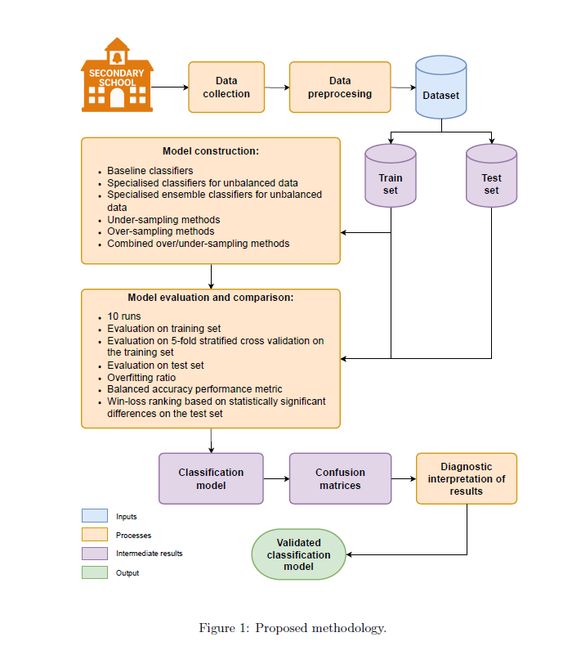
Study Phases
Data Collection
Data Preprocessing
Model Construction
Model Evaluation and Comparison
Diagnostic Interpretation of Results

Slide 13

Collected Data
Participants: Students from 1st to 4th year of secondary school (ESO) in the Region of Murcia (2024–2025 academic year)
Context: Erasmus+ KA2 Project
Sample: 9,133 individual exercises completed by 199 students
Exercise Distribution by Grade Level
1st year: 36 exercises
2nd–3rd year: 54 exercises
4th year: 39 exercises

Slide 14
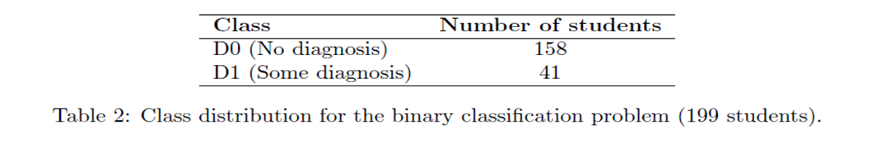
Clase | Diagnóstico | Nº estudiantes
D1 | Dislexia y Discalculia | 10
D2 | TDAH | 4
D3 | Cognición límite (ACNEAE) | 3
D4 | Desventaja lingüística | 5
D5 | Dislexia | 2
D6 | TEA (Trastorno Espectro Autista) | 12
D7 | Cognición límite (ACNEE) | 1
D8 | Alta capacidad intelectual | 4
Problem: Highly imbalanced classes → low model performance.

Slide 15
DATA PREPROCESSING
Variables Recorded per Exercise
Student-level: Grade level, gender, whether they are repeating the year, final grade, pending math subjects (M0–M7), diagnostic category (D0–D8)
Exercise-level:
  Type of exercise (across 14 topics)
  Evaluation criterion (C1–C61)
  Difficulty level (D1–D3)
  Response time
  Whether the exercise was attempted
  Whether the answer was correct

Slide 16
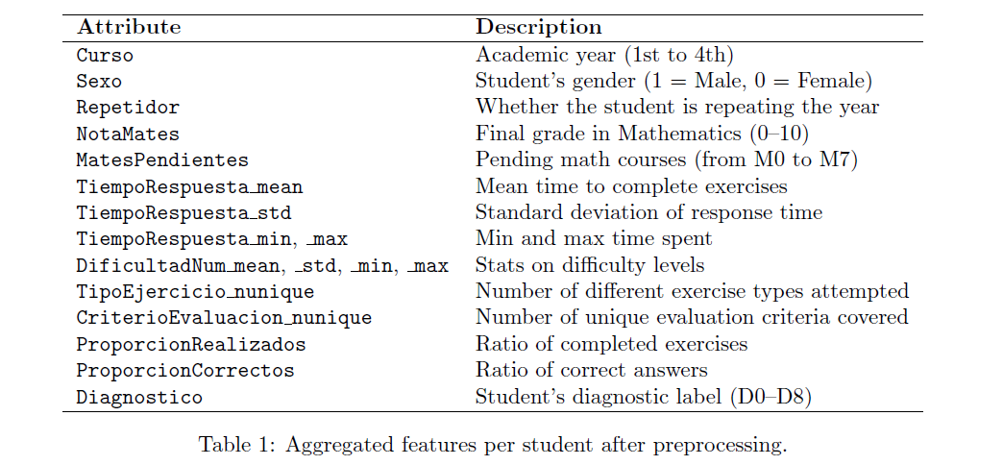

Slide 17
MODEL CONSTRUCTION AND EXPERIMENTAL SETUP

Slide 18
Dataset Splitting (Binary Classification)
Stratified split: 80% training / 20% testing
Stratification ensures that the class distribution is preserved in both subsets
Classification Approach
The following were applied:
-Traditional baseline classifiers
-Algorithms specialized for imbalanced data
-Resampling techniques:
  - Under-sampling
  - Over-sampling
  - Hybrid methods
Tools
-Implementation in Python
-Library used: imbalanced-learn
-Total: 70 strategies evaluated, combining classifiers and balancing techniques

Slide 19
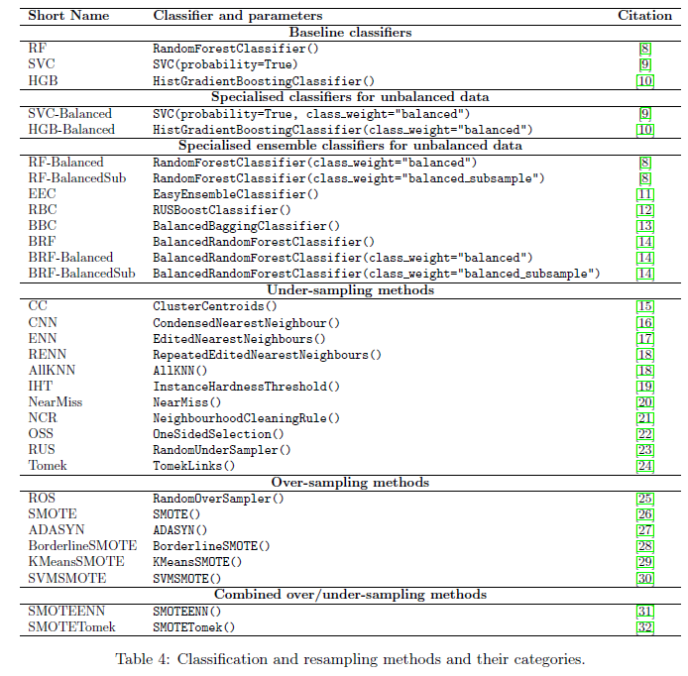
Algorithms Used and Class Imbalance Handling
Baseline Classifiers
    -Random Forest (RF): Ensemble method using decision trees with bagging.
-Support Vector Classifier (SVC): Finds the optimal hyperplane in a multidimensional space.
-Histogram-based Gradient Boosting (HGB): Fast and efficient boosting algorithm based on histograms.
All classifiers support class weight adjustment:
class_weight='balanced': adjusts class weights inversely proportional to class frequencies in the training data.
balanced_subsample: computes weights in each bootstrap sample (used in ensemble methods).

Slide 20
Classifier | Brief Description
Easy Ensemble Classifier (EEC) | Trains multiple classifiers using random subsets of the majority class
RUSBoost Classifier (RBC) | Combines random under-sampling with boosting
Balanced Bagging Classifier (BBC) | Applies bagging while ensuring class balance in each bootstrap sample
Balanced Random Forest (BRF) | Variant of Random Forest with under-sampling at each tree and support for class_weight

Slide 21
Model Evaluation and Comparison

Slide 22
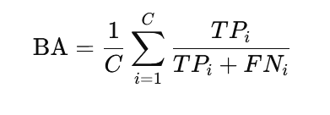
Experimental Design
Each model was run 10 times using different random seeds.
Evaluation Strategies
Directly on the training set
Stratified 5-fold cross-validation
Independent test set (20%)
Main Metric: Balanced Accuracy (BA)
Suitable for imbalanced datasets. Calculates the mean recall across classes, giving equal importance to each class.
Not influenced by majority class dominance.
Essential in educational diagnostics to ensure that minority-class students are not overlooked.
Statistical Comparison
Wilcoxon signed-rank test:
  Non-parametric
  Compares model performance without assuming normality
A win/loss ranking was created:
  Counts how many times each model significantly outperformed or underperformed others

Slide 23
Key Findings
Easy Ensemble Classifier (EEC) showed the best balance between performance and generalization.
Histogram-based Gradient Boosting (HGB) and Isolation-based Hard Trees (IHT) exhibited high overfitting.
Modelo | BA Test | BA CrossVal | BA Train | Overfitting Ratio
EEC | 0.750 | 0.733 | 0.858 | 1.144 ✅
HGB-Balanced | 0.696 | 0.741 | 0.999 | 1.436 ❌
IHT RF | 0.696 | 0.713 | 1.000 | 1.436 ❌
Educational Diagnostic Performance of EEC (Test Set)
24 true negatives (students without special needs correctly classified)
6 true positives (students with special needs correctly detected)
8 false positives (students without needs incorrectly flagged)
2 false negatives (students with needs not identified)
Minimizing false negatives is critical in education.
It is better to act preventively than to miss cases that require support.
Conclusion
EEC proves to be robust, sensitive, and generalizable.
It supports early detection and promotes inclusive education by reducing the risk of overlooking students with learning difficulties.

Slide 24
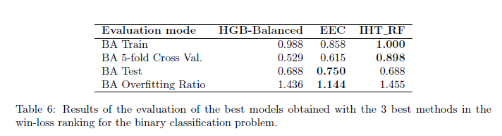
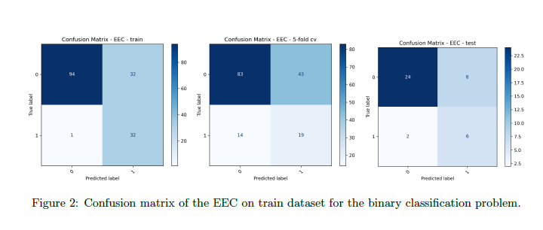

Slide 25
STUDY CONCLUSIONS

Slide 26
This study demonstrates that, through a well-defined pipeline for data collection, processing, and modeling, it is possible to generate automated diagnostic systems that accurately identify students with potential difficulties in mathematics learning.
The application of Machine Learning (ML) techniques in educational contexts enables the construction of robust and transferable predictive models.

Slide 27
Most existing research overlooks the inherent imbalance in educational data, where positive cases (diagnosed students) are significantly underrepresented. This study systematically addressed this limitation by applying specialized classification and resampling strategies to improve the detection of minority cases.
Addressing class imbalance is a critical factor in ensuring fair and equitable models in education.

Slide 28
Among the 70 strategies evaluated, EEC obtained the highest balanced accuracy (BA) on the test set (0.75) with the lowest overfitting rate, positioning it as the optimal candidate for real-world educational use. Its conservative profile minimizes false negatives—an essential feature aligned with the precautionary principle in the detection of educational needs
The Easy Ensemble Classifier (EEC) achieved the best overall diagnostic performance.

Slide 29
Aggregating over 9,000 individual records into 199 summary vectors enabled the model to capture meaningful patterns of performance, participation, and difficulty, while maintaining traceability of relevant curricular and diagnostic variables.
Consolidating data at the student level improves both interpretability and feasibility of predictive models.

Slide 30
The validated model will be integrated into Moodle as a decision-support system, enabling teachers to detect at-risk students early and design tailored interventions. This step enhances the practical applicability of the system and its potential impact in real classroom settings.
The proposed approach is scalable and integrable into learning management platforms.

Slide 31
The combination of advanced models, rigorous evaluation, and a targeted response to specific educational needs contributes to the creation of more equitable and personalized learning environments, aligned with the goals of inclusive education in Europe.
This study represents a methodological advance toward AI-based educational diagnostic support systems with an inclusive and preventive focus.

Slide 32
To Be Continued

Slide 33
BIBLIOGRAPHIC REFERENCES

Slide 34
Anjana Ravindran, Anjana J, and Meenakshi P. Prediction of learning disability using machine learning. International Journal for Research in Applied Science and Engineering Technology, 11:1248{1254, 08 2023.
Sahrish Panjwani-Charania and Xiaoming Zhai. AI for students with learning disabilities: A systematic review. In Uses of Articial Intelligence in STEM Education. Oxford University Press, 2024.
Toluwani Victor Aliu. Articial intelligence in special education: A literature review. Systemic Analytics, 2(2):188{199, 2024.
Saurabh Bhushan, Sampathkumar Arunkumar, Tarek A. E. Eisa, Mohammed Nasser, Amit Kumar Singh, and Pradeep Kumar. AI-enhanced dyscalculia screening: A survey of methods and applications for children. Diagnostics (Basel), 14(13):1441, July 2024.
Maria Apostolidou. Processes and tools for diagnosing learning diculties. World Journal of Advanced Engineering Technology and Sciences, 14:372{391, 03 2025.
Elena M. Galeano Weber, Rebecca Aissa, Vera Moser, and Marcus Hasselhorn and. Determining special educational needs in Germany: current status and the coherence of the rationale of support recommendations. European Journal of Special Needs Education, 0(0):1{17, 2025.
Guillaume Lema^tre, Fernando Nogueira, and Christos K. Aridas. Imbalanced-learn: A python toolbox to tackle the curse of imbalanced datasets in machine learning. Journal of Machine Learning Research, 18(17):1{5, 2017.
Leo Breiman. Random forest. Machine Learning, 45:5{32, 10 2001.13

Slide 35
Chih-Chung Chang and Chih-Jen Lin. Libsvm: A library for support vector machines. ACM Trans. Intell. Syst. Technol., 2(3), May 2011.
Guolin Ke, Qi Meng, Thomas Finley, Taifeng Wang, Wei Chen, Weidong Ma, Qiwei Ye, and Tie-Yan Liu. Lightgbm: a highly ecient gradient boosting decision tree. In Proceedings of the 31st International Conference on Neural Information Processing Systems, NIPS'17, pages 3149{3157, Red Hook, NY, USA, 2017. Curran Associates Inc.
Xu-Ying Liu, Jianxin Wu, and Zhi-Hua Zhou. Exploratory undersampling for class-imbalance learning. IEEE Transactions on Systems, Man, and Cybernetics, Part B (Cybernetics), 39(2):539{550, 2009.
Chris Seiert, Taghi M. Khoshgoftaar, Jason Van Hulse, and Amri Napolitano. Rusboost: A hybrid approach to alleviating class imbalance. IEEE Transactions on Systems, Man, and Cybernetics - Part A: Systems and Humans, 40(1):185{197, 2010.
Richard Maclin and David Opitz. An empirical evaluation of bagging and boosting. In AAAI'97/IAAI'97, pages 546{551. AAAI Press, 1997.
Chao Chen, Andy Liaw, and Leo Breiman. Using random forest to learn imbalanced data. Technical Report 666, University of California, Berkeley 110 (1-12): 24, 2004.
Show-Jane Yen and Yue-Shi Lee. Cluster-based under-sampling approaches for imbalanced data distributions. Expert Systems with Applications, 36:5718{5727, 01 2006.
P. Hart. The condensed nearest neighbor rule (corresp.). IEEE Transactions on Information Theory, 14(3):515{516, 1968.
Dennis L. Wilson. Asymptotic properties of nearest neighbor rules using edited data. IEEE Transactions on Systems, Man, and Cybernetics, SMC-2(3):408{421, 1972.
I. Tomek. An experiment with the edited nearest-neighbor rule. IEEE Transactions on Systems, Man, and Cybernetics, SMC-6(6):448{452, 1976.
Michael Smith, Tony Martinez, and Christophe Giraud-Carrier. An instance level analysis of data complexity. Machine Learning, 95:225{256, 2014.
J. Zhang and I. Mani. KNN Approach to Unbalanced Data Distributions: A Case Study Involving Information Extraction. In Proceedings of the ICML'2003 Workshop on Learning from Imbalanced Datasets, 2003.
Jorma Laurikkala. Improving identication of dicult small classes by balancing class distribution. In Silvana Quaglini, Pedro Barahona, and Steen Andreassen, editors, Articial Intelligence in Medicine, pages 63{66, Berlin, Heidelberg, 2001. Springer Berlin Heidelberg.
M. Kubat. Addressing the curse of imbalanced training sets: One-sided selection. In Fourteenth International Conference on Machine Learning, pages 179{186, 06 1997.
Ma lgorzata Bach, Aleksandra Werner, and Mateusz Palt. The proposal of undersampling method for learning from imbalanced datasets. Procedia Computer Science, 159:125{134, 2019. Knowledge-Based and Intelligent Information & Engineering Systems: Proceedings of the 23rd International Conference KES2019.
I. Tomek. Two modications of cnn. IEEE Transactions on Systems, Man, and Cybernetics, SMC-6(11):769{772, 1976.
Firuz Kamalov, Ho-Hon Leung, and Aswani Kumar Cherukuri. Keep it simple: random oversampling for imbalanced data. In 2023 Advances in Science and Engineering Technology International Conferences (ASET), pages 1{4, 2023.

Slide 36
Nitesh V. Chawla, Kevin W. Bowyer, Lawrence O. Hall, and W. Philip Kegelmeyer. Smote: synthetic minority over-sampling technique. J. Artif. Int. Res., 16(1):321{357, June 2002.
Haibo He, Yang Bai, Edwardo A. Garcia, and Shutao Li. Adasyn: Adaptive synthetic sampling approach for imbalanced learning. In 2008 IEEE International Joint Conference on Neural Networks (IEEE World Congress on Computational Intelligence), pages 1322{1328, 2008.
Hui Han, Wen-Yuan Wang, and Bing-Huan Mao. Borderline-smote: a new over-sampling method in imbalanced data sets learning. In Proceedings of the 2005 International Confer- ence on Advances in Intelligent Computing - Volume Part I, ICIC'05, pages 878{887, Berlin, Heidelberg, 2005. Springer-Verlag.
Georgios Douzas, Fernando Bacao, and Felix Last. Improving imbalanced learning through a heuristic oversampling method based on k-means and smote. Information Sciences, 465:1{20, October 2018.
Hien Nguyen, Eric Cooper, and Katsuari Kamei. Borderline over-sampling for imbalanced data classication. International Journal of Knowledge Engineering and Soft Data Paradigms, 3:4{21, 04 2011.
Gustavo E. A. P. A. Batista, Ronaldo C. Prati, and Maria Carolina Monard. A study of the behavior of several methods for balancing machine learning training data. SIGKDD Explor. Newsl., 6(1):20{29, June 2004.
Gustavo Batista, Ana Bazzan, and Maria-Carolina Monard. Balancing training data for automated annotation of keywords: a case study. In Proc. of Workshop on Bioinformatics, pages 10{18, 01 2003.
Kay H. Brodersen, Cheng Soon Ong, Klaas Stephan, and Joachim Buhmann. The balanced accuracy and its posterior distribution. Pattern Recognition, International Conference on, 0:3121{3124, 08 2010.
W. J. Conover. Practical Nonparametric Statistics. John Wiley & Sons, New York, third edition, 1999.
Moodle Project. Moodle - open-source learning platform. https://moodle.org/, 2025. Ac- cessed: 2025-04-25.15

Slide 37


