Slide 1


SYMPOSIUM: Intervention programs evaluation: effect size, moderator variables and methodological quality
  Validity Evidence of the Hospital Anxiety and Depression Scale (HADS) in Chilean Patients with Kidney Disease
José A. Lozano Lozano, Erica Villoria, Susana Sanduvete-Chaves, , Francisco Pablo Holgado-Tello, Salvador Chacón-Moscoso

Slide 2


Chronic Kidney Disease (CKD): Scope and Impact
CKD is a major global health issue, ranked the 12th leading cause of death worldwide in 2017 (Bikbov et al., 2020), projected to become the 5th by 2040 (Wei et al., 2024).
It progressively impairs physical, cognitive, and emotional functioning (Flores et al., 2009).
Patients face comorbidities, loss of autonomy, and reduced quality of life (Aggarwal et al., 2017).
Anxiety and depression are common, increasing with disease progression and dialysis dependence (Kalsoom, 2019).
CKD also imposes significant social and healthcare costs, especially in low- and middle-income countries.
2

Slide 3

Emotional Burden in CKD
Depression prevalence ranges from 12% to 77.5%; anxiety from 39.6% to 71%, depending on disease stage and assessment methods (Alshelleh et al., 2022; Semaan et al., 2018).
Symptoms are not mere reactions to diagnosis but stem from neurobiological alterations, treatment burden, prognosis uncertainty, lifestyle restrictions, and chronic fatigue (Dziubek et al., 2021).
Dialysis is invasive, time-consuming, and disrupts daily life, increasing emotional distress (Alkubati et al., 2024).
These emotional symptoms predict poorer adherence, more hospitalizations, greater disability, and reduced survival (Mosleh et al., 2020).
3

Slide 4

Screening Needs and the Role of HADS
Emotional disorders are frequently underdiagnosed due to symptom overlap with CKD manifestations -e.g., insomnia, fatigue, appetite loss- (Adejumo et al., 2024).
Screening requires empirically supported tools focusing on cognitive-affective symptoms.
The Hospital Anxiety and Depression Scale (HADS) is a 14-item instrument (7 anxiety, 7 depression), excluding somatic symptoms, brief, easy to administer, and widely used in medical settings.
Strong evidence supports its two-factor internal structure, internal consistency (Cronbach’s α ≈ 0.80), and associations with other anxiety and depression measures.
Alternative models (e.g., bifactor, tripartite) show similar fit but no clear theoretical advantage. Further research is needed on response processes and potential consequences of HADS use in somatic populations.
Most HADS evidence comes from Europe, Asia, or North America; cultural and linguistic factors may influence how patients interpret and respond to psychological assessments.
In Chile, HADS has only been validated in cancer patients; no studies have assessed its psychometric performance in CKD patients.
4

Slide 5

Objective
Examine the internal structure, internal consistency, and associations with related constructs of the HADS in Chilean adults undergoing dialysis.
5

Slide 6

Methods
Participants
Sample: 442 adults (≥18 years) undergoing hospital-based renal replacement therapy for CKD (hemodialysis 88.0%; peritoneal dialysis 12.0%).
Exclusion: neurological disabilities, advanced physical/psychological impairment, or ongoing psychiatric/psychological treatment.
Age range: 20–80 years (M = 49.73, SD = 14.53).
Sex: 38.2% men, 61.8% women.
Marital status: 37.6% single, 47.1% married, 7.2% divorced, 3.8% widowed, 4.3% civil partnership.
Education: 3.2% incomplete primary, 7.9% primary, 35.1% secondary, 53.8% technical/higher education.
Employment: 20.1% employed, 13.1% self-employed, 6.3% unemployed, 38.0% retired, 22.2% homemakers, 0.2% students.
6

Slide 7

Instruments
Sociodemographic & clinical data: ad hoc questionnaire (age, sex, marital status, education, employment, dialysis modality).
HADS (Hospital Anxiety and Depression Scale):
  → Chilean adaptation for oncology patients (Villoria & Lara, 2018);
  → 14 items, 7 anxiety (odd), 7 depression (even);
  → 4-point Likert scale (0–3); subscales 0–21.
DASS-21 (Depression Anxiety Stress Scales):
  → Chilean version (Antúnez & Vinet, 2012)
  → 21 items, 3 subscales (depression, anxiety, stress);
  → 4-point scale (0 = did not apply, 3 = applied most of the time).
7

Slide 8
Procedure
Scientific Ethics Committee
Submission of study Proposal
Approval from Ethical Committee
Recruitment
Phrase 1. Digital dissemination
Phase 2. Institutional outreach
Psychometric evaluation
Verification of statistical assumptions
Evidence based on internal structure
Internal consistency reliability
Evidence based on relations to other variables
Network analysis of psychological dimensions
Final sample (n = 442)
Phase 4. Data management
Phase 3. Electronic consent and Survey completion.
8

Slide 9

Data analysis
All analyses conducted in R 4.3.2
Descriptive stats (means, SDs, skewness, kurtosis); multivariate normality tested with Mardia’s tests and chi-square with Bonferroni corrections.
Given ordinal data and non-normality, polychoric correlations were used.
Confirmatory factor analysis with WLSMV estimator; model fit assessed via χ², CFI, TLI, RMSEA, SRMR; thresholds interpreted cautiously for ordinal data.
Reliability: Cronbach’s alpha, McDonald’s omega; item discrimination via corrected item-total correlations.
Convergent validity: Pearson and partial correlations between HADS and DASS-21 subscales (depression, anxiety, stress), controlling shared variance; significance p < .01.
Psychological network analysis explored interrelations among HADS and DASS-21 dimensions.
Network estimated using EBICglasso; centrality and bridge metrics computed to identify influential nodes.
9

Slide 10
Item | Mean | SD | Skewness | Kurtosis
1 | 1.46 | 1.05 | 0.08 | -1.20
2 | 1.39 | 1.08 | 0.09 | -1.27
3 | 1.47 | 1.10 | 0.02 | -1.32
4 | 1.24 | 1.08 | 0.37 | -1.15
5 | 1.40 | 1.11 | 0.10 | -1.33
6 | 1.31 | 1.08 | 0.22 | -1.23
7 | 1.37 | 1.05 | 0.18 | -1.16
8 | 1.48 | 1.05 | 0.04 | -1.20
9 | 1.25 | 1.09 | 0.33 | -1.20
10 | 1.36 | 1.12 | 0.15 | -1.36
11 | 1.28 | 1.08 | 0.29 | -1.20
12 | 1.37 | 1.10 | 0.16 | -1.30
13 | 1.36 | 1.09 | 0.17 | -1.28
14 | 1.24 | 1.13 | 0.33 | -1.29
Results
Descriptive Analysis of the items
Overall: no substantial univariate normality violations.
Mardia’s test of multivariate normality:
  → Multivariate skewness: b₁,p = 9.47, χ² = 697.67, p < .001;
  → Multivariate kurtosis: b₂,p = 232.84, kurtosis = 4.39, p < .001 → significant violations [47].
Results justify use of WLSMV estimator for CFA.
10

Slide 11
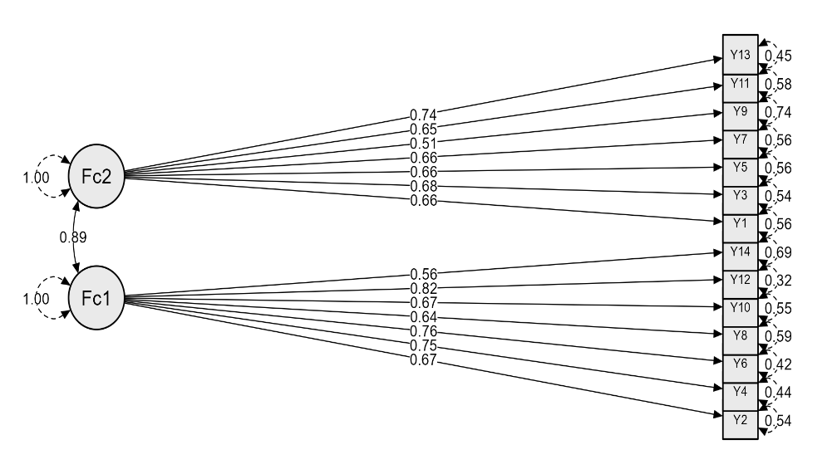
Validity Evidence: Internal Structure (CFA)
CFA tested original two-factor model by Zigmond & Snaith (1983).
  → Anxiety (odd items) & Depression (even items).
Global fit indices:
  χ²(76) = 181.18, p < .001;
  GFI = .99; CFI = .99; NFI = .99;
  RMSEA = .05, 90% CI [.046, .067];
  SRMR = .06
11

Slide 12
Reliability Evidence (Internal Consistency) and Average Item Discrimination for the HADS Factors
HADS Subscale | McDonald’s Omega | Cronbach’s Alpha | Mean discrimination
Anxiety | .81 | .80 | .54
Depression | .84 | .84 | .59
Evidence based on relations to other variables
HADS Subscale | DASS Depression |  | DASS Anxiety |  | DASS Stress
 | r | pr | r | pr | r | pr
Anxiety | .682* | .294* | .698* | .499* | .662* | .417*
Depression | .733* | .500* | .691* | .125* | .591* | .208*
12

Slide 13
Network analysis of Evidence Based on Relations to Other Variables
 | Edge weights
 | HADS_A | HADS_D | DAS_S | DAS_D | DAS_A
HADS_A | ---
HADS_D | .418 | ---
DAS_S | .119 | .000 | ---
DAS_D | .063 | .434 | .343 | ---
DAS_A | .294 | .000 | .441 | .156 | ---
 | Centrality indexes
Closeness | .062 | .063 | .062 | .066 | .060
Strength | .895 | .852 | .904 | .997 | .891
Hybrid | .750 | .281 | .625 | 1.00 | .500
R2 | .642 | .646 | .665 | .688 | .654
 | Bridge indexes
Closeness | .228 | .266 | .187 | .324 | .233
Strength | .477 | .434 | .119 | .497 | .294
Gateway | .935 | .924 | .843 | .982 | .928
Panel (a): Partial correlation network estimated using EBICglasso.
→ Nodes: five psychological dimensions (HADS Anxiety, HADS Depression; DASS-21 Depression, Anxiety, Stress).
→ Edge thickness: strength of regularized partial correlations between nodes.
Panel (b): Centrality metrics (strength, closeness, hybrid centrality) computed for each node.
→ Higher centrality = greater structural importance within the network.
13

Slide 14

Main Findings and Psychometric Evidence
Strong psychometric support for using the HADS in Chilean CKD patients.
Importance: high prevalence of emotional symptoms (Alshelleh et al., 2022; Semaan et al., 2018), impacting adherence, hospitalization, mortality (Rosseel et al., 2024).
Multiple sources of validity evidence:
  → Internal structure (two-factor CFA model, Zigmond & Snaith 1983), r = .89);
  → High internal consistency (α, ω > .80);
  → Correlations with DASS-21 confirm interpretive appropriateness.
Network analysis added value:
  → Visualized interactions among symptoms;
  → DASS Depression identified as central node (highest bridge & gateway centrality);
  → Clear separation between HADS and DASS subscales, supporting discriminant validity.
14

Slide 15
Other Implications, Limitations, and Future Directions
Clinical relevance:
  → Depressive symptoms reflect cumulative psychological burden (fatigue, autonomy loss, disease fear).
  → HADS offers brief, reliable, cost-effective screening for emotional distress, valuable in Latin American settings.
Limitations:
  → Cross-sectional design (no causal inferences);
  → Dialysis-only sample (cannot generalize to early CKD stages)
  → No clinical interviews; exploratory findings.
Future directions:
  → Longitudinal studies; larger, diverse samples; diagnostic interviews;
  → Examine predictive validity for clinical outcomes (e.g., readmission, adherence, mortality).
Conclusion:
  → Converging evidence across methods supports HADS as a robust tool for screening anxiety and depression in Chilean CKD patients, enhancing person-centered nephrology care.
15

Slide 16
References
Adejumo, O. A., Edeki, I. R., Sunday Oyedepo, D., Falade, J., Yisau, O. E., Ige, O. O., Adesida, A. O., Daniel Palencia, H., Sabri Moussa, A., Abdulmalik, J., Noubiap, J. J., & Ekrikpo, U. E. (2024). Global prevalence of depression in chronic kidney disease: A systematic review and meta-analysis. Journal of Nephrology, 37(9), 2455-2472. https://doi.org/10.1007/s40620-024-01998-5
Aggarwal, H. K., Jain, D., Dabas, G., & Yadav, R. K. (2017). Prevalence of Depression, Anxiety and Insomnia in Chronic Kidney Disease Patients and their Co-Relation with the Demographic Variables. PRILOZI, 38(2), 35-44. https://doi.org/10.1515/prilozi-2017-0020
Alkubati, S., Al-Sayaghi, K., Salameh, B., Halboup, A., Ahmed, W., J. Alkuwaisi, M., & Zoromba, M. (2024). Prevalence of Depression and Its Associated Factors Among Hemodialysis Patients in Hodeida City, Yemen. Journal of Multidisciplinary Healthcare, Volume 17, 689-699. https://doi.org/10.2147/JMDH.S452935
Alshelleh, S., Alhouri, A., Taifour, A., Abu-Hussein, B., Alwreikat, F., Abdelghani, M., Badran, M., Al-Asa’d, Y., Alhawari, H., & Oweis, A. O. (2022). Prevelance of depression and anxiety with their effect on quality of life in chronic kidney disease patients. Scientific Reports, 12(1), 17627. https://doi.org/10.1038/s41598-022-21873-2
Antúnez, Z., & Vinet, E. V. (2012). Escalas de Depresión, Ansiedad y Estrés (DASS - 21): Validación de la Versión abreviada en Estudiantes Universitarios Chilenos. Terapia Psicológica, 30(3), 49-55. https://doi.org/10.4067/S0718-48082012000300005
Bikbov, B., Purcell, C. A., Levey, A. S., Smith, M., Abdoli, A., Abebe, M., Adebayo, O. M., Afarideh, M., Agarwal, S. K., Agudelo-Botero, M., Ahmadian, E., Al-Aly, Z., Alipour, V., Almasi-Hashiani, A., Al-Raddadi, R. M., Alvis-Guzman, N., Amini, S., Andrei, T., Andrei, C. L., … Vos, T. (2020). Global, regional, and national burden of chronic kidney disease, 1990–2017: A systematic analysis for the Global Burden of Disease Study 2017. The Lancet, 395(10225), 709-733. https://doi.org/10.1016/S0140-6736(20)30045-3
16

Slide 17
References
Dziubek, W., Pawlaczyk, W., Rogowski, L., Stefanska, M., Golebiowski, T., Mazanowska, O., Krajewska, M., Kusztal, M., & Kowalska, J. (2021). Assessment of Depression and Anxiety in Patients with Chronic Kidney Disease and after Kidney Transplantation—A Comparative Analysis. International Journal of Environmental Research and Public Health, 18(19), 10517. https://doi.org/10.3390/ijerph181910517
Flores, J. C., Alvo, M., Borja, H., Morales, J., Vega, J., Zúñiga, C., Müller, H., & Münzenmayer, J. (2009). Enfermedad renal crónica: Clasificación, identificación, manejo y complicaciones. Revista Médica de Chile, 137(1). https://doi.org/10.4067/S0034-98872009000100026
Kalsoom, U. (2019). Gender role in anxiety, depression and quality of life in chronic kidney disease patients: Anxiety, depression and QOL in chronic kidney diseases patients. Pakistan Journal of Medical Sciences, 36(2). https://doi.org/10.12669/pjms.36.2.869
Mosleh, H., Alenezi, M., Al Johani, S., Alsani, A., Fairaq, G., & Bedaiwi, R. (2020). Prevalence and Factors of Anxiety and Depression in Chronic Kidney Disease Patients Undergoing Hemodialysis: A Cross-sectional Single-Center Study in Saudi Arabia. Cureus. https://doi.org/10.7759/cureus.6668
Rosseel, Y., Jorgensen, T. D., & De Wilde, L. (2024). lavaan: Latent Variable Analysis (p. 0.6-19) [Dataset]. https://doi.org/10.32614/CRAN.package.lavaan
Semaan, V., Noureddine, S., & Farhood, L. (2018). Prevalence of depression and anxiety in end-stage renal disease: A survey of patients undergoing hemodialysis. Applied Nursing Research, 43, 80-85. https://doi.org/10.1016/j.apnr.2018.07.009
Villoria, E., & Lara, L. (2018). Assessment of the Hospital Anxiety and Depression Scale for cancer patients. Revista Médica de Chile, 146(3), 300-307. https://doi.org/10.4067/s0034-98872018000300300
Wei, H., Ren, J., Li, R., Qi, X., Yang, F., & Li, Q. (2024). Global, regional, and national burden of chronic kidney disease attributable to high fasting plasma glucose from 1990 to 2019: A systematic analysis from the global burden of disease study 2019. Frontiers in Endocrinology, 15, 1379634. https://doi.org/10.3389/fendo.2024.1379634
Zigmond, A. S., & Snaith, R. P. (1983). The Hospital Anxiety and Depression Scale. Acta Psychiatrica Scandinavica, 67(6), 361-370. https://doi.org/10.1111/j.1600-0447.1983.tb09716.x
17

Slide 18

Thank you for your attention
This work was supported by the research project PID2020-115486GB-I00 funded by the Ministerio de Ciencia, Innovación y Universidades, MICIU/AEI/10.13039/501100011033, Government of Spain; and the Chilean government project FONDECYT Regular 1250316 funded by the National Fund for Scientific and Technological Development, ANID.
18

