Slide 1




SYMPOSIUM: Intervention programs evaluation: effect size, moderator variables and methodological quality
Effectiveness of psychoeducation on myositis: Quality of life and well-being
Susana Sanduvete‑Chaves, Salvador Chacón‑Moscoso, Imma Armadans‑Tremolosa, Maria Palacin‑Lois, Angela Castrechini‑Trotta and Albert Selva‑O’Callaghan
Susana Sanduvete-Chaves & Salvador Chacón-Moscoso

Slide 2
Introduction
Myositis refers to idiopathic inflammatory myopathies, which are systemic autoimmune conditions affecting multiple organs, including muscles, lungs, joints, and skin.
Rare disease.
Nature: These are chronic illnesses with no known cure.
Impact: They cause distress to patients and significantly affect their daily life.
Phenotypes: Five recognized types include dermatomyositis, antisynthetase syndrome, immune-mediated necrotizing myopathy, sporadic inclusion body myositis, and polymyositis.
Treatment: Specific immunosuppressive therapies may help manage the disease but do not provide a cure.
2

Slide 3
The Problem: Impact on Quality of Life (HRQoL)
• Common Decline: Individuals with myositis commonly experience a decline in health-related quality of life (HRQoL).
• Beyond Chronic Nature: The impact on HRQoL may not be solely due to the chronic nature of the disease; improving HRQoL could lead to a more favorable clinical status.
• Identified Areas for Improvement (from previous qualitative studies):
◦ Physical activity
◦ Relationships with healthcare professionals
◦ Lack of acknowledgment of their disease by others and society
◦ Need for reliable information about the disease
3

Slide 4
Objective
• Primary Goal: To assess the effectiveness of a psychoeducational intervention aimed at improving HRQoL in individuals with myositis.
• Specific Focus: The intervention focused on previously identified areas within the environmental domain of quality of life.
4

Slide 5
Methods: study design and ethics
• Design: A randomized controlled trial (RCT) with a control group and an experimental group, featuring two measurement time points (before and after intervention).
• Ethical Approval: Approved by The Medical Research Ethics Committee and Research Projects Commission of the Vall d’Hebron University Hospital.
• Trial Registration: NCT06300983.
• Methodological Quality: The study followed the CONSORT statement guidelines for reporting trials.
5

Slide 6
Methods: participants and recruitment
• Eligibility Criteria:
◦ Definite diagnosis of myositis.
◦ Ability to understand study purpose and procedures, motivation, and agreement to participate.
• Recruitment Process: 173 adult myositis patients from Vall d’Hebron General Hospital were potential candidates. 139 were excluded for various reasons (e.g., not meeting diagnostic criteria, severe illness, declined, psychiatric conditions).
• Final Sample: 34 eligible patients were randomly allocated.
◦ Experimental Group: n = 17 (40% women, mean age 51.13 years, 73.3% dermatomyositis).
◦ Control Group: n = 17 (62.5% women, mean age 55.13 years, 62.5% dermatomyositis).
• Completion Rates: 15 in the experimental group completed, 8 in the control group completed.
6

Slide 7
Methods: psychoeducational intervention details
• Target Group: Experimental group only (17 myositis patients).
• Control Group: Received usual care and were placed on a waiting list for the intervention.
• Structure: Consisted of 5 sessions, each lasting 100 minutes, delivered on a weekly basis.
• Format: Included individual pre-intervention sessions for consent and initial assessments, followed by group work.
• Facilitators: Two specialized professionals: a leader (facilitated dynamics) and an external observer (recorded minutes, observations).
7

Slide 8
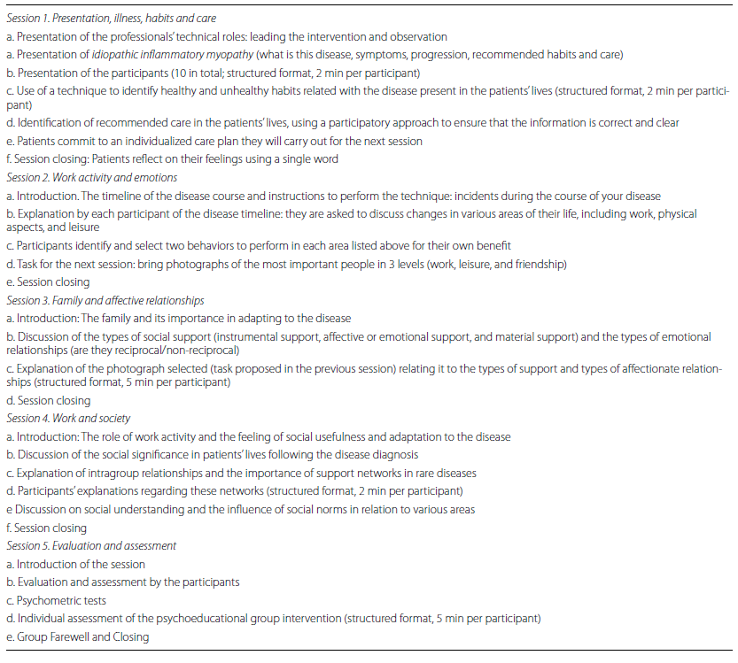
Methods. The intervention: key content areas
8

Slide 9
Methods: Instruments
• Administered: Questionnaires filled out twice: before intervention (pre-test) and on the last day of intervention (post-test) by both groups.
• Tools Used:
◦ World Health Organization Quality of Life Measure (WHOQOL-BREF): Evaluates overall quality of life across four domains: physical health, psychological health, social relationships, and environment. Higher scores indicate better quality of life.
◦ World Health Organization Well-Being Index (WHO-5): Assesses positive well-being. Higher scores indicate a greater sense of well-being.
◦ Self-Efficacy to Manage Chronic Disease Scale (SEMCD-S): Measures self-management following intervention. Higher scores indicate higher levels of self-efficacy.
◦ International Physical Activity Questionnaire—Short Form (IPAQ): Assesses types and intensity levels of physical activity and sitting time.
9

Slide 10
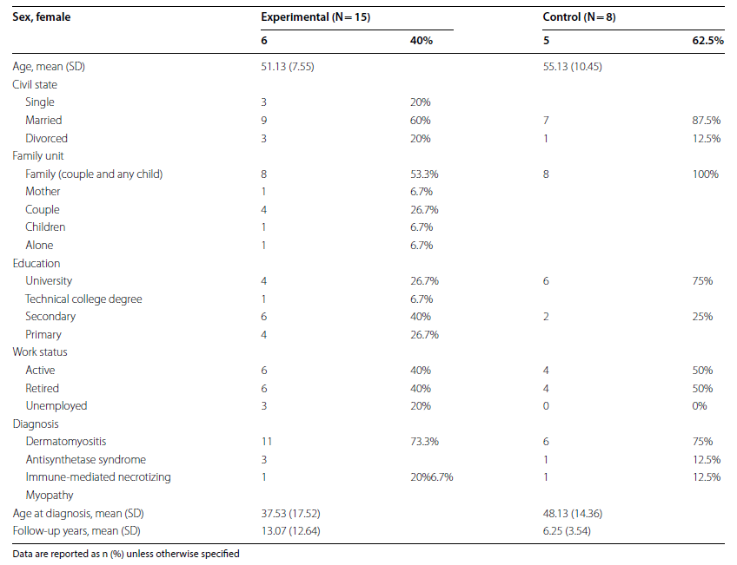
Results: characteristics of the sample
10

Slide 11
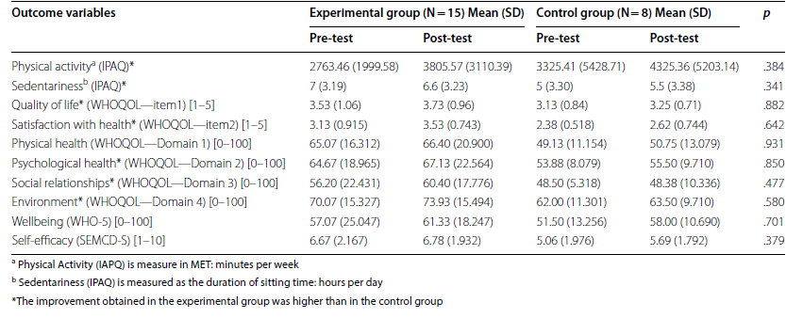
Results: outcome variables
11

Slide 12
Results: key findings – general outcome
• Experimental Group Improvements: In the experimental group, post-test scores were higher than pre-test scores across all variables, including quality of life, well-being, and self-efficacy to manage the disease.
• Comparison to Control: Improvements were more evident in the experimental group than controls in 70% of the variables studied. The post-test score was better in the experimental group than the control group in 80% of the variables.
• Overall HRQoL and Well-being: A modest enhancement was observed in both groups, but the experimental group showed a greater, though statistically non-significant, improvement.
12

Slide 13
Results: key findings – specific variables
• Sedentariness:
◦ Improvement in Experimental Group (decreased sitting time).
◦ Slight worsening in the control group.
◦ Small/medium effect size, but not statistically significant between groups.
• Satisfaction with Social Relationships:
◦ Increase in Experimental Group.
◦ Slight decrease in the control group.
◦ Small/medium effect size, but not statistically significant between groups.
◦ "Notably, the intervention had a substantial positive impact on social relationships, with the experimental group exhibiting increased satisfaction in this area.".
• Self-Efficacy to Manage the Disease:
◦ Improvement in Experimental Group.
◦ Small/medium effect size, but not statistically significant between groups.
13

Slide 14
Discussion: why is this important?
• First Myositis-Specific Intervention: This study is the first to evaluate a psychoeducational intervention specifically targeting patients with myositis.
• Supports Educational Interventions: Findings align with previous research showing enhanced quality of life through educational interventions.
• Positive Lifestyle Changes: Educational interventions are recognized as effective resources for achieving lifestyle changes.
• Impact on Physical Activity & Sedentariness: Improvements in these variables are crucial as physical activity contributes to better prognosis in myositis patients.
• Targeted Approach: The success stems from addressing specific domains (emotional, occupational, personal care, family, affection) identified in previous qualitative studies.
• Social Impact: Highlighted by the establishment of an ongoing association for individuals with myositis, whose core members participated in the program.
14

Slide 15
Discussion: strengths and innovations
• Novelty: First psychoeducational intervention specifically for myositis patients.
• Targeted Content: Addressed specific domains identified as critical for HRQoL in myositis, enhancing patients' life experiences.
• Comprehensive Description: Provides extensive details on patients, setting, sampling techniques, and intervention components.
• Positive Behavioral Changes: Showed positive impact on personal and social skills, social relationships, and sedentary behavior.
• Contribution to Management: Highlights the potential of targeted psychoeducation as a valuable component in managing chronic conditions like myositis.
15

Slide 16
Discussion: study limitations
• Small Sample Size: Due to the low incidence of myositis and strict inclusion criteria, statistical power was reduced.
• Homogeneous Sample: Decision to include only patients with definite myositis for homogeneity, though probable myositis patients would likely also benefit.
• Stable Patients: Majority of the sample consisted of stable patients, limiting conclusions about disease activity impact.
• Short-Term Nature: Short intervention and follow-up period; long-term effects need future investigation.
• Lack of Qualitative Assessments: Qualitative assessments with mixed methods could provide deeper insight into mechanisms of change.
16

Slide 17
Conclusions
• Evidence of Effectiveness: The study provides evidence supporting the effectiveness of a psychoeducational intervention to enhance HRQoL, well-being, and self-efficacy in myositis patients.
• Holistic Impact: The intervention positively impacted patients' personal and social skills, social relationships, and sedentary behavior.
• Future Role: These findings underscore the potential of targeted psychoeducation as a valuable component in the management of chronic conditions such as myositis.
17

Slide 18
Future directions
• Confirmation & Expansion: Further research is needed to confirm and expand upon these findings.
• Broader Patient Cohorts: Explore effectiveness in patients with probable myositis.
• Long-Term Effects: Conduct studies with longer follow-up periods to assess sustained benefits.
• Mixed Methods: Incorporate qualitative assessments to gain deeper insights into subjective experiences and mechanisms of change.
• Comprehensive Interventions: Continue developing patient-centered interventions for individuals living with myositis.
18

Slide 19
More detail available at:
Armadans-Tremolosa, I., Palacín-Lois, M., Castrechini-Trotta, A., Sanduvete-Chaves, S., Chacón-Moscoso, S., & Selva-O'Callaghan, A. (2024). Effectiveness of a psychoeducational intervention on myositis patients' quality of life and well-Being: A randomized controlled trial. Orphanet Journal of Rare Diseases, 19, Article 411. https://doi.org/10.1186/s13023-024-03426-0
Thank you for your attention
This study was funded by the Instituto de Salud Carlos III (grants PI22-00708), co- financed by the research project PID2020-115486GB-I00 funded by the Ministerio de Ciencia, Innovación y Universidades, MICIU/AEI/10.13039/501100011033, Government of Spain; and the Chilean government project FONDECYT Regular 1250316 funded by the National Fund for Scientific and Technological Development, ANID.
19

