Slide 1
A Multi-Method Approach to Investigating Between-Group Differences in Latent Variables
Marcos Romero-Suárez
Marta Evelia Aparicio-García
Jesús María Alvarado-Izquierdo
Notes:
Hello, my name is Marcos Romero-Suárez.
It’s a pleasure to be here today.
In this presentation, we’ll focus on A Multi-Method Approach to Investigating Between-Group Differences in Latent Variables.

Slide 2
HOW DID I END UP HERE?
Notes:
But you're probably wondering how I ended up here — giving an online presentation at a presential congress. Okay, let me explain, step by step.
First of all, I am actually here at the congress, in person. But right now, as you're watching this, I'm in another room — specifically, Room 11 — presenting one of the talks in the symposium 'Advancing Dynamic Methods for Modeling Change Over Time.'
Unfortunately, due to a scheduling conflict, I had to record this presentation in advance.
I’m telling you all this because if you have any questions, you can find me in Room 11. And if you happen to watch this video and later run into the in-person version of me somewhere at the congress — please tell me! It would be funny and, honestly, it would make my day.

Slide 3

WHAT IS THE PURPOSE OF THIS PRESENTATION?
Notes:
First of all, the method I’m going to present is designed to study differences between groups — but with a particular twist: these differences are not assessed on observed variables, but on latent variables.
In psychology, latent variables typically refer to constructs that are estimated from test items, such as cognitive ability, motivation, or anxiety.
So, in this presentation, I’ll walk you through the key steps required to study group differences at the construct level — that is, using latent variables rather than raw scores.

Slide 4



WHAT IS THIS METHOD—AND WHAT IS IT NOT?
What it is:
Multi-method approach combining several techniques
Aims for more robust, reliable conclusions
Conceptual order, but flexible sequence
Balances data-driven diagnostics with theory
Can incorporate additional techniques if needed
What it is not:
Not infallible
Not purely data-driven
Not theory-only
Not a rigid or fixed sequence
Notes:
This is a multi-method approach that combines several mathematical techniques to reach more robust conclusions.
The key idea is that by using multiple tools, we can compensate for the weaknesses of any one technique.
While there is a general conceptual order to follow, this isn’t a rigid sequence: you may not need to apply all techniques every time, and you can also add complementary methods if relevant.
Compared to relying on just one analysis, this approach tends to be more reliable and complete, and in general, it’s quite robust.
That said, it’s important to be clear about what this method is not.
It’s not infallible — no method is.
It’s also not purely data-driven: although data-driven diagnostics are key, theoretical reasoning should guide our decisions when possible.
And it’s not purely theory-based either — empirical evidence matters.
Ultimately, it’s not a rigid recipe, but a flexible, integrated framework for making more informed decisions.

Slide 5

STEP BY STEP
Dimensionality Assessment
Bootstrap Exploratory Methods to Enhance Dimensional Stability
Confirmatory Factor Analysis and Model Fit
Testing Measurement Invariance
Differences between groups
Notes:
So, let me walk you through the steps of this multimethod approach.
This approach is built around three core questions:
First, am I measuring well?
Second, can I compare groups?
And finally, what are the actual differences between those groups?
We begin with a basic but fundamental step: assessing the dimensionality of the test or scale. How many factors are we really capturing? What’s the underlying structure?
Then, to check if this structure is robust and not just a fluke from a specific sample, we use bootstrap-based exploratory methods. These help us evaluate the stability of the dimensionality across resamples.
Once we identify a plausible and stable structure, we move on to confirmatory factor analysis, where we test how well that model actually fits the data.
If the model fits well, we proceed to test measurement invariance — this tells us whether the structure holds across different groups. It’s a key step before making any comparisons.
And finally, if invariance holds, we can compare groups meaningfully and interpret any observed differences, knowing we’re measuring the same thing in the same way.

Slide 6
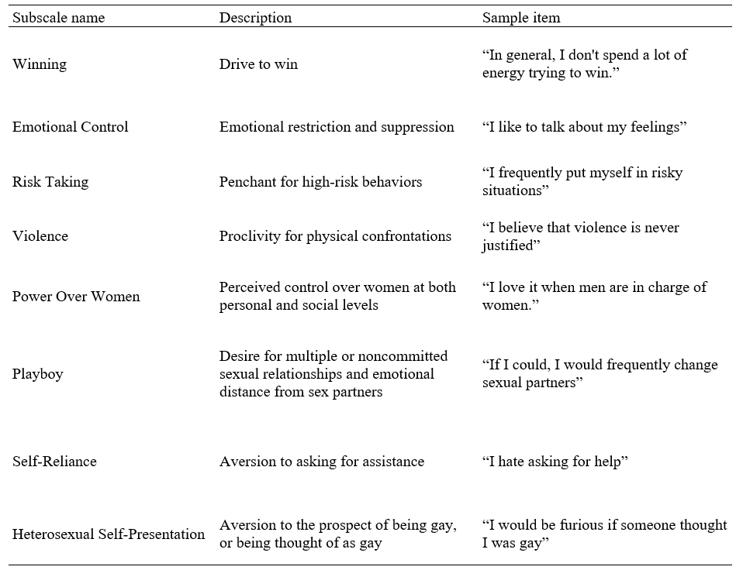

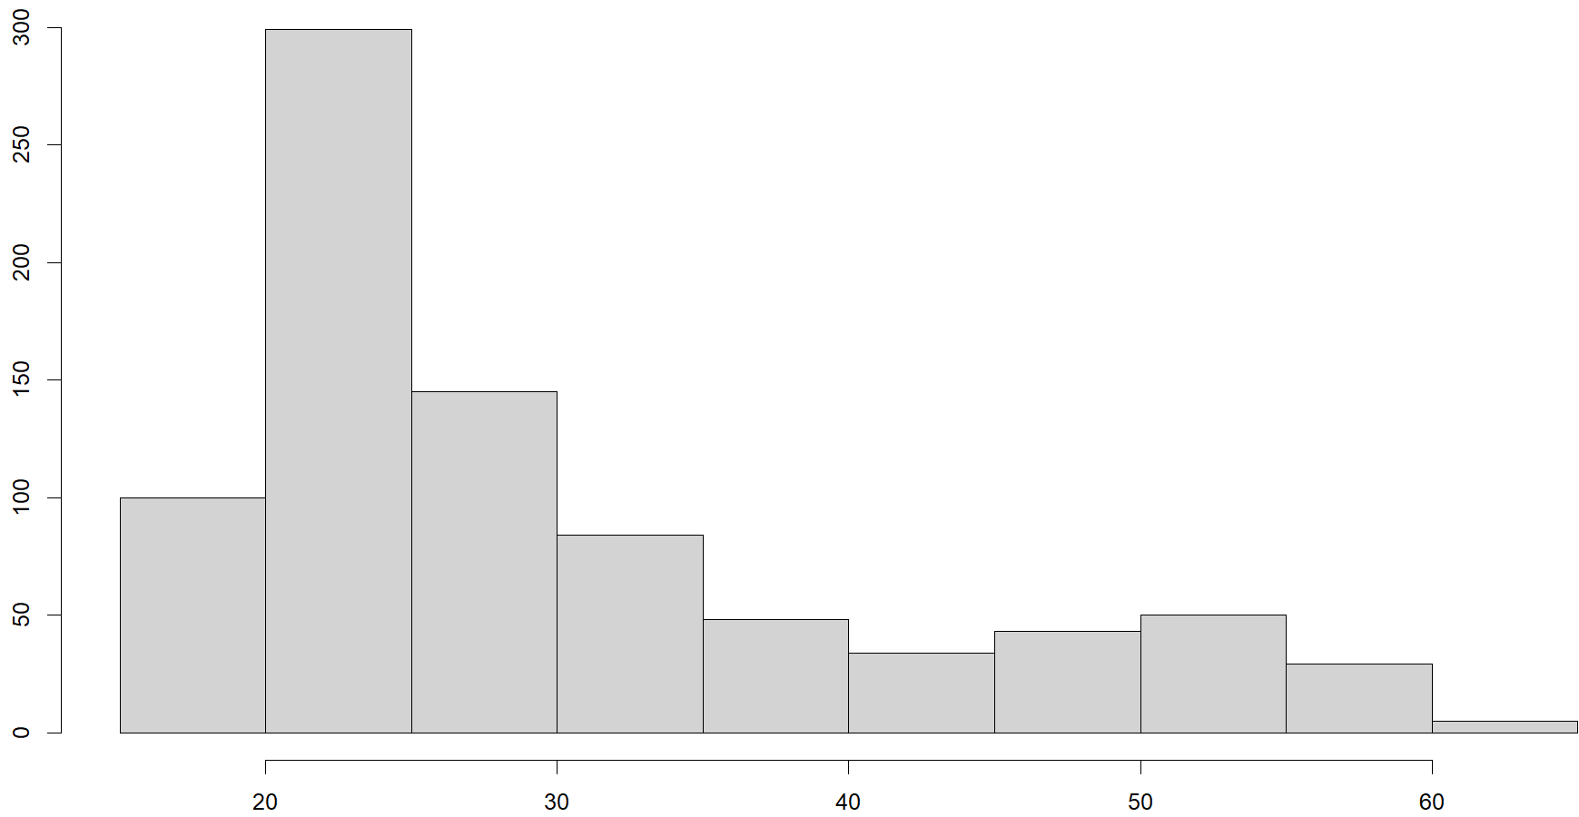

Conformity to Masculine Norms Inventory (CMNI-29)
837 men
18 - 64 years
Positively skewed
Two Groups:
398 older adults
26
439 younger adults
2
Notes:
Let’s take a look at the data I used to illustrate this method.
The sample included 837 men, aged between 18 and 64 years. Because the age distribution was highly positively skewed — with most participants being quite young — and based on the concept of emerging adulthood, I divided the sample into two age groups using the median age of 26 as the cutoff.
This gave me 439 participants in Group 1 (26 or younger), and 398 in Group 2 (over 26).
In the table on the right, we can see the test used to measure masculinity, the CMNI-29, which is made up of 8 subscales. For example, the description of self-reliance would be aversion to asking for assistance, and an example item would be I hate asking for help.

Slide 7
Dimensionality Assessment

Slide 8
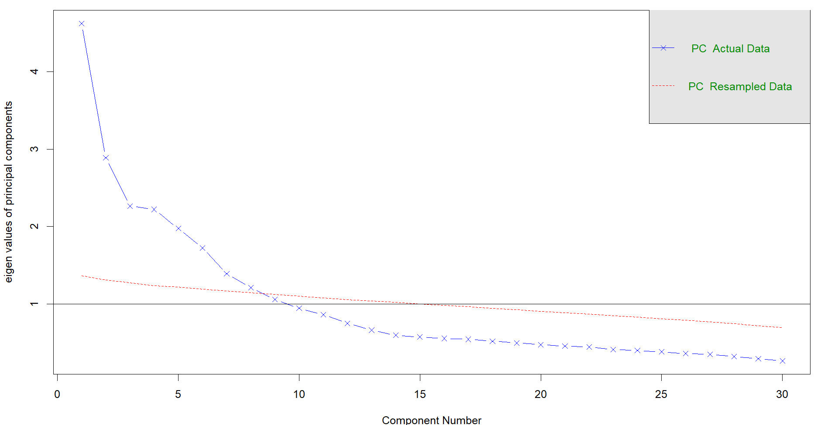
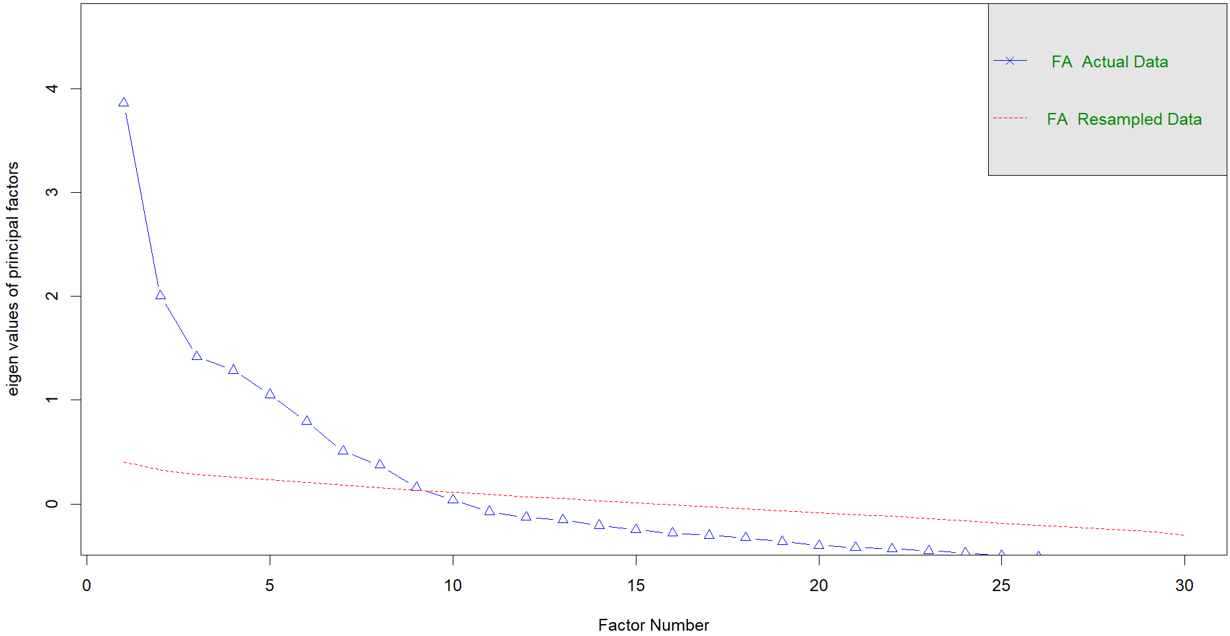
Parallel Analysis
Principal Component Analysis (PA-PCA)
Principal Axis Factor analysis (PA-PAF)
8
9
Crawford et al. (2010) ➜ to learn more about the differences and when to use each PA
Notes:
To start the dimensionality analysis, we’ll use two types of parallel analysis.
The first is PA based on principal components analysis, which is generally recommended when the factors are expected to be weakly correlated.
The second is PA based on principal axis factoring, which tends to work better when the factors are moderately or highly correlated.
On the right, you can see the results from the PA-PCA method — it suggests a solution with 8 factors.
In this case, that might be the more appropriate method, since low correlations between factors are expected theoretically for this test.
And on the left, we have the results from PA-PAF, which suggests 9 factors instead.

Slide 9
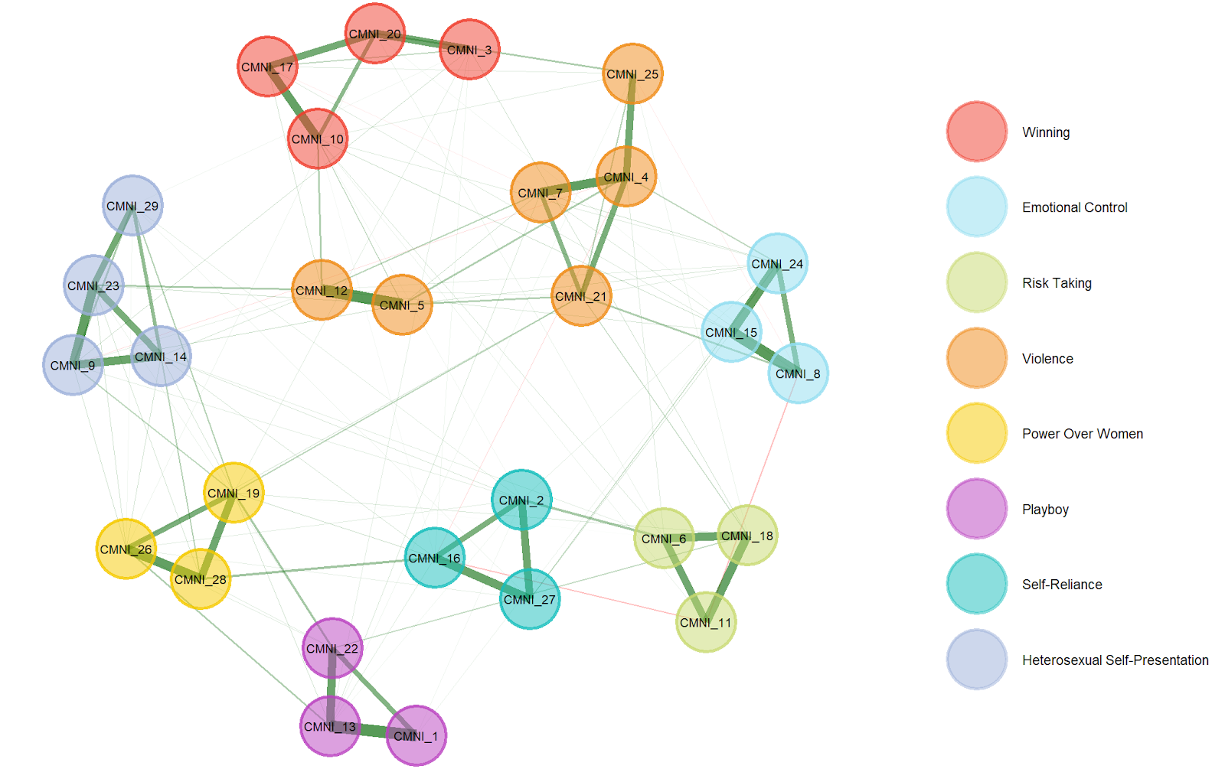
Exploratory Graph Analysis (EGA)
Winning
Emotional Control
Risk Taking
Violence
Power Over Women
Playboy
Self-Reliance
Heterosexual Self-Presentation
8
(Golino & Epskamp 2017) ➜ first EGA article
Notes:
Now let’s take a look at what Exploratory Graph Analysis, or EGA, tells us. Broadly speaking, EGA is a psychometric network technique based on partial correlations. It applies some adjustments to remove spurious connections and then uses clustering to identify groups of items. The result is an exploratory model that not only estimates the number of dimensions but also indicates which items belong to which factors.
In this case, EGA suggests an 8-factor solution and largely recovers the underlying theoretical structure—except for items 5 and 12. These two are placed under the Violence factor, even though, theoretically, they belong to Heterosexual Self-Presentation.
However, given their spatial proximity in the network, this misclassification likely reflects cross-loadings—meaning these items have meaningful associations with both factors. We’ll revisit this issue later.
But for now, the main takeaway is that the 8-factor solution matches the theoretical model quite well, which gives us confidence in the dimensionality.

Slide 10
2. Bootstrap Exploratory Methods to Enhance Dimensional Stability

Slide 11
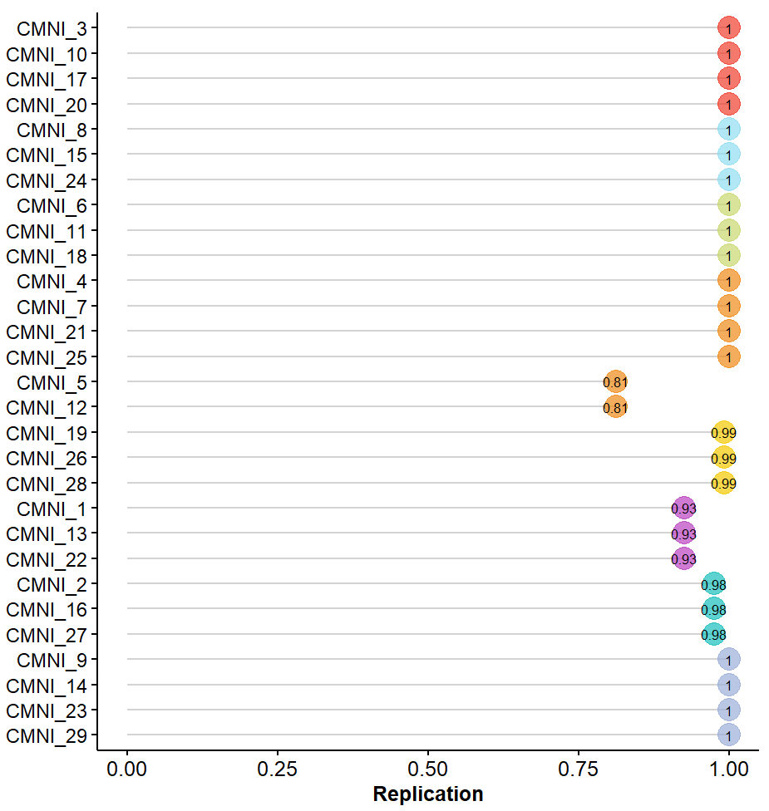
Bootstrap Exploratory Graph Analysis (bootEGA)
Bootstrap Exploratory Factor Analysis (bootEFA)
 | Low | Het. SP | Upper | Low | Violence | Upper
Item 5 | .37 | .44 | .50 | .37 | .43 | .50
Item 12 | .41 | .47 | .54 | .28 | .34 | .41
CMNI_5
CMNI_12
“It is not a bad thing for others to think you are gay.”
“I wouldn't mind at all if someone thought I was gay.”
(Christensen & Golino, 2019) ➜ For more bootEGA
(Zhang et al., 2010) ➜ For more bootEFA
Notes:
When we apply Bootstrap Exploratory Graph Analysis, we find that the main replicability issues are indeed linked to items 5 and 12. This suggests that the factor assignment from the original EGA is not entirely stable.
In contrast, Bootstrap Exploratory Factor Analysis reveals cross-loadings involving the Violence factor; however, the highest loadings still correspond to the items’ theoretical factor.
Considering these results, along with the content of the two items, it seems reasonable to attribute the cross-loadings to sampling variability. Therefore, we believe it is appropriate to retain the original theoretical structure for now—though this should definitely be considered in future applications or revisions of the instrument.

Slide 12
3. Confirmatory Factor Analysis and Model Fit

Slide 13
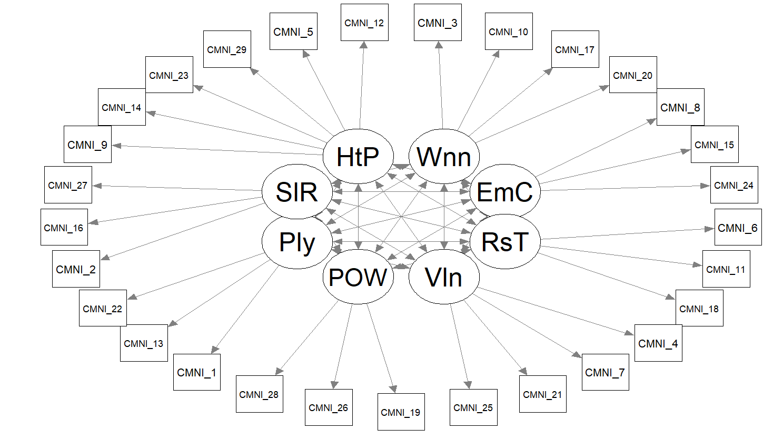








Winning
Emotional Control
Risk Taking
Violence
Power Over Women
Playboy
Self-Reliance
Heterosexual Self-Presentation
HSP
W
SR
EC
P
RT
POW
V
Notes:
This is the model we decided to analyze using Confirmatory Factor Analysis, which also aligns with the theoretical structure.

Slide 14
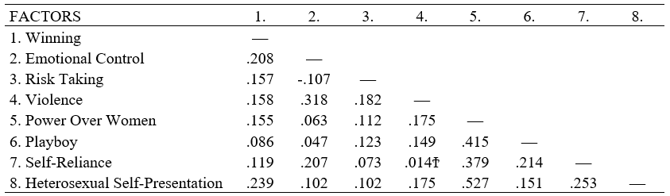
Correlation coefficients between factors.
Notes:
Here, we can see the correlations between factors, which are indeed low. This helps explain why PA-PCA outperformed PA-PAF in the earlier steps.

Slide 15
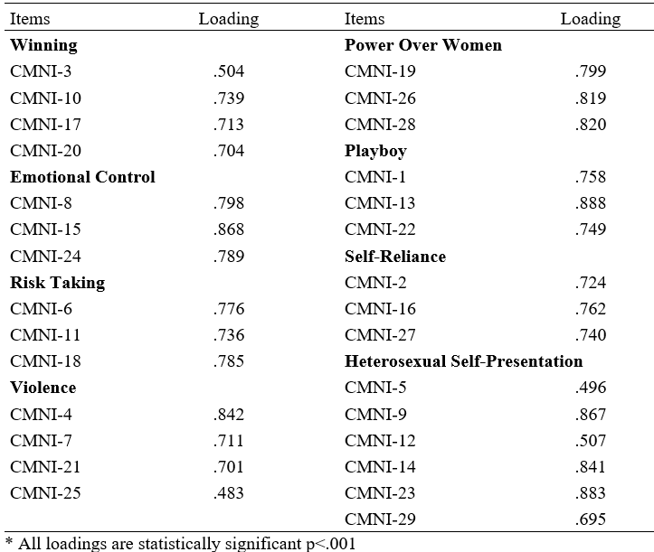
Standardized factor loading for CFA model to the CMNI-29
Fit Indices
RMSEA = .069
SRMR = 0.065
CFI = .959
TLI = .953
Notes:
We also see the item loadings and overall fit indices for the model. Most indices suggest a good fit. The only concern is the RMSEA, which shows slightly problematic values—likely due to the cross-loadings we identified earlier.
Overall, though, the model performs well, and we can conclude that the test provides a solid measurement of the intended constructs.

Slide 16
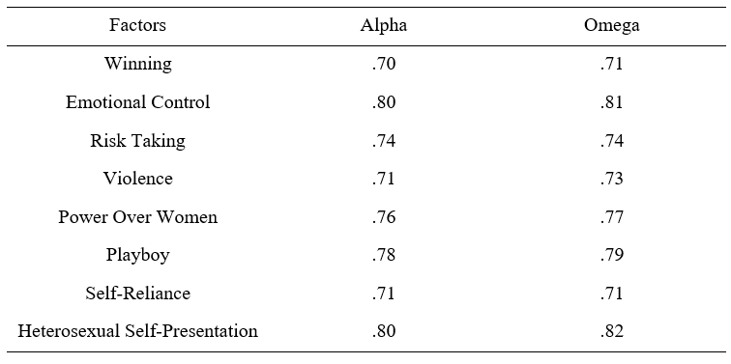
Reliability indices for factors
Notes:
For transparency, here we report the reliability indices for each subscale, calculated using both Cronbach’s alpha and McDonald’s omega. The results indicate acceptable levels of reliability across all subscales.

Slide 17
4. Testing Measurement Invariance

Slide 18
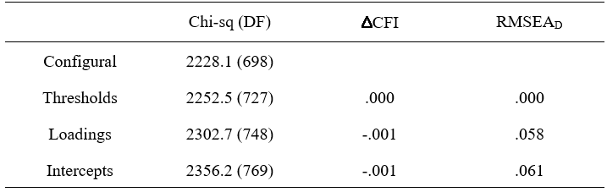
Levels of Measurement Invariance for categorical items
Svetina et al. (2020) ➜ For more Measurement Invariance for categorical items
Chen (2007) ➜ For more ∆CFI
Savalei et al. (2023) ➜ For RMSEA_{D}
Notes:
To ensure valid comparisons between groups, we tested measurement invariance—verifying that the construct emerges in the same way across both age groups. This includes invariance in the factorial structure, item loadings, and potential baseline biases.
Since the items are categorical, we also tested threshold invariance. This step assumes that responses reflect thresholds on an underlying continuous (normally distributed) latent trait, and that these thresholds manifest similarly across groups.
We assessed invariance using common criteria such as changes in CFI, and also RMSEA_D, a less commonly used index that considers a change above 0.06 as evidence of non-invariance.
We found evidence of invariance at all levels. For intercepts, results were right at the threshold: the change in CFI supported invariance, while RMSEA_D was right at the 0.06 cutoff. Given that these cutoffs are guidelines rather than strict rules—and CFI supported invariance—we concluded that measurement invariance holds between the two age groups.

Slide 19
5. Differences between groups

Slide 20







How can I study the age differences in both groups?
$$Winning=β·Age+ ε$$
$Emotional Control=β·Age$ $+ ε$
Risk Taking $=β·Age+ ε$
V$iolence=β·Age+ ε$
P$ower Over Women=β·Age+ ε$
P$layboy=β·Age+ ε$
Self-Reliance $=β·Age+ ε$
$Heterosexual Self Presentation=β·Age$ $+ ε$
Notes:
Once we confirmed that the test is psychometrically sound and that group comparisons are meaningful, we proceeded to quantify the differences between groups.
To do this, we ran one regression per factor, using age group as the independent variable and each latent factor as the dependent variable. The key idea here is to predict latent scores—something that can be done either through SEM or by extracting factor scores from the measurement model.
Since factor scores are standardized, the intercepts in these regressions are zero, and the beta coefficients directly represent group differences. These coefficients indicate not only the direction of the difference but also its magnitude in standard deviation units.

Slide 21
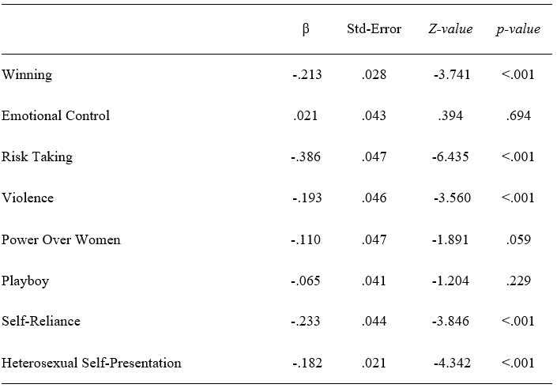







Regression coefficient of Age on the factors
$$Winning=−.213·Age$$
$$Emotional Control=β·Age$$
Risk Taking $=−.386·Age$
V$iolence=−.193·Age$
P$ower Over Women=β·Age$
P$layboy=β·Age$
Self-Reliance $=−.233·Age$
$$Heterosexual Self\text{−} Presentation=−.182·Age$$
Notes:
Here we can see the results, showing differences in masculinity across the dimensions of Winning, Risk Taking, Violence, Self-Reliance, and Heterosexual Self-Presentation.
All of these factors show a decrease in average masculinity when comparing younger adults to older adults.
Thanks to this procedure, we ensure that our measurements are valid, the group comparisons are appropriate, and that any differences are assessed more rigorously—directly at the level of the latent variable.

Slide 22


marcos.romero@uam.es
marcosromerosuarez30@gmail.com
Notes:
And that’s all, thank you very much. Feel free to add me on LinkedIn or contact me by email if you want to get in touch. Stay tuned, because soon an article will be published where I will explain all of this in greater depth and detail.

