Slide 1
The Effectiveness of Training for Mental Health Professionals: A Multilevel Meta-Analysis
José Mena-Raposo , Susana Sanduvete-Chaves, José A. Lozano-Lozano and Salvador Chacón-Moscoso

Slide 2
Training for Mental Health Professionals
Mental health is a growing global priority, and well-trained professionals are crucial for improving care quality.
Training programs for mental health professionals aim to enhance clinical skills, therapeutic abilities, and case management through various formats such as workshops, online courses, or supervision.
Although recent reviews and meta-analyses have been conducted, none have exclusively focused on randomized controlled trials (RCTs) and accounted for different outcome levels (e.g., knowledge, attitudes, behaviors).
This meta-analysis aims to fill that gap by rigorously evaluating the effectiveness of training programs based solely on RCTs, analizing multiple outcome levels, and identifying key program characteristics that contribute to better results.
The conclusions of this study would help guide the design and implementation of more effective training strategies for mental health training programs.

Slide 3
Kirkpatrick & Kirkpatrick Model: Key Outcomes
We based our evaluation on the well-known model by Kirkpatrick & Kirkpatrick (2006), which emphasizes the importance of assessing different types of changes produced by training programs.
Two of these levels (Level 1: Reaction and Level 4: Transfer) were not included in our study because reaction is typically measured without a pre-training baseline, and transfer results are usually assessed at the service or organizational level rather than at the participant level.
Therefore, our meta-analysis focuses on three intermediate levels measurable at the individual level:
  Level 2 – learning-knowledge: acquisition of information, concepts, and understanding (e.g., diagnostic criteria, treatment protocols).
  Level 2 – learning-attitudes: shifts in beliefs, perceptions, or motivation (e.g., increased empathy, reduced stigma).
  Level 3 - behavior: application of skills and changes in professional practice (e.g., level of use of new techniques).

Slide 4
Overview of Study Scope and Framework
Conducted following PRISMA 2020 guidelines (Page et al., 2021).
Protocol registered on PROSPERO (CRD42024396347).
Guided by the UTOSTi framework (Chacón-Moscoso et al., 2014):
  The Units of analysis were mental health professionals.
  The Treatments consisted of structured training programs aimed at enhancing professional development.
  The Outcomes targeted three types: change in professional knowledge, attitudes, and behavioral modifications related to clinical practice (Kirkpatrick & Kirkpatrick, 2006).
  There was no exclusions regarding Settings (e.g., hospitals, community centers and educational institutions).
  nor Time restrictions (duration of the interventions varied considerably, ranging from single-session workshops to programs extending over several weeks).

Slide 5
Search Strategy, Criteria and Data Extraction
Comprehensive search on 6 Feb 2024 across multiple databases (Web of Science, Scopus, MEDLINE, etc.).
Only randomized controlled trials (RCTs) with pre- and post-intervention data for intervention and control groups included (follow up also possible).
Accepted both partially active controls (e.g., training as usual) and inactive controls (e.g., waitlist). Excluded studies comparing two active interventions without control group.
Interventions delivered in person or via online/multimedia platforms
Languages: English, Spanish, or German.

Slide 6
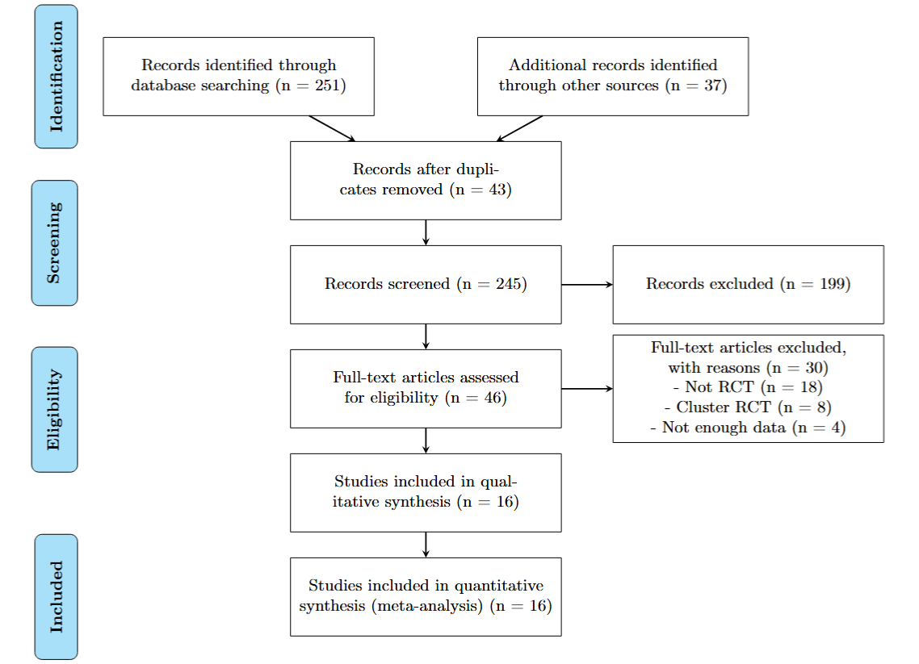
PRISMA 2020 Flow Diagram

Slide 7
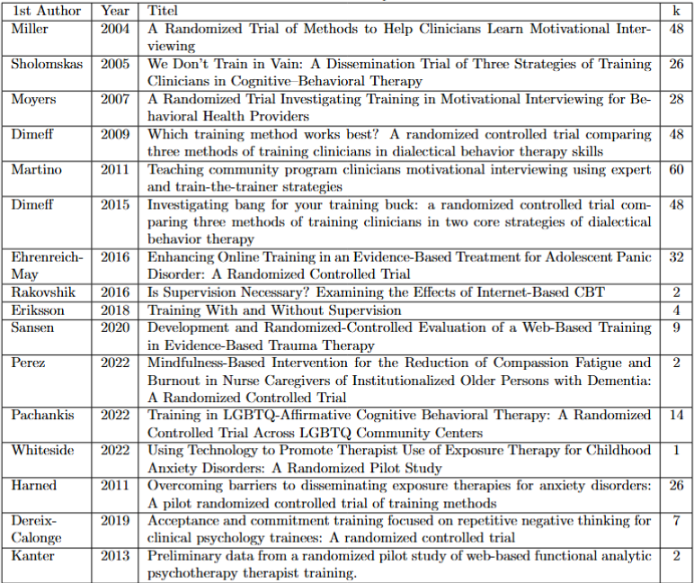
Selected Studies

Slide 8
Effect Size Estimation and Meta-analysis
Effect Sizes Calculated: Standardized effect sizes computed using Difference in Standardized Mean Change (dppc2) following Morris (2008), with baseline SD standardization.
Assumption of Pre-Post Correlation: Fixed correlation coefficient 𝑟=0.7 as per Rosenthal (1991), with sensitivity analyses to test robustness.
Three-Level Random-Effects Model: Applied REML estimation considering within-study variance (Level 1), within-study heterogeneity (Level 2), and between-study variance (Level 3).
Moderator Analysis: Univariate models assessed individual moderators, followed by multivariate models using AIC, BIC, and likelihood ratio tests.
Publication Bias: checked with Yang et al. (2024) two-step procedure based on proposed multilevel version of Egger's regression (Nakagawa et al., 2022)
Software and Tools: Analyses performed in R 4.3.1 using metafor for modeling and orchard for visualization and bias analysis.

Slide 9
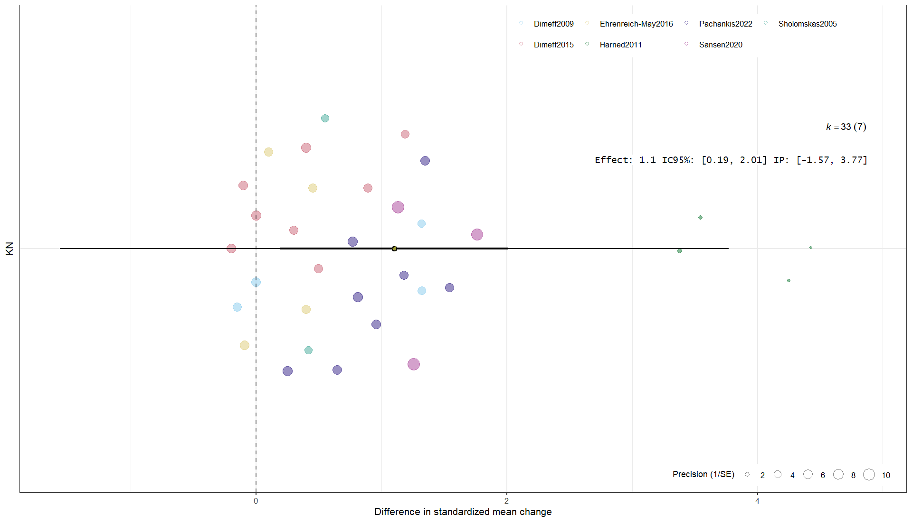
Results for Knowledge change
Orchar Plot (Nakagawa et al., 2023)

Slide 10
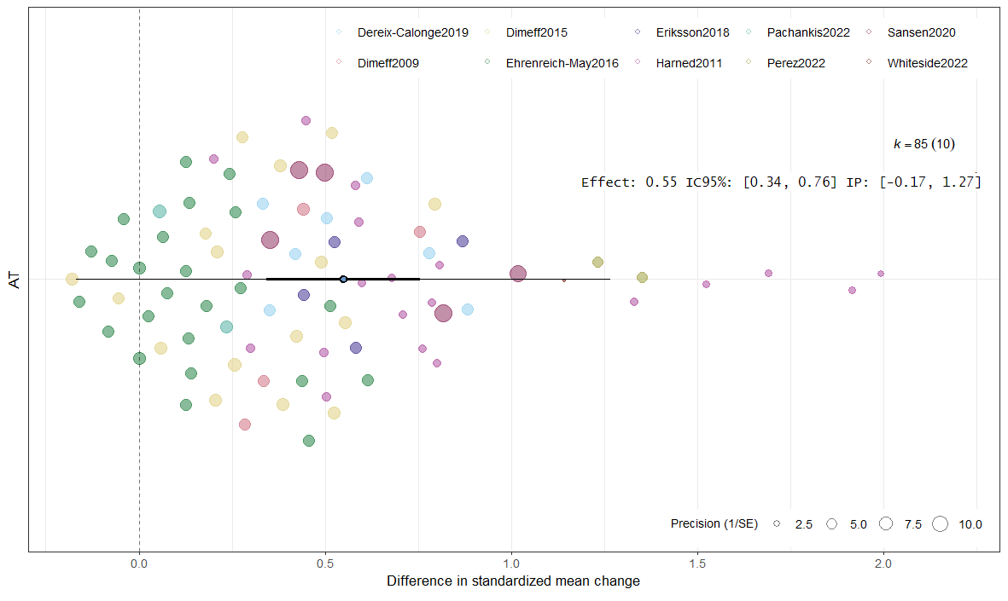
Results for Attitudes modification
Orchar Plot (Nakagawa et al., 2023)

Slide 11
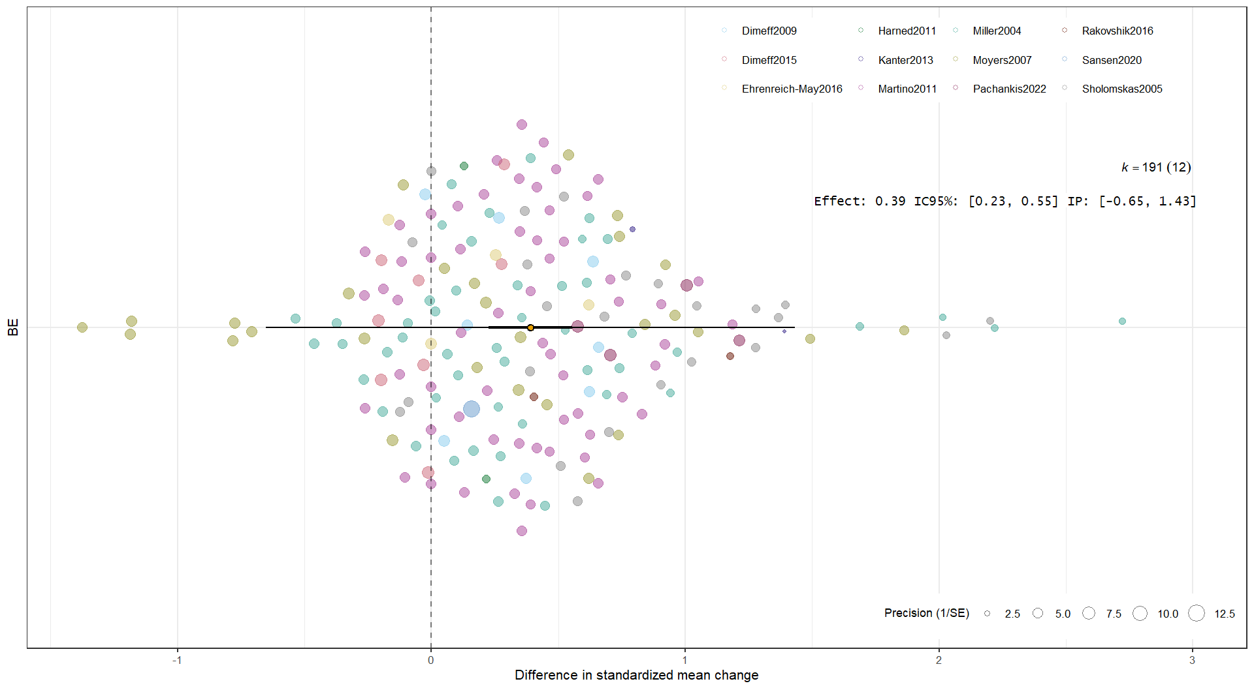
Results for Behaviour modification
Orchar Plot (Nakagawa et al., 2023)

Slide 12
Although the inclusion of [Post/Follow] explained 12% of the variance (R² marginal), the likelihood ratio test was not significant (p = .224), suggesting that while the moderator accounts for a modest proportion of heterogeneity, it does not lead to a statistically significant improvement in overall model fit.
Although inclusion of [Control Group] significantly improved model likelihood (LRT p <.001.), the overall explained variance decreased (conditional R² lower), suggesting that while the moderator accounts for some systematic differences in effect sizes, it does not reduce residual heterogeneity and may increase unexplained variability..
Examples of Moderator analysis (Categorical)
Moderator | Estimate | ci.lb | ci.ub | AIC | BIC | AICc | LRT | p | I2 | Within studies I2 | Between studies I2 | R2 marginal | R2 conditional
Attitude | 0.549 | 0.342 | 0.756 | 54.7 | 62.1 | 55.0 |  |  | 80.94 % | 21.2 % | 59.7 % | - | 73.80 %
Post/Follow |  |  |  | 55.3 | 65.0 | 55.8 | 1.48 | .224 | 81.99 % | 19.2% | 62.8% | 12,15% | 76.91%
Post | 0.612 | 0.376 | 0.848
Follow | 0.529 | 0.310 | 0.749
Knowledge | 1.101 | 0.189 | 2.013 | 73.9 | 78.5 | 74.8 |  |  | 98.39 % | 11.28 % | 87.11 % | - | 88.54 %
Control group |  |  |  | 52.6 | 60.1 | 54.8 | 25.4 | <.001 | 87.48 % | 87.48 % | 0% | 86,75% | 86,75%
No Therapy | 1.062 | 0.793 | 1.332
Self Study | 0.394 | 0.178 | 0.611
TAU | 3.850 | 3.153 | 4.548
AIC:Akaike Information Criterion; BIC: Bayesian Information Criterion; LRT: Likelihood Ratio Test

Slide 13
Final Reflections
✅ Although 309 effect sizes were analysed, they derive from only 16 independent studies, which limits generalizability and increases the influence of between-study.
📊 Disaggregating the data into KN (knowledge), AT (attitudes), and BE (behaviours) allowed us to detect clearer patterns across outcome domains. However, this also reduced the number of studies per category, increasing the risk of unstable estimates and reduced power.
🟢 The multilevel meta-analytic approach proved crucial to appropriately partition within- and between-study variance, providing more reliable estimates than single-level models and accounting for dependence among multiple effect sizes from the same study.
🔎 Some moderators (program duration, presence of a control group, or timing of measurement) show potential in explaining heterogeneity, but further analysis of LRT significance and explained variance (R²) is needed to rule out risks of overfitting, small-sample bias, and multicollinearity.

Slide 14
Thank you for your attention
This work was supported by the research project PID2020-115486GB-I00 funded by the Ministerio de Ciencia, Innovación y Universidades, MICIU/AEI/10.13039/501100011033, Government of Spain; and the Chilean government project FONDECYT Regular 1250316 funded by the National Fund for Scientific and Technological Development, ANID.

