Slide 1

SYMPOSIUM: Intervention programs evaluation: effect size, moderator variables and methodological quality
Convergent-Discriminant Validity Evidence of the Methodological Quality Scale for Observational Methodology: A Multitrait-Multimethod Analysis
Daniel López-Arenas, Susana Sanduvete-Chaves, Salvador Chacón-Moscoso & José Mena-Raposo

Slide 2
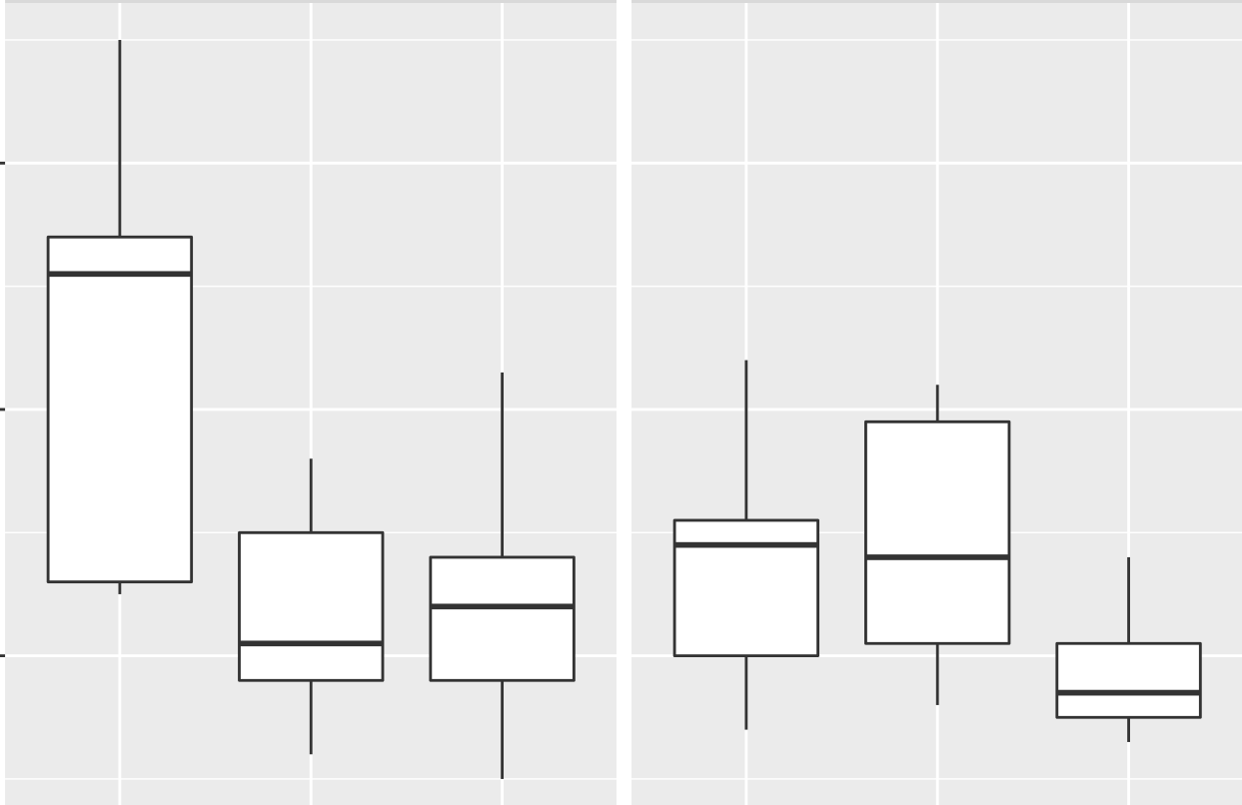
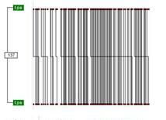
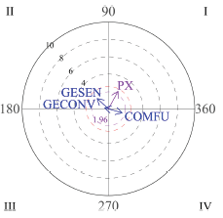
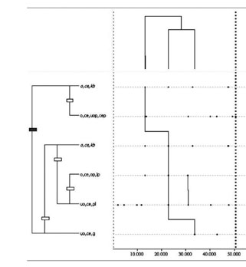

Observational Methodology
2
Observational methodology as a Mixed Methods approach
Natural Context
Ad hoc observational Instrument
Data Quality Control
Observational Design
Register
Data Analysis
Interpretation of results
QUALITATIVE STEP
QUANTITATIVE STEP
QUALITATIVE STEP

Slide 3
Observational Methodology
“Observational Methods”
(MT Anguera, 1993)
3

Slide 4
Observational Methodology
A long-time need
2015
2018
2019
2025
Methodological Quality Checklist for studies based on Observational Methodology
(MQCOM)
(Chacón-Moscoso et al., 2019)
Guidelines for Reporting Experiments based on Observational Methodology
(GREOM)
(Portell et al., 2015)
Preliminary checklist for reporting observational studies
(Chacón-Moscoso et al., 2018)
Methodological Quality Scale for Observational Methodology
(MQSOM)
(Sanduvete-Chaves et al., 2025)
MQSOM is the first scale with evidence of reliability and validity to evaluate the methodological quality of studies based on observational methodology
4

Slide 5
Mixed Methods
5
Observational Methodology
2015
2018
2019
2025
Methodological Quality Checklist for studies based on Observational Methodology
(MQCOM)
(Chacón-Moscoso et al., 2019)
Guidelines for Reporting Experiments based on Observational Methodology (GREOM)
(Portell et al., 2015)
Preliminary checklist for reporting observational studies
(Chacón-Moscoso et al., 2018)
Methodological Quality Scale for Observational Methodology
(MQSOM)
(Sanduvete-Chaves et al., 2025)
2018
2020
2025
Mixed Methods Appraisal Tool (MMAT)
(Hong et al., 2018)
Methodological Rigor in Mixed Methods (MRMM)
(Harrison et al., 2020)

Slide 6
Objectives
Obtain evidence of convergent and discriminant validity of MQSOM with contrast instruments
MQSOM
MRMM
GREOM
MMAT
6

Slide 7
Method
Participants
Instruments
Inter-Intracoder Reliability
Multitrait-Multimethod Analysis
96 studies → 14.77% of the sample from the original study (Sanduvete-Chaves et al., 2025)
  - OM employed
  -Original works
  -Following the standard publication format
Methodological Rigor in Mixed Methods (MRMM; Harrison et al., 2020)
Guidelines for Reporting Experiments based on Observational Methodology
(GREOM; Portell et al., 2015)
Mixed Methods Appraisal Tool (MMAT; Hong et al., 2018)
Methodological Quality Scale for Observational Methodology
(MQSOM; Sanduvete-Chaves et al., 2025)
25% of the sample
  Intraclass Correlation Coefficient
Spearman’s Rho
7

Slide 8
Instruments: MQSOM
Observational Methodology employment
ω = .87
D = .55
Observational Unit
Quality of Design
Temporality
Factor 1
Dimensionality
Codificacion Manual
Methodological Quality Overall
General Factor
Data Type
Observational Instrument
Recording, Quality Control & Analysis Softwares
Factor 2
Quality of Measurement & Analysis
Type of Parameter
Data Quality Control
Data Analysis
8

Slide 9
Instruments for comparison
MRMM
GREOM
MMAT
6 items
ω = .72
D = .62
14 items
ω = .65
D = .45
15 items
ω = .79
D = .46
Aim & Purpose
Intervention & Expected Outcomes
Qualitative
Component
Data Collection
Design
Quantitative Component
Data Analysis
Samples
Data Integration
Instruments
Mixed Methods
Mixed Method Design
Data Quality Control
Elements of Writing
Results
9

Slide 10
Results (I)
Convergent-validity evidence of the Quality of Design dimension
Analogous constructs
MMAT
Qualitative Component
*p ≤ .05
**p ≤ .001
Same constructs
MRMM
Mixed Method Design
.21*
GREOM
Intervention & Expected Outcomes
.22*
.34**
Quality of Design
.23*
MRMM
Aim & Purpose
.22*
GREOM
Observational Design
.47**
MRMM
Elements of Writing
10

Slide 11
Results (II)
Convergent validity evidence of the Quality of Measurement & Analysis dimension
Same constructs
Analogous constructs
MMAT
Qualitative Component
*p ≤ .05
**p ≤ .001
MRMM
Data Analysis
GREOM
Data Quality Control
.61**
.42**
.64**
MMAT
Quantitative Component
Quality of Measurement & Analysis
.21*
.64**
MMAT
Mixed Methods
.33**
.61**
.48**
GREOM
Results
GREOM
Instruments
MRMM
Data Integration
11

Slide 12
Results (III)
Discriminant validity evidence of the Quality of Design dimension
GREOM
Samples
MMAT
Quantitative Component
GREOM
Instruments
ρ ϵ (-.1 , .2)
GREOM
Results
MRMM
Data Collection
Quality of Design
MRMM
Data Analysis
GREOM
Data Quality Control
MMAT
Mixed Methods
MRMM
Data Integration
12
The Quality of Measurement and Analysis dimension did not show evidence of discriminant validity with other constructs

Slide 13
Conclusion
MQSOM as a response to a persistent lack in the literature based on Observational Methodology
Usefulness of MQSOM to measure methodological quality
MQSOM
General Quality
Factor 1
Quality of Design
Factor 2
Quality of Measurement & Analysis
MRMM
GREOM
MMAT
ρ = .21 – .64
ρ = -.096 – 0.20
13

Slide 14
References
Anguera, M. T. (1993). Observational Methods (General). In R. Fernández-Ballesteros (Ed.), Encyclopedia of Psychological Assessment, Vol. 2 (pp. 632-637). Sage.
Chacón-Moscoso, S., Anguera, M. T., Sanduvete-Chaves, S., Losada, J. L. y Portell, M. (2019). Methodological quality checklist for studies based on observational methodology (MQCOM). Psicothema, 31 (4), 458-464. https://doi.org/10.7334/ psicothema2019.116
Harrison, R., Reilly, T., & Creswell, J. (2020). Methodological rigor in mixed methods: An application in management studies. Journal of Mixed Methods Research, 14(4), 473-495.
Hong, Q. N. (2018). Revision of the Mixed Methods Appraisal Tool (MMAT): A mixed methods study. [PhD thesis, McGill University (Canada)]. ProQuest Dissertation & Theses. https://www.proquest.com/docview/2503422955/fulltextPDF/C42D3223B4294336PQ/1?accountid=14744&sourcetype=Dissertations%20&%20Theses
Portell, M., Anguera, M. T., Chacón-Moscoso, S. y Sanduvete-Chaves, S. (2015). Guidelines for reporting evaluations based on observational methodology. Psicothema, 27 (3), 283-289. https://doi.org/10.7334/psicothema2014.276
Sanduvete-Chaves, D., López-Arenas, D., Anguera, M. T., & Chacón-Moscoso, S. (2025). A Scale for Evaluating the Methodological Quality of studies based on Observational Methodology. Psicothema, 37(1), 1-10. https://doi.org/10.70478/psicothema.2025.37.01
14

Slide 15
SYMPOSIUM
Intervention programs evaluation: effect size, moderator variables and methodological quality
Convergent-Discriminant Validity Evidence of the Methodological Quality Scale for Observational Methodology: A Multitrait-Multimethod Analysis
Thank you for your attention
This work was supported by Project PID2020-115486GB-I00 funded by the Ministerio de Ciencia e Innovación, MCIN/AEI/10.13039/501100011033, Government of Spain. We gratefully acknowledge the support of the Chilean national project FONDECYT Regular 2019; the National Agency for Research and Development (ANID) of Chile (1250316); the Julio Olea Grant for Young Researchers from the Spanish Association for Methodology of Behavioral Sciences (AEMCCO); the Research Group of the Generalitat de Catalunya (Grup de Recerca e Innovació en Dissenys [GRID] “Tecnología i aplicació multimedia i digital als dissenys observacionals” [grant number 2021 SGR 00718] (2022-2024); and the support of the Project funded by the Spanish government “Integration between observational data and data from external sensors: Evolution of the LINCE PLUS software and development of the mobile application for the optimization of sport and physical activity beneficial to health” [EXP_74847] (2023), Ministry of Culture and Sport, Higher Council of Sport and the European Union.
15

