Slide 1
Detecting careless responding in ipsative data
Professor Anna Brown
University of Kent, Canterbury, UK

Slide 2
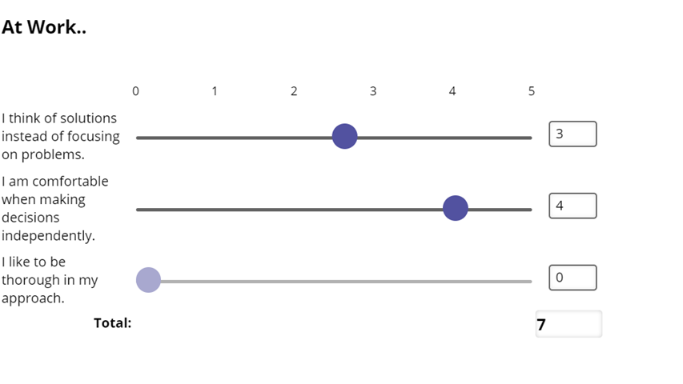
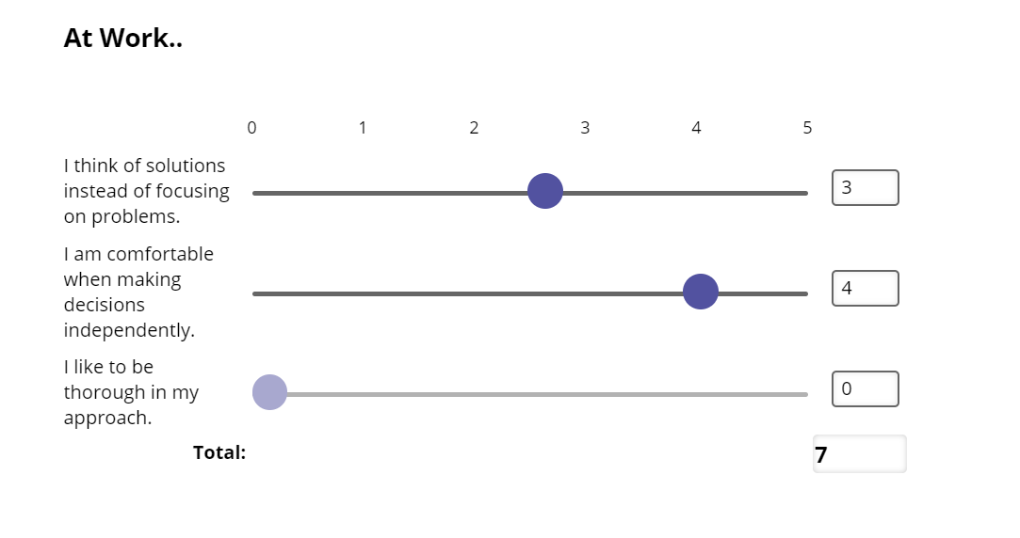
'Ipsative' response formats
Impossible to endorse all desirable alternatives
Facilitate differentiation and "slow" thinking (Kahneman, 2011)
Popular since proper scaling methods have become available, e.g. Thurstonian models family (Brown & Maydeu-Olivares, 2011; 2013; 2018; Brown; 2016a; Brown; 2016b)
  Normative trait scores can be obtained from ipsative data

Slide 3
carelessness in ipsative assessments
Like any other questionnaires, ipsative questionnaires can be subject to careless responding when respondents are not sufficiently motivated to give their full attention to the questions.
However, detecting such responding can be more challenging than when using Likert scales
  modelling of ipsative responses is inherently multidimensional;
  method factors need to take to account the comparative nature of ipsative responses

Slide 4
objectives
To describe and evaluate two alternative strategies for dealing with careless responses in ipsative data:
identifying (and ultimately removing from the sample) careless responders using ‘person fit’ indices designed for ipsative formats;
controlling for careless responding using method factors embedded in the Thurstonian IRT model (Brown & Maydeu-Olivares, 2012).

Slide 5
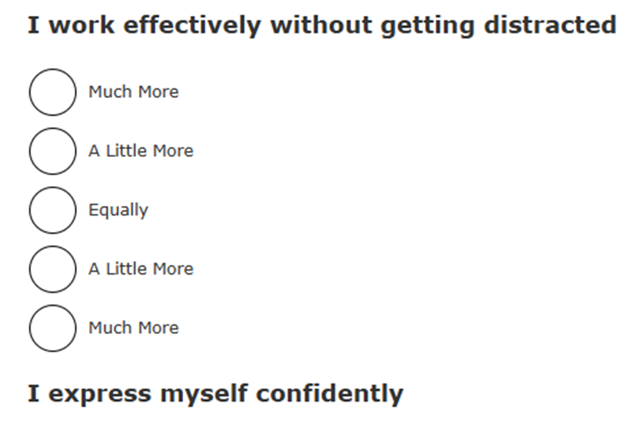
EMPIRICAL STUDY
Bespoke questionnaire for assessing applicants to public sector jobs in the UK
  measures 24 non-cognitive skills, covering the Big Five domains
  consists of 276 multidimensional ‘graded response’ pairs
Data can be analysed as ordinal or continuous
Sample.
  N=1,388 volunteers who participated in a trial

Slide 6
‘person fit’ indices
Test takers should express preferences in line with their trait scores; for example, if they are higher on trait A than on trait B, they should prefer items measuring A over items measuring B consistently (adjusted for item parameters)
Comparing observed responses with responses expected under the measurement model
  We know observed responses to pair of items {a,b} for person i
  Observed_{{a.b}i} (for example, =4)
  We compute observed response according to the Thurstonian model
  Expected_{{a.b}i} =intercept_{{a.b}} + loading_{{a}}*TraitA_{i} − loading_{{b}}*TraitB_{i}
For each test taker, ‘fit’ between their observed responses and their expected responses are measured by summarising either:
  Discrepancies
  Concordance

Slide 7
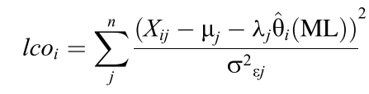
Person fit as a measure of discrepancies
Ferrando (2010) proposed a simple person-fit statistic for linear factor models (also known as “congeneric”), “lco”
  Summary of squared differences of observed and expected responses
lco can be easily extended to Thurstonian factor model
  The numerator is simply (observed-expected)²
  The denominator (error variance) is constant for all pairs, so can be omitted
  I suggest computing the mean across 276 pairs rather than the sum
lco_{i}* =MEAN(Observed_{{a.b}i} - Expected_{{a.b}i})²

Slide 8
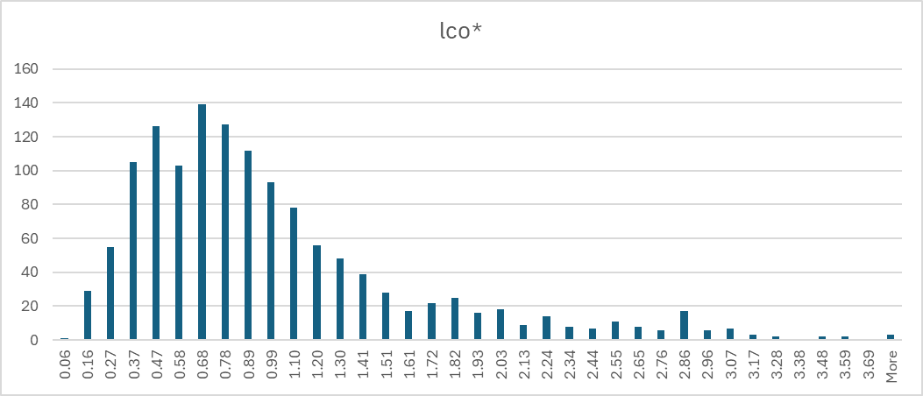
Distribution of lco*
For the trial sample (before any data cleaning!)
  We have a long positive tail of outliers (those with large misfit to model)
  Median = 0.770
  5th percentile = 0.247
  10th percentile = 0.311
  90th percentile = 1.85
  95th percentile = 2.46

Slide 9
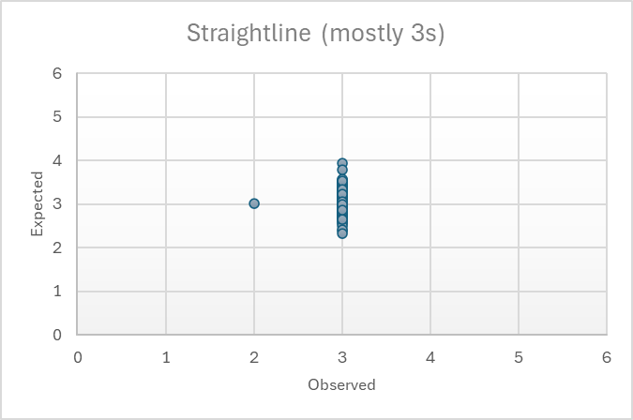
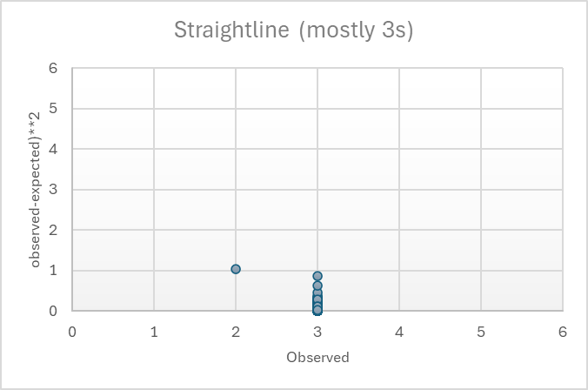
Problem
With polytomous items, candidates providing midpoint responses will obtain average trait scores
  Their expected responses will also show central tendency, and will be very similar to their observed responses
Index lco* will be very small, suggesting perfect person-fit
This problem is also described in Ferrando (2010); in single scales, any response pattern using only one or two adjacent categories will have this problem
  In our case, only patterns with predominant response “3” are problematic

Slide 10
Person fit as a measure of concordance
Pearson’s correlation can be computed to capture concordance between observed and expected responses, for each candidate
  For genuine responses, the correlation should be positive and high
  For random responses, the correlation should be near zero
  For central tendency responses, the correlation should be near zero

Slide 11
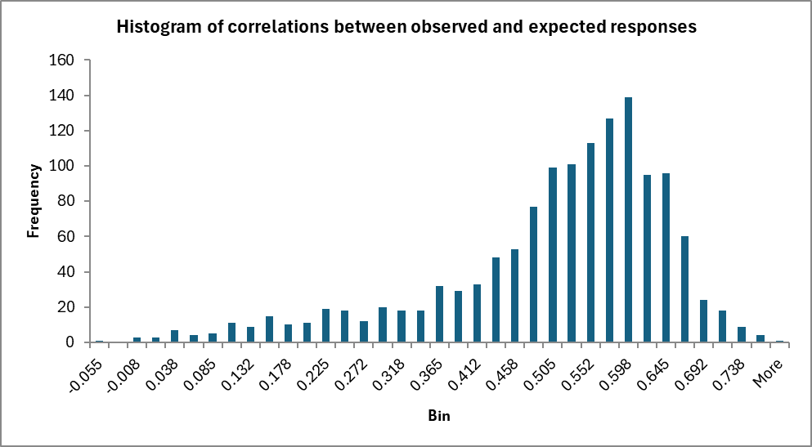
Distribution of cor(obs, exp)
For our trial sample (before any data cleaning)
  We have a long negative tail (those with small concordance with the model)
  Median(cor) = 0.532
  5th percentile = 0.170
  10th percentile = 0.280
  90th percentile = 0.642
  95th percentile = 0.664

Slide 12
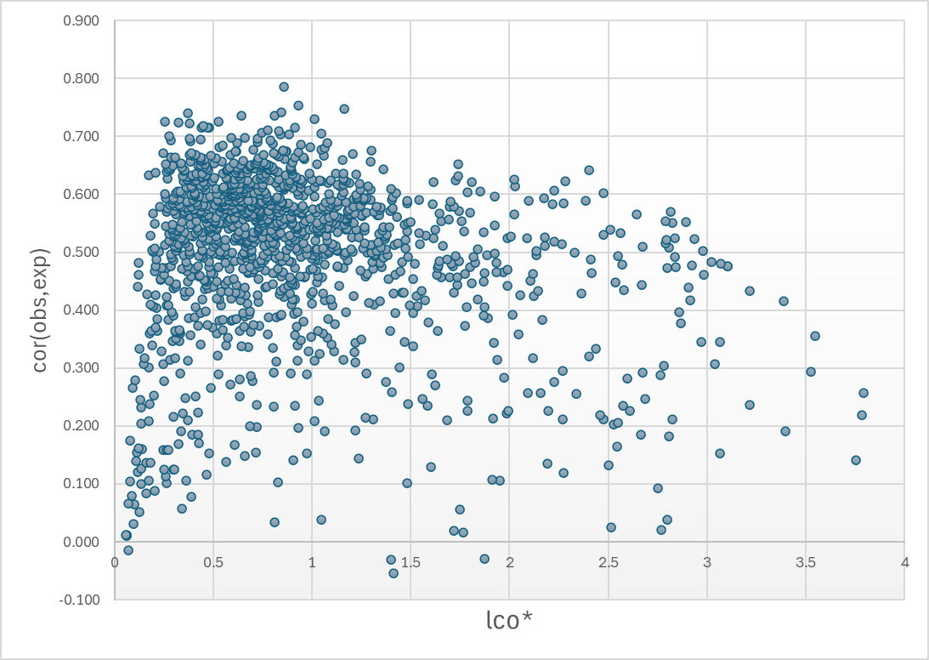
Do the person fit indices agree?
Not really (only for careful responders)
They complement each other for detecting careless responders, who have either:
  high lco*
  or low cor(obs,exp)
  or both

Slide 13
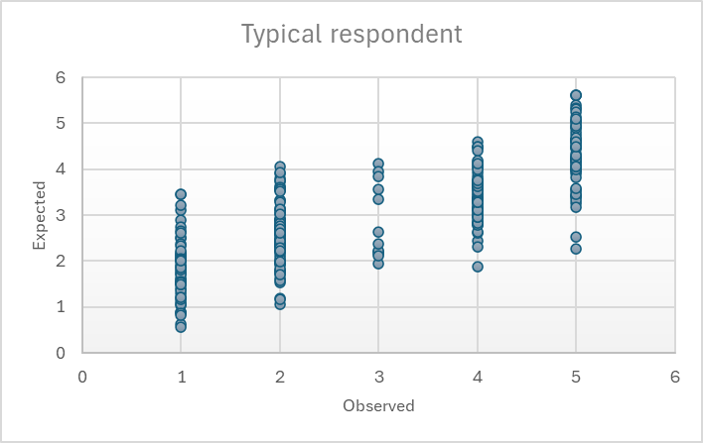
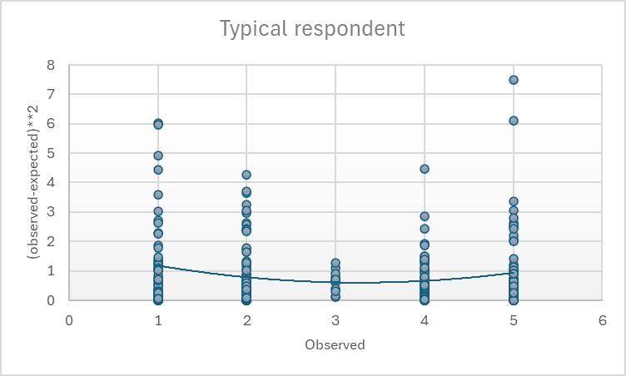
Example: TYPICAL lco* and cor
MEAN_RESPONSE 3.01
SD_RESPONSE 1.49
lco* 0.858
cor(obs, exp) 0.785

Slide 14
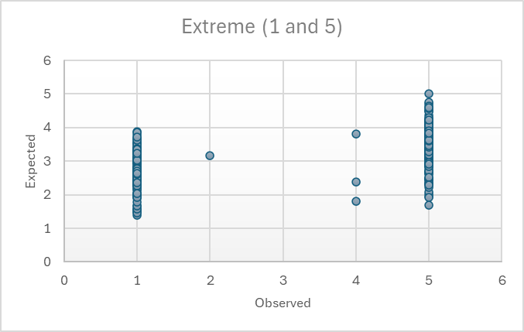
Example: Outliers according to lco*
MEAN_RESPONSE 3.17
SD_RESPONSE 1.99
lco* 3.105
cor(obs, exp) 0.475
MEAN_RESPONSE 4.7
SD_RESPONSE 1.00
lco* 2.687
cor(obs, exp) 0.247

Slide 15
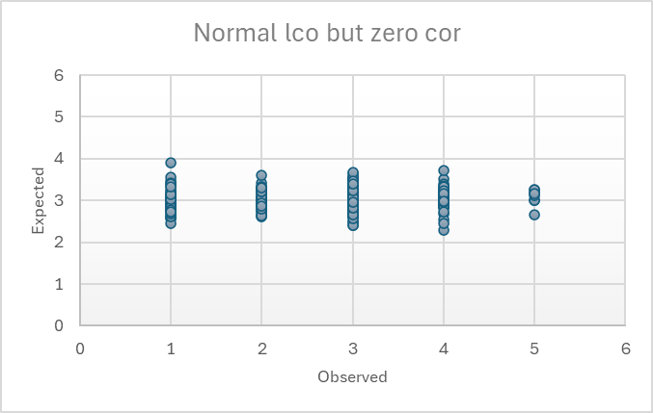
Example: Outliers according to cor(obs,exp)
MEAN_RESPONSE 3.00
SD_RESPONSE 0.06
lco* 0.058
cor(obs, exp) 0.011
MEAN_RESPONSE 2.85
SD_RESPONSE 0.99
lco* 1.040
cor(obs, exp) 0.038

Slide 16
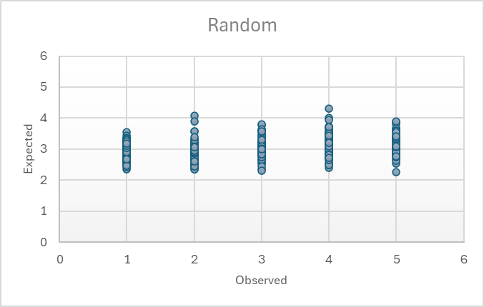
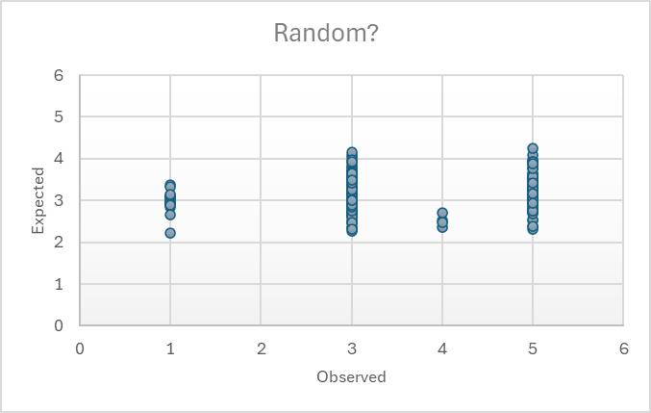
Example: Random responses
Computer generated
  MEAN_RESPONSE 2.98
  SD_RESPONSE 1.419
  lco* 1.897
  cor(obs, exp) 0.242
Respondent generated
  MEAN_RESPONSE 3.51
  SD_RESPONSE 1.11
  lco* 1.221
  cor(obs, exp) 0.311

Slide 17
‘method’ factor
A ‘random intercept’ can be added to the Thurstonian factor model to control carelessness expressed as overusing one response option
Expected_{{a.b}i} =
= intercept_{{a.b}} + rand.intercept_{i} +
+ loading_{{a}}*TraitA_{i} − loading_{{b}}*TraitB_{i}

Slide 18
random intercept model results
The RI factor had variance 0.054 (p < .001)
  5.4% of the substantive traits’ variances
  explained approx. 4% variance of observed responses
Goodness of fit
  baseline Thurstonian model (N=1,388): SRMR = .068
  Thurstonian model with RI (N=1,388): SRMR = .055
  baseline Thurstonian model without careless responders detected with lco* and cor (N=1,245): SRMR = .063

Slide 19
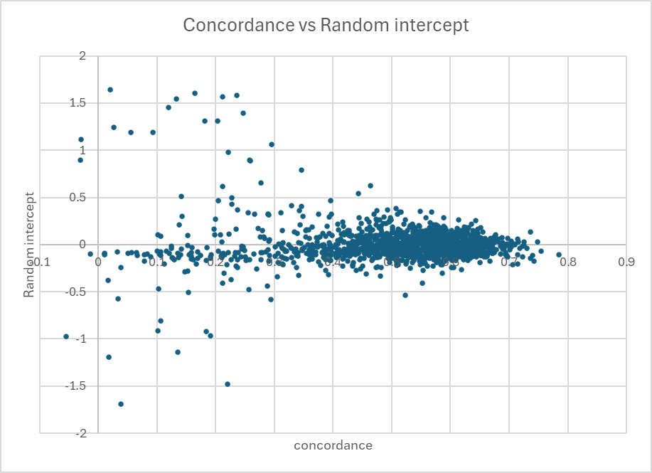
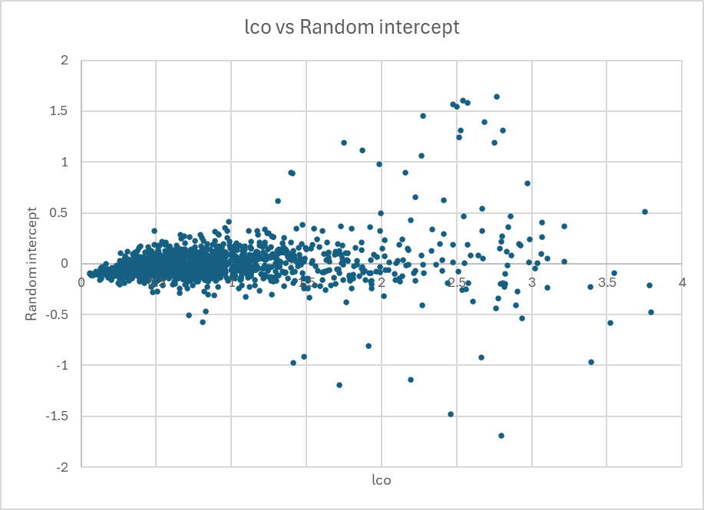
Do person fit indices and RI agree?
Not really (only for careful responders)
corr(cor, RI) = -.052
corr(lco, RI) = .190

Slide 20
Conclusions
No single index is 100% effective at detecting all types of careless responses
At the individual level, the measures of discrepancy, concordance and random intercept agreed only for careful responders
  "All happy families are alike; each unhappy family is unhappy in its own way“ (L. Tolstoy)
Combination of lco* and cor(obs,exp) work for detecting
  Random responding
  Straight-lining (any category)
  Over-using a category or several categories
Method (RI) factor works for detecting (and controlling for)
  Over-using one category

Slide 21
RECOMMENDATIONs
Determine cut-offs for lco* and cor indices empirically on your data
Implement these cut-offs for flagging careless responders
But consider also implementing simple prevention measures during the test administration, for example:
  Allow only a certain proportion of responses in certain category, for example, no more than 20% of “equally true” (the middle category)
  Warn the test taker that they should not select too many responses in the middle category, and when they exceed the limit, warn them that their profile will be void

Slide 22
thank you!
Any comments or questions?
a.a.brown@kent.ac.uk
http://annabrown.name

