Slide 1

Analysis of the factor structure of the Yoni Task instrument for its cross-cultural validation in the Spanish-speaking population
Leire Aperribai (UPV/EHU), Elena Rodríguez Naveiras & África Borges (ULL)

Slide 2
Yoni Task
Social Cognition
Theory of Mind
Introduction

Slide 3
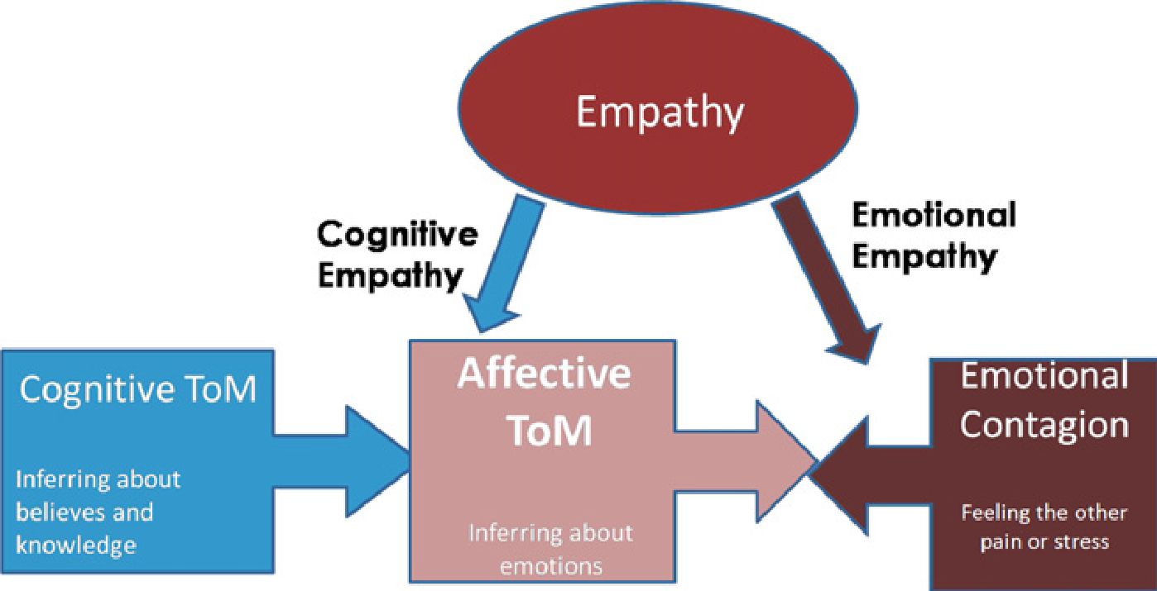
Figure 1. Shamay-Tsoory et al’s (2010) model illustrating how affective ToM involves cognitive aspects of empathy and interacts with emotional empathy. Likewise, it highlights cognitive ToM as a prerequisite for affective ToM. Retrived from: Shamay-Tsoory, S., Harari, H., Aharon-Peretz, J. & Levkovitz, L. (2010). The role of the orbitofrontal cortex in affective theory of mind deficits in criminal offenders with psychopathic tendencies. Cortex, 46, 668-677.

Slide 4
Participants
596 participants
Instruments
Yoni Task: 98 items
Procedure
Ethics Committee Aproval
Data analyses
18-65 years
Three countries:
Argentina
Good reliability index
Social cognition platform
Pre-factor
México
Spain
Sampling (Snow Ball, Email)
Procedure for the assignment of items
Robust factor analysis
Decalogue (Ferrando et al., 2022)
Exploratory factor analysis
Method

Slide 5
Original version
98 items
RDI & ICI
46 items
MSA
45 items
Pre-factor
Results

Slide 6
Exploratory Factor Analysis
Factor model
45 ítems
Pearson correlations
Factor solution
4 factors
Items’ inadequacy:
Decissions
Items’ assignment
3 factors
Result: 17 ítems in 2 factors (Affective and Cognitive)
Parallel análisis
Morgana extraction method
Robust promin rotation method
Bad psychometric properties
Lack of sustantive correspondance to factors
Results

Slide 7
Robust Factor Analysis
Factor model
17 ítems
Polychoric correlations
Factor solution
2 factors
Items’ adequacy
Assessing indices
Goodnes of fit indices:
Multiple group analyses
Robust Morgana extraction method
Losefer correction
2 factors
Rotation to target method (Procrustes)
Good reliability índices
AGFI: 0.976
GFI: 0.984
Indices of factor simplicity:
Bentler’s simplicity index (S): 0.97866 (Percentile 97)
RMSR: 0.0503
(See next slide)
Results

Slide 8
Item | F1 Loadings | F2 Loadings | Communalities | Congruence
1- Q28. Affective | 0.428 |  | 0.782 | 0.999
2- Q37. Affective | 0.304 |  | 0.983 | 0.842
3- Q45. Affective | 0.570 | -0.479 | 0.834 | 0.766
4- Q60. Affective | 0.630 |  | 0.444 | 0.989
5- Q61. Affective | 0.518 |  | 0.577 | 0.989
6- Q65. Cognitive |  | 0.846 | 0.731 | 0.967
7- Q66. Cognitive |  | 0.806 | 0.797 | 0.991
8- Q68. Cognitive |  | 0.747 | 0.597 | 0.996
9- Q69. Cognitive |  | 0.781 | 0.937 | 0.993
10- Q72. Affective | 0.621 |  | 0.910 | 0.992
11- Q73. Cognitive |  | 0.570 | 0.800 | 0.929
12- Q74. Affective | 0.618 |  | 0.786 | 1.000
13- Q75. Affective | 0.452 | 0.312 | 0.775 | 0.823
14- Q84. Cognitive |  | 0.662 | 1.000 | 1.000
15- Q85. Cognitive |  | 0.418 | 0.885 | 0.835
16- Q87. Cognitive |  | 0.620 | 0.884 | 0.996
17- Q90. Affective | 0.495 |  | 0.912 | 0.980
Explained variance | 28.59% | 51.69% | Overall congruence | 0.929
Reliability: Orion Index | 0.826 | 0.896 | McDonalds’ ordinal Ω | 0.88
Results
Factor Solution

Slide 9
Brief version:Reliable
Ensure replicability in a new sample
Adequate factor structure
Conclusions
for this sample

Slide 10
Ferrando, P.J., & Lorenzo-Seva, U. (2017). Program FACTOR at 10: origins, development and future directions. Psicothema, 29(2), 236-241. doi: 10.7334/psicothema2016.304
Ferrando, P. J., Lorenzo-Seva, U., Hernández-Dorado, A., & Muñiz, J. (2022). Decálogo para el análisis factorial de los ítems de un test. Psicothema, 34(1), 7-17. https://doi.org/10.7334/psicothema2021.456
Happé, F., Cook, J. L., & Bird, G. (2017). The structure of social cognition: In (ter) dependence of sociocognitive processes. Annual review of psychology, 68, 243-267.
Kalbe, E., Schlegel, M., Sack, A., Nowak, D., Dafotakis, M., Bangard, C., Brand, M., Shamay-Tsoory, S., Onur, O., Kessler, J. (2010). Affective and cognitive theory of mind in patients with parkinson’s disease. Cortex, 46, 769-780.
Shamay-Tsoory S. G., Aharon-Peretz J., & Levkovitz Y. (2007). The neuroanatomical basis of affective mentalizing in schizophrenia: Comparison of patients with schizophrenia and patients with localized prefrontal lesions. Schizophrenia Research 90, 274–283.
Shamay-Tsoory, S. G. (2021). Brains that Fire Together Wire Together: Interbrain Plasticity Underlies Learning in Social Interactions. The Neuroscientist, online first. https://doi.org/10.1177/1073858421996682
Shamay-Tsoory, S., Harari, H., Aharon-Peretz, J., & Levkovitz, L. (2010). The role of the orbitofrontal cortex in affective theory of mind deficits in criminal offenders with psychopathic tendencies. Cortex, 46, 668-677.
References

Slide 11
Thank you!
¡Muchas gracias!
Leire Aperribai
Elena Rodríguez Naveiras
África Borges
Contact: leire.aperribai@ehu.eus

