Slide 1
Subjective perception of Fear of Public Speaking. A mixed-methods research
Quintero, R., Borges, A.González, A. and Pereda, E.

Slide 2
Fear of Public Speaking (FoPS) is subtype of Social Anxiety Disorder
FoPS affects the personal, academic, and professional spheres
It is characterized by cognitive, emotional, and physical manifestation
FoPS limits the performance and social interactions of those who experience it.

Slide 3
Objective
Exploring the relationship between Fear of Public Speaking and its associated manifestations through a mixed research approach

Slide 4
PARTICIPANTS
436
Undergraduates
74% female
Age 21.1 (SD 3.46)
26% male

Slide 5
Social Anxiety Questionnaire for Adults (SAQ-A30)
Instruments
Are you afraid of public speaking?
What does public speaking do to you?
Cognitive, emotional, physical
Public speaking (F1)
Interactions with the opposite sex
Assertive expression of dislike.
Interactions with strangers
To be embarrassed or ridiculed

Slide 6
Procedure and data analysis
Request for authorization from the ethics committee
Request for collaboration from ULL students in all areas
Data collection was done online (Google forms)
Spss v28 - IRAMUTEQ

Slide 7
Genre | N | Average | SD
Woman | 310 | 20,42 | 4,58
Men | 92 | 17,17 | 5,11
t(400) | p | Cohen
5,8 | <.001 | .689

Slide 8
R | R² | F | p
.685 | .426 | 87.64 | <.001
 | beta | t | p
Interactions with strangers | .351 | 7.28 | <.001
Interactions with the opposite sex | .099 | 2.19 | .035
Assertive expression of dislike | .043 | 0.91 | .359
To be embarrassed or ridiculed | .341 | 7.44 | <.001

Slide 9
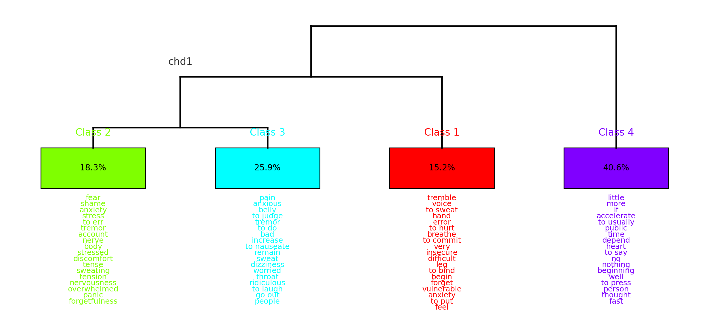
Segments 460 - Classifieds 421
92.52%

Slide 10
Class 1: High sense of nervousness
Fear - Yes
F1 - High
Woman
High social anxiety
I feel embarrassed and scared—my legs tremble and my hands sweat

Slide 11
Class 2: Fear of making a mistake
Fear - Yes
F1 - High
Fear of mistakes and not being understood

Slide 12
Class 3: Fear of ridicule
Fear - Yes
F1 - Medium
Messing up and them laughing at me or me not knowing how to explain—nervous, sweaty hands, stomach ache.

Slide 13
Class 4: A little nervous
Fear - No
F1 - Small
Men
Small social anxiety
Not saying things that might tense the situation—a bit nervous but it passes, stomach ache

Slide 14
The lexical analysis categorizes people into those without fear and those with fear of public speaking, with the latter group divided by emotional and physical symptom expressions
Emotional symptoms include feelings of anxiety and distress, while physical symptoms involve neurological and physiological signs like sweating and pain
The analysis should consider individual differences in the importance given to emotional versus physical symptoms
A comprehensive scale including emotional and physiological factors is suggested for better detection and evaluation

Slide 15
Thank you for your attention
aborges@ull.edu.es

