Slide 1
Longitudinal Causal Inference in Psychology
Lukas Junker
LMU Munich

Slide 2
What is Causal Inference (Potential Outcomes) in longitudinal Settings?
Can we do that in psychological research?

Slide 3




What is Causal Inference (Potential Outcomes) in longitudinal Settings?
$$X_{t}$$
$$Y$$

Slide 4
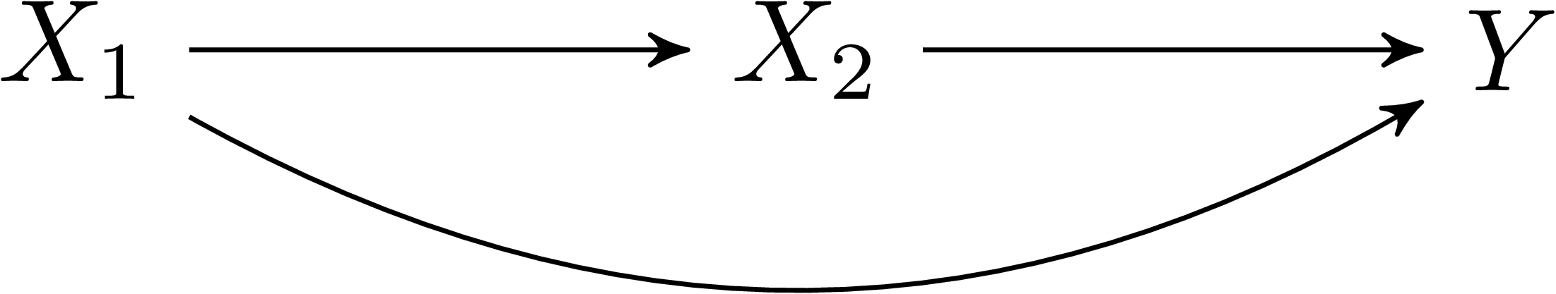




What is Causal Inference (Potential Outcomes) in longitudinal Settings?
$X_{t}$: Smartphone Usage
$Y$: Sleep quality

Slide 5
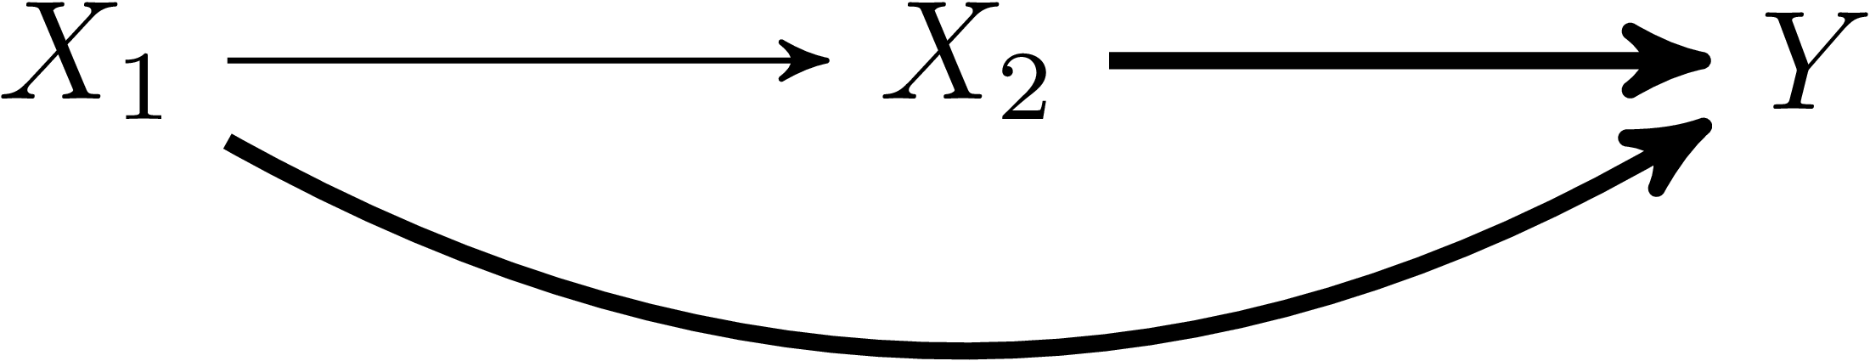
What is Causal Inference (Potential Outcomes) in longitudinal Settings?
$$X_{t}$$
$$Y$$
A Potential Outcome is defined under multiple interventions:
The contrast of two Potential Outcomes is then the joint effect:

Slide 6
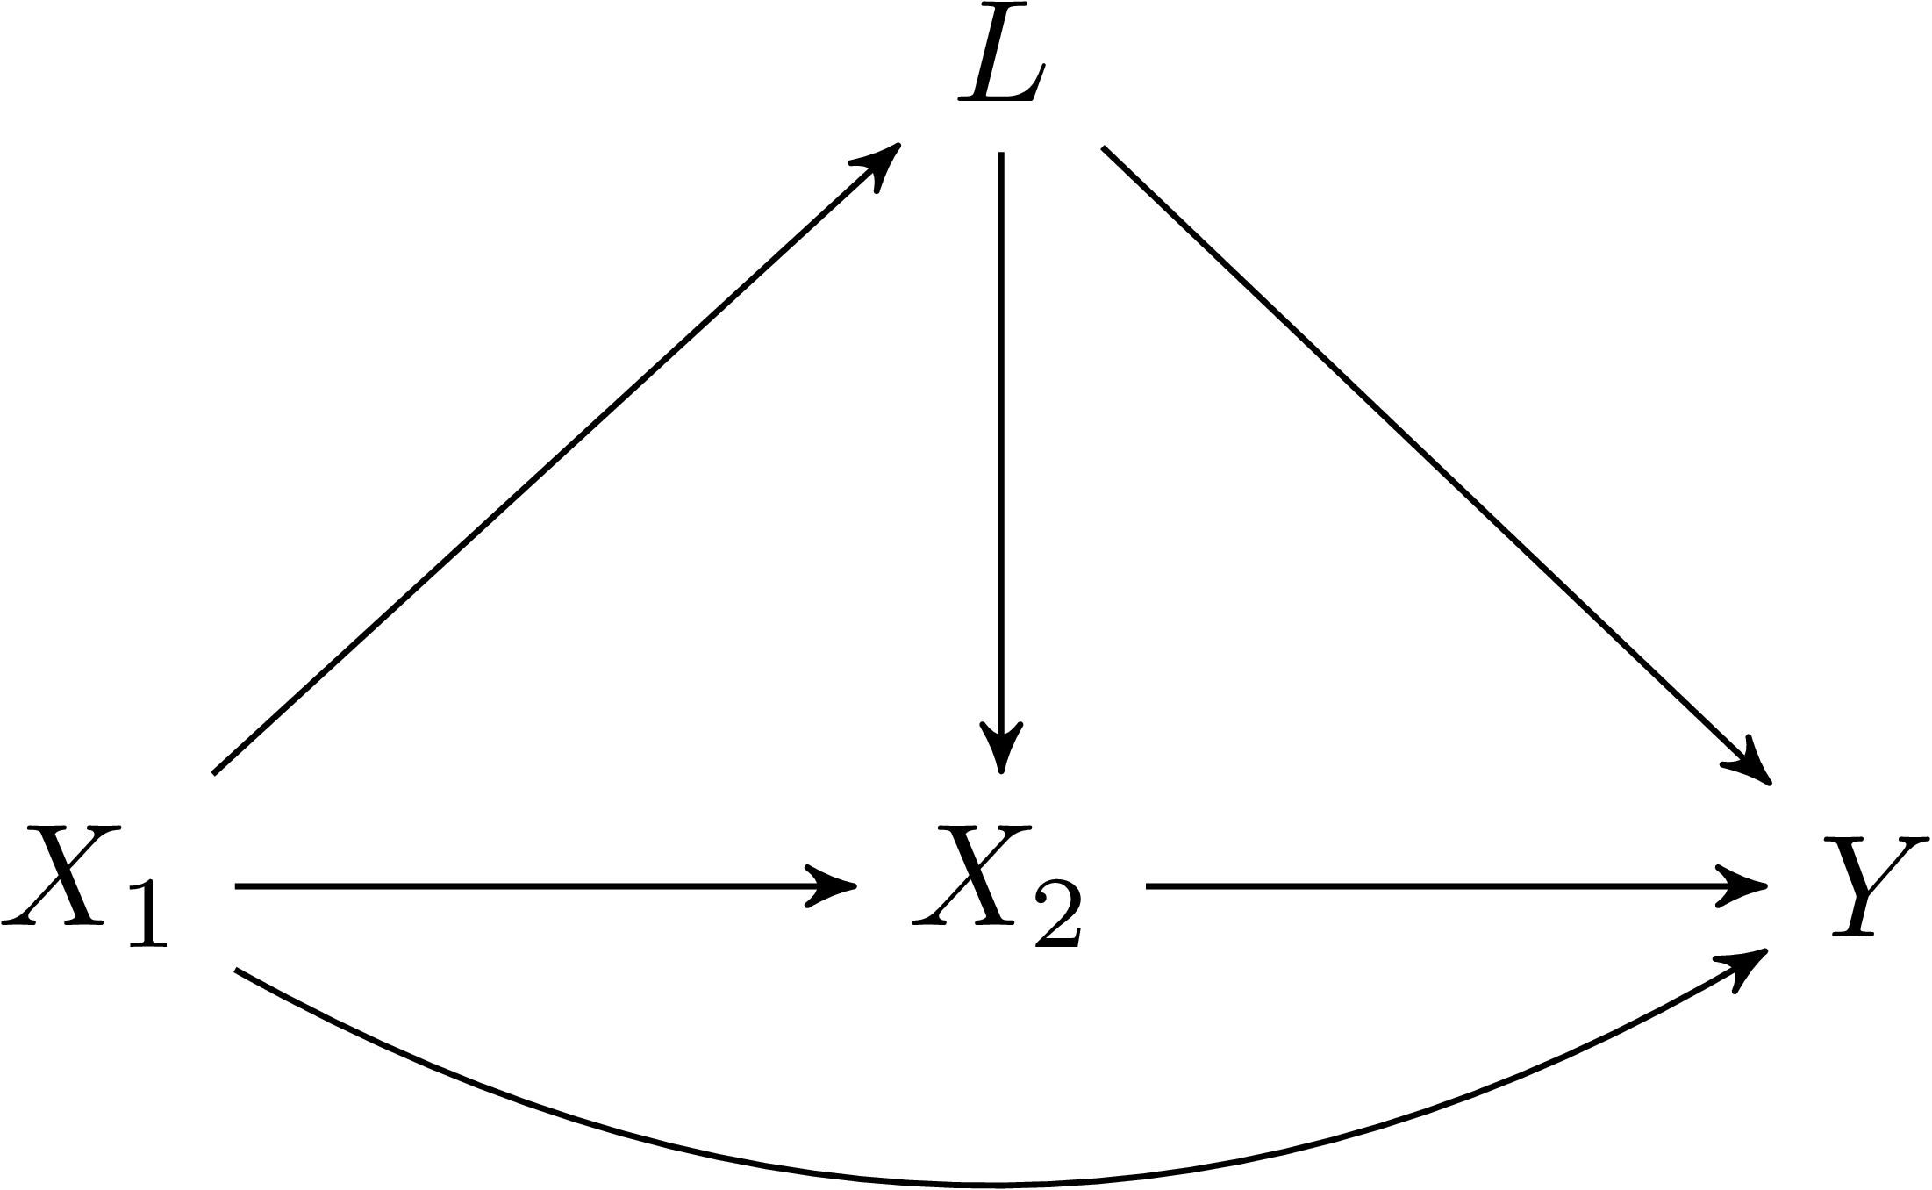


Longitudinal Causal Inference:
It‘s complicated…
$$X_{t}$$
$$Y$$
$$L_{t}$$

Slide 7
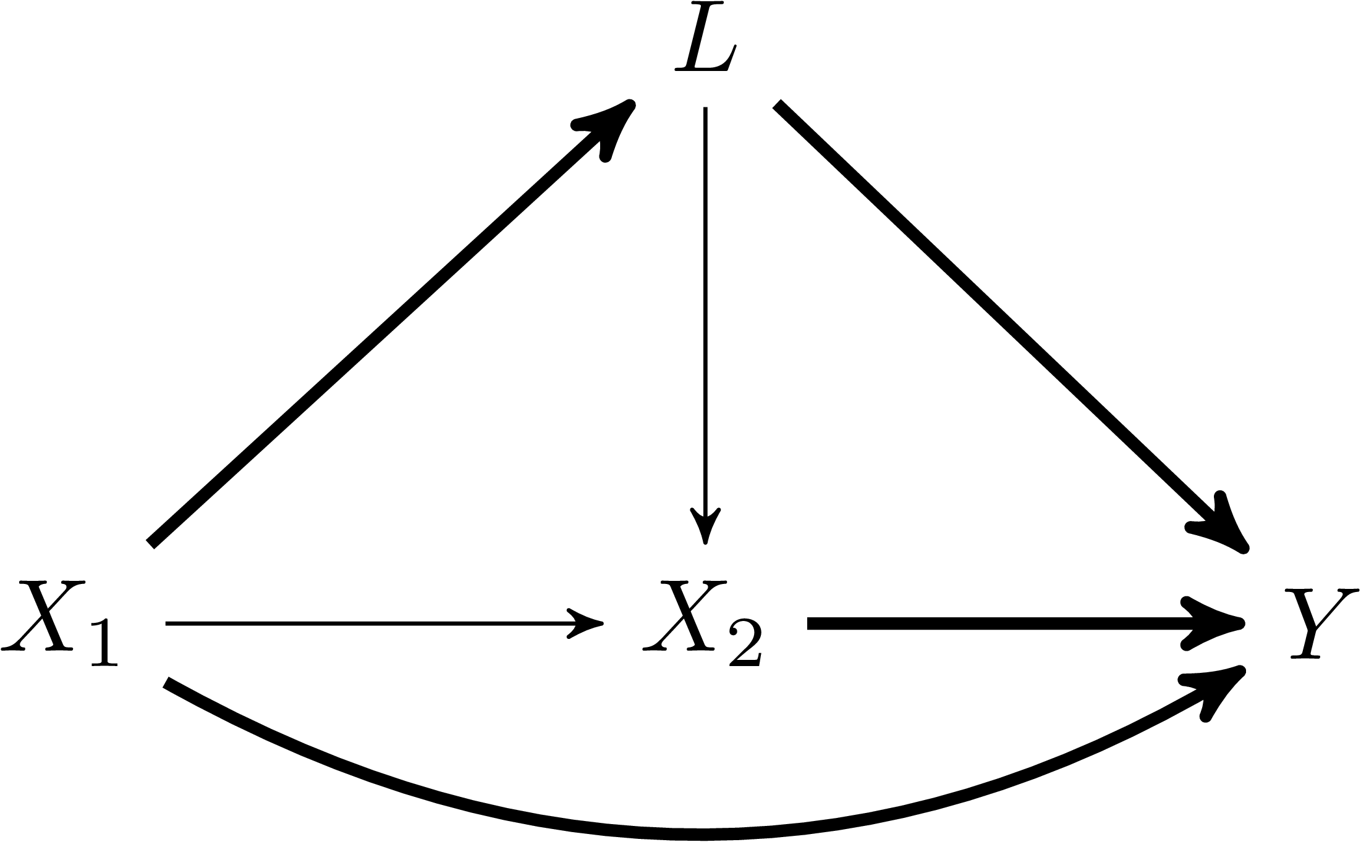
Longitudinal Causal Inference:
It‘s complicated…
$$X_{t}$$
$$Y$$
$$L_{t}$$

Slide 8
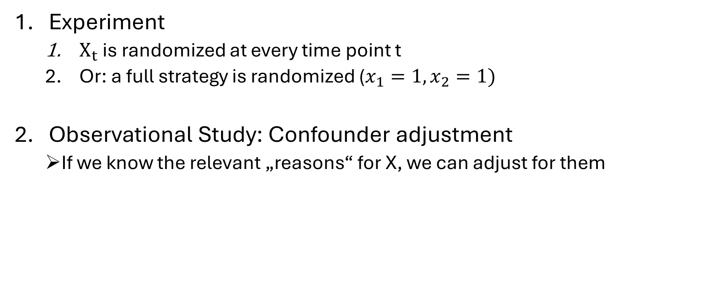
How to identify joint effects?
Experiment
  $X_{t}$ is randomized at every time point t
  Or: a full strategy is randomized ($x_{1}=1, x_{2}=1)$
Observational Study: Confounder adjustment
  If we know the relevant „reasons“ for X, we can adjust for them

Slide 9
What is Causal Inference (Potential Outcomes) in longitudinal Settings?
Can we do that in psychological research?

Slide 10
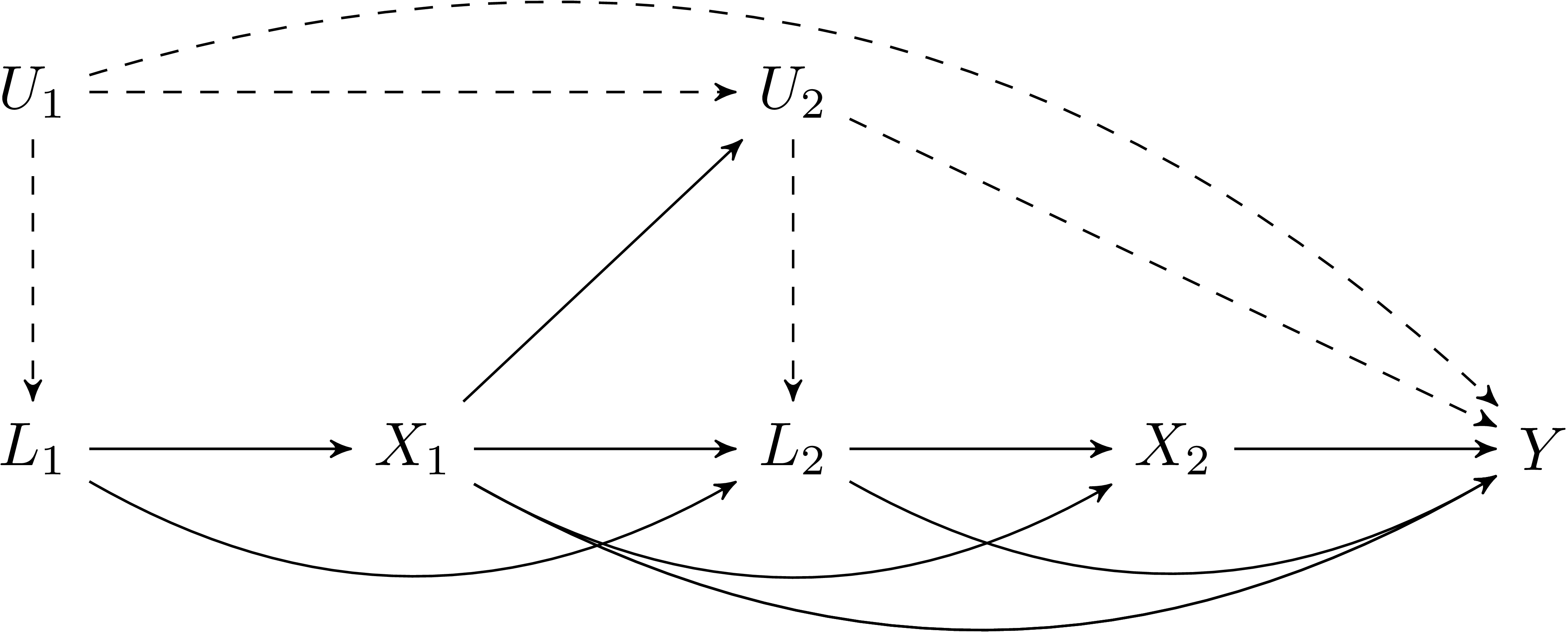
What do we need to identify joint effects?
$$X_{t}$$
$$Y$$
$$L_{t}$$

Slide 11
What do we need to identify joint effects?
$$X_{t}$$
$$Y$$
$$L_{t}$$

Slide 12
When are variables independent in psychology?
Randomization
Information Restriction
(Gelman, 2011)

Slide 13
When are variables independent in psychology?
If X is self-selected, U is not measureable
If X is assigned by a person based on information,
it cannot be influenced by unobservables

Slide 14
Who assigns X based on observables L?
Doctors
X = Treatment
L = Biomarker
Y = Health
Psychotherapists
X = Treatment
L = Questionnaire
Y = Mental Health
Teachers
X = Extra Classes
L = Grades
Y = Passing the course

Slide 15
Summary
Causal Inference is applicable in longitudinal settings
Causal Inference is possible without full randomization
Psychology needs clever research designs
Leverage Information Restriction

Slide 16
Furthermore…
SEM (path analysis) relies on unrealistic assumptions
g-Methods from epidemiology rely on more reasonable assumptions
Junker, L., Schoedel, R., & Pargent, F. (2025). Towards a Clearer Understanding of Causal Estimands: The Importance of Joint Effects in Longitudinal Designs with Time-Varying Treatments. https://doi.org/10.31234/osf.io/zmh5a

Slide 17
Thank you!

