Slide 1
Analysis of the relationship between self-esteem level and interest, importance and learning achievements in highly able students through mixed method design
Leire Aperribai, Karmele Salaberria & Ainize Sarrionandia (UPV/EHU)
Authors’ affiliation:

Slide 2
Highly Able Students
Self-Esteem
Academic Interest,
Importance, Achievement
Introduction

Slide 3
Participants
8 girls & 17 boys
Instruments
The Rosenberg Self-Esteem Scale (EAR)
Procedure
Ethics Committee Aproval
Data analyses
10-13 years
Primary & Secondary Education
Province of Gipuzkoa
Open questions about the importance and usefulness of the subject content, and about the achievements and effort made
Aupatuz Association
Consents
Sakonduz platform
Quantitative: Descriptive statistics
Qualitative: Descending hierarchical cluster analysis (Alceste method)
Method

Slide 4
Quantitative Results
Table 1 Frecuencies and percentages of self-esteem levels (Rosenberg, 2001) by gender
Self-esteem |  | Frequency | Percentage
High | Girls | 4 | (50% of girls)
 | Boys | 11 | (64.7% of boys)
 | Total | 15 | 60%
Average | Girls | 4 | (50% of girls)
 | Boys | 3 | (17.65% of boys)
 | Total | 7 | 28%
Low | Girls | 0 | (0% of girls)
 | Boys | 3 | (17.65% of boys)
 | Total | 3 | 12%
Results

Slide 5
Qualitative Results
Table 2 Forms (with frequencies equal or higher than 3) classified on the basis of the level of self-esteem (high, average or low)
High |  | Average |  | Low
Tema | 7 | Tema | 3 | Asignatura | 4
Aprender | 6 | Aprender | 3 | Aprender | 3
Importante | 6 | Servir | 3 | Importante | 3
Asignatura | 5 | Juego | 3
Esfuerzo | 5 | Desconocer | 3
Clase | 5
Curso | 5
Vida | 4
Bien | 4
Actividad | 4
Entender | 4
Trabajo | 4
Opinión | 4
Tratar | 3
Nota | 3
Estudiar | 3
Ejercicio | 3
Servir | 3
Tiempo | 3
Results

Slide 6
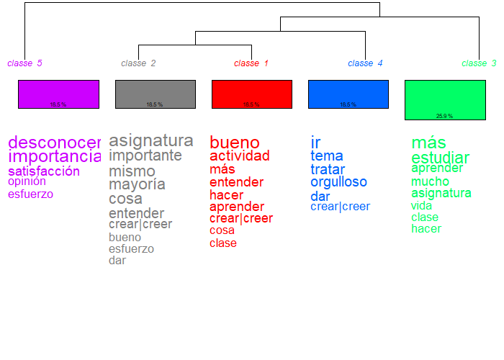
Qualitative Results
Classified text segments:
27/38 (71%)
Results

Slide 7
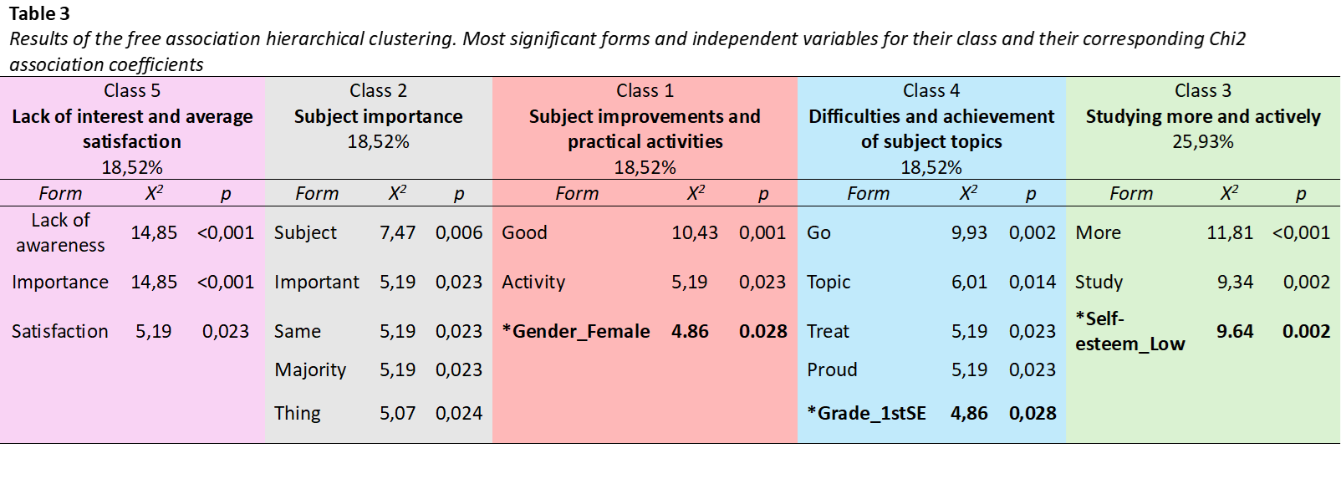
Qualitative Results
Independent variables:
Self-esteem level
Gender
Education grade/level
Results

Slide 8
Self-Esteem
Highly Able Students’ Academic Performance
Academic Interest,
Importance & Achievement
Conclusions

Slide 9
References
Denscombe, M. (2008). Communities of Practice. Journal of Mixed Methods Research, 2(3), 270–283. https://doi.org/10.1177/1558689808316807
Idoiaga, N., Berasategi, N., Eiguren, A., y Picaza, M. (2020). Exploring children’s social and emotional representations of the Covid-19 pandemic. Frontiers in Psychology, 11, 1952. https://doi.org/10.3389/fpsyg.2020.01952
Johnson, R.B., y Onwuegbuzie, A.J. (2004). Mixed Methods Research: A Research Paradigm Whose Time Has Come. Educational Researcher, 33(7), 14–26. https://doi.org/10.3102/0013189x033007014
Martinot, D., Beaton, A., Tougas, F., Redersdorff, S., & Rinfret, N. (2020). Links between psychological disengagement from school and different forms of self-esteem in the crucial period of early and mid-adolescence. Social Psychology of Education: An International Journal, 23(6), 1539-1564. https://doi.org/10.1007/s11218-020-09592-w
Ratinaud, P. (2008-2020). Iramuteq 0.7 alpha 2. Interface de R pour les Analyses Multidimensionnelles de Textes et de Questionnaires. Un logiciel libre construit avec le logiciels libres. Laboratoire LERASS.
Reinert, M. (1983). Une méthode de classification descendante hiérarchique: application à l’analyse lexicale par contexte. Les cahiers de l’analyse des données, 8, 187–198.
Reinert, M. (1990). Alceste, Une méthode d’analyse des données textuelles. Application au texte “Aurélia” de Gérard de Nerval. Bulletin de Méthodologie Sociologique, 26, 25–54. https://doi.org/10.1177/07591063900260010
Reinert, M. (2001). Alceste, une méthode statistique et sémiotique d’analyse de discours; application aux Rêveries du promeneur solitaire. La Revue Française de Psychiatrie et de Psychologie Médicale, 49, 32–36.
Rosenberg, M. (1965). Society and the adolescent self-image. Princeton University Press.
Rosenberg, M. (1979). Components of Rosenberg’s self-esteem scale. Conceiving the self. Basic Books.
Vázquez, A. J., Jiménez, R., & Vázquez-Morejón, R. (2004). Escala de autoestima de Rosenberg. Fiabilidad y validez en población clínica española. Apuntes de Psicología, 22(3), 247-256. https://hdl.handle.net/11441/84760

Slide 10
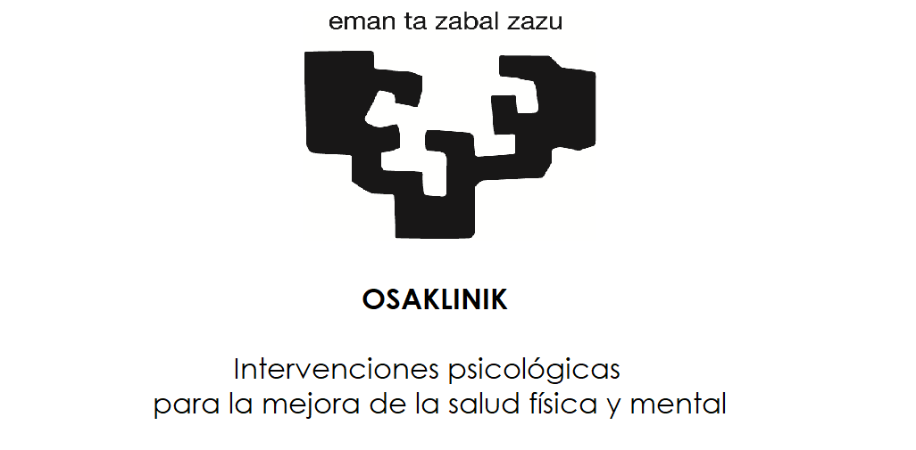
Thank you!
¡Muchas gracias!
Leire Aperribai
Karmele Salaberria
Ainize Sarrionandia
Contact: leire.aperribai@ehu.eus

