Slide 1
Symposium: Advances in Investigating Response Behavior
Marie-Ann Sengewald & Esther Ulitzsch

Slide 2
Benefits of Process Data for Evaluating the Differential Effectiveness of App-Based Treatments
Marie-Ann Sengewald, Janne v. K. Torkildsen, Jarl K. Kristensen, & Esther Ulitzsch

Slide 3


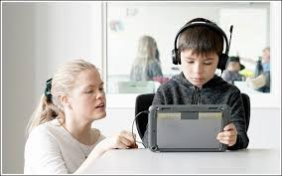

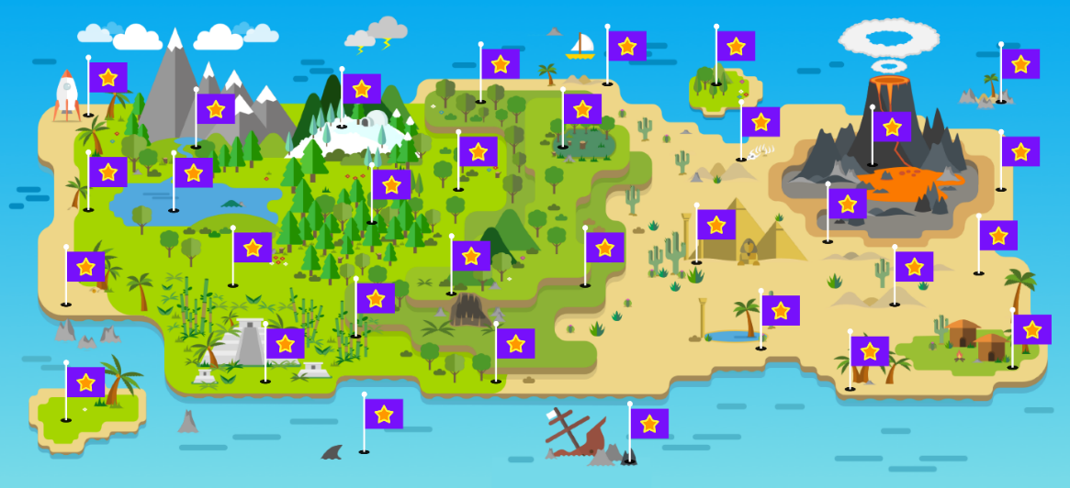
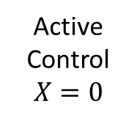
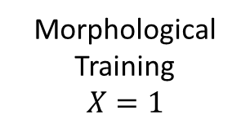
Use Case
The students help Captain Morph collect stardust by solving tasks about morphemes and morphologically complex words
Morphological Training
$$X=1$$
Active Control
$$X=0$$
366 students
351 students
Notes:
- More and more Interventions in digital contexts – such as Learning Apps.
Use Case with a well-constructed App-based training
Involving 717 students in 2nd grade – RCT with active control group (math training)
Lasting effects in word knowlege

Slide 4
Overview
Who benefits most from the treatment?
Differential effect analysis for investigating the variation of treatment effects in relation to baseline characteristics.
Causal Effect Analysis
Psychometric
Analysis
Response Time Analysis
How informative is process data in digital assessments?
Additional information to enhance data quality, but possibly also to inform substantive analyses.
Notes:
Investigate not only whether the training is on average effective, but evaluate effect heterogeneity
Using RCT data for a differential effect analysis = estimating conditional treatment effects in relation to baseline characteristics
Different sources of bias can reduce efficieny and accuracy of causal effects
Include analysis strategies to account for the error and investigate the benefit.

Slide 5

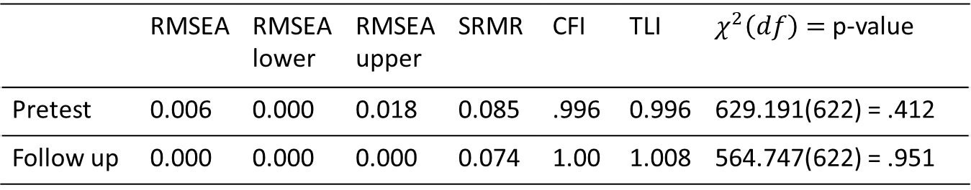







1. Psychometric Analysis
Receptive Word Knowledge Test
$$Pretest$$
8-week Training
$$Posttest$$
6-month Break
$$Follow up$$
Unidimensional model for the 26 dichotomous items (Kristensen et al., 2023)
Two group model with strong measurement invariance (equal loadings & thresholds between groups)
$$X=x$$
 | RMSEA | RMSEA lower | RMSEA upper | SRMR | CFI | TLI | $χ^{2}\left(df\right)=$ p-value
Pretest | 0.006 | 0.000 | 0.018 | 0.085 | .996 | 0.996 | 629.191(622) = .412
Follow up | 0.000 | 0.000 | 0.000 | 0.074 | 1.00 | 1.008 | 564.747(622) = .951
$$Y_{1t}$$
$$Y_{2t}$$
$$η_{t}$$
…
$$Y_{26t}$$
Good reliability in both treatment groups ($ω_{xt}$estimates for ordinal scale; Green & Yang, 2009)
→ $ω_{01}=.721 \& ω_{11}=.714; ω_{03}=.847 \&{ ω}_{13}=.866$
Notes:
Items with low (or even negative) discriminations were excluded

Slide 6


















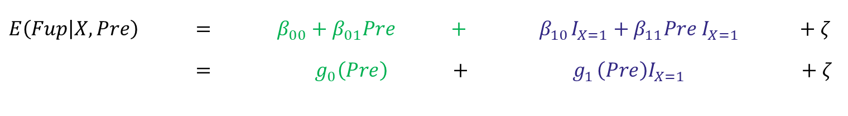








2. Causal Effect Analysis
Treatment Effects
Structural Equation Model in lavaan with EffectLiteR for moderated group comparison
Active Control Group X = 0
Treatment Group X = 1
$$Y_{11}$$
$$α_{00}$$
$$Y_{13}$$
$$Y_{11}$$
$$α_{10}$$
$$Y_{13}$$
$$α_{01}$$
$$α_{11}$$
$$Y_{21}$$
$$Pre$$
$$Fup$$
$$Y_{23}$$
$$Y_{21}$$
$$Pre$$
$$Fup$$
$$Y_{23}$$
…
…
…
…
$$Y_{261}$$
$$Y_{263}$$
$$Y_{261}$$
$$Y_{263}$$
$β_{00}=α_{00}$ $β_{01}=α_{01}$
$β_{10}=α_{10}−α_{00}$ ${ β}_{11}=α_{11}−α_{01}$
$E\left(Fup | X,Pre\right) =$ $β_{00}+β_{01}Pre +{ β}_{10}I_{X=1}+β_{11}Pre{ I}_{X=1} +ζ$
$= g_{0}\left(Pre\right) +{ g}_{1}\left(Pre\right)I_{X=1} +ζ$
Average treatment effect ($AE$)
$$= E\left[g_{1}\left(Pre\right)\right]$$
Conditional treatment effects ($CE$)
$${= g}_{1}\left(Pre\right)$$

Slide 7
2. Causal Effect Analysis
Treatment Effects
Moderated group comparison with Structural Equation Models in lavaan & EffectLiteR (Sengewald & Mayer, 2024)
 | Covariates | AE Est. (SE) | p-value | Effect
latent | None | 0.163 (0.075) | 0.029 | 0.264
 | Pretest | 0.165 (0.074) | 0.026 | 0.269
Adding a covariates has little impact on the AE (randomized experiment)
Substantial variation of treatment effects in relation to the pretest ability
Notes:
(between -0.17 and 0.59)

Slide 8
3. Response Time Analysis
Identifying Disengaged Responses
Very short response times indicate disengaged test taking (e.g., Wise 2017)
56 responses
> 120s (2min)

Slide 9
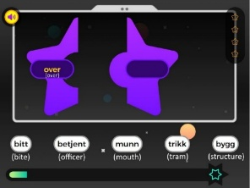
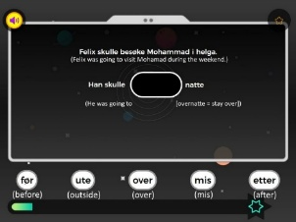
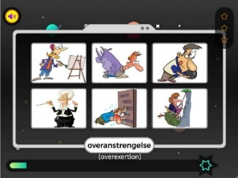
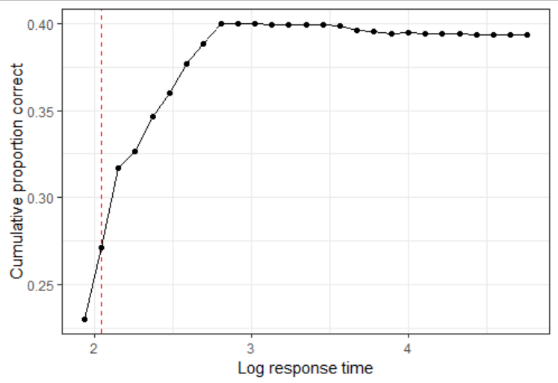
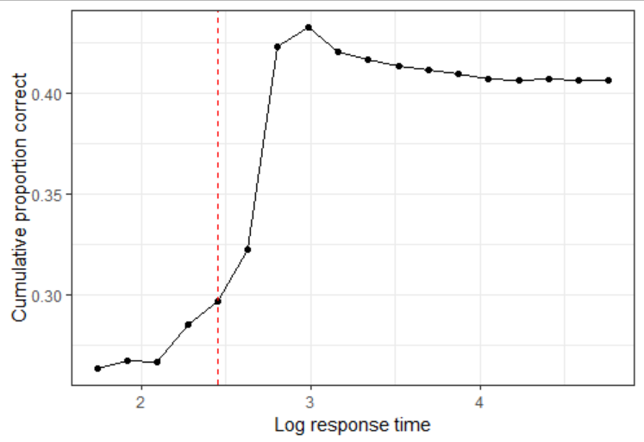
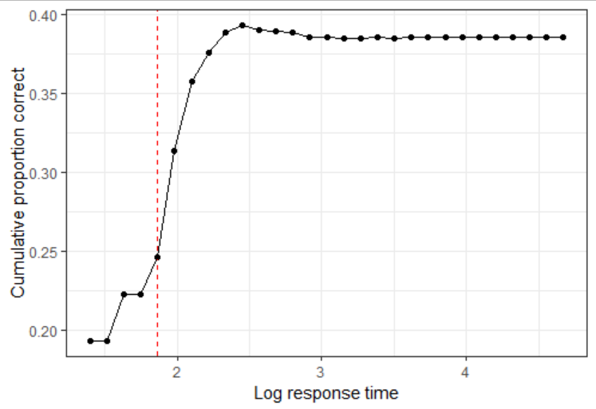
3. Response Time Analysis
  Cumulative Proportions Correct (Guo et al. 2016)
Identifying Disengaged Responses
Word
combination
(9 items)
Sentence
completion
(7 items)
Picture
selection
(11 items)
3.62%
11.31%
7.10%
All responses below the threshold are classified as disengaged
Notes:
Model for item responses = predicting probability to solve the item
c = common guessing parameter in case of disengaged responses
person ability ($θ_{i}$) and item parameters (difficulty and discrimination?)
Model for response times = lognormal distribution
→ person average speed ($β_{D}$) and variance across items ($σ^{2}$) = no relation to person ability
person (working) speed parameter ($τ_{i}$) and item speed parameter ($β_{j}=β_{D}+$offset parameter for longer response times) = relation to person ability due to a multivariate distribution for estimating the model parameters.
Both information are used for estimating the latent classes of engaged and disengaged response
latent class probability $∆_{ij}$ for each response (each person and item).
Then can be summarized in person engagement $φ_{i}$ and item engagement difficulty $ι_{j}$

Slide 10















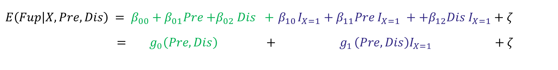













4. Benefits
Correcting for Disengaged Responses
→ Data Quality by imputing disengaged responses + Person Indicator for Pretest Disengagement
Active Control Group X = 0
Treatment Group X = 1
$$Y_{11}$$
$$α_{00}$$
$$Y_{13}$$
$$Y_{11}$$
$$α_{10}$$
$$Y_{13}$$
$$α_{01}$$
$$α_{11}$$
$$Y_{21}$$
$$Pre$$
$$Fup$$
$$Y_{23}$$
$$Y_{21}$$
$$Pre$$
$$Fup$$
$$Y_{23}$$
…
$$α_{02}$$
…
…
$$α_{12}$$
…
$$Y_{261}$$
$$Dis$$
$$Y_{263}$$
$$Y_{261}$$
$$Dis$$
$$Y_{263}$$
$$E\left(Fup | X,Pre, Dis\right) = β_{00}+β_{01}Pre{+β}_{02}Dis +{ β}_{10}I_{X=1}+β_{11}Pre{ I}_{X=1} ++β_{12}Dis{ I}_{X=1}+ζ$$
$= g_{0}\left(Pre,Dis\right) +{ g}_{1}\left(Pre, Dis\right)I_{X=1} +ζ$
Average treatment effect ($AE$)
$$=E\left[g_{1}\left(Pre, Dis\right)\right]$$
Conditional treatment effects ($CE$)
$${=g}_{1}\left(Pre, Dis\right)$$
Notes:
Here the question arises – what can be a plausible indicator for disengagement at a person level?

Slide 11
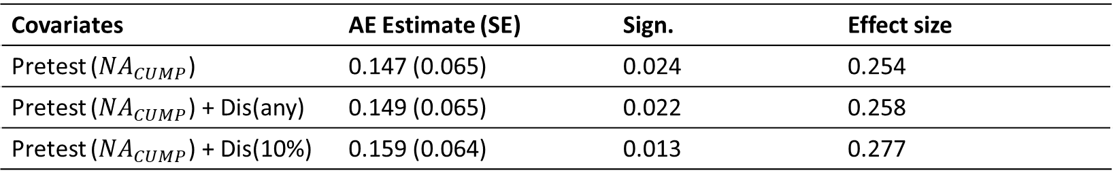
4. Benefits
Correcting for Disengaged Responses
→ Data Quality by imputing disengaged responses + Person Indicator for Pretest Disengagement
Covariates | AE Estimate (SE) | Sign. | Effect size
Pretest ($NA_{CUMP}$) | 0.147 (0.065) | 0.024 | 0.254
Pretest ($NA_{CUMP}$) + Dis(any) | 0.149 (0.065) | 0.022 | 0.258
Pretest ($NA_{CUMP}$) + Dis(10%) | 0.159 (0.064) | 0.013 | 0.277

Slide 12


4. Benefits
Correcting for Disengaged Responses
→ Data Quality by imputing disengaged responses + Person Indicator for Pretest Disengagement
Pretest ($NA_{CUMP}$) + Dis(any)
Pretest ($NA_{CUMP}$) + Dis(10%)
Substantial variation of treatment effects in relation to the Disengagement Indicators
Amount of Disengagement is most likely relevant (any disengaged response vs. 10% of the items)
Notes:
+ Dis(any): 0.04 to 0.34

Slide 13
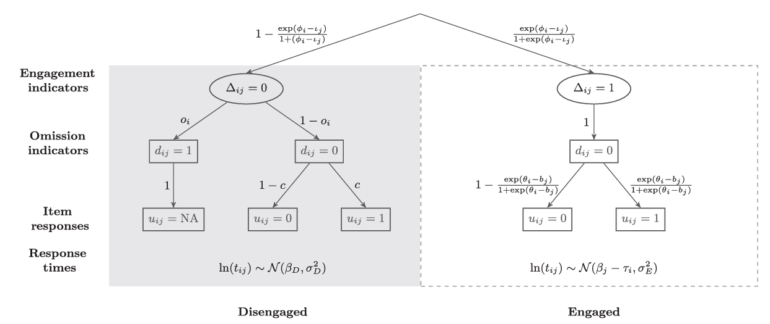
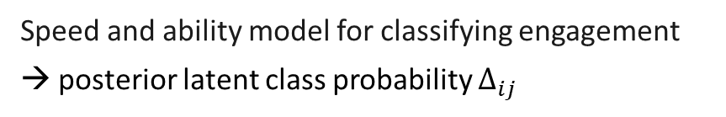
5. Discussion
More insights about intervention effects, allowing more targeted treatment decisions
Disengagement indicators for each response
  fallible information in CUMP
  latent modeling strategies, but complete model is computational challenging
Person disengagement across items
  classification with cutt-off
  continous indicator with functional form assumptions
Practical benefits in the use case and future research for optimal modeling strategies
  Latent Mixture Model (Ulitzsch et al., 2020)
Speed and ability model for classifying engagement
→ posterior latent class probability $∆_{ij}$

Slide 14
Tank you for your interest!

Slide 15
References
Aiken, L. S., & West, S. G. (1991). Multiple regression: Testing and interpreting interactions. Newbury Park, CA: Sage.
Guo, H., Rios, J. A., Haberman, S., Liu, O. L., Wang, J., and Paek, I. (2016). A new procedure for detection of students’ rapid guessing responses using response time. Appl. Meas. Educ. 29, 173–183. https://10.1080/08957347.2016.1171766
Kristensen, Jarl Kleppe; Torkildsen, Janne von Koss & Andersson, Björn (2024). Repeated mistakes in app-based language learning: Persistence and relation to learning gains. Computers & Education. 210, 1–14. https://doi.org/10.1016/j.compedu.2023.104966
Mayer, A., Dietzfelbinger, L., Rosseel, Y., & Steyer (2016). The EffectLiteR approach for analyzing average and conditional effects. Multivariate Behavioral Research. 51(2-3), 374–91. https://doi.org/10.1080/00273171.2016.1151334
Sengewald, M.-A., & Mayer, A. (2024). Causal effect analysis in nonrandomized data with latent variables and categorical indicators: The implementation and benefits of EffectLiteR. Psychological Method, 29(2), 287–307. https://doi.org/10.1037/met0000489
Sengewald, M.-A., & Pohl, S. (2019). Compensation and amplification of attenuation bias in causal effect estimates. Psychometrika, 84(2), 589–610. https://doi.org/10.1007/s11336-019-09665-6
Torkildsen, Janne von Koss; Bratlie, Siri Steffensen; Kristensen, Jarl Kleppe; Gustafsson, Jan-Eric; Lyster, Solveig Alma Halaas, Snow, Catherine, Charles Hulme, Riikka-Maija Mononen, Kari-Anne B. Næss, Anita López-Pedersen, Ona Bø Wie, & Bente Hagtvet (2021). App-based morphological training produces lasting effects on word knowledge in primary school children: A randomized controlled trial. Journal of Educational Psychology, 114(4), 833–854. https://doi.org/10.1037/edu0000688
Ulitzsch, E., von Davier, M., & Pohl, S. (2020). A hierarchical latent response model for inferences about examinee engagement in terms of guessing and item‐level non‐response. British Journal of Mathematical and Statistical Psychology, 73, 83-112. https://doi.org/10.1111/bmsp.12188
Wise, S. L. (2017). Rapid‐guessing behavior: Its identification, interpretation, and implications. Educational Measurement: Issues and Practice, 36(4), 52-61. https://doi.org/10.1111/emip.12165

