Slide 1
Investigating the interplay of text rereads with IRT parameters
EAM, San Cristobal de La Laguna, Tenerife
24th July 2025
Jana Welling, Esther Ulitzsch & Gabriel Nagy

Slide 2

Background | process data in large-scale assessments
Focus mostly on item response times
(e.g., Molenaar et al., 2016; Nagy & Ulitzsch, 2021)
But how do test-takers allocate their time spend on an item (e.g., how thoroughly do they respond)?
How is different time allocation related to test performance?
Notes:
Previous research often focuses on item response times:
Can different response times distinguish different test-taking behaviours? (e.g., Nagy & Ulitzsch, 2021; Pokropek, 2016)
Do long and short responses correspond to the same processes? (e.g., Molenaar et al., 2016; Molenaar & De Boeck, 2018)
Erkenntnisse, dass sich kurze und lange Bearbeitungszeiten voneinander unterscheiden können → Erklärungen durch weitere Prozessdaten?
Komplexitäts-adequates Antwortverhalten → dual-processing theory

Slide 3


Background | reading tasks
READING TASK
TEXT
ITEM 1
ITEM 2
ITEM 3
ITEM 4
Navigation between pages
→ Text rereads possible for each item
Source: https://icon-icons.com/de/symbol/text-Dokument-beschrieben-Schnittstelle-symbol-mit-Linien/57757; https://thenounproject.com/icon/multiple-choice-139103/

Slide 4
Research questions
Do responses with and without text rereads relate in the same way to test performance?
Does a propensity to reread exist and how is it related to test performance?

Slide 5


Methods | sample and study design
National Educational Panel Study
(NEPS; Blossfeld & Roßbach, 2019)
Starting Cohort 5 (Wave 12)
Web-based, unproctored setting
1,933 (former) students
59% female
23 to 59 years old (M = 28 yrs)
95% native speakers
Reading comprehension test
5 texts with respective item set
14 multiple choice items

Slide 6

















Methods | implementation
SB
$$\frac{exp⁡(δ_{j}+γ_{2}l_{ij}+ω_{i})}{1+exp⁡(δ_{j}+γ_{2}l_{ij}+ω_{i})}$$
$$1−\frac{exp⁡(δ+γ_{1}l_{ij})}{1+exp⁡(δ+γ_{1}l_{ij})}$$
Number of rereads = 0
TR
Number of rereads > 0
Test-taking behavior
$${SB}_{ij}=0$$
$${SB}_{ij}=1; {TR}_{ij}=0$$
$${SB}_{ij}=1; {TR}_{ij}=1$$
$$\frac{exp⁡(α_{1j}θi−β1j)}{1+exp⁡(α_{1j}θi−β1j)}$$
$$1−\frac{exp⁡(α_{1j}θi−β1j)}{1+exp⁡(α_{1j}θi−β1j)}$$
$$\frac{exp⁡(α_{2j}θi−β2j)}{1+exp⁡(α_{2j}θi−β2j)}$$
$$1−\frac{exp⁡(α_{2j}θi−β2j)}{1+exp⁡(α_{2j}θi−β2j)}$$
$$z_{j}$$
$${1−z}_{j}$$
Item responses
$$y_{ij}=1$$
$$y_{ij}=0$$
$$y_{ij}=1$$
$$y_{ij}=0$$
$$y_{ij}=1$$
$$y_{ij}=0$$
Rapid guessing
Solution behavior w/o reread
Solution behavior with reread
$δ$,$γ$: regression parameters; $α_{j}$, $β_{j}$, $z_{j}$: item discrimination, item difficulty and guessing parameter of item $j$
$y_{ij}$, $l_{ij}$: item response and log-transformed response time of person $i$ on item $j$; $ω_{i}$: propensity to reread the text of person $i$

Slide 7
Methods | model estimation
Three models were estimated in Mplus (marginal maximum likelihood):
Table 1. Overview of all estimated models
Model | Name | Item discriminations | Item difficulties
1 | Invariant | equal between groups | equal between groups
2 | Partly invariant | equal between groups | free between groups
3 | Not invariant | free between groups | free between groups

Slide 8
Results | Research question 1
(1) Do responses with and without text rereads relate in the same way to test performance?
Table 2. Information criteria and deviance test for all estimated models
 |  |  | Information criteria |  |  |  | χ²-test
Model | n parameter | Deviance | AIC | BIC | aBIC | Entropy | ΔDeviance | p-value
Invariant | 47 | 50622 | 50716 | 51098 | 50949 | 0.983
Partly invariant | 61 | 50455 | 50577 | 51073 | 50879 | 0.982 | 161 | < .001
Not invariant | 75 | 50422 | 50572 | 51182 | 50943 | 0.981 | 33 | < .001
best model
Notes:
Results:
The item difficulties differ between responses with and without text rereads
Descriptively, they differ more in their variance than overall difficulty
Partly explained by the item-specific propability of rereading the text

Slide 9
Results | RESEARCH QUESTION 1

Slide 10
Results | explorative analysis
Can complexity-adequate behavior explain the differences in item difficulties?

Slide 11
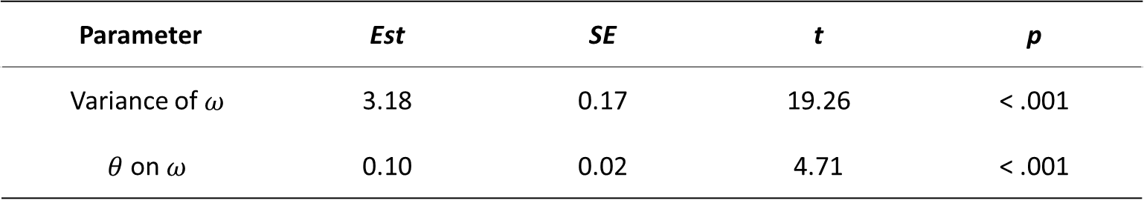
Results | Research question 2
(2) Does a propensity to reread exist and how is it related to test performance?
A propensity to reread the text does exist and
is positively related to test performance
Table 3. Results of latent regression (test performance)
Parameter | Est | SE | t | p
Variance of $ω$ | 3.18 | 0.17 | 19.26 | < .001
$θ$on $ω$ | 0.10 | 0.02 | 4.71 | < .001
Note. $ω$ = individual tendency to reread the text. $θ$ = test performance.

Slide 12
Discussion | summary and Interpretation of results
How does rereading the test influence item and person parameters?
  Rereading the text can lead to increased and reduced item difficulties
  The propensity to reread the text is slightly related to test performance
Complexity-adequate behavior may explain differences in item difficulties
  Complex items rely on slow, controlled thought processes and thus require relecture of text
  → better accuracy with relecture (item becomes „easier“)
  Easy items rely on fast, automatic processes and do not require relecture of text
  → worse accuracy with relecture (item becomes „harder“)

Slide 13
Discussion | limitations and future research
Replication with more items → enables inference statistics on item level
Include other response processes as indicators of test thoroughness (e.g., answer change, item revisit)

Slide 14
Thank you for your attention!

Slide 15
Literature
Jeon, M., Boeck, P., & van der Linden, W. (2017). Modeling Answer Change Behavior: An Application of a Generalized Item Response Tree Model. Journal of Educational and Behavioral Statistics, 42(4), 467–490. https://doi.org/10.3102/1076998616688015
Molenaar, D., & De Boeck, P. (2018). Response Mixture Modeling: Accounting for Heterogeneity in Item Characteristics across Response Times. Psychometrika, 83(2), 279–297. https://doi.org/10.1007/s11336-017-9602-9
Molenaar, D., Oberski, D., Vermunt, J., & De Boeck, P. (2016). Hidden Markov Item Response Theory Models for Responses and Response Times. Multivariate Behavioral Research, 51(5), 606–626.
Nagy, G., & Ulitzsch, E. (2021). A Multilevel Mixture IRT Framework for Modeling Response Times as Predictors or Indicators of Response Engagement in IRT Models. Educational and Psychological Measurement, 001316442110453. https://doi.oDR/10.1177/00131644211045351
Pokropek, A. (2016). Grade of Membership Response Time Model for Detecting Guessing Behaviors. Journal of Educational and Behavioral Statistics, 41(3), 300-325. https://doi.org/10.3102/1076998616636618
van der Linden, W. J., & Jeon, M. (2012). Modeling Answer Changes on Test Items. Journal of Educational and Behavioral Statistics, 37(1), 180–199. https://doi.org/10.3102/1076998610396899
Welling, J., Gnambs, T., & Carstensen, C. H. (2023). Identifying Disengaged Responding in Multiple-Choice Items: Extending a Latent Class Item Response Model with Novel Process Data Indicators. Educational and Psychological Measurement, 00131644231169211.
Zhang, S., Li, A., & Wang, S. (2023). Exploration of Latent Structure in Test Revision and Review Log Data. Educational Measurement: Issues and Practice, emip.12576. https://doi.org/10.1111/emip.12576

Slide 16
Background | test-taking behaviour
Dual-processing theory
(Schneider & Shiffrin, 1977)
Automatic & fast
process
Controlled & slow
process
→ fast, simple responses
on easy items?
→ slow, elaborated responses
on difficult items?
Notes:
Previous research often focuses on item response times:
Can different response times distinguish different test-taking behaviours? (e.g., Nagy & Ulitzsch, 2021; Pokropek, 2016)
Do long and short responses correspond to the same processes? (e.g., Molenaar et al., 2016; Molenaar & De Boeck, 2018)
Erkenntnisse, dass sich kurze und lange Bearbeitungszeiten voneinander unterscheiden können → Erklärungen durch weitere Prozessdaten?
Komplexitäts-adequates Antwortverhalten → dual-processing theory

Slide 17
Results | model comparison
Table 2. Information criteria and deviance test for all estimated models
 |  |  | Information criteria |  |  |  | χ²-test
Model | n parameter | Deviance | AIC | BIC | aBIC | Entropy | ΔDeviance | p-value
Invariant | 47 | 50622 | 50716 | 51098 | 50949 | 0.983
Partly invariant | 61 | 50455 | 50577 | 51073 | 50879 | 0.982 | 161 | < .001
Not invariant | 75 | 50422 | 50572 | 51182 | 50943 | 0.981 | 33 | < .001
best model

Slide 18
Results | descriptives by latent class membership
Table 3. Descriptive results by latent class
Latent class | Probability of latent class membership | Response time (in seconds) | Correct response
 |  | M (SD) | (percentage)
Solution behavior with text reread | 32.7% | 34.39 (18.04) | 56.2%
Solution behavior without text reread | 64.6% | 25.40 (16.48) | 55.7%
Rapid guessing | 2.7% | 3.37 (1.22) | 29.6%

Slide 19












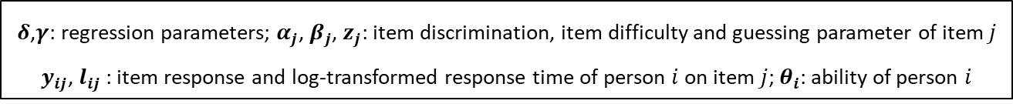
implementation | mixture model of engagement (Pokropek, 2016)
SB
$$1−\frac{exp⁡(δ+γl_{ij})}{1+exp⁡(δ+γl_{ij})}$$
$$\frac{exp⁡(δ+γl_{ij})}{1+exp⁡(δ+γl_{ij})}$$
Test-taking behavior
$${SB}_{ij}=0$$
$${SB}_{ij}=1$$
$$\frac{exp⁡(α_{j}θi−βj)}{1+exp⁡(α_{j}θi−βj)}$$
$$1−\frac{exp⁡(α_{j}θi−βj)}{1+exp⁡(α_{j}θi−βj)}$$
$$z_{j}$$
$${1−z}_{j}$$
Item responses
$$y_{ij}=1$$
$$y_{ij}=0$$
$$y_{ij}=1$$
$$y_{ij}=0$$
Rapid guessing
Solution behavior
$δ$,$γ$: regression parameters; $α_{j}$, $β_{j}$, $z_{j}$: item discrimination, item difficulty and guessing parameter of item $j$
$y_{ij}$, $l_{ij}$: item response and log-transformed response time of person $i$ on item $j$; $θ_{i}$: ability of person $i$

Slide 20
implementation | research questions
Do responses with and without text rereads relate in the same way to test performance, when test-taking engagement is accounted for?
Testing measurement invariance between the two solution behavior classes:
Fully invariant model: same item discriminations and item difficulties
Partly invariant model: same item discriminations, but differing item difficulties
Not invariant model: differing item discriminations and item difficulties

Slide 21
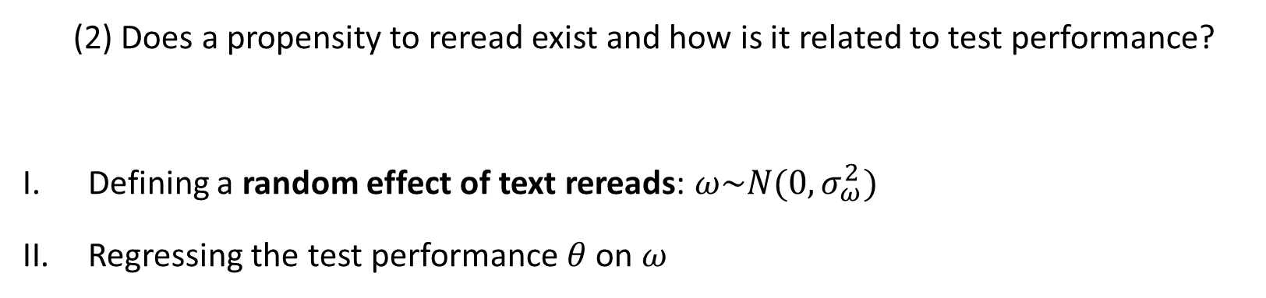
implementation | research questions
(2) Does a propensity to reread exist and how is it related to test performance?
Defining a random effect of text rereads: $ω\sim N(0,σ_{ω}^{2})$
Regressing the test performance $θ$on $ω$

Slide 22
Methods | operationalization of indicators
  For each item-person encounter:
  Item response time is defined as the time the participant spent in total on an item page
  → the time spent on the text page(s) does not count as item response time
  Text reread is defined as a navigation event from the current item page to a text page

Slide 23
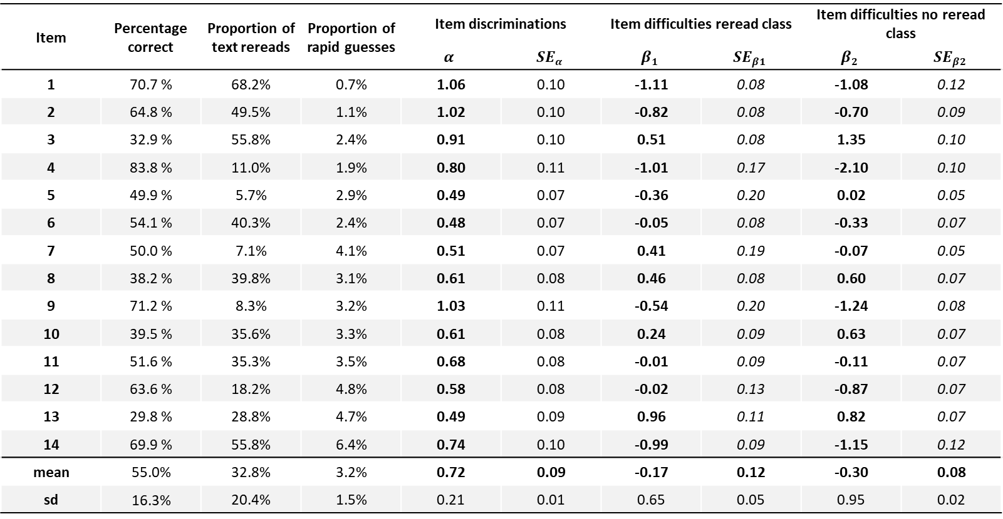
Results | item parameters
Table 3. Item parameters by latent class
Item | Percentage correct | Proportion of text rereads | Proportion of rapid guesses | Item discriminations |  | Item difficulties reread class |  | Item difficulties no reread class
Item |  | Reread probability |  | $$α$$ | $$SEα$$ | $$β1$$ | $$SEβ1$$ | $$β2$$ | $$SEβ2$$
1 | 70.7 % | 68.2% | 0.7% | 1.06 | 0.10 | -1.11 | 0.08 | -1.08 | 0.12
2 | 64.8 % | 49.5% | 1.1% | 1.02 | 0.10 | -0.82 | 0.08 | -0.70 | 0.09
3 | 32.9 % | 55.8% | 2.4% | 0.91 | 0.10 | 0.51 | 0.08 | 1.35 | 0.10
4 | 83.8 % | 11.0% | 1.9% | 0.80 | 0.11 | -1.01 | 0.17 | -2.10 | 0.10
5 | 49.9 % | 5.7% | 2.9% | 0.49 | 0.07 | -0.36 | 0.20 | 0.02 | 0.05
6 | 54.1 % | 40.3% | 2.4% | 0.48 | 0.07 | -0.05 | 0.08 | -0.33 | 0.07
7 | 50.0 % | 7.1% | 4.1% | 0.51 | 0.07 | 0.41 | 0.19 | -0.07 | 0.05
8 | 38.2 % | 39.8% | 3.1% | 0.61 | 0.08 | 0.46 | 0.08 | 0.60 | 0.07
9 | 71.2 % | 8.3% | 3.2% | 1.03 | 0.11 | -0.54 | 0.20 | -1.24 | 0.08
10 | 39.5 % | 35.6% | 3.3% | 0.61 | 0.08 | 0.24 | 0.09 | 0.63 | 0.07
11 | 51.6 % | 35.3% | 3.5% | 0.68 | 0.08 | -0.01 | 0.09 | -0.11 | 0.07
12 | 63.6 % | 18.2% | 4.8% | 0.58 | 0.08 | -0.02 | 0.13 | -0.87 | 0.07
13 | 29.8 % | 28.8% | 4.7% | 0.49 | 0.09 | 0.96 | 0.11 | 0.82 | 0.07
14 | 69.9 % | 55.8% | 6.4% | 0.74 | 0.10 | -0.99 | 0.09 | -1.15 | 0.12
mean | 55.0% | 32.8% | 3.2% | 0.72 | 0.09 | -0.17 | 0.12 | -0.30 | 0.08
sd | 16.3% | 20.4% | 1.5% | 0.21 | 0.01 | 0.65 | 0.05 | 0.95 | 0.02
Notes:
Zu viele Zahlen → raus? Das Gleiche wird ja auch auf der nächsten Folie graphisch dargestellt!

Slide 24
Results | latent regression of text rereads
Table 5. Results of hierarchical latent regression (text rereads)
Parameter | Est | SE | t | p
Intercept item 1 | -8.41 | 0.22 | -38.60 | < .001
Intercept item 2 | -10.45 | 0.24 | -43.55 | < .001
Intercept item 3 | -9.08 | 0.22 | -41.48 | < .001
Intercept item 4 | -12.73 | 0.25 | -51.34 | < .001
Intercept item 5 | -13.21 | 0.26 | -51.61 | < .001
Intercept item 6 | -10.29 | 0.23 | -45.13 | < .001
Intercept item 7 | -12.84 | 0.25 | -51.57 | < .001
Intercept item 8 | -10.49 | 0.23 | -45.19 | < .001
Intercept item 9 | -13.86 | 0.27 | -51.71 | < .001
Intercept item 10 | -10.60 | 0.23 | -45.89 | < .001
Intercept item 11 | -11.11 | 0.24 | -45.91 | < .001
Intercept item 12 | -12.55 | 0.26 | -49.02 | < .001
Intercept item 13 | -10.50 | 0.23 | -46.07 | < .001
Intercept item 14 | -7.62 | 0.20 | -37.93 | < .001
Log response time | 2.97 | 0.07 | 45.71 | < .001
Notes:
T nur in Excel geschätzt, Rundungsfehler!

Slide 25
Results | latent regression of solution behavior
Table 4. Results of latent regression (solution behavior)
Parameter | Est | SE | t | p
Intercept | -10.56 | 2.25 | -4.69 | < .001
Log response time | 5.88 | 1.12 | 5.27 | < .001
Notes:
T nur in Excel geschätzt, Rundungsfehler!

Slide 26
Results | comparison of item difficulties
Notes:
Alte Daten

Slide 27
Results | external criteria
Table 8. Correlations with external criteria
 |  | 1 | 2 | 3 | 4
1. | Test performance | 1.00
2. | Tendency to reread text | 0.23***¹ | 1.00
3. | Grade in German | 0.15***² | 0.08***² | 1.00
4. | Thoroughness | -0.01² | 0.05*² | 0.09***² | 1.00
¹ Pearson correlation coefficient.
² Kendall rank correlation coefficient.

Slide 28
Results | descriptive results
Table 1. Descriptive results for all 14 multiple-choice items
 | item position |  | item*person encounters | response time | item responses | text reread
task | within task | within test | N | M (SD) | percentage correct | percentage r_{ij} = 1
1 | 1 | 1 | 1930 | 30.17 (28.09) | 70.7 % | 68.2 %
1 | 2 | 2 | 1928 | 36.24 (18.58) | 64.8 % | 49.5 %
1 | 3 | 3 | 1928 | 27.87 (15.77) | 32.9 % | 55.9 %
2 | 2 | 6 | 1898 | 26.06 (18.27) | 83.8 % | 11.0 %
2 | 3 | 7 | 1900 | 21.67 (12.85) | 49.9 % | 5.7 %
3 | 1 | 10 | 1872 | 27.67 (14.62) | 54.1 % | 40.3 %
3 | 2 | 11 | 1867 | 21.03 (12.74) | 50.0 % | 7.3 %
3 | 3 | 12 | 1856 | 29.85 (17.64) | 38.2 % | 40.0 %
3 | 4 | 13 | 1849 | 33.03 (17.53) | 71.2 % | 8.3 %
3 | 6 | 15 | 1808 | 27.36 (13.68) | 39.5 % | 36.1 %
4 | 1 | 16 | 1733 | 32.55 (27.07) | 51.6 % | 35.5 %
4 | 3 | 18 | 1617 | 32.44 (17.80) | 63.6 % | 18.7 %
5 | 1 | 19 | 1464 | 22.34 (12.32) | 29.8 % | 28.8 %
5 | 2 | 20 | 1413 | 17.35 (12.23) | 69.9 % | 57.1 %

Slide 29
Discussion | open questions and limitations
Validation with external criteria
  Is it ok to use just one item for measuring thoroughness?
  Other validation criteria, e.g. interest in reading?
Limitations
  Hierarchical data structure of items belonging to tasks is not accounted for
  Relationships on item level only carefully interpretable due to low number of items
  Homogenous sample

