Slide 1
A Multilevel Mixture IRT Model for
Partial Engagement in Proficiency Tests
Gabriel Nagy
Leibniz Institute for Science and Mathematics Education, Kiel
Esther Ulitzsch
University of Oslo

Slide 2
Test-Taking Engagement
Maximum Test-Taking Engagement (TTE) Assumption
Proficiency tests aim to measure what students know and can do
Assumes students give their best effort (maximum TTE)
Assumption typically violated in low-stakes assessments
Low TTE causes systematic bias in results (e.g., Nagy et al., 2019)
Accounting for low Test-Taking Engagement (TTE)
Identification of disengaged respondents and responses:
  Self-reported TTE (Ecklöf, 2007)
  Aberrant response patterns (e.g., item position effects; Nagy et al., 2016)
  Collateral response information (e.g., item response times; Ulitzsch et al., 2020)
Partial Engagement in Proficiency Tests | EAM 2025

Slide 3


Item Response Times
Rapid Guessing Behavior (Wise, 2017)
Dichotomous classification of TTE on item level (within-individual; Ulitzsch et al., 2020)
  Within-individual relationships of response times with accuracies fully accounted by TEE
Response Times
Response Accuracies
Disengaged
Engaged
$$P\left(Y=1|Engaged\right)$$
$$P\left(Y=1\right)$$
$$P\left(Y=1|Disengaged\right)$$
Partial Engagement in Proficiency Tests | EAM 2025

Slide 4
Item Response Times
Continuous Relationships
Measurement characteristics differ between faster and slower responses
(e.g., Bolsinova et al., 2017; Molenaar & de Boeck, 2018)
  Dichotomous of TTE might not fully account for within-individual relationships
Gradual Relationships
Possible Interpretation
Quick trails that are partially (dis-)engaged
Faster responses reflect superficial,
error-prone processing (e.g., fewer checks)
→ Lower average success rates
Low proficiency leads to especially low success under superficial processing
→ Stronger item discriminations
Partial Engagement in Proficiency Tests | EAM 2025

Slide 5
Item Response Times
Item Response Times and Gradual Levels of TTE
Extension of Mixture IRT model to gradual differences in TTE
Approximation by multiple latent classes (e.g., Lindsay, Clogg & Grego, 1987)
Accounts for relationships with item difficulties and item discriminations
Partially Engaged
Disengaged
Engaged
Gradual
TTE
Partial Engagement in Proficiency Tests | EAM 2025

Slide 6
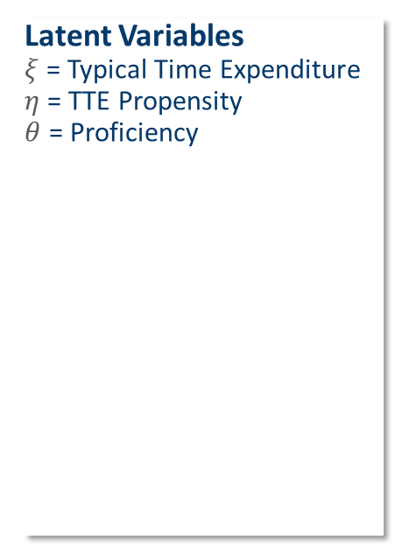
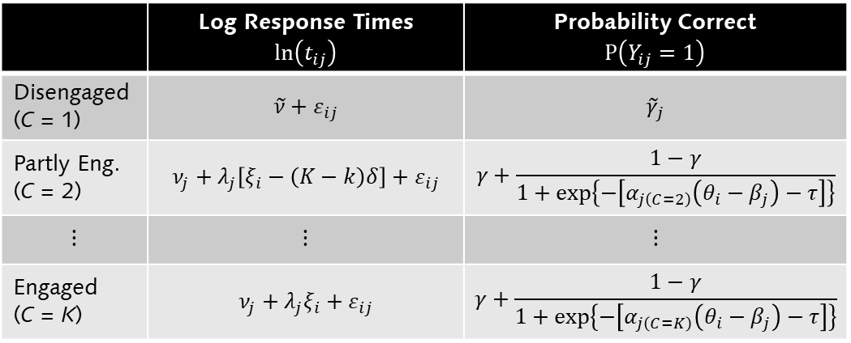
Modeling Partial TEE
IRT Formulation of Partial Test-Taking Engagement
Latent Variables
$ξ$ = Typical Time Expenditure
$η$= TTE Propensity
$θ$ = Proficiency
Measurement Equations
Class Membership
 | Log Response Times $$ln\left(t_{ij}\right)$$ | Probability Correct $P\left(Y_{ij}=1\right)$
Disengaged (C = 1) | $$\tilde{ν}+ε_{ij}$$ | $${\tilde{γ}}_{j}$$
Partly Eng. (C = 2) | $$ν_{j}+λ_{j}\left[ξ_{i}−\left(K−k\right)δ\right]+ε_{ij}$$ | $$γ+\frac{1−γ}{1+exp\left\{−\left[α_{j\left(C=2\right)}\left(θ_{i}−β_{j}\right)−τ\right]\right\}}$$
$$⋮$$ | $$⋮$$ | $$⋮$$
Engaged (C = K) | $$ν_{j}+λ_{j}ξ_{i}+ε_{ij}$$ | $$γ+\frac{1−γ}{1+exp\left\{−\left[α_{j\left(C=K\right)}\left(θ_{i}−β_{j}\right)−τ\right]\right\}}$$
$$P\left(C_{ij}=k\right)=\frac{exp\left(ω_{0\left(C=k\right)}+ω_{1\left(C=k\right)}η_{i}\right)}{\sum_{k=1}^{K}{exp\left(ω_{0\left(C=l\right)}+ω_{1\left(C=l\right)}η_{i}\right)}}, ω_{0\left(C=K\right)}=ω_{1\left(C=K\right)}=0$$
Partial Engagement in Proficiency Tests | EAM 2025

Slide 7
The Present Study
Research Questions
Usefulness of model extension
  Goodness-of-fit relative to IRT models for dichotomous TTE
  More differentiated information
Validity of interpretation as TTE
  Relationships with item positions
  Relationships with self-reported effort
Model Estimation
Considered models:
  Van der Linden’s (2007) RT-IRT model
  ILC-IRT model for TTE (Nagy & Ulitzsch, 2022)
  ILC-IRT model for gradual TTE
Marginal maximum likelihood estimation in Mplus 8.11 (Muthén & Muthén, 2020)
Specification in Multilevel-Mixture-IRT framework (Nagy & Ulitzsch, 2022)
Sample and Measures
N = 404 students (6th grade)
Science test wit J = 24 items
P = 48 random item positions
Self-reported test effort (α = .75)
Statistical Analyses
Relationships of item-level posterior probabilities
Relationships of EAP trait estimates
Partial Engagement in Proficiency Tests | EAM 2025

Slide 8
Results
Model Comparisons
Evidence for low TTE
Accounting for TTE improves goodeness-of-fit
Fit of 4-class IRT model (gradual TTE) better than fit of 2-class TTE-IRT model
 | # Par. | LL | AIC | BIC | SBIC
3PL + Van der Linden | 79 | -16196.853 | 32551.706 | 33118.884 | 32867.834
3PL + Dichotomous TTE | 86 | -12602.275 | 25376.549 | 25993.984 | 25720.689
3PL + Partial TTE | 92 | -12514.550 | 25213.101 | 25873.612 | 25581.250
Partial Engagement in Proficiency Tests | EAM 2025

Slide 9
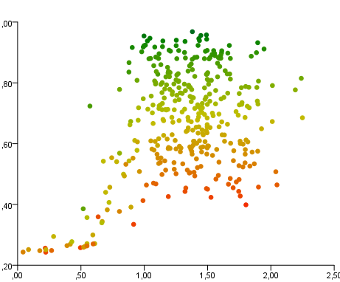
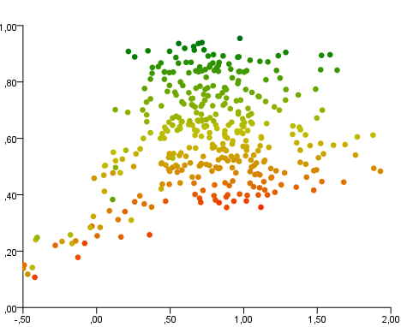
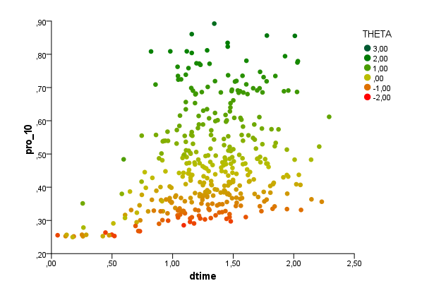

Results
Relationships with Response Time
Adjusted response times above rapid guessing behavior and model implied solution probabilities (based on posterior probabilities and EAP trait estimates)
Easy Item
Intermediate Item
Hard Item
Theta ($\hat{θ}$)
max.
Predicted Prob. Correct
min.
Residualized Response Time
Residualized Response Time
Residualized Response Time
Partial Engagement in Proficiency Tests | EAM 2025

Slide 10
Results
Prevalence of Test-Taking Engagement
Similar amount of TTE estimated in models for dichotomous and gradual TTE
Increasing proportion of partial TTE over the course of the test
Marginal Prop. of TTE
Proportion of TTE by Item Position
Engaged
Partially
Engaged
Disengaged
Partial Engagement in Proficiency Tests | EAM 2025

Slide 11
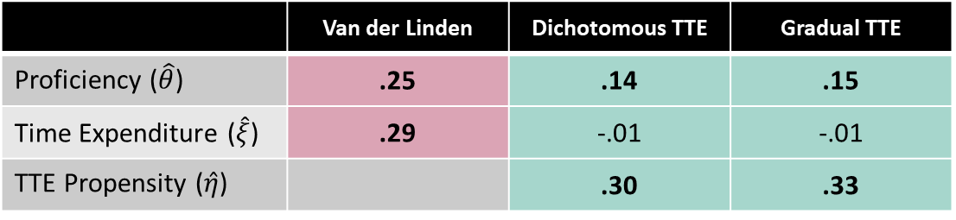

Results
Relationships of Self-Reported Effort with Trait Estimates
Correlations support interpretation of $η$ as TTE Propensity
Little difference between models for dichotomous and gradual TTE
Evidence that accounting for TTE “improves” the interpretation of $θ$ as proficiency
Correlations with EAP Trait Estimates
 | Van der Linden | Dichotomous TTE | Gradual TTE
Proficiency ($\hat{θ}$) | .25 | .14 | .15
Time Expenditure ($\hat{ξ}$) | .29 | -.01 | -.01
TTE Propensity ($\hat{η}$) |  | .30 | .33
Partial Engagement in Proficiency Tests | EAM 2025

Slide 12
Summary and Conclusion
Test-Taking Engagement as a Continuum
Person-item interactions reflect varying degree of engagement
Response times as a basis for nuanced TTE analysis
Approximation to gradual TTE possible via Multilevel-Mixture-IRT framework
Practical Implications
No disadvantage of using the more complex model
Little practical gains from added model complexity
Results may vary across datasets
Future Research
Replication in other samples and test domains
Systematic variation of time limits to test model assumptions
Partial Engagement in Proficiency Tests | EAM 2025

Slide 13
Thank you for your (gradual) attention
Gabriel Nagy (nagy@leibniz-ipn.de)
Esther Ulitzsch (esther.ulitzsch@cemo.uio.no)

