Slide 1
Reliability generalization of the Emotional Quotient Inventory Youth Version (EQ-i:YV):A meta-analitic structural equation modelling approach
Alejandro Veas ¹, José Antonio López-López ¹, Julio Sánchez-Meca ¹, and Raimundo Aguayo ²
1. University of Murcia. 2. Complutense University of Madrid

Slide 2

THE BEGGINING AND THE END…
α
ω

Slide 3
Justification
Problems in univariate MA-GR using Cronbach Alfa as effect size: lack of equivalence between total reliability and subscales reliability.
Principles of Alfa Cronbach difficult to address:
  Equivalence of the contribution of each item to the scale (Tau-equivalence).
  Independence of errors.
  Unidimensionality.
  Dunn, T. J., Baguley, T., & Brunsden, V. (2013). From Alpha to omega: a practical solution to the pervasive problem of internal consistency estimation. British Journal of Psychology, 105(3), 399-412. https://doi.org/10.1111/bjop.12046

Slide 4
Basic principles of MASEM
1
2
3
Estimation of Random Effects Model
Estimation and check of Structural Equation Model fit, based on the pooled correlation matrices
Combination of correlation matrices from different primary studies

Slide 5
INTRODUCTION
Antecedent of MASEM: Invariance analysis of SEM across primary studies (Raykov & Marcoulides, 2013).
Different MASEM procedures have been proposed:
  Correlation-based MASEM:
    Two-stage MASEM (TSMASEM).
    One-stage MASEM (OSMASEM).
  Parameter-based MASEM.
Jak, S., & Cheung, M. W. L. (2020). Meta-analytic structural equation modeling with moderating effects on SEM parameters. Psychological methods, 25(4), 430.
Raykov, T., & Marcoulides, G. A. (2013). Meta-analysis of scale reliability using latent variable modelling. Structural Equation Modeling: A multidisciplinary Approach, 20(2),338-353.

Slide 6
MASEM
 | Correlation-based |  | Parameter-based
 | Two-stage | One-stage
Common effect size | inter-items correlation matrix. | inter-items correlation matrix | Reliability coefficients
Factor structure | Stage 1: Combine the matrices. Stage 2: Run the CFA. | Unic stage: estimate the pooled matrices and run the CFA. | Unic stage: Run a separate CFA per primary study.
Reliability Generalization | 1. Estimate the average reliability 2. Evaluate heterogeneity of correlations. 3. Only quantitative moderators. | 1. Estimate the average reliability. 2. Evaluate the heterogeneity of correlations. 3. Analysis of moderators influencing factor loadings. | 1. Combine the reliability coefficients. 2. Evaluate the heterogeneity of reliability coefficients. 3. Analysis of moderators.
Notes:
Con TSMASEM no se podría comprobar directamente la invarianza métrica (igualdad de cargas factoriales), puesto que la moderación es sobre correlaciones
Con OSMASEM sí se puede comprobar invarianza métrica.

Slide 7
Objective of the study
To Implement MASEM on the Emotional Quotient Inventory Youth Version (EQ-i:YV; Bar-On & Parker, 2003)
Characteristics of the scale
  60-item self-report measure.
  4 dimensions: Intrapersonal scale, interpersonal scale, stress management scale, adaptability scale.
  *There is a popular short version of 35 items with the same factors.

Slide 8
Example of items
Intrapersonal:
  It is easy to tell people how I feel.
Interpersonal
  I care what happens to other people.
Stress management
  I can stay calm when I am upset.
Adaptability
  It is easy for me to understand new things

Slide 9

Search of studies
  Initial identification: 320 potential studies.
  Screening: 100 studies.
  Studies assessed: 84
  Final studies included: 17
    Reasons for exclusión: qualitative study, lack of correlation matrices.
    Matrices of correlations included: 19.
Esta foto de Autor desconocido está bajo licencia CC BY-NC-ND

Slide 10
Codification
Only correlations between factors included. None of the studies reported the inter-item correlation matrices.
Two studies reported two correlation matrices as they used different types of simples.
Subsamples (not included in the MASEM):
  Adolescents.
  Gifted students.
  Children.
  Students with disabilities.

Slide 11
Method
Scherer, R., & Teo, T. (2020). A tutorial on the Meta-analytic structural equation modeling of reliability coefficients. Psychological Methods, 25(6), 747-775. https://doi.org/10.1037/met0000261
Procedures | R packages
Univariate | Metafor
Parameter-based MASEM | Metafor, Psych
One-Stage MASEM | Lavaan, MetaSEM
Two-stage MASEM | Lavaan, MetaSEM

Slide 12
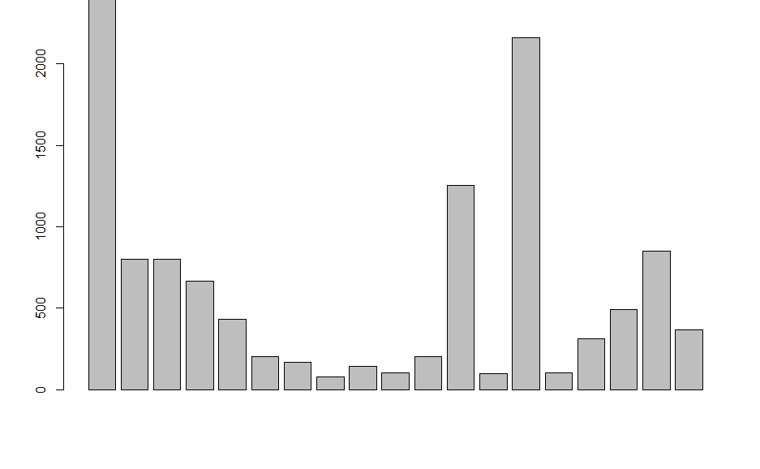
SAMPLE DISTRIBUTION ACROSS PRIMARY STUDIES

Slide 13
Results: Two-Stage MASEM
 | Intra | Inter | SM | AD
Intra | 1
Inter | 0,30 | 1
SM | 0,22 | 0,20 | 1
AD | 0,32 | 0,48 | 0,20 | 1

Slide 14
Results: Two-stage MASEM. Fixed-effects Model
CORRELATION MATRIX FIXED EFFECTS MODEL
Modelo | χ² (gl) | RMSEA (IC) | CFI | AIC
FEM | 1771,62 (108)* | 0,12 (0,118-0,128) | 0,84 | 1555.62
The fixed-effect model is not a suitable representation of the correlation matrix, given its poor fit indices. This may already be interpretaed as evidence for the existence of the between-sample variation of correlations. Therefore, a random-effects model should be estimated.
Notes:
Modelo de 2 factores: Correlación entre factores: 0,81

Slide 15
Results: Two-stage MASEM. Random effects model
 | Intra | Inter | SM | AD
Intra | 1
Inter | 0,31 | 1
SM | 0,14 | 0,13 | 1
AD | 0,33 | 0,48 | 0,13 | 1

Slide 16
Results: Two-Stage MASEM Random-effects model
Hetereogeneity indces (based on the estimated Tau2):
Intercept 1. I2 = 0.93
Intercept 2. I2 = 0.95
Intercept 3. I2 = 0.93
Intercept 4. I2 = 0.93
Intercept 5. I2 = 0.89
Intercept 6. I2 = 0.93

Slide 17
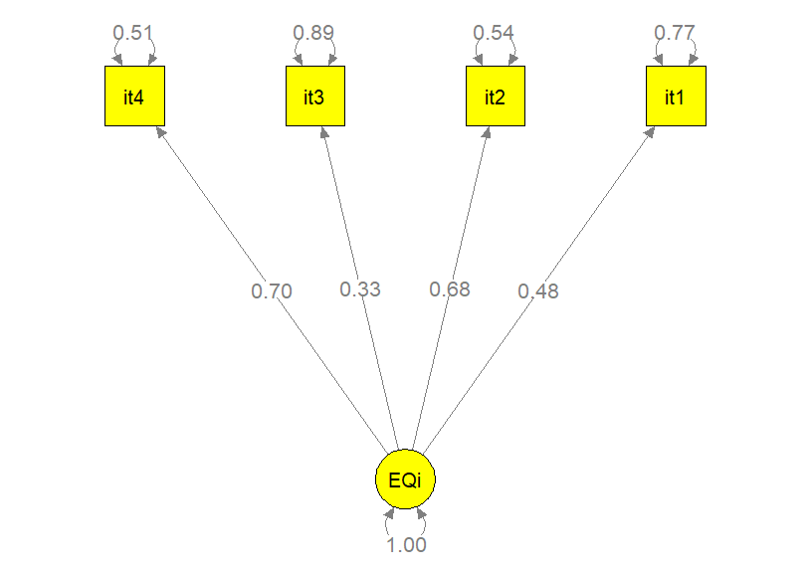
Results. Two-Stage. Model estimation FEM
CFI = 0.98
TLI = 0.94
RMSEA = 0.06
SRMR = 0.03
AIC = 174.31
BIC = 158.58
OMEGA = 0,638 [0,629-0,645]
Likelihood-Based CI

Slide 18
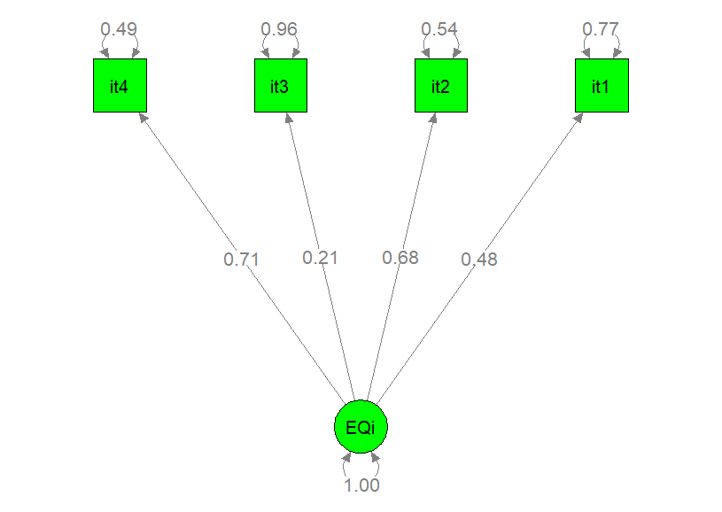
Results. Two-Stage. Model estimation REM
CFI = .99
TLI = .99
RMSEA = .002
AIC = -1.84
BIC = -17.56
OMEGA = 0.609 [0.578, 0.638).
Likelihood-Based CI

Slide 19
Discussion and conclusions
Type of MASEMS applied to EQ-i: YV | Reliability values (Omega)
Two-stage MASEM FEM | 0.638
Two-Stage MASEM REM | 0.609
Random effects models show a better representation of the data structure, as the inter-studies heterogeneity is considered.
Low Omega values may confirm the multidimensionality nature of the scale.
General limitations in MASEM: Normally, primary studies do not report inter-item correlation matrices.
Recommendation that helps applied researchers: Expansion of Shiny App:
Jak et al. (2021). Meta-analytic structural equation modeling made easy: A tutorial and web application for one-stage MASEM. Research Synthesis Methods, 12(5), 590-606. https://doi.org/10.1002/jrsm.1498

Slide 20
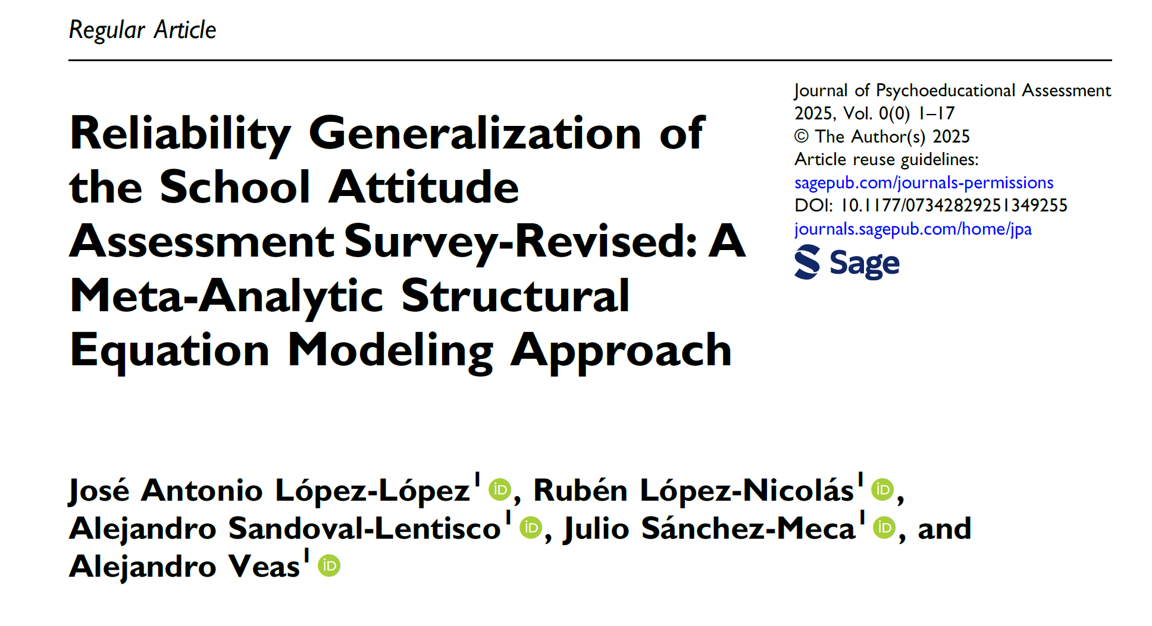

Extra information… published MASEM with moderator analyses

Slide 21
THANK YOU VERY MUCH!!
e-mail: alejandro.veas@um.es
Twitter: @Alejandro_veas

