Slide 1

Bias and Mean Squared Error of Six Estimators of the Standardized Mean Change in Pretest-Posttest Designs.
Manuel Jesús Albaladejo-Sánchez, Fulgencio Marín-Martínez, Julio Sánchez-Meca, José Antonio López-López, María Rubio-Aparicio & Juan José López-García
University of Murcia, Spain

Slide 2
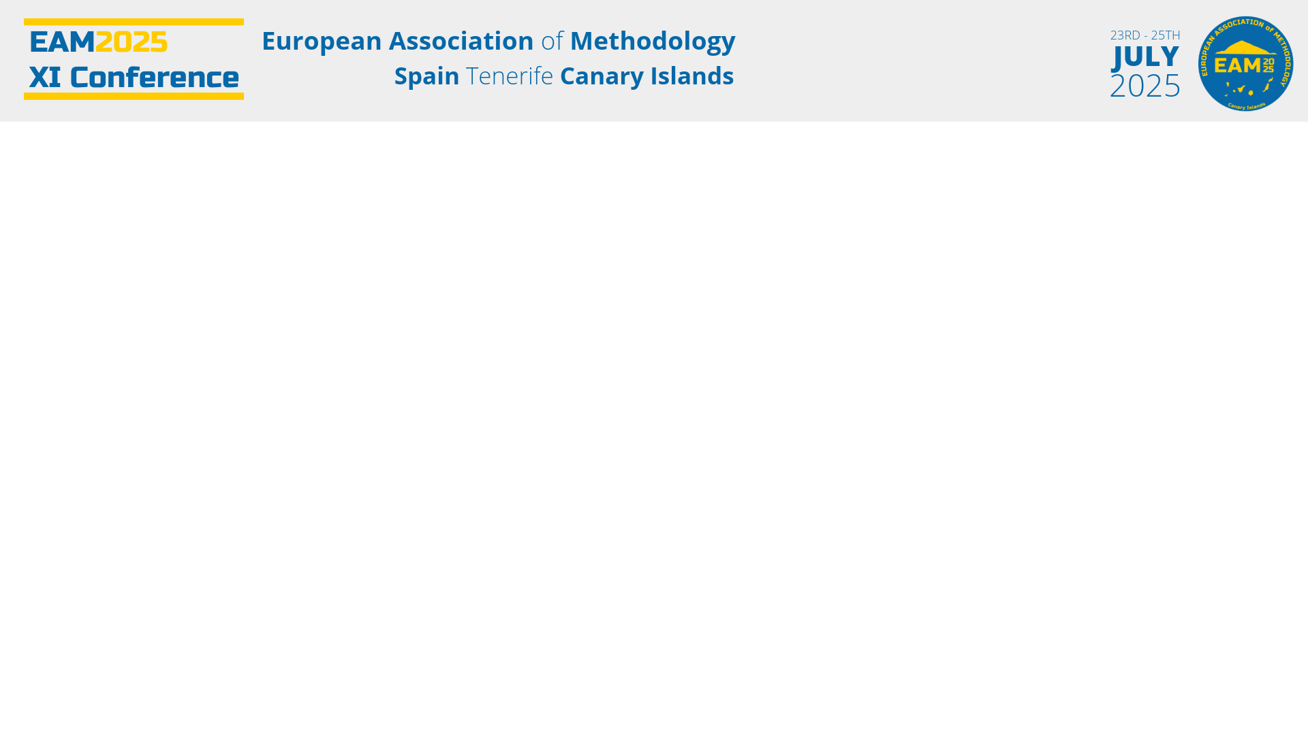
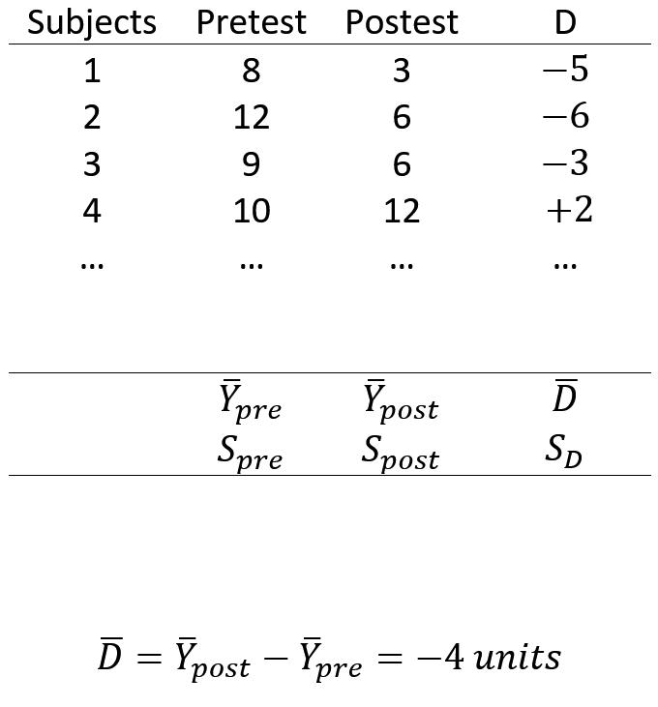

Slide 3
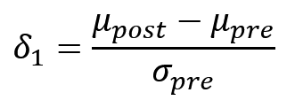
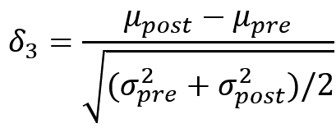
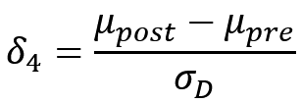
Parameters

Slide 4
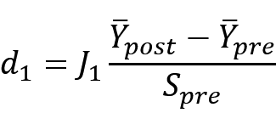
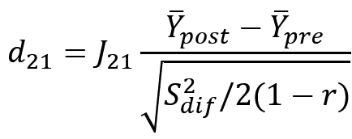
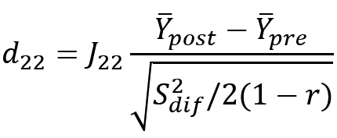
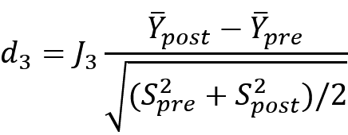
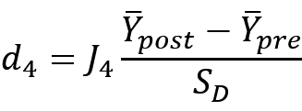
Standardized mean change estimators
Becker
Borenstein(2)
Borenstein(1)
Bonett
Gibbons

Slide 5
Objectives
To compare the bias and mean squared error (MSE) of the 5 estimators with respect to δ₁ and δ₃

Slide 6
Monte Carlo Simulation
The starting point is a bivariate normal distribution N(0; 1; δ; σ_{post} ; ρ)
10,000 replications
600 conditions (3x8x5x5):
  n ={10, 30, 50}
  ρ = {0, 0.2, 0.4, 0.5, 0.6, 0.7, 0.8, 0.9}
  δ = {0, 0.2, 0.5, 0.8, 1.1}
  σ_{post}= {1.5, 1.2, 1, 1/1.2, 1/1.5}

Slide 7
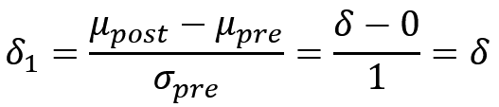
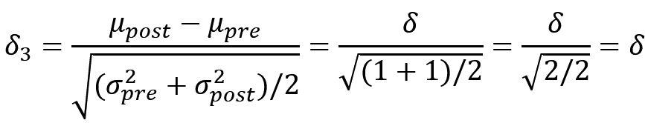
Results (homoscedasticity)
The starting point is a bivariate normal distribution N(0; 1; δ; 1; ρ)

Slide 8
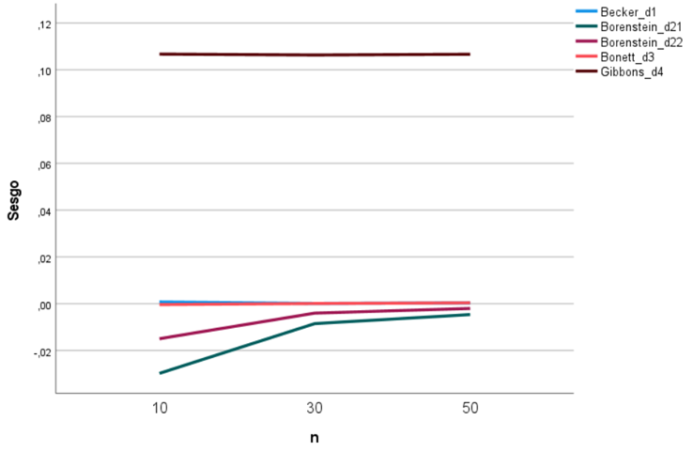
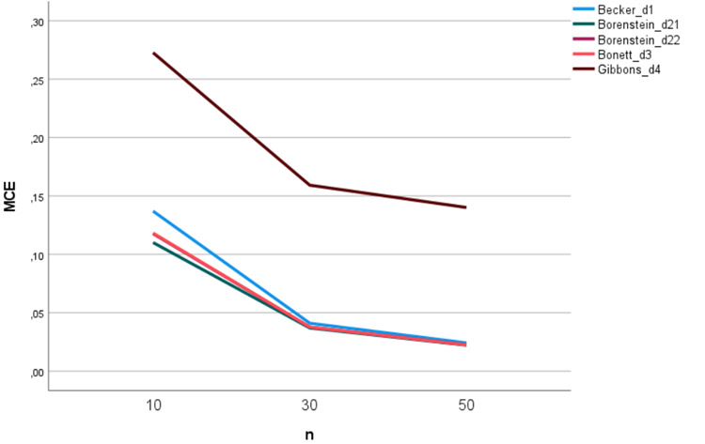
Bias and MSE as a function of n
Bias
MSE

Slide 9
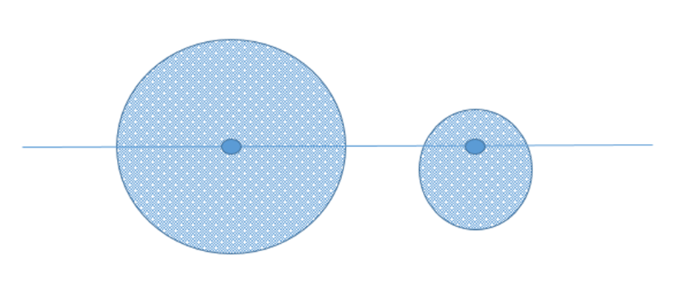
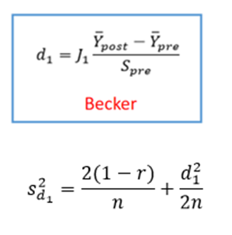
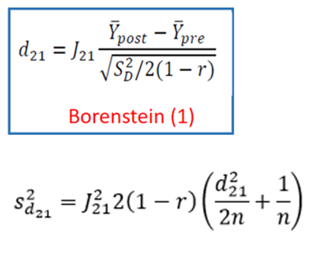

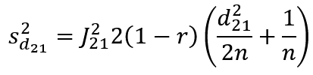
MSE = Bias² + Variance

Slide 10
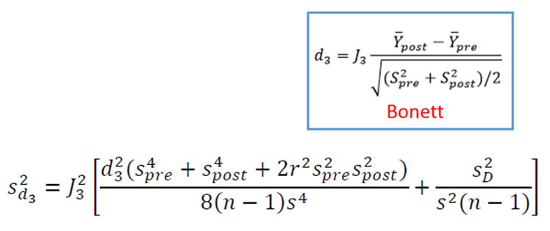
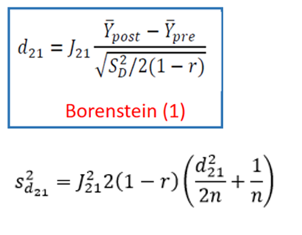


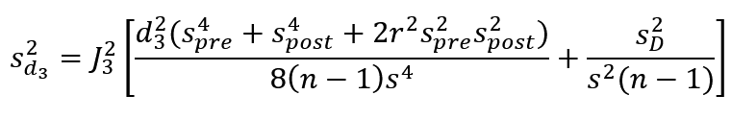

MSE = Bias² + Variance
1 = 0 + 1
0.96 = (-0.1)² + 0.95

Slide 11
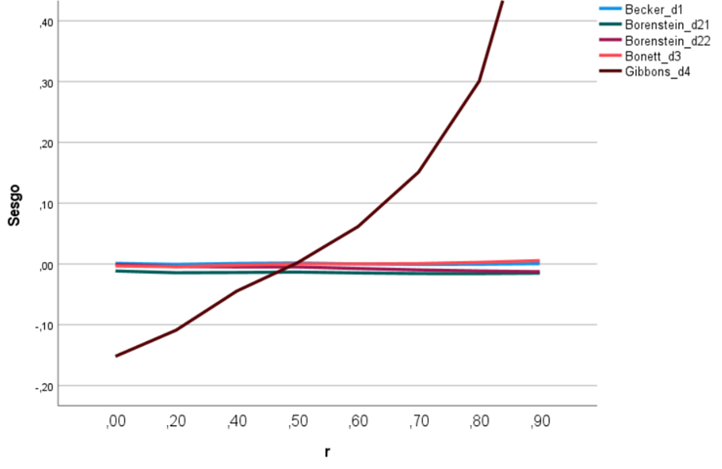
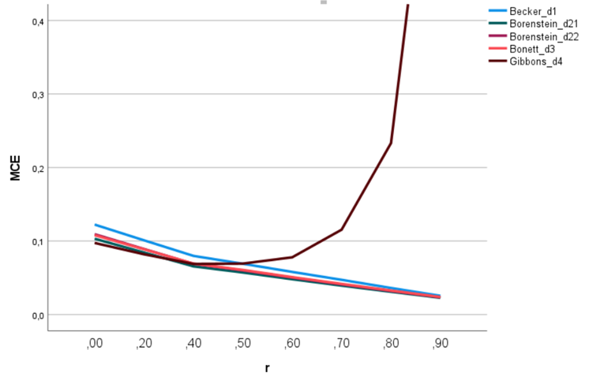
Bias and MSE as a function of r
Bias
MSE

Slide 12

Bias and MSE as a function of r
Bias
MSE

Slide 13
Results (heteroscedasticity)

Slide 14
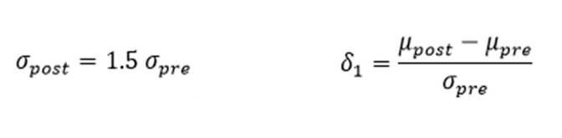
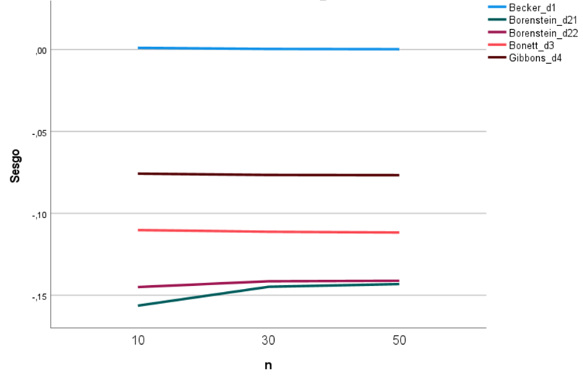
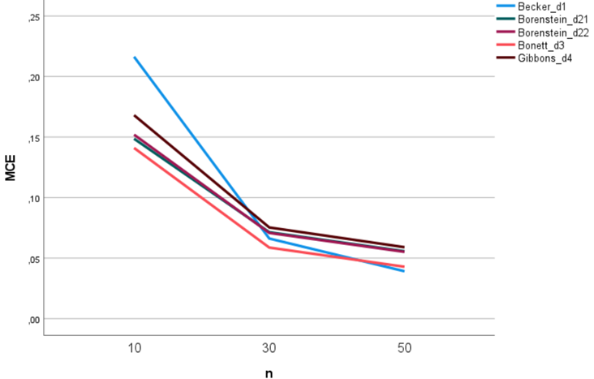
Bias and MSE as a function of n
Bias
MSE

Slide 15

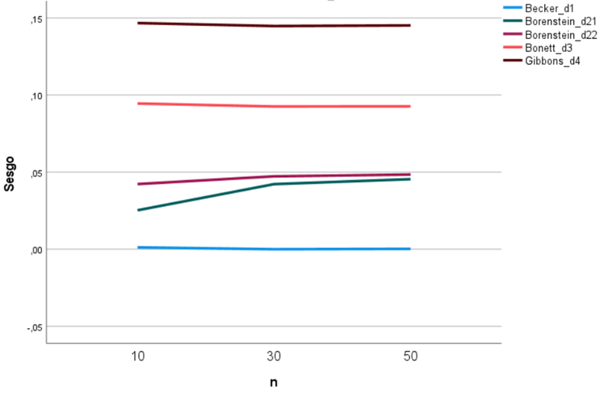
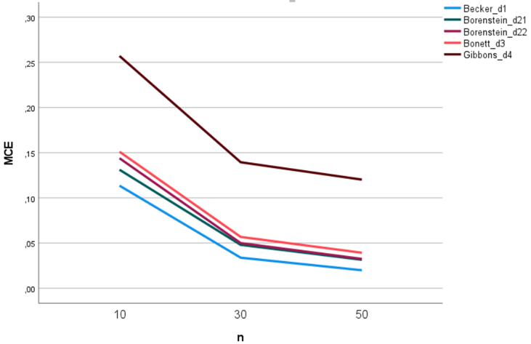
Bias and MSE as a function of n
Bias
MSE

Slide 16
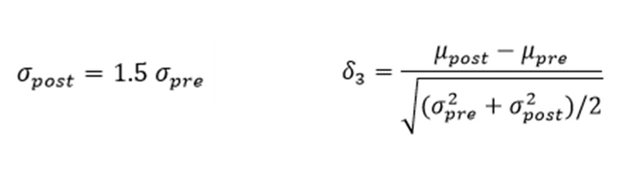
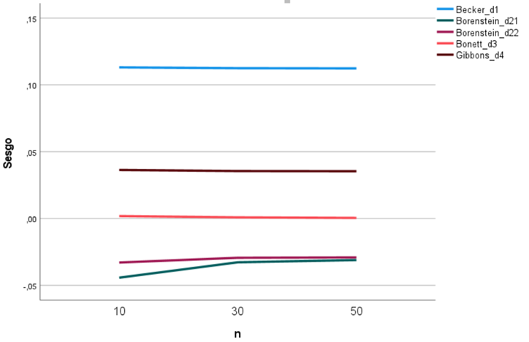
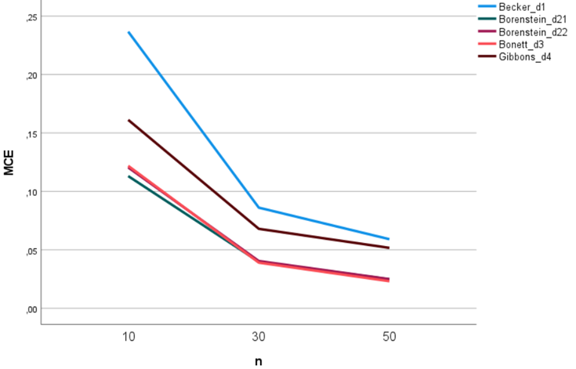
Bias and MSE as a function of n
Bias
MSE

Slide 17
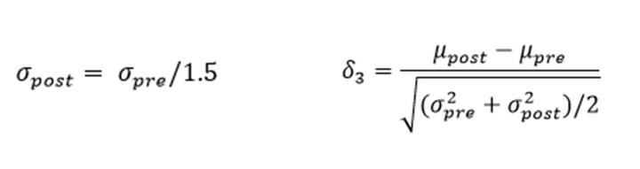
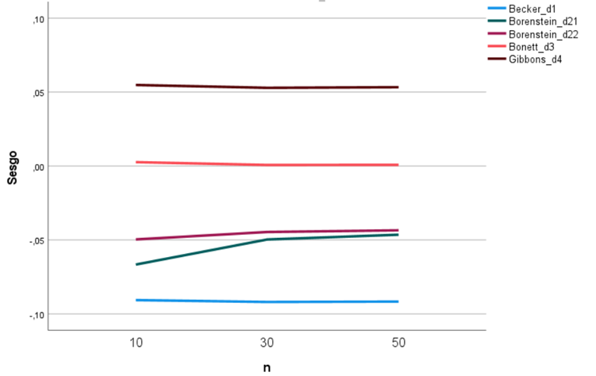
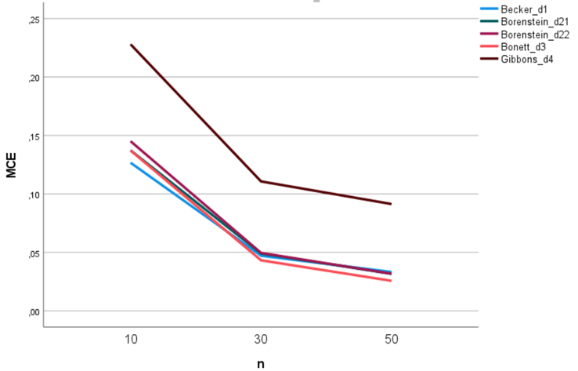
Bias and MSE as a function of n
Bias
MSE

Slide 18
Conclusion
  Under homoscedasticity, d₂₁ is the most efficient estimator, although it is negatively biased. d₃ is the most efficient among the unbiased estimators.
  Under heteroscedasticity, the choice of estimator depends on the target parameter and on whether the variability is greater in the pre-test or post-test scores.
  Although d₄ is not a direct estimator of δ₁ or δ₃, it is sometimes more efficient than other estimators when the pre-post correlation is below 0.50 (but biased!).
  In most scenarios, the most efficient estimator is biased.

Slide 19
Bias and Mean Squared Error of Six Estimators of the Standardized Mean Change in Pretest-Posttest Designs.
Manuel Jesús Albaladejo-Sánchez, Fulgencio Marín-Martínez, Julio Sánchez-Meca, José Antonio López-López, María Rubio-Aparicio & Juan José López-García
University of Murcia, Spain

