Slide 1



Correcting Moderator Effects in Meta-Analysis for Publication Bias: A Simulation Study
Franziska Rüffer
Joint work with Robbie van Aert, Marcel van Assen, and Jelte Wicherts
Notes:
Wednesday 23 July, 10.00-11.30
Symposium 4 Recent Developments in Meta-Analysis
Room 0.5
15 min time slot (10-12 min presentation + 3 min discussion)

Slide 2








Why study publication bias in moderator effects?
$p≤$.05
Publication bias:
  Favouring statistically significant results for publication^{1,2,3}
    Overestimation of meta-analytic mean effect sizes ^{4,5,6}
Moderator effects:
  Primary studies differ in certain characteristics (e.g., participant pool)
  Explaining/exploring effect size heterogeneity
  Important for generating new hypotheses
How does publication bias affect moderator effects in meta-analysis?
Can the currently available methods correct for publication bias in moderator effects?
$p>$.05
vs

Slide 3


Main Findings
How does publication bias affect moderator effects? (Theoretical Study)
  Artificial moderator effects can be induced
  True moderator effects can be hidden, diminished or amplified
  Bias typically occurs when the primary study sample sizes and/or publication bias differ between the moderator levels
vs
vs
Can the currently available methods correct for publication bias in moderator effects? (Simulation Study)
  Ignoring publication bias leads to substantial bias in moderator estimates
  Selection models perform well if the moderator is not related to publication bias

Slide 4
Possible Scenarios
The moderator is not associated with publication bias and sample size
The moderator is associated with publication bias
  Pre-registered vs non-pre-registered ^{7, 8, 9, 10,11}
  Industry-funded vs non-industry funded ^{12,13}
The moderator is associated with sample size
  → Single vs multi-centre trials ^{14,15}
The moderator is associated with publication bias and sample size
  → original vs replication studies ^{7, 8, 9, 10}
vs
vs
vs

Slide 5
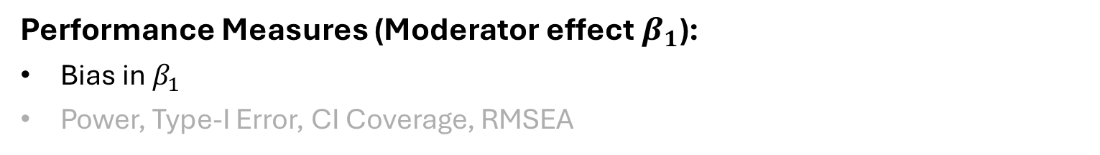
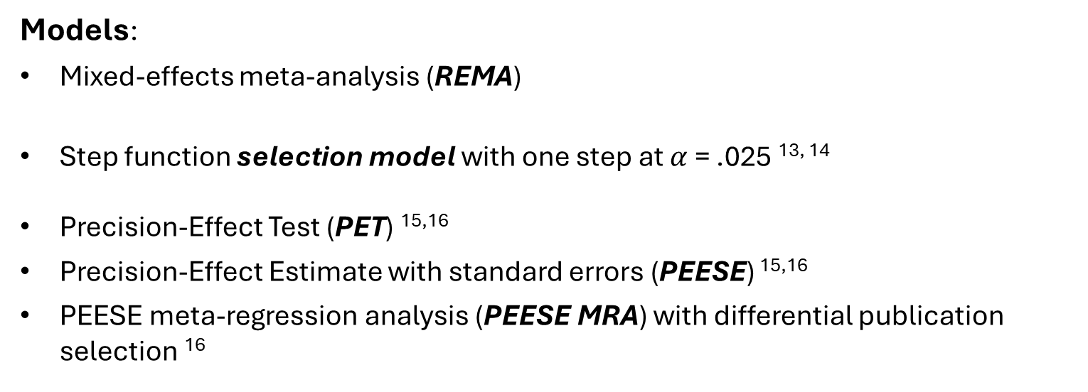
Simulation: Models and Outcomes
Models:
Mixed-effects meta-analysis (REMA)
Step function selection model with one step at $α$= .025 ^{13, 14}
Precision-Effect Test (PET) ^{15,16}
Precision-Effect Estimate with standard errors (PEESE) ^{15,16}
PEESE meta-regression analysis (PEESE MRA) with differential publication selection ¹⁶
Performance Measures (Moderator effect $β_{1}$):
Bias in $β_{1}$
Power, Type-I Error, CI Coverage, RMSEA

Slide 6
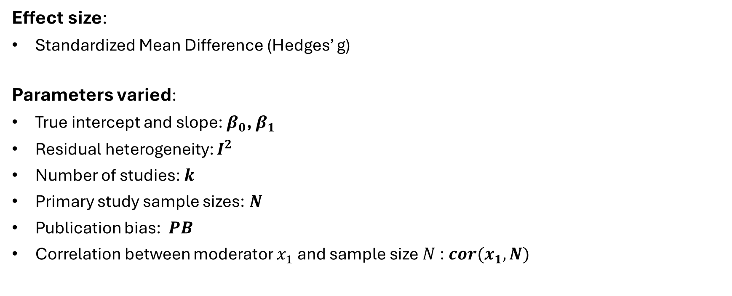
Simulation Design
Effect size:
Standardized Mean Difference (Hedges’ g)
Parameters varied:
True intercept and slope: $β_{0}$, $β_{1}$
Residual heterogeneity: $I^{2}$
Number of studies: $k$
Primary study sample sizes: $N$
Publication bias: $PB$
Correlation between moderator $x_{1}$ and sample size $N$: $cor(x_{1},N)$
Binary Moderator:
→ 1,458 scenarios
Continuous Moderator:
→ 270 scenarios

Slide 7
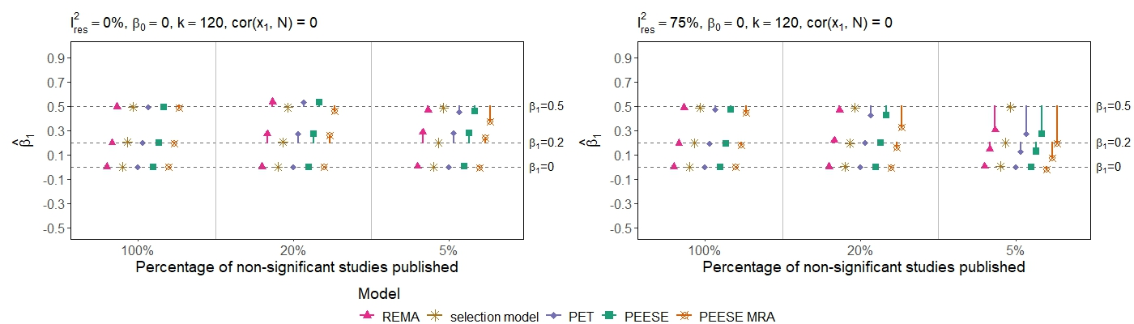
Main results: Bias in the Binary Moderator
1. The moderator is not associated with publication bias and sample size

Slide 8
Main results: Bias in the Binary Moderator
1. The moderator is not associated with publication bias and sample size
Selection model performs adequately
REMA, PET, PEESE and PEESE MRA increase in bias with increasing moderator effect, heterogeneity and selection bias severity

Slide 9
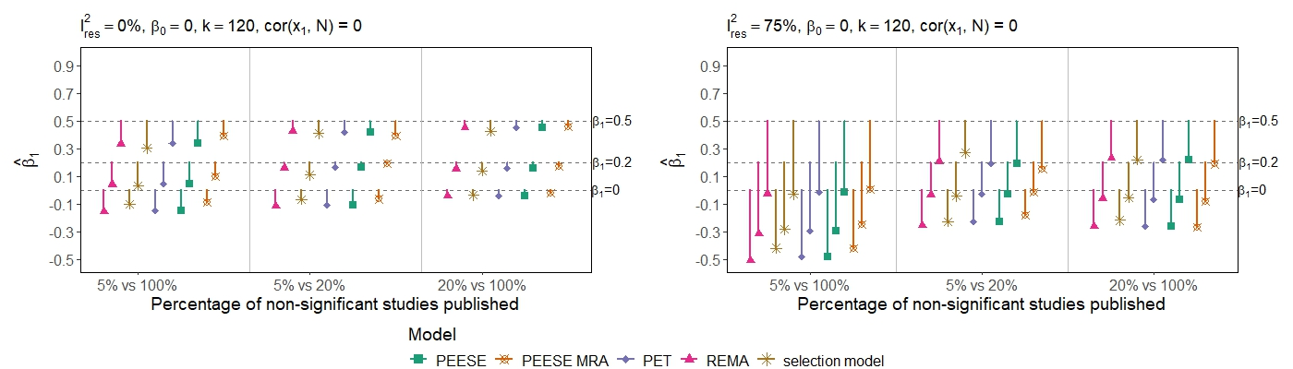

Main results: Bias in the Binary Moderator
2. The moderator is associated with publication bias
None of the models performs well
Bias in moderator effects increases with increasing differences in publication bias and increasing heterogeneity
vs

Slide 10
Main results: Bias in the Binary Moderator
3. The moderator is associated with sample size
PET, PEESE and PEESE MRA perform worse than the uncorrected REMA
Selection model corrects for the bias
vs
4. The moderator is associated with publication bias and sample size
Similar results to scenario 2: → Differences in publication bias and increasing heterogeneity are the main drivers of bias
None of the models performs well
vs

Slide 11

Discussion
Publication bias poses a serious threat to the correct estimation of moderator effects in meta-analysis
  → Shiny app for sensitivity analysis (in progress)
Correcting for publication bias in moderator analysis:
  WLS meta-regression models (PET, PEESE, PEESE MRA) cannot correct for bias in many scenarios
  Selection models can account for publication bias in moderator effects, except when publication bias is related to the moderator
    Future research: Selection model extension?

Slide 12
Main Findings
  Thank you!
  Questions?
  Contact: f.f.ruffer@uvt.nl
How does publication bias affect moderator effects?
  Artificial moderator effects
  Hidden, diminished or amplified true moderator effects
  Bias when sample sizes and/or publication bias differ between moderator levels
Can the currently available methods correct for publication bias in moderator effects?
  Selection models perform well if the moderator is not related to publication bias
  Ignoring publication bias (REMA) or using WLS meta-regression models (PET, PEESE, PEESE MRA) yields biased moderator estimates in most scenarios

Slide 13
References
¹Coursol, A., & Wagner, E. E. (1986). Effect of positive findings on submission and acceptance rates: A note on meta-analysis bias. Professional Psychology: Research and Practice, 17 (2), 136–137. https://doi.org/10.1037/0735-7028.17.2.136
²Fanelli, D. (2010). “Positive” results increase down the hierarchy of the sciences. PLOS ONE, 5 (4), e10068. https://doi.org/10.1371/journal.pone.0010068
³Sterling, T. D., Rosenbaum, W. L., & Weinkam, J. J. (1995). Publication decisions revisited: The effect of the outcome of statistical tests on the decision to publish and vice versa. The American Statistician, 49(1), 108–112. https://doi.org/10.1080/00031305.1995.10476125
⁴Hedges, L. V. (1984). Estimation of effect size under nonrandom sampling: The effects of censoring studies yielding statistically insignificant mean differences. Journal of Educational Statistics, 9 (1), 61–85. https://doi.org/10.2307/1164832
⁵Hedges, L. V., & Vevea, J. L. (1996). Estimating effect size under publication bias: Small sample properties and robustness of a random effects selection model. Journal of Educational and Behavioral Statistics, 21 (4), 299–332. https://doi.org/10.3102/10769986021004299
⁶Lane, D. M., & Dunlap, W. P. (1978). Estimating effect size: Bias resulting from the significance criterion in editorial decisions. British Journal of Mathematical and Statistical Psychology, 31 (2), 107–112. https://doi.org/10.1111/j.2044-8317.1978.tb00578.x

Slide 14
References
⁷Camerer, C. F., Dreber, A., Forsell, E., Ho, T.-H., Huber, J., Johannesson, M., Kirchler, M., Almenberg, J., Altmejd, A., Chan, T., Heikensten, E., Holzmeister, F., Imai, T., Isaksson, S., Nave, G., Pfeiffer, T., Razen, M., & Wu, H. (2016). Evaluating replicability of laboratory experiments in economics. Science, 351 (6280), 1433–1436. https://doi.org/10.1126/science.aaf0918
⁸Errington, T. M., Mathur, M., Soderberg, C. K., Denis, A., Perfito, N., Iorns, E., & Nosek, B. A. (2021). Investigating the replicability of preclinical cancer biology. eLife, 10, e71601. https://doi.org/10.7554/eLife.71601
⁹Klein, R. A., Vianello, M., Hasselman, F., Adams, B. G., Adams, R. B., Alper, S., Aveyard, M., Axt, J. R., Babalola, M. T., Bahn´ık, S., Batra, R., Berkics, M., Bernstein, M. J., Berry, D. R., Bialobrzeska, O., Binan, E. D., Bocian, K., Brandt, M. J., Busching, R., . . . Nosek, B. A. (2018). Many Labs 2: Investigating Variation in Replicability Across Samples and Settings. Advances in Methods and Practices in Psychological Science, 1 (4), 443 490. https://doi.org/10.1177/2515245918810225
¹⁰Open Science Collaboration. (2015). Estimating the reproducibility of psychological science. Science, 349 (6251), aac4716. https://doi.org/10.1126/science.aac4716
¹¹Scheel, A. M., Schijen, M. R. M. J., & Lakens, D. (2021). An excess of positive results: Comparing the standard psychology literature with registered reports. Advances in Methods and Practices in Psychological Science, 4(2), 1–12. https://doi.org/10.1177/25152459211007467
¹² Bekelman, J. E., Li, Y., & Gross, C. P. (2003). Scope and impact of financial conflicts of interest in biomedical research: A systematic review. JAMA, 289(4), 454–465. https://doi.org/10. 1001/jama.289.4.454

Slide 15
References
¹³ Lexchin, J., Bero, L. A., Djulbegovic, B., & Clark, O. (2003). Pharmaceutical industry sponsorship and research outcome and quality: Systematic review. BMJ, 326(7400), 1167–1170. https://doi.org/10.1136/bmj.326.7400.1167
¹⁴Bellomo, R., Warrillow, S. J., & Reade, M. C. (2009). Why we should be wary of single-center trials. Critical Care Medicine, 37 (12), 3114. https://doi.org/10.1097/CCM.0b013e3181bc7bd5
¹⁵Unverzagt, S., Prondzinsky, R., & Peinemann, F. (2013). Single-center trials tend to provide larger treatment effects than multicenter trials: A systematic review. Journal of Clinical Epidemiology, 66 (11), 1271–1280. https://doi.org/10.1016/j.jclinepi.2013.05.016
¹⁶Hedges, L. V. (1992). Modeling Publication Selection Effects in Meta-Analysis. Statistical Science, 7 (2), 246–255. https://doi.org/10.1214/ss/1177011364
¹⁷Hedges, L. V., & Vevea, J. L. (1996). Estimating effect size under publication bias: Small sample properties and robustness of a random effects selection model. Journal of Educational and Behavioral Statistics, 21 (4), 299–332. https://doi.org/10.3102/10769986021004299
¹⁸ Stanley, T. D. (2008). Meta-regression methods for detecting and estimating empirical effects in the presence of publication selection. Oxford Bulletin of Economics and Statistics, 70 (1), 103–127. https://doi.org/10.1111/j.1468-0084.2007.00487.x
¹⁹ Stanley, T. D., & Doucouliagos, H. (2014). Meta-regression approximations to reduce publication selection bias. Research Synthesis Methods, 5 (1), 60–78. https://doi.org/10.1002/jrsm.1095

Slide 16

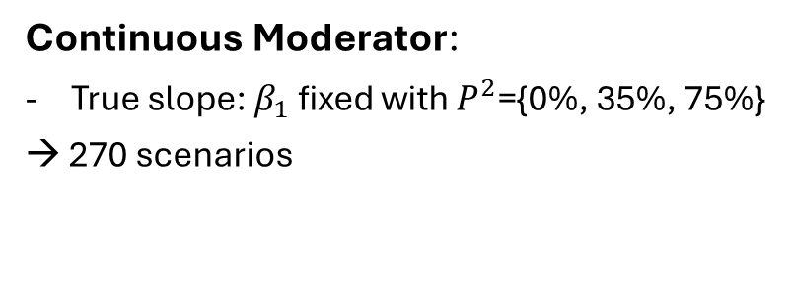
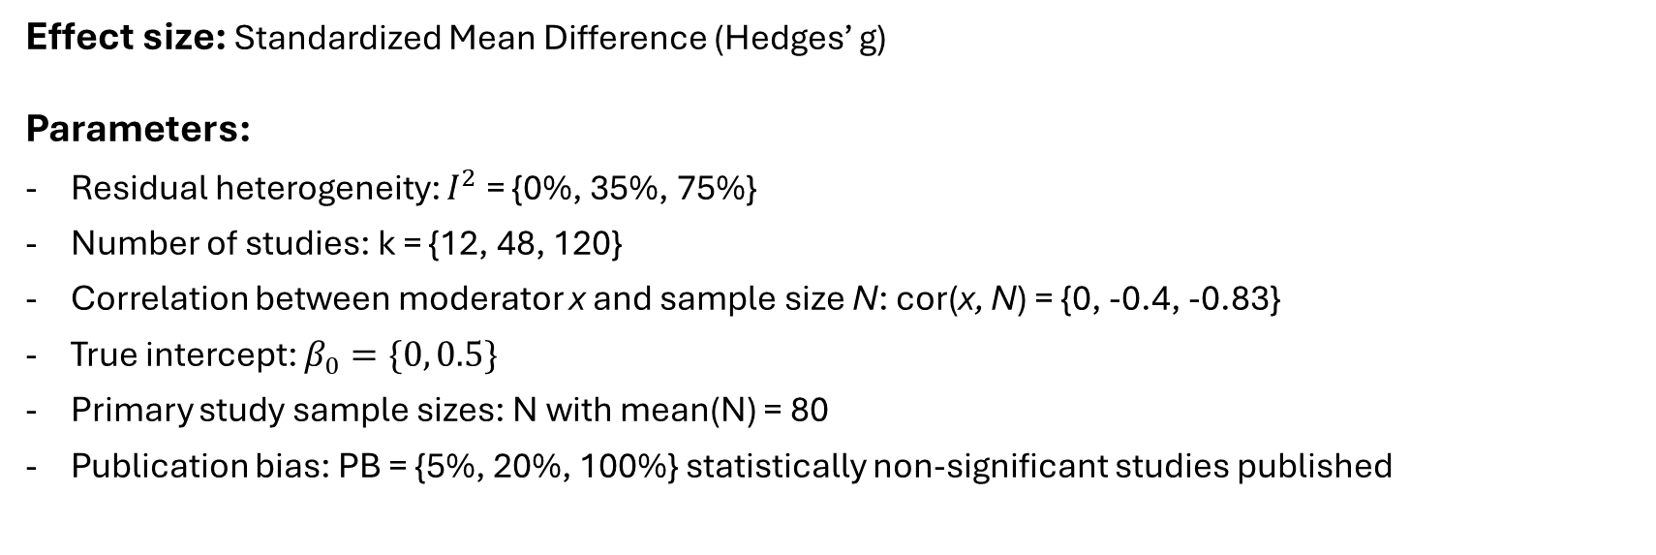
Simulation Design
Effect size: Standardized Mean Difference (Hedges’ g)
Parameters:
Residual heterogeneity: $I^{2}$ = {0%, 35%, 75%}
Number of studies: k = {12, 48, 120}
Correlation between moderator x and sample size N: cor(x, N) = {0, -0.4, -0.83}
True intercept: $β_{0}=\{0, 0.5\}$
Primary study sample sizes: N with mean(N) = 80
Publication bias: PB = {5%, 20%, 100%} statistically non-significant studies published
Continuous Moderator:
True slope: $β_{1}$ fixed with $P^{2}$={0%, 35%, 75%}
→ 270 scenarios
Binary Moderator:
True slope: $β_{1}=\left\{0, 0.2, 0.5\right\}$
Differences in PB between moderator levels
→ 1458 scenarios

Slide 17
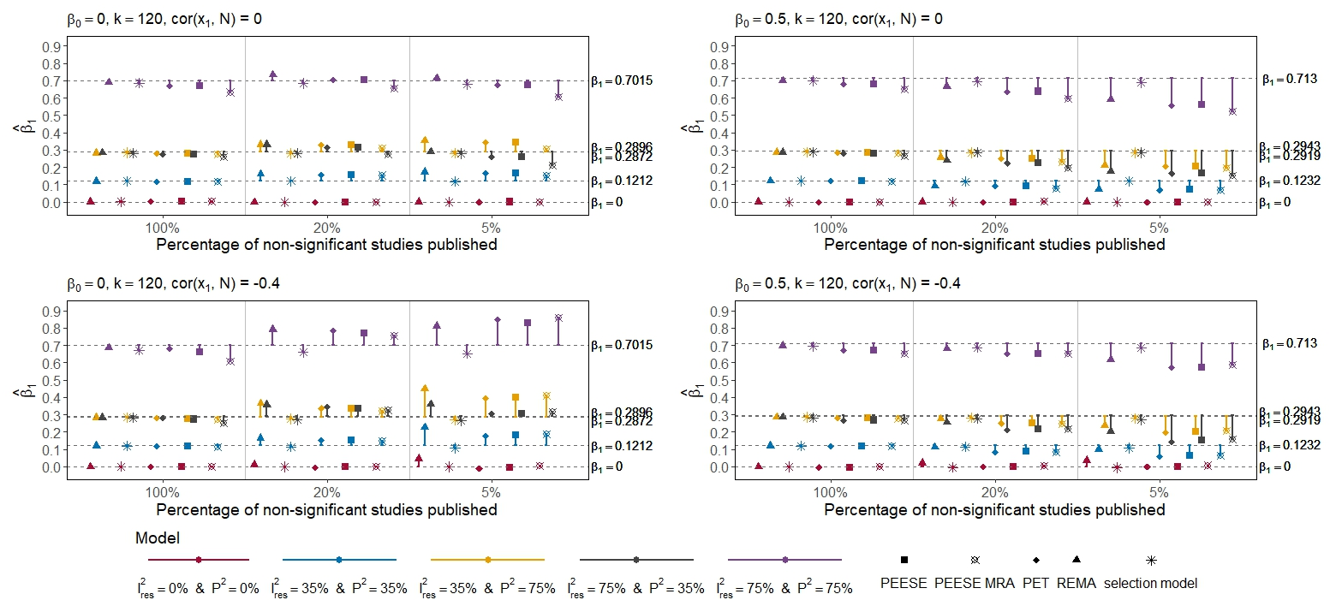
Main results: Bias in Continuous Moderator

Slide 18
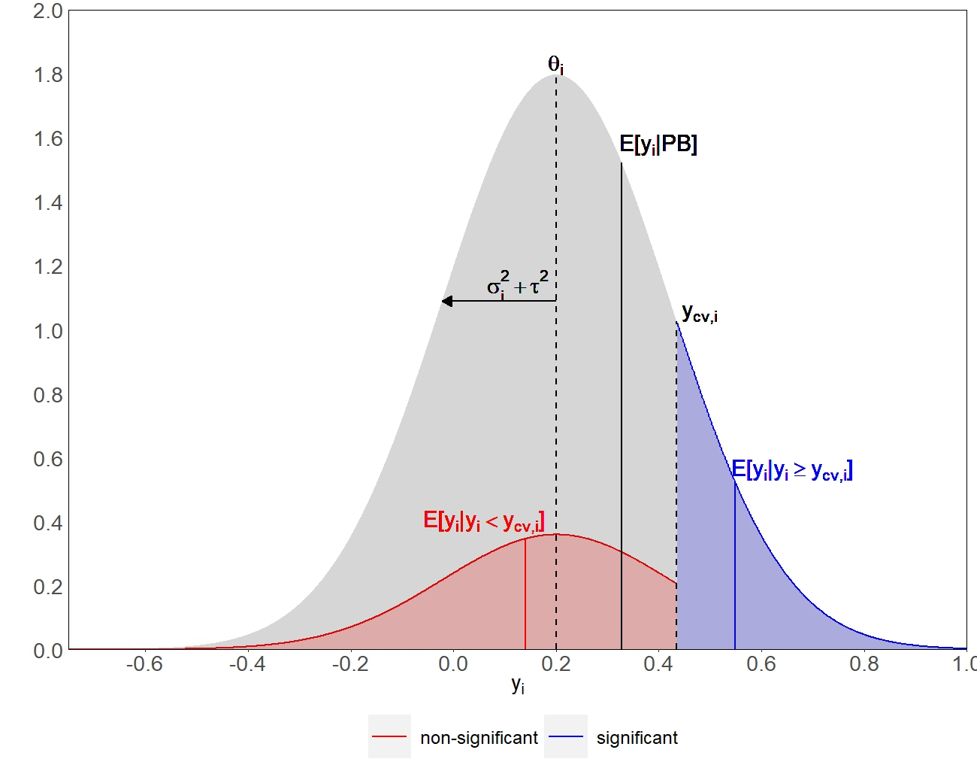
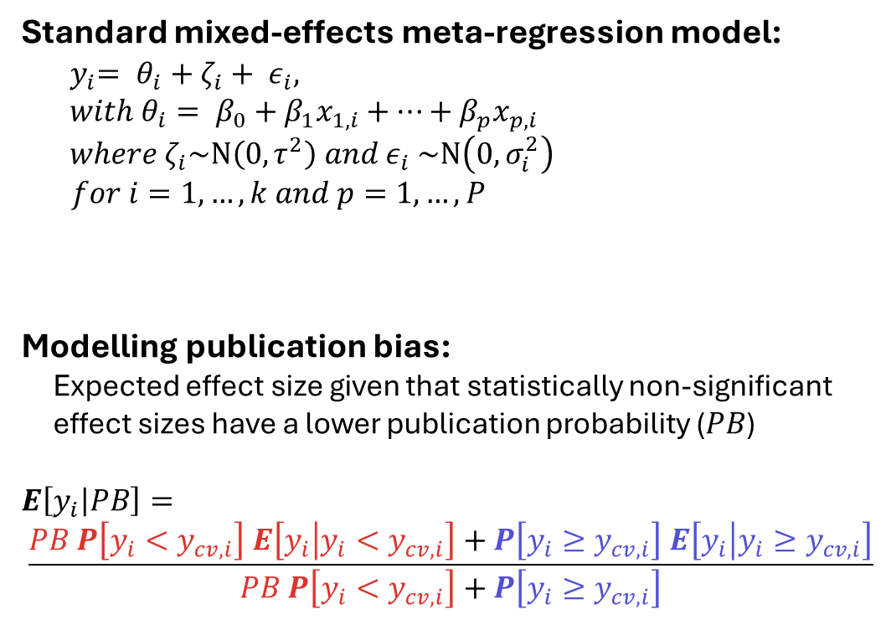
Model & Method (Theoretical Study)
Standard mixed-effects meta-regression model:
$${ y}_{i}= θ_{i}+ζ_{i}+ ε_{i},$$
$$with{ θ}_{i}= β_{0}+β_{1}x_{1,i}+…+β_{p}x_{p,i}$$
$where ζ_{i}\sim N\left(0,τ^{2}\right) and ε_{i}$ $\sim N\left(0,σ_{i}^{2}\right)$
$for i=1,…,k and p=1,…,P$
Modelling publication bias:
Expected effect size given that statistically non-significant
effect sizes have a lower publication probability ($PB$)
$$E\left[y_{i} | PB\right]=$$
$$\frac{PB P\left[y_{i}<y_{cv,i}\right] E\left[y_{i} | y_{i}<y_{cv,i}\right]+P\left[y_{i}≥y_{cv,i}\right] E\left[y_{i} | y_{i}≥y_{cv,i}\right]}{PB P\left[y_{i}<y_{cv,i}\right]+P\left[y_{i}≥y_{cv,i}\right]}$$

Slide 19
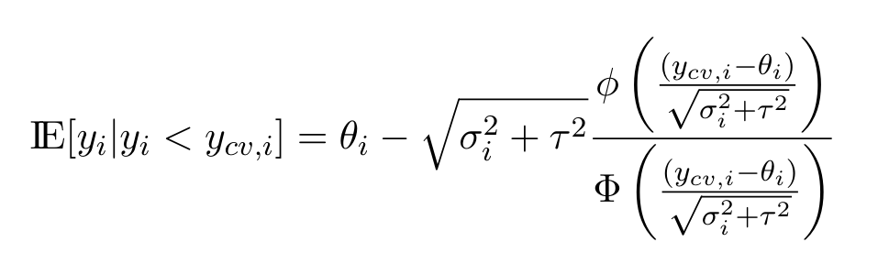
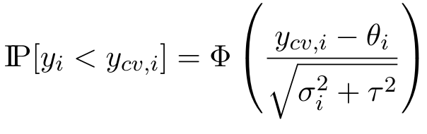
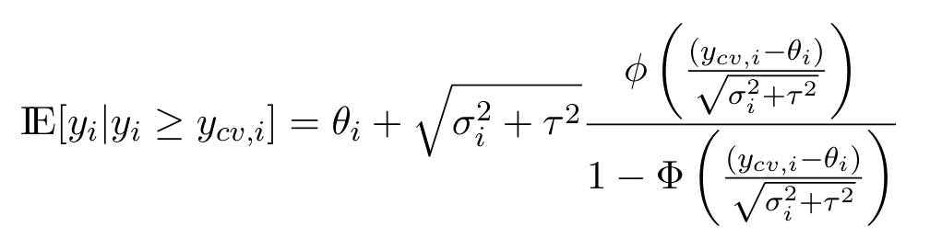
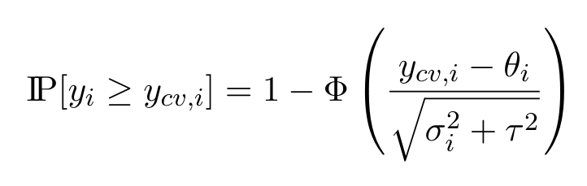
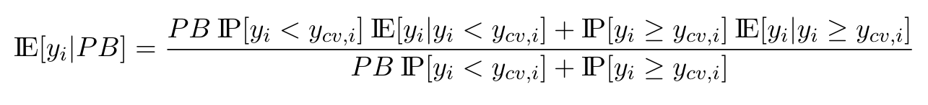
Additional Formulas (Theoretical Study)
Non-significant effect sizes
Significant effect sizes

