Slide 1
The advancements in mixed methods research over the present decade as outlined in the Journal of Mixed Methods Research: A scoping review
Olatz Lopez-Fernandez

Slide 2

Outline
Introduction
Aim
Method
Results
Discussion
Conclusion

Slide 3
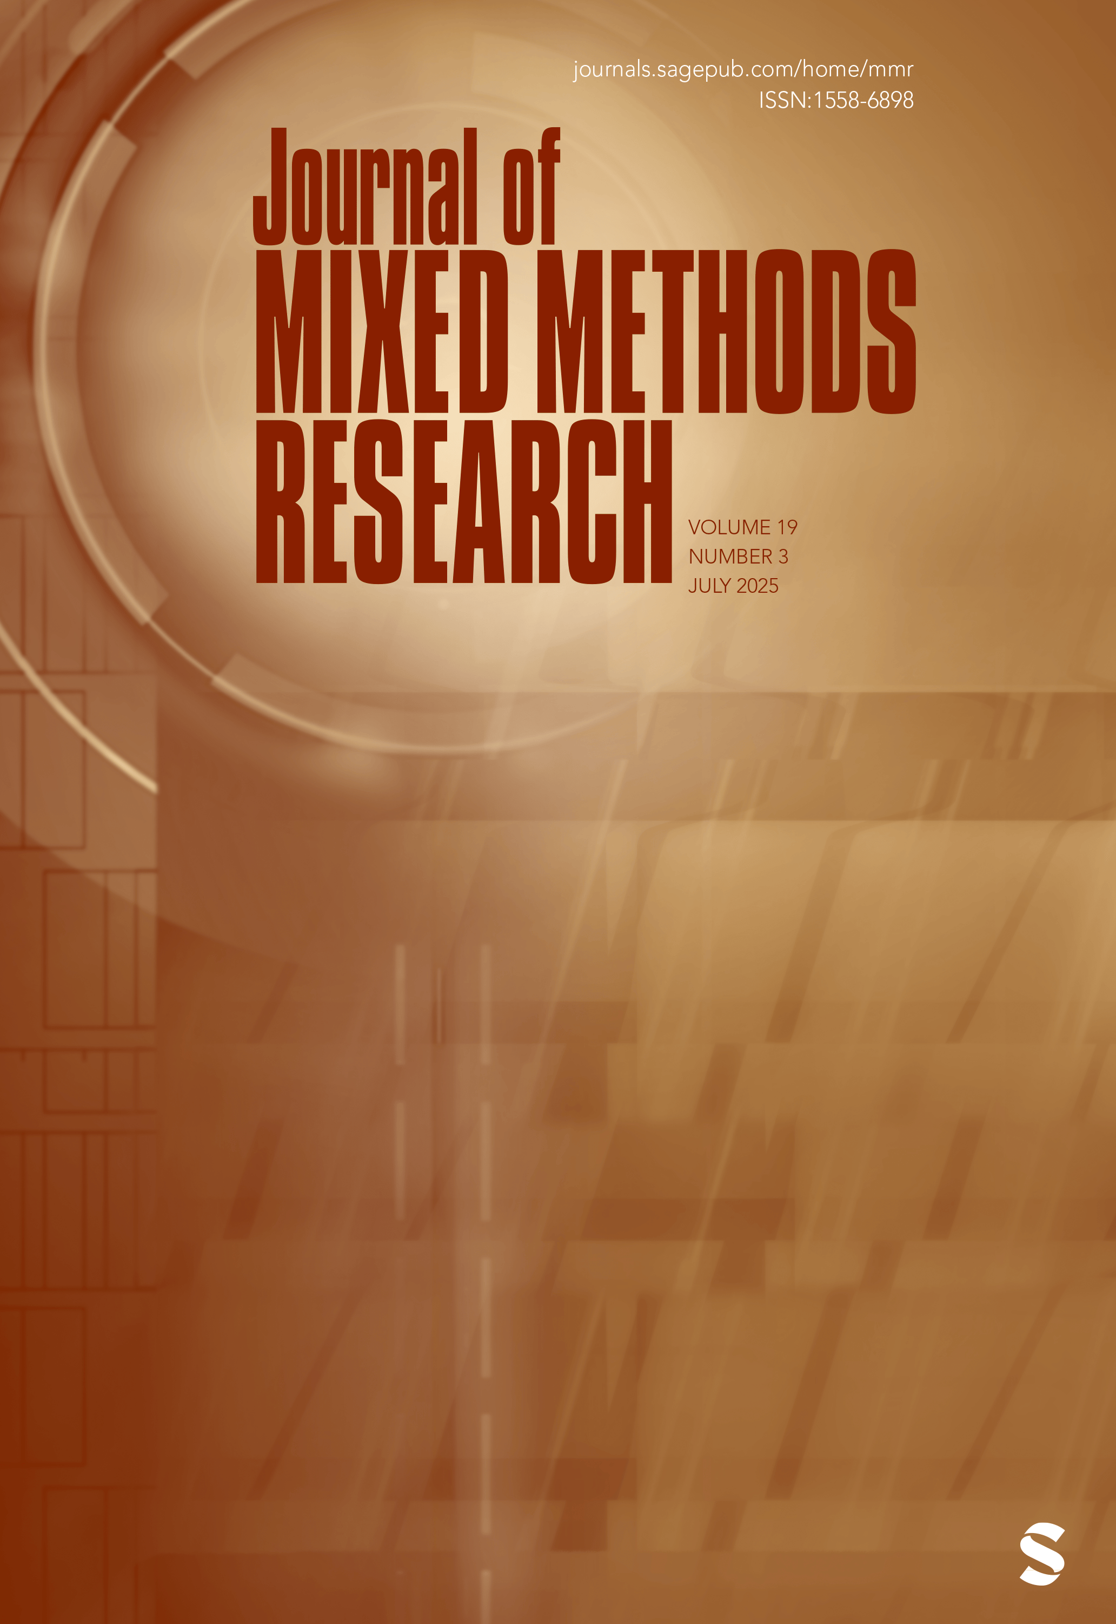


Introduction
The JMMR was launched in 2009, such as MMIRA.
It has gained a strong academic reputation and significant growth in its JIF within JCR.
It embraces an interdisciplinary approach to mixed methods research.
Editorial: SAGE.

Slide 4

Aim
To rapidly analyse the evolution of JMMR (2020–2025) through the articles that have made contributions to its advancement:
  JIF evolution (JCR & Scimago)
  Theoretical and conceptual trends
  Techno-methodological elements
  MMR implementation and report face

Slide 5
Method
Scoping review methodology
Rapid analysis of JIF & JBA research articles
Combined quantitative and qualitative analysis

Slide 6
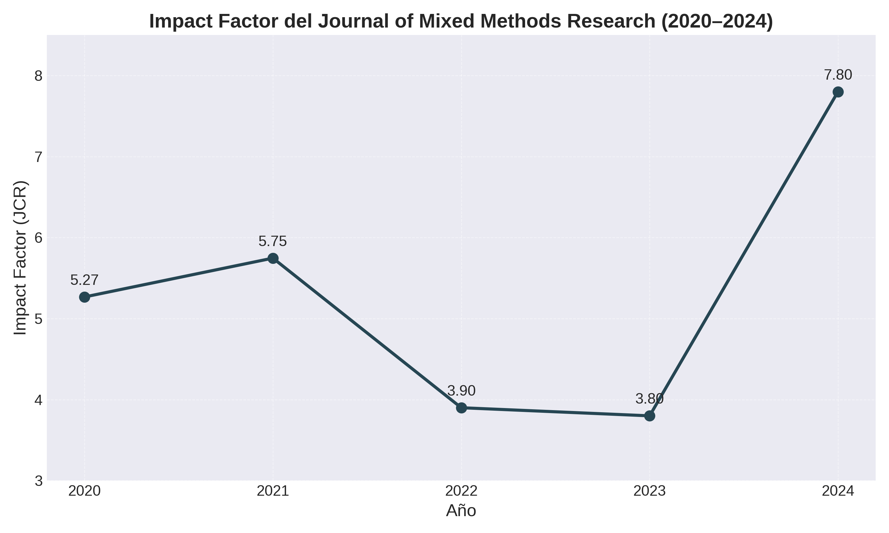
Results:
JIF (JCR)

Slide 7
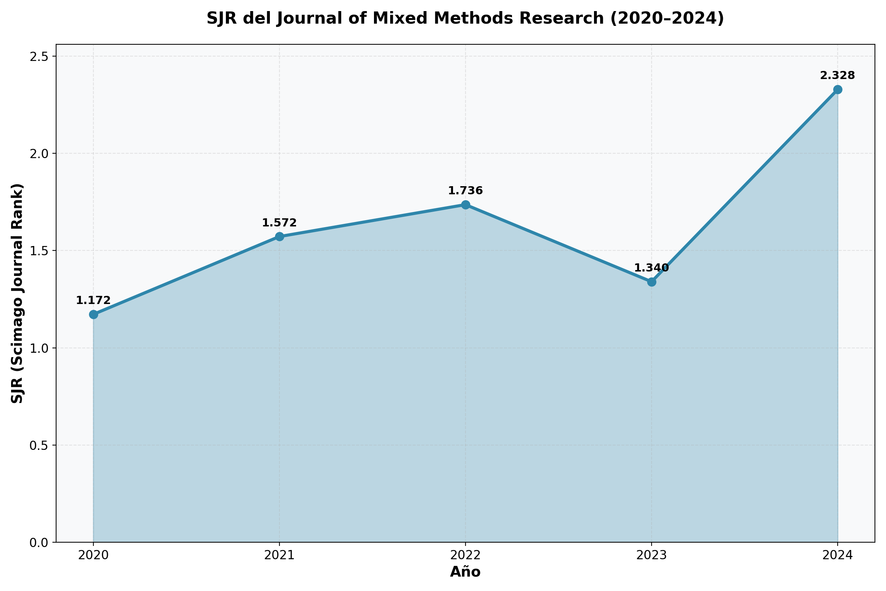
Results:
JIF (Scimago)

Slide 8
Results:
Main topics over time
(5 Vol. X 6 Issues -1: n = 29)
Early years:
Later years:
A rise in the application of mixed-content digital techniques and increased use of visual elements
The dichotomy of QUAN vs QUAL of the methods, designs, techniques, and data analyses, plus the integration of both
Integrating computational methods into textual analysis
QUAN-QUAL integration
Sequential & longitudinal designs
AI techniques starting to be applied
A comprehensive review of terminology, AI ethics & policy, quality standards and guidelines & policy

Slide 9
Volume | Issue | Key Advancements | Theoretical & Conceptual Foundations
14 (2020) | 1 | New integration strategies using joint displays | Pragmatism; methodological integration and triangulation
14 (2020) | 2 | Advances in explanatory sequential designs in health | Pragmatism and transformative paradigms
14 (2020) | 3 | Meta-inference frameworks for validity | Pragmatism and constructivism
14 (2020) | 4 | Participatory mixed methods in education | Transformative paradigm; empowerment focus
15 (2021) | 1 | Machine learning for data pattern recognition | Pragmatism; methodological innovation
15 (2021) | 2 | Ethics in vulnerable populations | Transformative and critical paradigms
15 (2021) | 3 | Longitudinal mixed methods designs | Pragmatism; process-oriented frameworks
15 (2021) | 4 | Enhanced mixed methods case studies | Constructivist and pragmatic paradigms
16 (2022) | 1 | Mixed methods approaches in big data | Pragmatism; adapting to technology
16 (2022) | 2 | Cultural responsiveness in indigenous research | Transformative and decolonizing paradigms
16 (2022) | 3 | Multi-layered triangulation techniques | Pragmatism and post-positivism
16 (2022) | 4 | Training frameworks for mixed methods | Pragmatism; competence development focus
17 (2023) | 1 | Policy evaluation with stakeholder integration | Pragmatism and transformative paradigms
17 (2023) | 2 | Qualitative visualization with quantitative data | Constructivist paradigm
17 (2023) | 3 | Philosophical discussion in AI research | Pragmatism and critical realism
17 (2023) | 4 | Complex systems mixed methods research | Pragmatism and systems thinking
18 (2024) | 1 | Integration of AI tools in mixed methods designs | Pragmatism and post-positivism; AI-augmented inquiry
18 (2024) | 2 | Mixed methods in climate change resilience | Transformative paradigms; sustainability focus
18 (2024) | 3 | Advancements in real-time data integration | Pragmatism; dynamic mixed methods
18 (2024) | 4 | Community-based participatory research innovations | Transformative and decolonizing paradigms
19 (2025) | 1 | Enhanced visualization techniques for complex data | Constructivist and pragmatic paradigms
19 (2025) | 2 | Ethics in AI-assisted mixed methods research | Pragmatism and critical realism
19 (2025) | 3 | Systems thinking applied to global health | Pragmatism and systems paradigms
19 (2025) | 4 | Mixed methods and digital ethnography integration | Pragmatism and constructivist paradigms

Slide 10
Volume | Issue | Techno-methodological Characteristics | Data Analysis Techniques
14 (2020) | 1 | Joint displays for data merging | Data convergence and transformation
14 (2020) | 2 | Explanatory sequential design, adaptive sampling | Sequential integration and modeling
14 (2020) | 3 | Meta-inference validity frameworks | Meta-analysis + thematic synthesis
14 (2020) | 4 | Participatory design, co-creation | Narrative + quantitative content analysis
15 (2021) | 1 | Machine learning integration | ML algorithms + triangulation
15 (2021) | 2 | Ethical frameworks for vulnerable groups | Reflexive thematic + quantitative stats
15 (2021) | 3 | Longitudinal mixed methods | Time series + qualitative trajectories
15 (2021) | 4 | Enhanced case study designs | Cross-case synthesis; pattern matching
16 (2022) | 1 | Big data mixed methods adaptation | Data mining + qualitative coding
16 (2022) | 2 | Cultural responsiveness in research | Multilingual thematic + quantitative cultural
16 (2022) | 3 | Multi-layered triangulation | Triangulation + convergence coding
16 (2022) | 4 | Curriculum development | Simulation + practice-based evaluation
17 (2023) | 1 | Stakeholder-integrated evaluation | Qualitative policy analysis + outcome modeling
17 (2023) | 2 | Visual integration of qual & quant data | Visual narrative + statistical charts
17 (2023) | 3 | Philosophical & AI applications | Conceptual framework + pattern exploration
17 (2023) | 4 | Systems-oriented mixed methods | Systems mapping + mixed modeling
18 (2024) | 1 | AI-assisted data collection and integration | AI tools for mixed data processing
18 (2024) | 2 | Climate resilience mixed methods frameworks | Multi-layered environmental data modeling
18 (2024) | 3 | Real-time data integration platforms | Dynamic data fusion and analysis
18 (2024) | 4 | Innovative community participatory designs | Co-created data analysis and feedback loops
19 (2025) | 1 | Advanced visualization platforms | Interactive data visualization and narrative
19 (2025) | 2 | Ethical protocols for AI-assisted research | AI audit trails combined with mixed data analysis
19 (2025) | 3 | Systems modeling in global health | System dynamics modeling + qualitative coding
19 (2025) | 4 | Integration of digital ethnography | Mixed digital qualitative-quantitative coding

Slide 11
2020: Joint displays, sequential designs, meta-inference, participatory methods.
2021: Machine learning, ethics, longitudinal designs, enhanced case studies.
2022: Big data, cultural responsiveness, triangulation, training frameworks.
2023: Policy evaluation, data visualization, AI philosophy, systems thinking.
2024: AI integration, climate resilience, real-time data, community participation.
2025: Advanced visualization, AI ethics, global health, digital ethnography.

Slide 12
Journal Impact Factors (JCR & Scimago)
JMMR shows steady growth in impact factor (JCR) since 2020
Consistently ranks high in Social Sciences and Multidisciplinary categories (Scimago)
Increasing citation rates reflect growing influence of mixed methods research
SJR highlights strong international collaboration and interdisciplinary reach
Impact metrics indicate rising recognition but also competition with broader methodological journals
Critique:
Impact factors fluctuate annually; interpret with caution
Citation-based metrics may undervalue qualitative and mixed methods work
Emphasis on metrics can overshadow research quality and innovation

Slide 13
Theoretical & Conceptual Advances (2020–2025)
Pragmatism deepened; integration with constructivist & transformative paradigms
Improved meta-inference frameworks enhance validity and transparency
Emerging philosophy on AI’s role in knowledge and reflexivity
Growth of transformative, decolonising paradigms emphasizing ethics & empowerment
Adoption of systems thinking and complexity for dynamic, multi-level analysis
Critique:
Risk of eclecticism without clear epistemology
Meta-inference needs practical application
AI integration is promising but still developing
Need to translate theory into real-world impact

Slide 14
Techno-Methodological Advances (2020–2025)
Innovative sampling and sequential designs adapted for complex contexts
Integration of machine learning and AI tools for data collection & analysis
Real-time data integration and dynamic mixed methods platforms
Advanced triangulation and joint display techniques enhance data merging
Participatory and community-based designs with co-created analysis
Enhanced visualisation techniques for complex, multi-layered data
Critique:
High-tech methods require specialized skills and resources
Balancing AI automation with researcher insight remains challenging
Real-time data poses ethical and logistical complexities
Need for accessible training and clearer guidelines

Slide 15
Conclusion
From 2020 to 2025, mixed methods research has advanced both theoretically and technologically
It has integrated pragmatic and transformative paradigms with cutting-edge AI and data techniques
These developments have enhanced validity, ethical rigor, and analytical sophistication.
However, challenges remain in balancing methodological innovation with epistemological clarity (e.g., reproducibility) and ensuring equitable access to complex tools (e.g., deep learning).
The growing impact of MMR journals reflects the field’s expansion addressing complex real-world problems
Regarding Psychology, surprisingly, the field is underrepresented despite its methodological strength comparing with other disciplines

Slide 16
Thank you!
Olatz.Lopez@psi.uned.es

