Slide 1
What do patients and surgeons know and believe about shared decision-making when choosing treatments for colorectal cancer? A qualitative work in progress
Olatz Lopez-Fernandez, Bárbara Horrillo, Ángels Roca, Maite Carreras, Víctor Horno, Jonathan McFarland , María Luisa Sánchez de Molina Rampérez, & Héctor Guadalajara

Slide 2

Outline
Introduction
Aim
Method
Results
Discussion
Conclusion

Slide 3

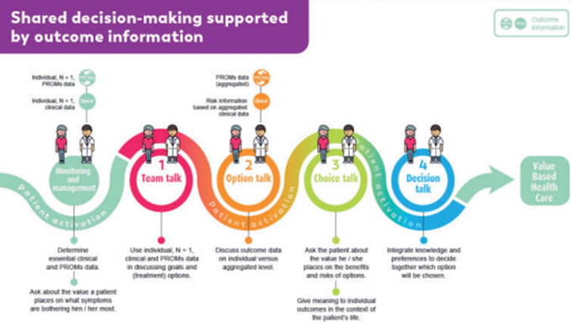
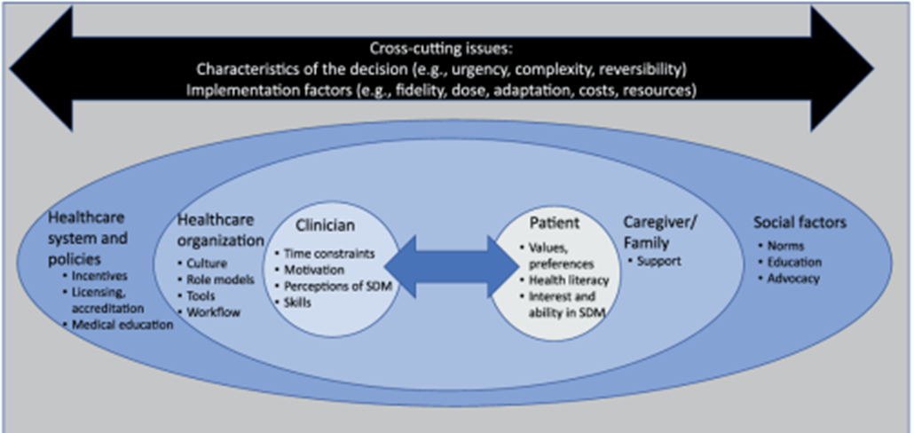
Introduction: study problem
Medicine / Oncology / Psycho-oncology / Personalised health Psychology (Value Based-Health Care)
SDM is a collaborative approach in healthcare that involves patients in clinical decision-making processes
SDM has gained traction in Spain since 2000: Law 41/2002, of November 14, regulating basic patient autonomy and rights and obligations regarding information and clinical documentation
However, its implementation poses certain complexities:
  There are still few studies grounded in scientific evidence
  Physicians trying to add SDM often encounter challenges due to limited time and training
  Physicians try to be transparent, use personalised communication or educate patients about options
  There are almost no resources

Slide 4
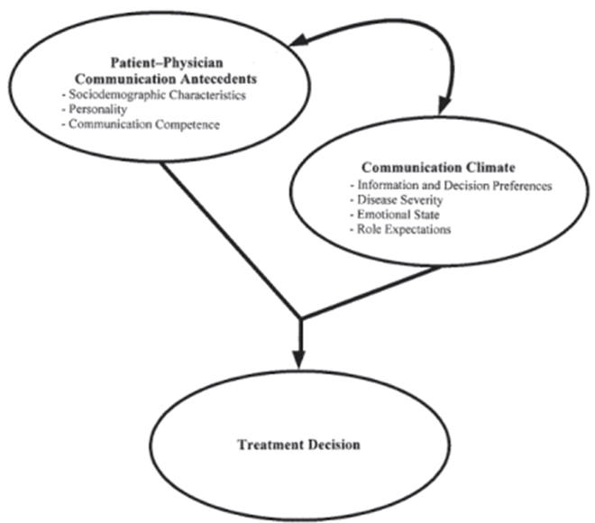
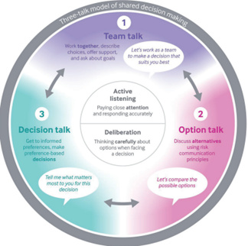
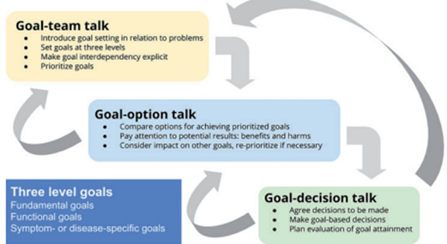
3 theoretical models based on the
“Three-talk model”
3 Steps Model (Elwyn et al. 2017)
SDM based on Aims Model (Elwyn y Vermunt, 2020)
Communication Model of SDM (Siminoff y Step, 2005)

Slide 5
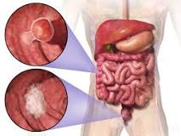
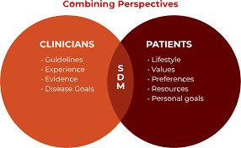
Main Aim: specific aims
Aim
The present research pretends to explore the implications of applying SDM in the context of CRC
CRC: a disease recognised for its high prevalence at national and international levels.
The specific aims are:
To understand what CRC surgeons and patients know and think about SDM in treatment options
To determine their experiences or expectations with SDM in CRC
To clarify the associated implications with SDM in CRC
To ascertain the aspects they value or have concerns about.

Slide 6

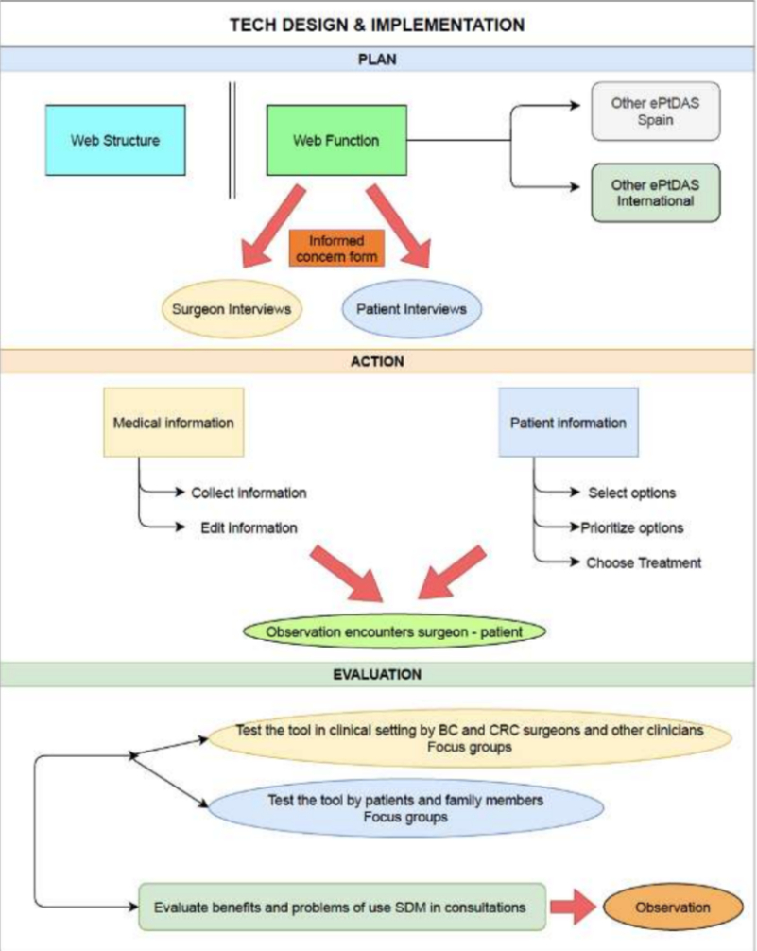
FIS21 02011
Method: Design & Techniques
A qualitative ethnographic study is currently in progress
3 research techniques:
  In-depth interviews with CRC surgeons
  Semi-structured interviews with patients recently diagnosed with CRC
  Focus groups involving patients undergoing treatment for CRC, former patients, and clinicians.
Notes:
All interviews and focus group discussions were online
All have been transcribed
A pilot exploratory and inductive content analysis has been conducted
A thematic analysis through Atals-ti has been developed

Slide 7
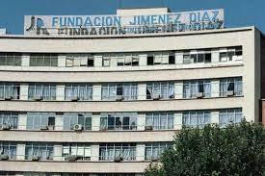
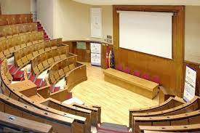


Study timeline:
2023-2025
N=40
Interviews 2023:
  3 CRC surgeons
  6 newly diagnosed CRC patients
Focus groups 2024:
  3 FGs of 5-10 patients (majority middle-aged males)
Data analysis 2025

Slide 8

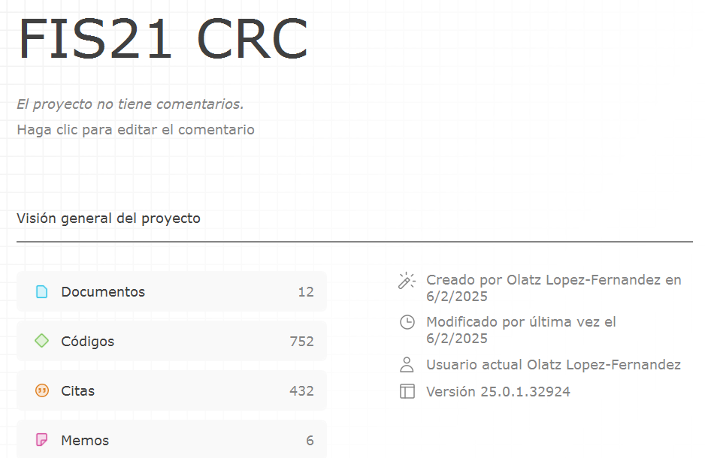
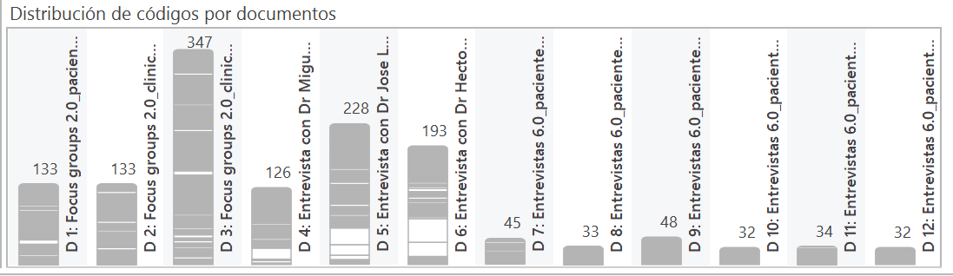
Qualitative Data Análisis (QDA): Atlast-ti v.24 + AI
Exploratory Data Analysis (EDA) of the automatic coding

Slide 9
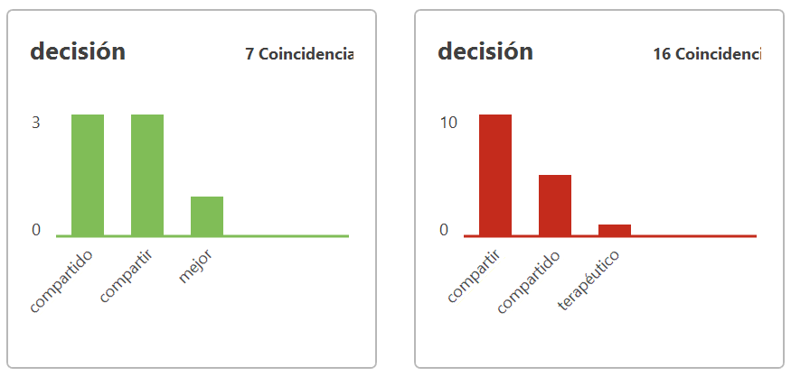
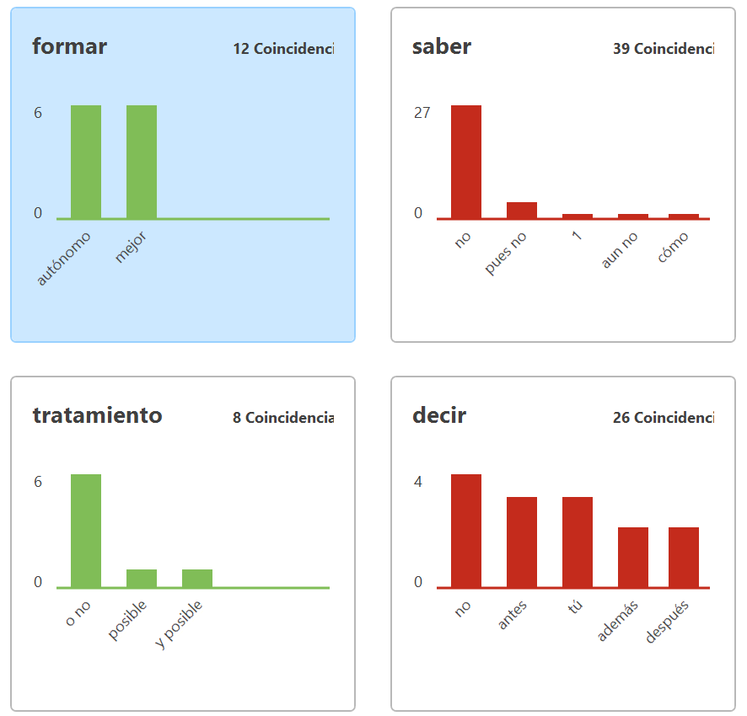
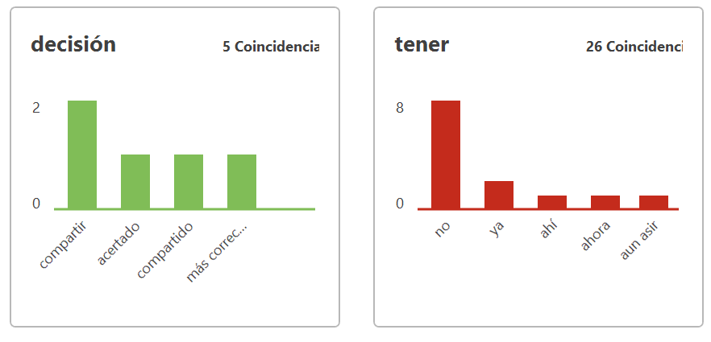
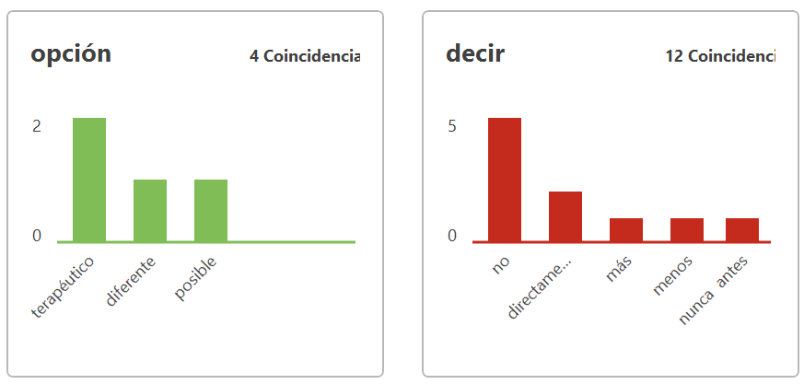
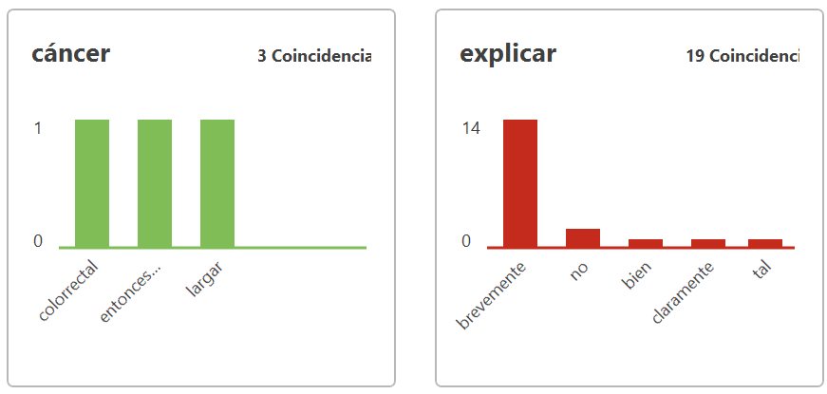
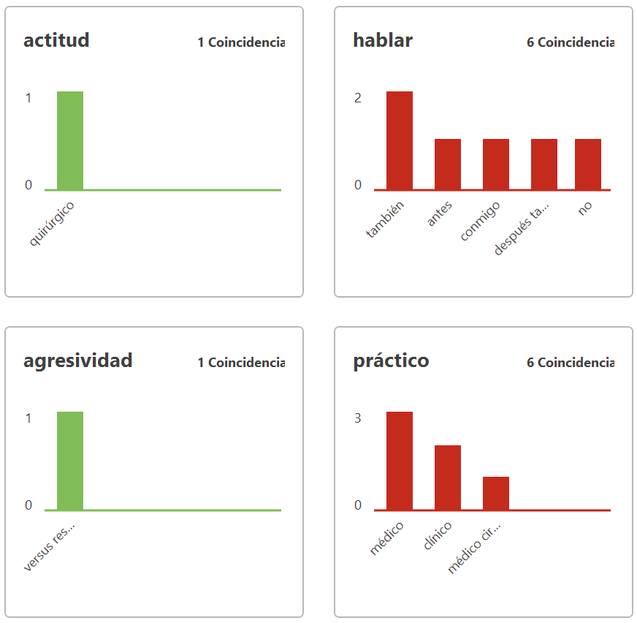
Physicians
EDA - Opinion mining: positive & negatives
Patients

Slide 10
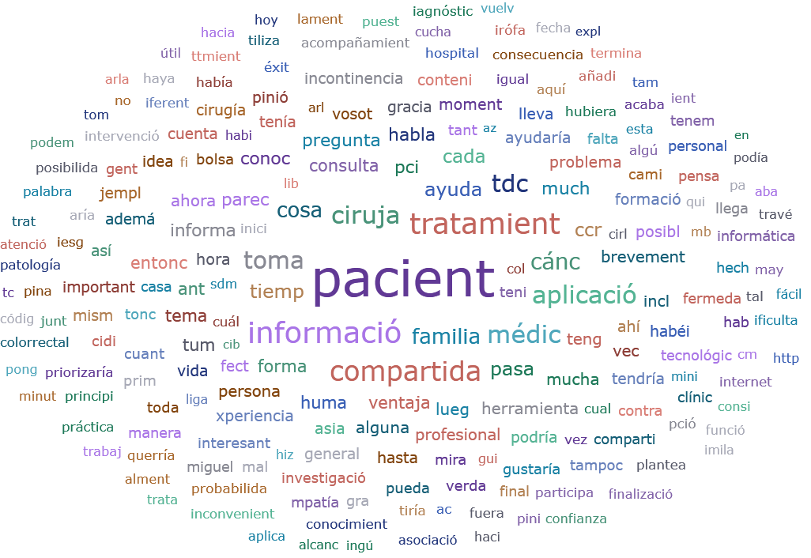
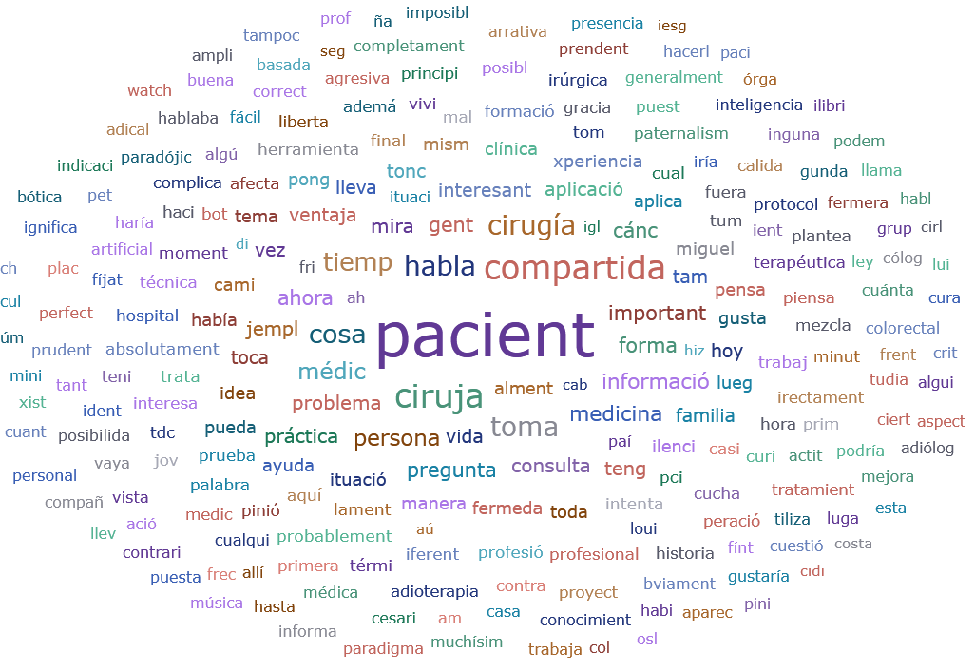
EDA – Word clouds
Patients
Physicians

Slide 11
EDA – Automatic summary of the transcriptions
Patients
Physicians
The patient 1,2,3,5 are familiar with SDM, 4 &6 & FG are not familiarized with it.
Shared personal experiences in FGs revealed a common pattern of lack of information and support in their treatments
Almost all wish to actively participate in their treatment choices and know about the side effects
Only identified a few disadvantages: a few does not want to know the details of their CRC, or not sure about effectiveness.
They expressed interest in being informed and educated about the disease and treatments, but with general info
They expressed the importance of considering patients' preferences and the need for more humane and empathetic healthcare by professionals
Almost all agreed to use an app to facilitate SDM and communication, but a few will need family support
They find an app is probably useful and are willing to use it independently, with the option of sharing it with surgeon
Most prefers the surgeon to make decisions
All revealed the need of honesty & clarity in the doctor-patient relationship to directly discuss options
Surgeon 1 (young) believes that only 30-40% of patients are interested in actively participating in decisions
All surgeons have implemented SDM on a few occasions and highlight the setting and time to provide the necessary info
Surgeon 1 believe SDM will not transform medical practice
All acknowledge the family involvement in SDM
Surgeon 2 (older) explains patients want to know more and how decisions will impact in their lives
Surgeon 3 (middle-aged) express SDM should balance scientific info & personal patient history
All express the usefulness of apps that offer information, but with cautions about effectiveness, as it depends on the patient's profile, age, education & tech skills
Surgeon 2 alerts about the equilibrium between tech and empathy
Surgeon 3 alerts about the AI in medicine, SDM, and about time impact

Slide 12
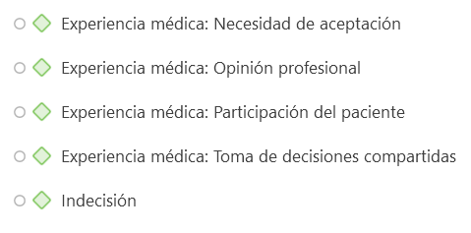
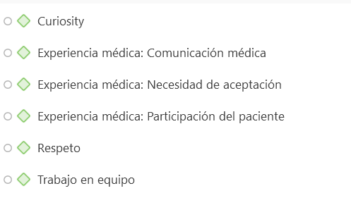
EDA – Quotes & Pre-themes (sentences & sentiment analysis)
Patients
Physicians

Slide 13
EDA – Patients: Themes & Subthemes
1) SDM: "Creo que la TDC es una gran arma, un gran tema de investigación para el médico (que sepa lo que el paciente necesita y lo que quiere saber) y por parte del paciente (porque si quiere saber, sabrá y entenderá y que puedas compartir), entonces podrás tomar decisiones”
  Understanding of SDM: Patients' awareness and comprehension of SDM processes in oncology.
  Perceived Benefits: Increased patient involvement, feeling informed, and having a say in treatment options.
  Challenges and Concerns: Patients express uncertainty about their ability to make informed decisions and the potential for increased anxiety from knowing too much.
2) Information Needs: "Si la quieres de buena calidad esto tendría que ser obligatorio con todos los procesos patológicos."[
  Desire for Information: Patients want comprehensive information about their condition and treatment options.
  Quality of Information: Concerns about the reliability of information found online and the need for trustworthy sources.
  Personalization of Information: Preference for information tailored to individual cases rather than generic data.
3) Emotional and Psychological Support: "La medicina humanista está en manos de las asociaciones"
  Impact of Diagnosis: The emotional toll of receiving a cancer diagnosis and the need for psychological support.
  Role of Healthcare Professionals: Importance of empathy and human connection in patient-provider interactions.
  Support Networks: The value of peer support and patient associations in coping with cancer.
4) Technology in Healthcare: "Yo esta APP sería estupendo"
  Use of Applications: Interest in using technology (e.g., apps) to facilitate access to information and support shared decision-making.
  Concerns about Technology: Skepticism regarding the effectiveness of tech in replacing human interaction and the potential for confusion.
5) Patient Empowerment: "Se nos olvida que como pacientes podemos formar parte de la decisión, podemos ser agentes, no solo pacientes"
  Autonomy in Decision-Making: The desire for patients to have a more active role in their treatment decisions.
  Education and Preparation: The need for better education on how to engage in decision-making processes and understand treatment implications.
6) Healthcare System Dynamics: "La confianza, que expongan claramente lo que tienes y que sean lo más sinceros posibles"
  Communication Gaps: Issues with the clarity and thoroughness of communication from healthcare providers.
  Time Constraints: The impact of limited consultation time on the quality of patient-provider interactions.
  Need for Systemic Change: Calls for improvements in how healthcare systems support shared decision-making and patient education.

Slide 14
EDA – Physicians: Themes & Subthemes
1) Patient Involvement in Decision-Making: "A mí (…) me gusta que el paciente me haga esa pregunta de que usted qué haría... no debemos de ofrecer cosas que nosotros no queríamos para nosotros mismos"
  SDM: Importance of involving patients in treatment decisions. Challenges faced in implementing SDM due to time and patient preferences
  Role of Family in Decision-Making: The influence of family members in helping patients process information and make decisions
2) Communication and Information Delivery: “Para una toma de decisiones compartidas necesitas tiempo y espacio para poder ofrecer toda la información. Si tienes poco tiempo, vas directamente al dictamen"
  Information Overload: The challenge of providing comprehensive information in a limited time
  Use of Technology for Information Dissemination: Potential benefits of applications to provide patients with information at their own pace
3) Barriers to Effective Patient Engagement: “Muchos de los pacientes... dicen directamente lo que usted me diga doctor, yo me dejo llevar y fin de las decisiones compartidas"
  Patient Demographics and Preferences: Variability in engagement based on age and educational background
  Time Constraints in Clinical Settings: The impact of limited consultation time on the quality of patient interactions
4) The Role of Healthcare Professionals: "La gran virtud del cirujano, el gran acto de valentía, realmente de valentía del cirujano es saber cuándo no tenía que operar, cuando no estaba indicada la cirugía"
  Evolving Role of Surgeons: The shift from a paternalistic approach to a more collaborative model
  Interdisciplinary Collaboration: The importance of teamwork among healthcare professionals in supporting patient decisions
5) Emotional and Psychological Aspects of Care: "El respeto por el paciente es esencial... y dejar un poco de libertad también en el sentido de tomar las decisiones"
  Empathy in Patient Care: The necessity of building trust and empathy in the surgeon-patient relationship
  Impact of Treatment Decisions on Quality of Life: Consideration of how treatment choices affect patients' emotional and physical well-being

Slide 15
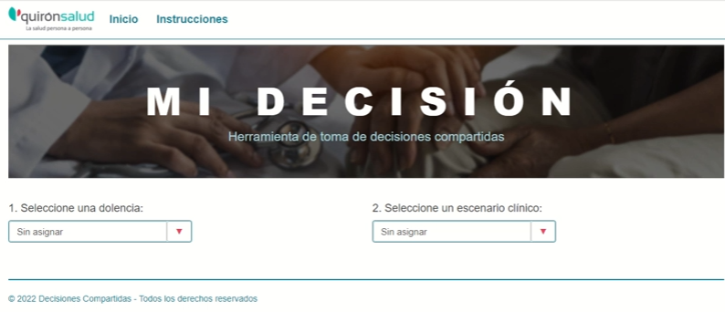
Discussion: SDM in CRC
Little is known about SDM in Madrid, although both parties interviewed understand it and view it positively, while also recognising the risks inherent to it and those of the healthcare system.
The most immediate implications would include training for surgeons, not only in SDM (none mentioned any of the Elwyn models), but also in patient communication, tools to manage and adapt info to the patient and the CRC, as well as support for their role in SDM.
Patients require human and clinical support, i.e., family or patient associations and psychological treatment in some cases, as well as aids and tools & surgeon contact to accompany them in the SDM process applied in hospitalised CRC treatment.
Evidence-based research is lacking to support the development of SDM application protocols using app in CRC
The FIS21 02011 project is conducting a mixed-methods research study, in which the QUAL section with its preliminary findings has partially been presented, although the app is still a prototype.

Slide 16
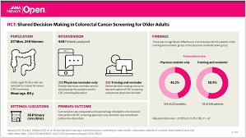
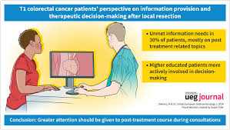
Conclusions: SDM in CRC
Key Conclusions on Patient Involvement in Healthcare Decision-Making: Patients vs Physicians
SDM
Human Element vs. Technology
Need for Comprehensive Information
Role of Family and Support Systems
Concerns About Information Overload
Desire for Empathy and Understanding
Potential for Patient Empowerment
Patient Engagement Variability
Need for Time and Space
Role of Technology
Impact of Family Involvement
Cultural and Educational Factors
Evolving Role of Healthcare Professionals

Slide 17
Thank you!
Olatz.Lopez@psi.uned.es

