Slide 1
Estimating Context Effects in Small Samples while Controlling for Covariates: An Optimally Regularized Bayesian Estimator for Multilevel Latent Variable Models
Dr. Valerii Dashuk, MSH Medical School Hamburg

Slide 2
Agenda:
Motivation
Theory & Estimator
Simulation Insights
The MLOB R Package
Example Application
Discussion & Conclusion

Slide 3
Motivation
Estimate between-group effects in multilevel data.
Small samples or low ICCs pose challenges.
Maximum likelihood can be unstable or biased.
We propose an MSE-optimal regularized Bayesian estimator.
Supports covariates for realistic modelling.
Available on CRAN via the MLOB R package.

Slide 4
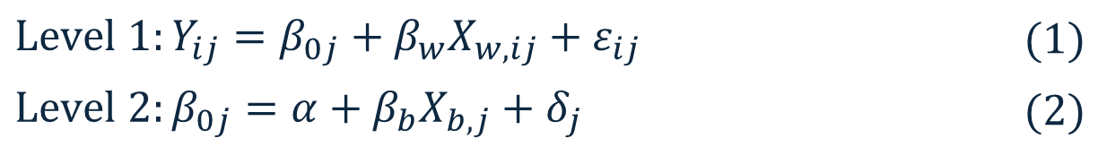
Theory: Univariate Model Estimation
Start from the multilevel latent variable models as denoted by Zitzmann et al. (2020, 2021):
Maximum likelihood (ML): vs. Regularized Bayesian:
$$Level 1:Y_{ij}=β_{0j}+β_{w}X_{w,ij}+ε_{ij}$$ | $$(1)$$
$$Level 2:β_{0j}=α+β_{b}X_{b,j}+δ_{j}$$ | $$(2)$$
$${\hat{β}}_{b,ML}= \frac{{\hat{τ}}_{YX}}{{\hat{τ}}_{X}^{2}}$$ | $$(3)$$ | $${\hat{β}}_{b,B}= \frac{{\hat{τ}}_{YX}}{\left(1−ω\right)τ_{0}^{2}+ω{\hat{τ}}_{X}^{2}}$$ | $$(4)$$

Slide 5
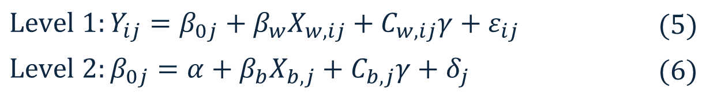
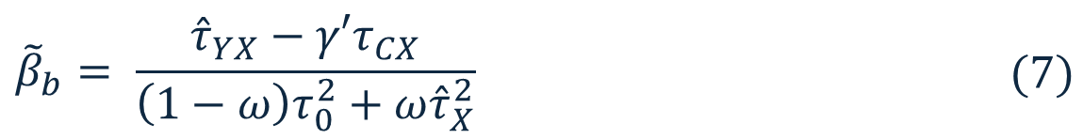
Theory: Extended Model Estimation
Introduce covariates into the multivariate latent variable model (Dashuk et al., 2025):
Extended regularized Bayesian estimator (more details):
$$Level 1:Y_{ij}=β_{0j}+β_{w}X_{w,ij}+C_{w, ij}γ+ε_{ij}$$ | $$(5)$$
$$Level 2:β_{0j}=α+β_{b}X_{b,j}+C_{b,j}γ+δ_{j}$$ | $$(6)$$
$${\tilde{β}}_{b}= \frac{{\hat{τ}}_{YX}−γ′τ_{CX}}{\left(1−ω\right)τ_{0}^{2}+ω{\hat{τ}}_{X}^{2}}$$ | $$(7)$$

Slide 6
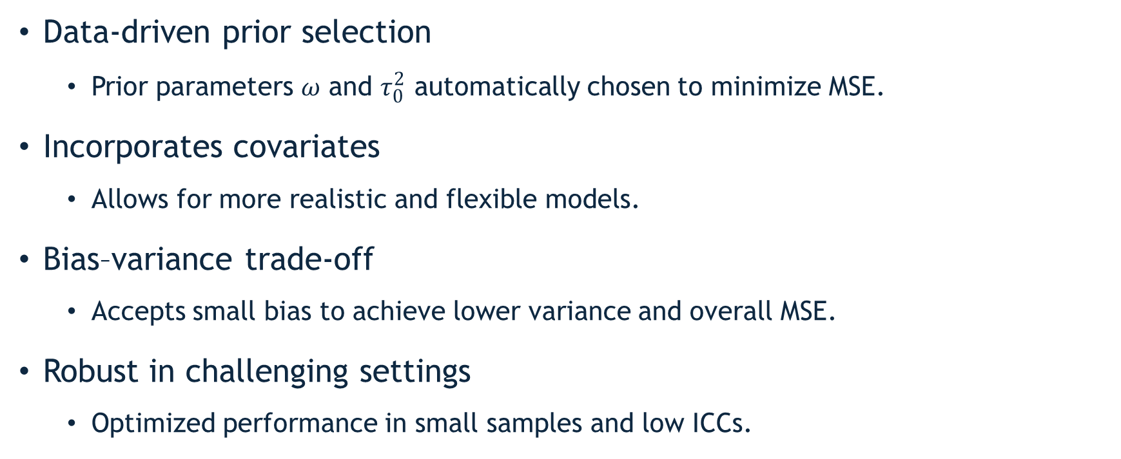
Theory: Advantages of New Estimator
Data-driven prior selection
  Prior parameters 𝜔 and $τ_{0}^{2}$ automatically chosen to minimize MSE.
Incorporates covariates
  Allows for more realistic and flexible models.
Bias–variance trade-off
  Accepts small bias to achieve lower variance and overall MSE.
Robust in challenging settings
  Optimized performance in small samples and low ICCs.

Slide 7
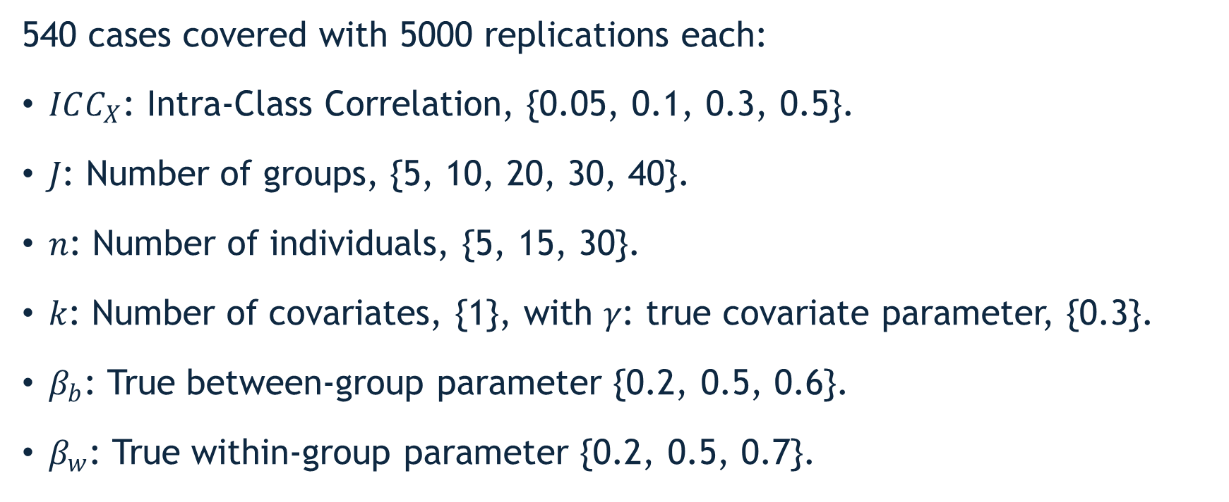
Simulation. Data-Generating Process
540 cases covered with 5000 replications each:
$ICC_{X}$: Intra-Class Correlation, {0.05, 0.1, 0.3, 0.5}.
𝐽: Number of groups, {5, 10, 20, 30, 40}.
𝑛: Number of individuals, {5, 15, 30}.
𝑘: Number of covariates, {1}, with 𝛾: true covariate parameter, {0.3}.
$β_{b}$: True between-group parameter {0.2, 0.5, 0.6}.
$β_{w}$: True within-group parameter {0.2, 0.5, 0.7}.

Slide 8
Simulation. Methods and Quality Evaluation
We estimated the generated data with 3 estimators:
Extended regularized Bayesian estimator.
Standard ML estimator.
Transformed ML estimator, applied to the transformed model.
Quality of estimators is measured with:
Root mean squared error (RMSE). | Relative bias (RB).
Coverage rate (CR). | Standard error ratio (SER).

Slide 9
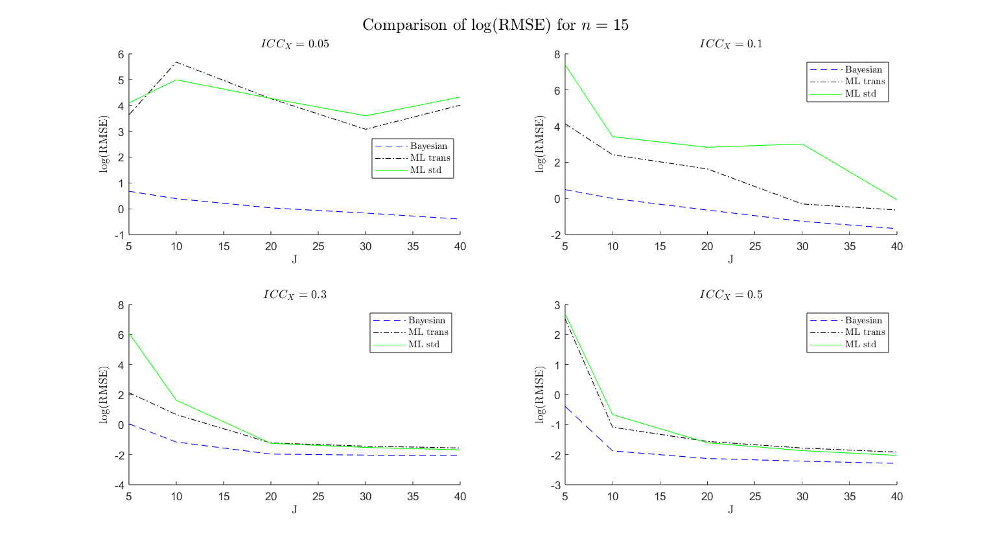

Slide 10
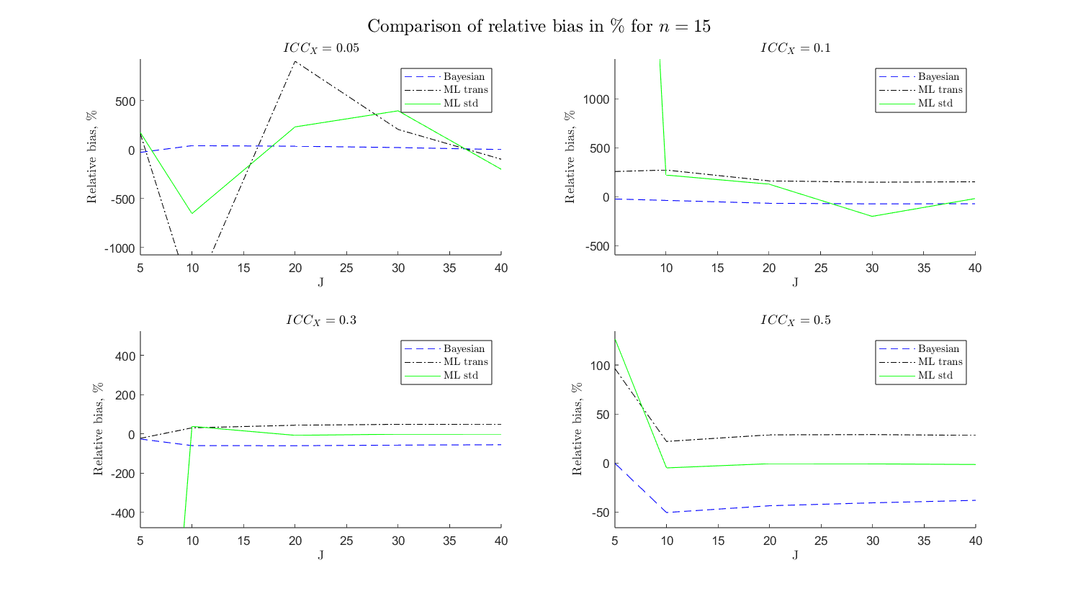

Slide 11
MLOB Package: Key Features
To empower applied researchers use our estimator, we developed MLOB package in R:
Estimates between-group effects using the extended regularized Bayesian approach.
Handles unbalanced designs by effectively balancing it.
Offers delete-d jackknife standard errors.
Returns user-friendly output: estimates, SEs, CIs, Z-values, p-values.

Slide 12
MLOB Package: Usage in R
# Install
install.packages("MultiLevelOptimalBayes")
# Load
library(MultiLevelOptimalBayes)
# Fit model
result < - mlob(formula, data, group, balancing.limit, conf.level, jackknife, punish.coeff)
summary(result)
Note: Dev. version of the MLOB package is available here:
https://github.com/MLOB-dev/MLOB

Slide 13
Real-World Application: Estimation
PASSNYC Dataset (1,272 schools, 32 Districts) – Estimating Math Proficiency (https://www.kaggle.com/datasets/passnyc/data-science-for-good/data):
# Load and clean data
data <- read.table("2016 School Explorer.csv", sep=',', header=TRUE)
data_s <- data[data$Average.Math.Proficiency != 'N/A',]
data_s$math <- as.numeric(data_s$Average.Math.Proficiency)
data_s$ELA <- as.numeric(data_s$Average.ELA.Proficiency)
data_s$ENI <- as.numeric(data_s$Economic.Need.Index)
# Run extended regularized Bayesian model
result <- mlob(math ~ ENI + ELA + ENI:ELA, data = data_s, group = 'District’, balancing.limit = 0.35)

Slide 14
Real-World Application: Results
summary(result)
Call: mlob(math ~ ENI + ELA + ENI:ELA, data = data_subset, group = District, balancing.limit = 0.35)
Summary of Coefficients:
Estimate Std. Error Lower CI (95%) Upper CI (95%) Z value Pr(>|z|) Significance
beta_b -0.1169 0.01868 -0.1535 -0.0802 -6.2562 3.94e-10 ***
gamma_ELA 1.1324 0.21136 0.7182 1.5467 5.3580 8.41e-08 ***
gamma_ENI:ELA 0.3369 0.57599 -0.7920 1.4658 0.5849 5.58e-01
For comparison, summary of coefficients from unoptimized analysis (ML):
Estimate Std. Error Lower CI (95%) Upper CI (95%) Z value Pr(>|z|) Significance
beta_b -0.7721 0.3323 -1.4235 -0.1207 -2.3233 2.01e-02 *
gamma_ELA 1.1324 0.2113 0.7182 1.5467 5.3580 8.41e-08 ***
gamma_ENI:ELA 0.3369 0.5759 -0.7920 1.4658 0.5849 5.58e-01
Signif. codes: 0 ‘***’ 0.001 ‘**’ 0.01 ‘*’ 0.05 ‘.’ 0.1 ‘ ’ 1

Slide 15
Limitations & Future Steps
Limitations: | Future steps:
Advantage over ML diminishes with increasing sample size. | Extend the model to more than two levels.
Small risk of model misspecification under extreme conditions. | Extend the model to handle directly unbalanced data.
Current model assumes two-level grouping only. | Extend the model to relax distributional assumptions.

Slide 16
Conclusion
Introduced an extended regularized Bayesian estimator for between-group effects of multilevel latent variable model with covariates.
Estimator is MSE-optimal: balances bias and variance.
Handles small samples, low ICCs, and unbalanced data.
Implemented in the MLOB R package with user-friendly interface.
Validated with real-world data.
Try MLOB on your own data via CRAN!

Slide 17
Sources & Funding
Dashuk, V., Hecht, M., Lüdtke, O., Robitzsch, A. & Zitzmann, S. (2024). An Optimally Regularized Estimator of Multilevel Latent Variable Models, with Improved MSE Performance.
Dashuk, V., Hecht, M., Lüdtke, O., Robitzsch, A. & Zitzmann, S. (2025). Estimating Context Effects in Small Samples while Controlling for Covariates: An Optimally Regularized Bayesian Estimator for Multilevel Latent Variable Models.
Dashuk, V., Timilsina, B., Hecht, M. & Zitzmann, S. (2025). MultiLevelOptimalBayes (MLOB): An R package for Regularized Bayesian Estimation of Multilevel Latent Variable Models with Covariates.
Funding: Funded by DFG (Project No. 471861494).

Slide 18

Thank you!
We invite and welcome your esteemed participation for any inquiries, reflections, and questions.
Contact: valerii.dashuk@research-development-innovation.de

Slide 19
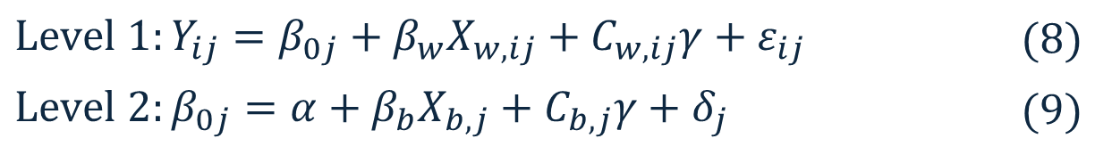
Extended Regularized Bayesian Estimator 1
Model from Dashuk et al. (2025):
Regress covariates 𝐶_𝑖𝑗 on 𝑋_(𝑏,𝑗) and 𝑋_(𝑤,𝑖𝑗):
Compute residuals:
$$Level 1:Y_{ij}=β_{0j}+β_{w}X_{w,ij}+C_{w, ij}γ+ε_{ij}$$ | $$(8)$$
$$Level 2:β_{0j}=α+β_{b}X_{b,j}+C_{b,j}γ+δ_{j}$$ | $$(9)$$
$${\hat{C}}_{ij,k}={\hat{φ}}_{0}+{\hat{φ}}_{1}X_{b,j}+{\hat{φ}}_{2}X_{w,ij}$$ | $$(10)$$
$${{\tilde{C}}_{ij,k}=C_{ij,k}−\hat{C}}_{ij,k}$$ | $$(11)$$
⟵

Slide 20
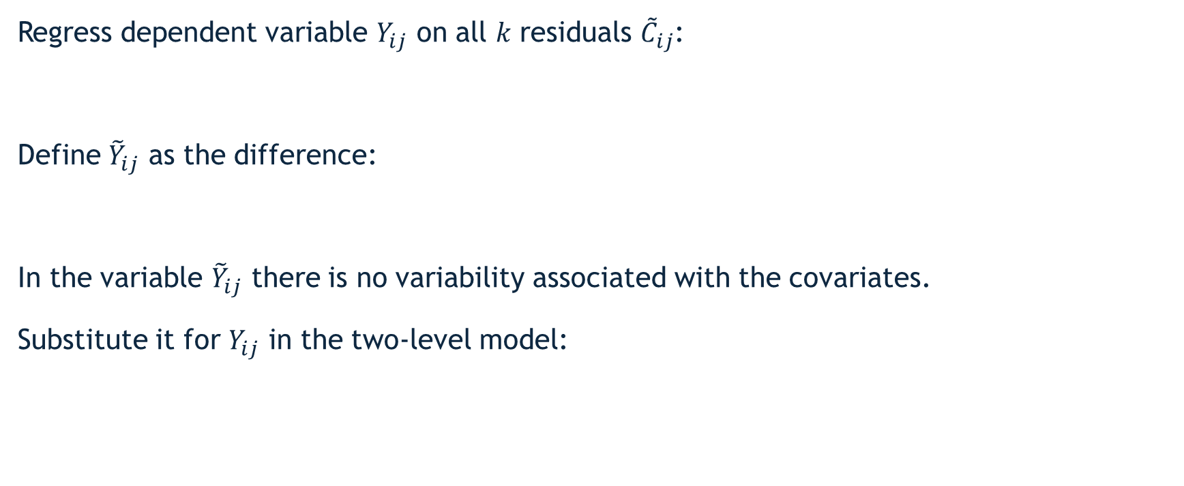
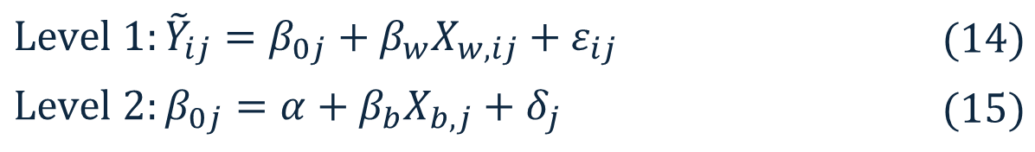
Extended Regularized Bayesian Estimator 2
Regress dependent variable $Y_{ij}$ on all 𝑘 residuals ${\tilde{C}}_{ij}$:
Define ${\tilde{Y}}_{ij}$ as the difference:
In the variable ${\tilde{Y}}_{ij}$ there is no variability associated with the covariates.
Substitute it for $Y_{ij}$ in the two-level model:
$${\hat{Y}}_{ij}={\tilde{C}}_{ij} \hat{γ}$$ | $$(12)$$
$${{\tilde{Y}}_{ij}=Y_{ij}−\hat{Y}}_{ij}$$ | $$\left(13\right)$$
$$Level 1:{\tilde{Y}}_{ij}=β_{0j}+β_{w}X_{w,ij}+ε_{ij}$$ | $$(14)$$
$$Level 2:β_{0j}=α+β_{b}X_{b,j}+δ_{j}$$ | $$(15)$$
⟵
⟵

Slide 21
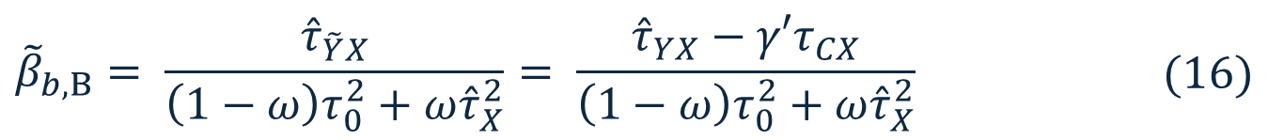

Extended Regularized Bayesian Estimator 3
The model compress to the univariate case, therefore apply the regularized Bayesian estimator for the univariate model:
The estimator is derived, but how to choose priors 𝜔 and $τ_{0}^{2}$ to minimize MSE?
$${\tilde{β}}_{b,B}= \frac{{\hat{τ}}_{\tilde{Y}X}}{\left(1−ω\right)τ_{0}^{2}+ω{\hat{τ}}_{X}^{2}}= \frac{{\hat{τ}}_{YX}−γ′τ_{CX}}{\left(1−ω\right)τ_{0}^{2}+ω{\hat{τ}}_{X}^{2}}$$ | $$(16)$$
$$MSE\left(ω,τ_{0}^{2}\right)=Var\left({\tilde{β}}_{b}\left(ω,τ_{0}^{2}\right)\right)+{\left(Bias\left({\tilde{β}}_{b}\left(ω,τ_{0}^{2}\right)\right)\right)}^{2}$$ | $$(17)$$
⟵

Slide 22
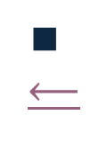
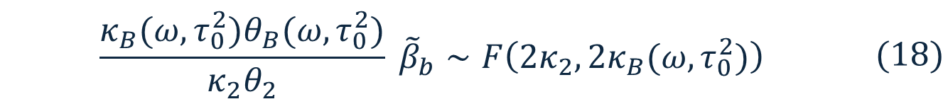
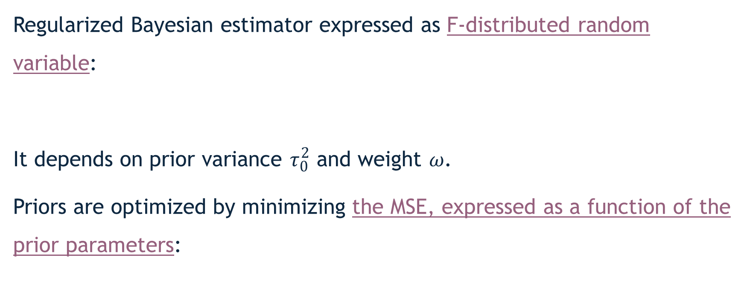
Extended Regularized Bayesian Estimator 4
Regularized Bayesian estimator expressed as F-distributed random variable:
It depends on prior variance $τ_{0}^{2}$​ and weight 𝜔.
Priors are optimized by minimizing the MSE, expressed as a function of the prior parameters:
$$\frac{κ_{B}{(ω,τ_{0}^{2})θ}_{B}(ω,τ_{0}^{2})}{κ_{2}θ_{2}} {\tilde{β}}_{b}∼F\left(2κ_{2}, 2κ_{B}(ω,τ_{0}^{2})\right)$$ | $$(18)$$
$${\left(ω,τ_{0}^{2}\right)}_{optimal}=\arg{\min_{\left(w,τ_{0}^{2}\right)}{MSE({\tilde{β}}_{b} (ω,τ_{0}^{2}))}}$$ | $$(19)$$
$$∎$$
⟵

Slide 23
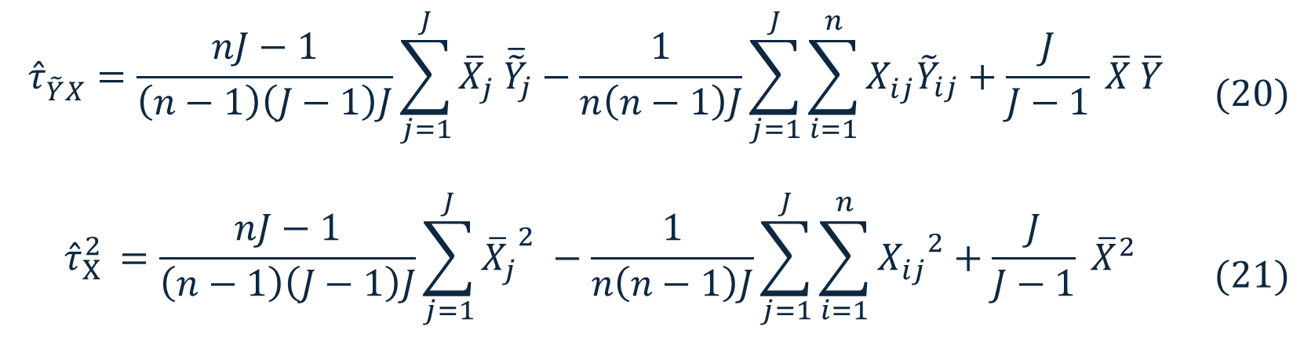

Extended Regularized Bayesian Estimator 5
Sample covariances ${\hat{τ}}_{X}^{2 }$and ${\hat{τ}}_{\tilde{Y}X}^{ }$can be calculated as:
$$\begin{aligned}{\hat{τ}}_{\tilde{Y}X}^{ }=\frac{nJ−1}{\left(n−1\right)\left(J−1\right)J}\sum_{j=1}^{J}{{\overline{X}}_{j}^{ } {\overline{\tilde{Y}}}_{j}}−\frac{1}{n\left(n−1\right)J}\sum_{j=1}^{J}{\sum_{i=1}^{n}{X_{ij}^{ }{\tilde{Y}}_{ij}}}+\frac{J}{J−1} \overline{X} \overline{Y} \end{aligned}$$ | $$(20)$$
$$\begin{aligned}{\hat{τ}}_{X}^{2 }=\frac{nJ−1}{\left(n−1\right)\left(J−1\right)J}\sum_{j=1}^{J}{{{\overline{X}}_{j}^{ }}^{2} }−\frac{1}{n\left(n−1\right)J}\sum_{j=1}^{J}{\sum_{i=1}^{n}{{X_{ij}^{ }}^{2}}}+\frac{J}{J−1} {\overline{X}}^{2}\#\end{aligned}$$ | $$(21)$$

Slide 24
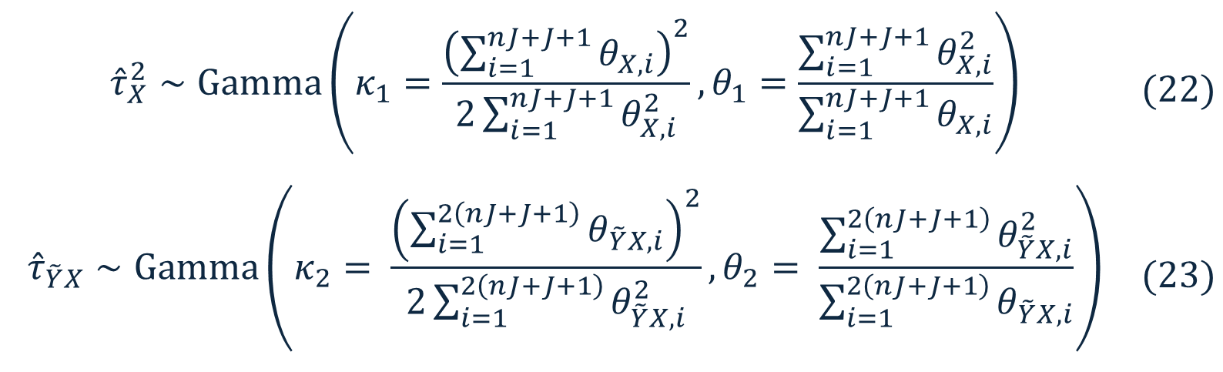
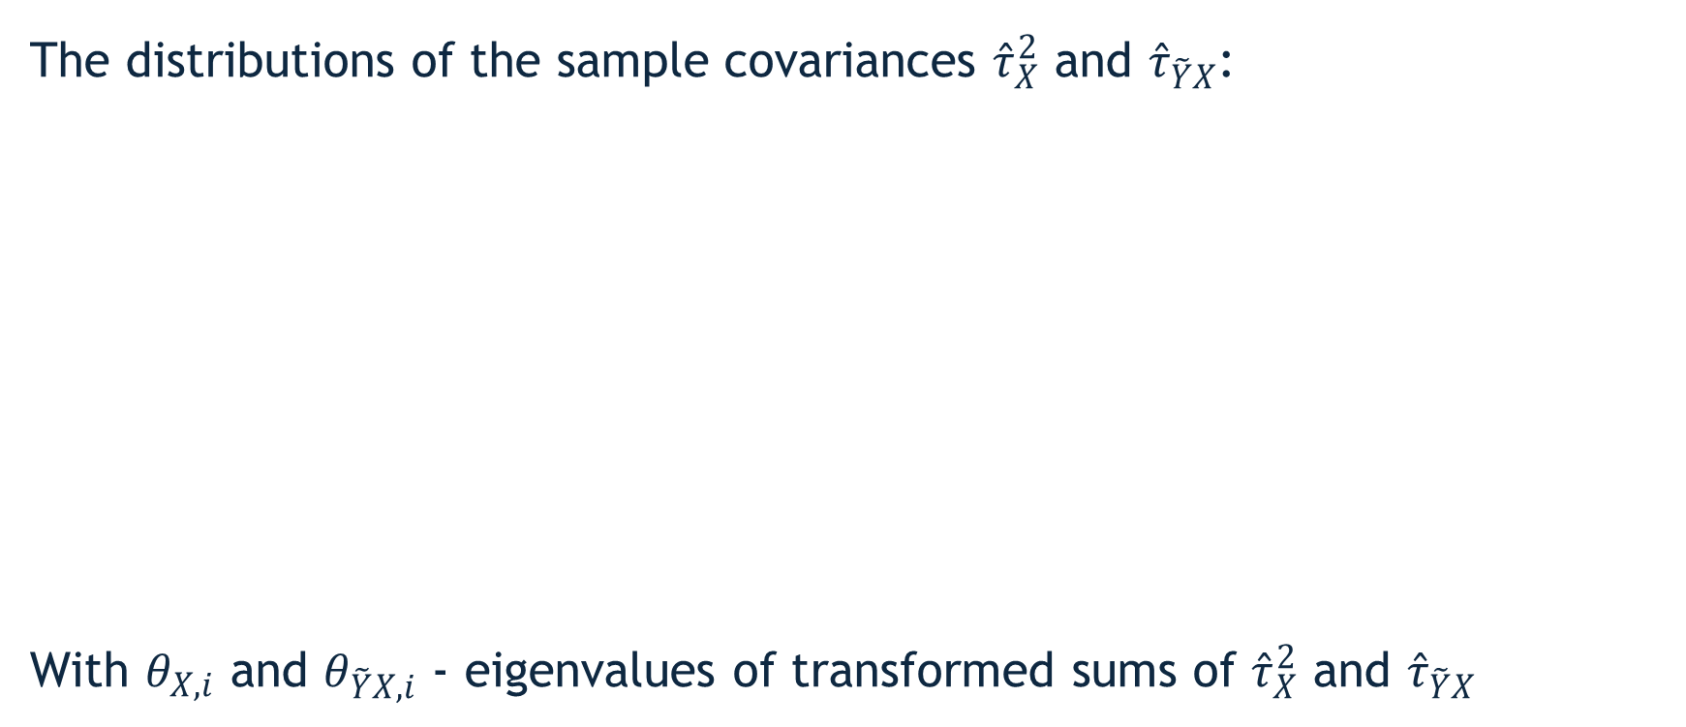
Extended Regularized Bayesian Estimator 6
The distributions of the sample covariances ${\hat{τ}}_{X}^{2}$ and ${\hat{τ}}_{\tilde{Y}X}$:
With $θ_{X,i}$ and $θ_{\tilde{Y}X,i}$ - eigenvalues of transformed sums of ${\hat{τ}}_{X}^{2}$ and ${\hat{τ}}_{\tilde{Y}X}$
$${\hat{τ}}_{X}^{2}∼Gamma\left(κ_{1}=\frac{{\left(\sum_{i=1}^{nJ+J+1}{θ_{X,i}}\right)}^{2}}{2\sum_{i=1}^{nJ+J+1}{θ_{X,i}^{2}}}, θ_{1}=\frac{\sum_{i=1}^{nJ+J+1}{θ_{X,i}^{2}}}{\sum_{i=1}^{nJ+J+1}{θ_{X,i}}}\right)$$ | $$(22)$$
$${\hat{τ}}_{\tilde{Y}X}∼Gamma\left(κ_{2}= \frac{{\left(\sum_{i=1}^{2\left(nJ+J+1\right)}{θ_{\tilde{Y}X,i}}\right)}^{2}}{2\sum_{i=1}^{2\left(nJ+J+1\right)}{θ_{\tilde{Y}X,i}^{2}}}, θ_{2}= \frac{\sum_{i=1}^{2\left(nJ+J+1\right)}{θ_{\tilde{Y}X,i}^{2}}}{\sum_{i=1}^{2\left(nJ+J+1\right)}{θ_{\tilde{Y}X,i}}}\right)$$ | $$(23)$$
⟵

Slide 25
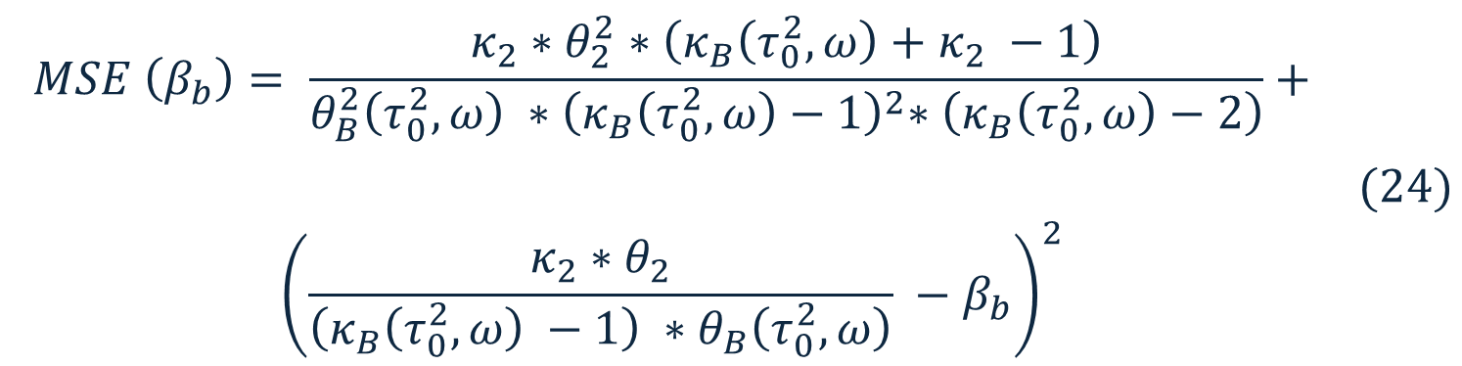

Extended Regularized Bayesian Estimator 7
The MSE of Bayesian estimation for between-group parameter $β_{b}$ as a function of prior parameters $τ_{0}^{2}$ and $ω$:
Equation (24) is further optimized for $τ_{0}^{2}$ and $ω$
$$MSE \left(β_{b}\right)= \frac{κ_{2}{∗θ}_{2}^{2} ∗\left(κ_{B}\left(τ_{0}^{2},ω\right)+κ_{2} −1\right)}{θ_{B}^{2}\left(τ_{0}^{2},ω\right) {∗\left(κ_{B}\left(τ_{0}^{2},ω\right)−1\right)}^{2}∗\left(κ_{B}\left(τ_{0}^{2},ω\right)−2\right)}+$$ | $$(24)$$
$$\begin{aligned}{\left(\frac{κ_{2}∗θ_{2}}{\left(κ_{B}\left(τ_{0}^{2},ω\right) −1\right) ∗θ_{B}\left(τ_{0}^{2},ω\right)} −β_{b}\right)}^{2}\#\end{aligned}$$
⟵

