Slide 1

Measurement structure and invariance of intimate partner violence against women in lower- and middle-income countries
Irina Bergenfeld, Cari Jo Clark, Angie Bengtson, Regine Haardörfer

Slide 2
Intimate Partner Violence (IPV)
The most common form of violence worldwide with high social, health, and economic costs
Studied by many disciplines, including public health, sociology, psychology, and criminology
Measurement and monitoring efforts since 1970s and 1980s have led to a proliferation of theories about what IPV is and why IPV occurs

Slide 3
Issues in IPV Measurement
What salient domains and acts comprise IPV?
  Physical (e.g. slapping, hitting, kicking, burning)
  Sexual (e.g. forced or coerced sex acts)
  Emotional/Psychological (e.g. insults, threats)
  Economic/Financial (e.g. taking money, sabotaging work)
  Controlling behaviors (e.g. isolating from family and friends)
How are these domains related to each other?
What are the best items to measure these domains?
What is measured and reported?

Slide 4
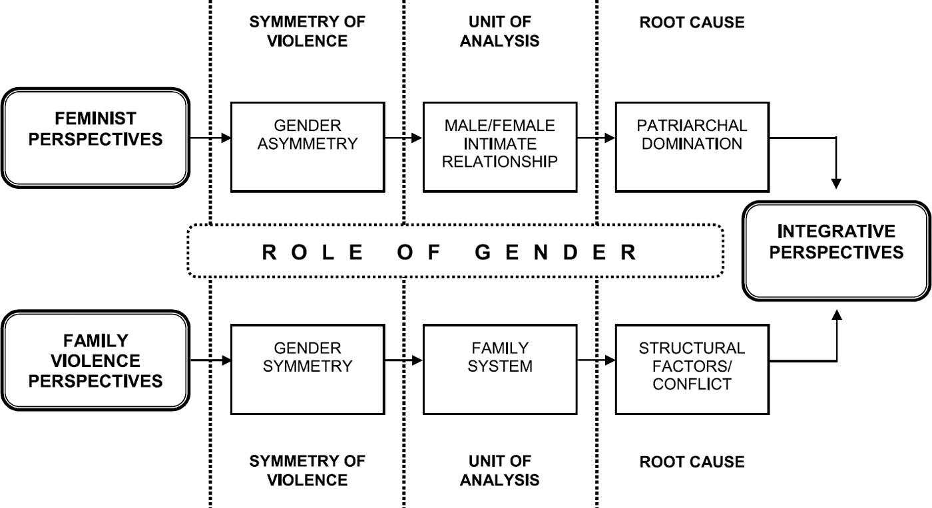
Theory
Debate between family violence vs. feminist theory
Family violence theorists: gender symmetry, quantitative methods
Feminist theorists: gender asymmetry, qualitative methods
Situational couple violence vs. intimate terrorism
Lawson, J. (2012). Sociological theories of intimate partner violence. Journal of human behavior in the social environment, 22(5), 572-590.

Slide 5
The Conflict Tactics Scales
Informed by family violence theory
Prominent in quantitative IPV measurement
Adapted by large scale survey programs including DHS (USAID), MICS (UNICEF), and WHO’s Violence Against Women Multi-Country Study
Most other scales validated against CTS

Slide 6
Outcome Construction
IPV tends to be modeled dichotomously in prevalence estimates and prevention trials
This method risks loss of information/statistical power and potentially spurious trial inference
Alternatives include summative measures that consider item frequency and severity
Latent modeling is another alternative that can be used to create continuous or categorical outcomes

Slide 7
Aims
To identify the best-fitting measurement model of IPV incorporating physical, sexual, psychological, and controlling behaviors subdomains
To assess the comparability of the best-fitting model across countries within World Health Organization-designated regions
To provide guidance to researchers about the most appropriate way to model IPV within and across contexts

Slide 8
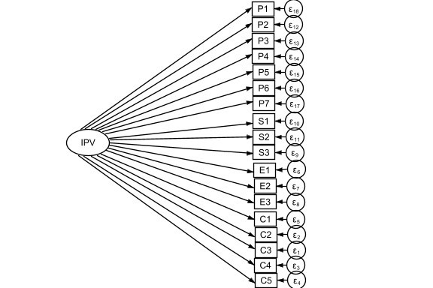
Unidimensional

Slide 9
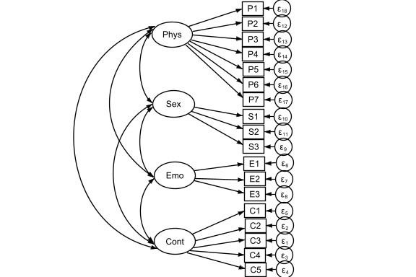
Multifactorial

Slide 10
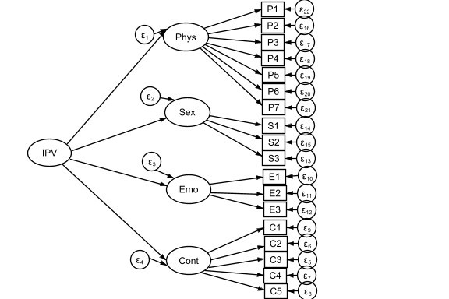
Hierarchical

Slide 11
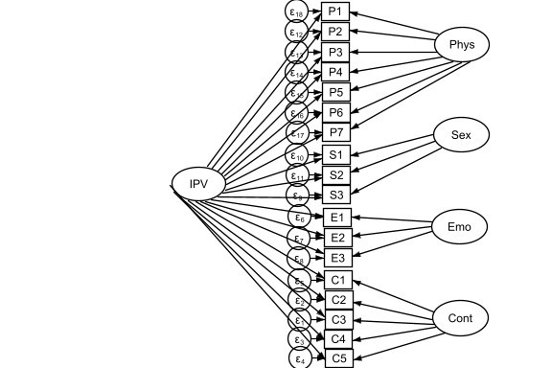
Bifactor

Slide 12
Bifactor S-1

Slide 13
Methods
Confirmatory factor analysis (CFA): tests how closely data fit to a predetermined model
RMSEA ≤ 0.06
CFI ≥0.95
TLI ≥ 0.95
SRMR ≤ 0.08
Multi-group confirmatory factor analysis (MGCFA): tests how comparable a model is across groups
Change in CFI ≤ -0.004 from less to more constrained model

Slide 14
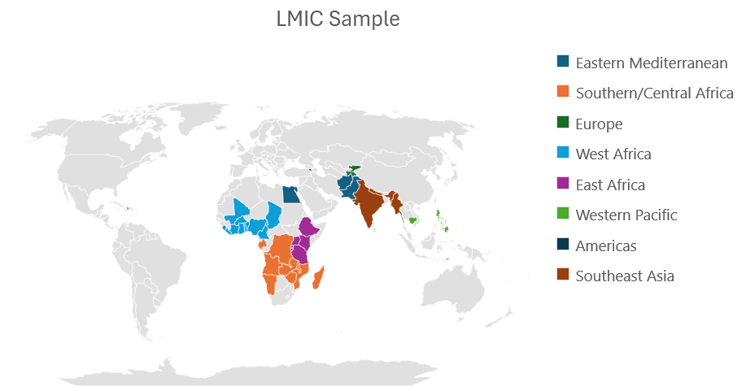
Sample
Most recent DHS or MICS from each country
Complete set of items:
  7 physical (ever & past year)
  3 sexual (ever & past year)
  3 emotional (ever & past year)
  5 controlling behaviors (ever)

Slide 15
Results
Bifactor/bifactor S-1 showed best fit overall, but a few did not converge or had superinflated loadings
Unidimensional showed worst fit, but still adequate by most indices
Multidimensional and hierarchical similarly good fit, but emotional and physical highly correlated
Bifactor models were primarily unidimensional in most cases and strongly (not strictly) invariant within regions in most cases
Controlling behaviors had lowest loadings on IPV

Slide 16
Results: Country models
Models of IPV | B | B (S-1) | M | H | U
Lifetime (controlling behaviors) | 45*(98%) | 44†(96%) | 45 (98%) | 44 (96%) | 10 (22%)
Lifetime (no controlling behaviors) | 45⁑(98%) | 45 (98%) | 45 (98%) | 45 (98%) | 23 (50%)
Past year | 39‡(85%) | 43 (93%) | 42 (91%) | 42 (91%) | 28 (61%)
Best fit across all models (n=138) | 107 (78%) | 29 (21%) | 2 (1%) | 0 (0%) | 0 (0%)

Slide 17
Results: Strong invariance
Region | Ever w/ controlling behaviors | Ever w/o controlling behaviors | Past year
E. Mediterranean | Yes | Yes | Yes
W. Pacific | Yes | No | Yes
S. & SE. Asia | Yes | Yes | Yes
E. Africa | Yes | Yes | Yes
W. Africa | No | Yes | No
Central & S. Africa | Yes | Yes | Yes
Europe | Yes | Yes | Yes

Slide 18
Takeaways: Theory
Takeaways: Practice
Of all proposed domains of IPV, controlling behavior is least correlated with others
Physical and emotional IPV are highly related
IPV is best described as a single construct with nuanced facets in most contexts that is largely invariant within regions
Bifactor models are optimal for modeling IPV in many contexts
Unidimensional models acceptable when more complex models are not feasible
Summative measures as a next best outcome construction when latent modeling not feasible

Slide 19
Limitations
Data:
  Content validity of emotional and sexual IPV
  Sparseness and other data quality issues
  DHS underestimates IPV
  No data from men or high-income countries
Analysis:
  More complex models may fail to converge, esp. with small ns
  Interpretability in bifactor models

Slide 20
Future Directions
How to model IPV in high-income countries? (pending)
Do different models affect trial inference?
What are the implications for descriptive and explanatory theories of IPV?

Slide 21
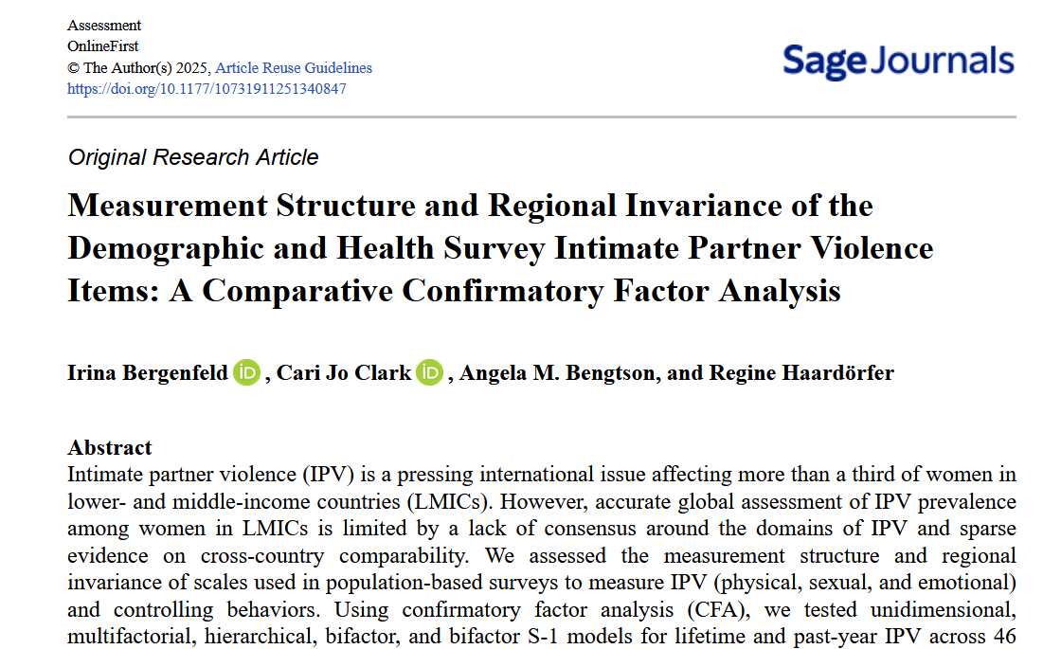

Slide 22
  Questions?
  Contact: irina.bergenfeld@emory.edu

