Slide 1





SEMtrees in longitudinal studies: The utility of goodness-of-fit indices for building theory
PhD Candidate Elizabeth Lucia Valeriano Lorenzo^{1,2}
Prof. Carmen Ximenez¹
Dr. Teodoro del Ser²
¹Department of Psychology, Autonomous University of Madrid, Madrid, Spain
²Reina Sofía Foundation Alzheimer Centre, CIEN Foundation, ISCIII, Madrid, Spain

Slide 2


Main goals of this study
Illustrates the application of SEMtrees to empirical data in the context of Alzheimer's disease and discusses the substantive interpretation of the results.
Analyses the performance of some of the most well-known goodness-of-fit indices for SEM models within each latent class grouping.
Provide practical recommendations for accurately tracking heterogeneity in longitudinal studies.

Slide 3
Main goals of this study
Illustrates the application of SEMtrees to empirical data in the context of Alzheimer's disease and discusses the substantive interpretation of the results.
Analyses the performance of some of the most well-known goodness-of-fit indices for SEM models within each latent class grouping.
Provide practical recommendations regarding advanced new methods for accurately tracking heterogeneity in longitudinal studies.

Slide 4
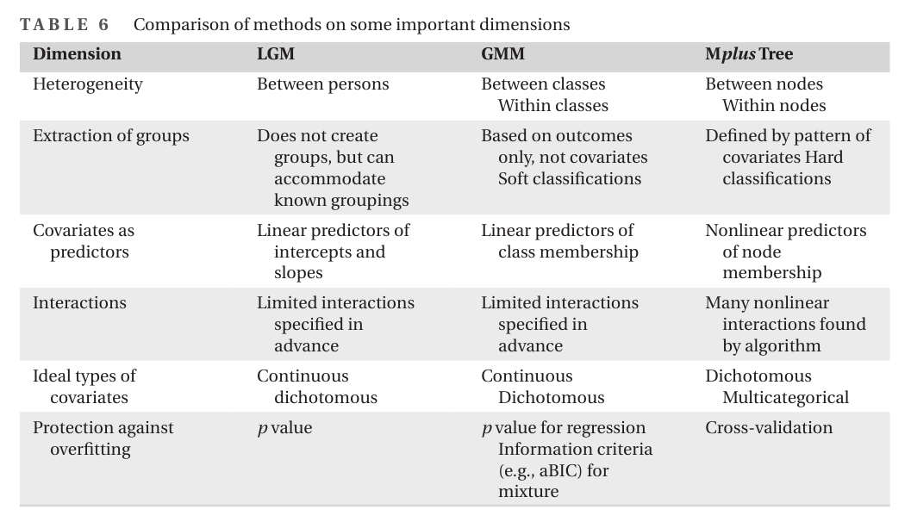
Methods to assess heterogeneity
/SEMtree
Serang, S. (2021). A comparison of three approaches for identifying correlates of heterogeneity in change. New Directions for Child and Adolescent Development, 2021(175), 141-160.

Slide 5

Create distinct subgroups composed of individuals with similar estimated parameters.
SEMtree
SEM
Examines the direct and indirect relationships among multiple variables within a hypothetical model.
Based on a pre-existing theoretical framework.
Decision tree
Applies the Recursive Partitioning Paradigm.
An approach that builds predictive models by repeatedly splitting the data into increasingly homogeneous groups (split candidates), facilitating classification and outcome prediction.
Does not require a pre-existing theoretical model.
McArdle, J. J., & Ritschard, G. (Eds.). (2013). Contemporary issues in exploratory data mining in the behavioural sciences. Routledge.

Slide 6
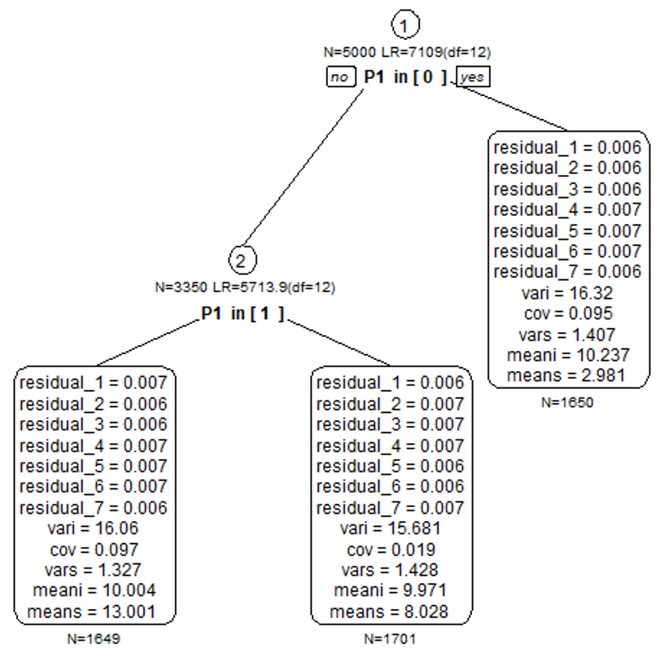
SEMtree
Analyse the SEM model using all observations in the current node.
- Recursive partitioning paradigm (split candidates).
- Optimal split points in the covariates → LEARNING phase.
Assess whether the estimated SEM parameters remain constant or vary according the covariate.
Specify the SEM model (theoretical model). The SEM template structure will remain the same at each node.
Select the covariate that produces—or is associated with—the greatest group differences.
- Covariate selection is based on optimal split points.
Decision tree
1
2
3
4
Adaptado de Arnold, Voelkle & Brandmaier, 2021

Slide 7



Analysis with empirical data
Vallecas Project Cohort - Madrid
Sample characteristics
913
Participants from the Vallecas Project
73,8±3,8
Mean age
10,2± 0,6
Average follow-up/ years.
64% Women
100 %
Cognitively healthy at baseline

Slide 8
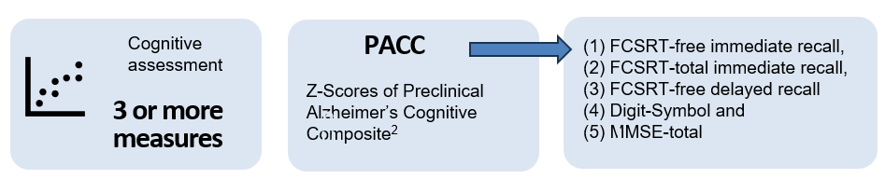
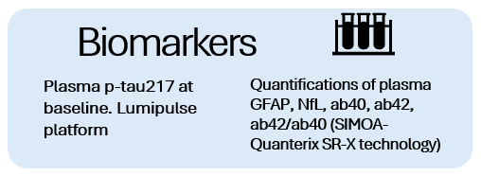
Analysis with empirical data
Outcome
Education level, cognitive reserve, several medical conditions, healthy lifestyles, level of functionality, anxiety and depression
Covariates

Slide 9
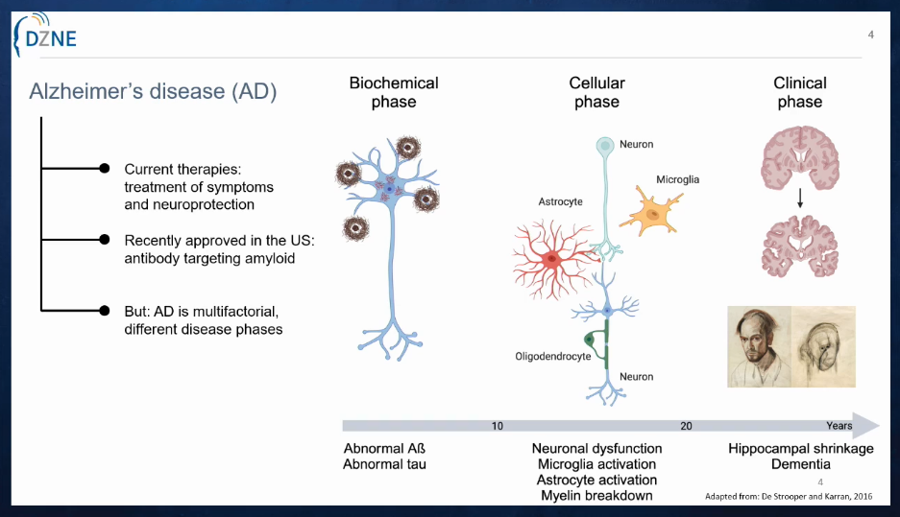
Research question:
¿Do baseline concentrations of p-tau217proteins, measured 10 years before, predict distinct patterns of cognitive trajectories in older adults?

Slide 10
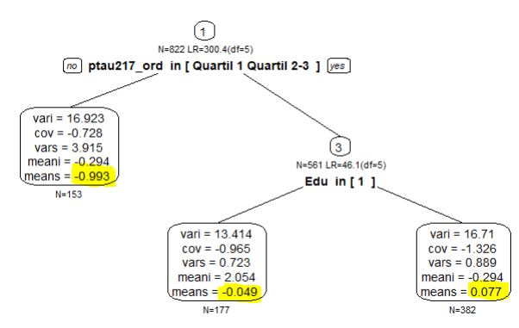
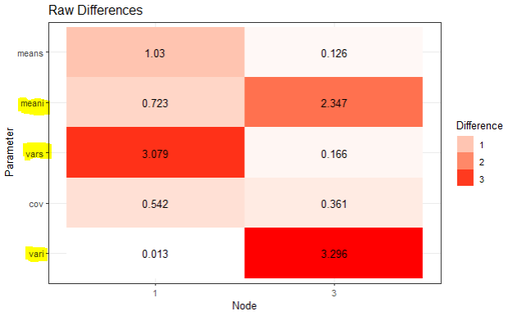
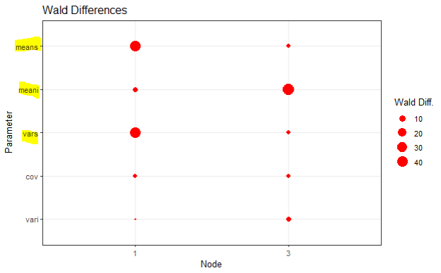
Statistical Differences in SEM Parameters
21,5%
24,8%
53,7%
The resulting subgroups show differences in the dispersion of the rate of change and mean rate of change.
The subgroups that emerge from this split start from different points, but do not necessarily change at different rates.

Slide 11
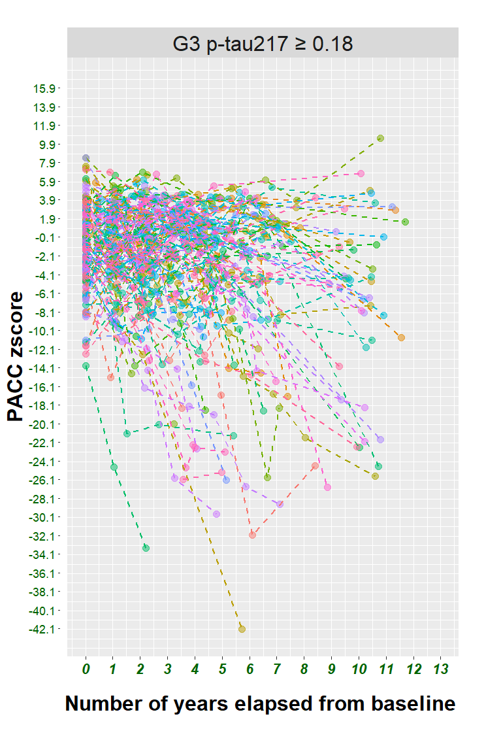
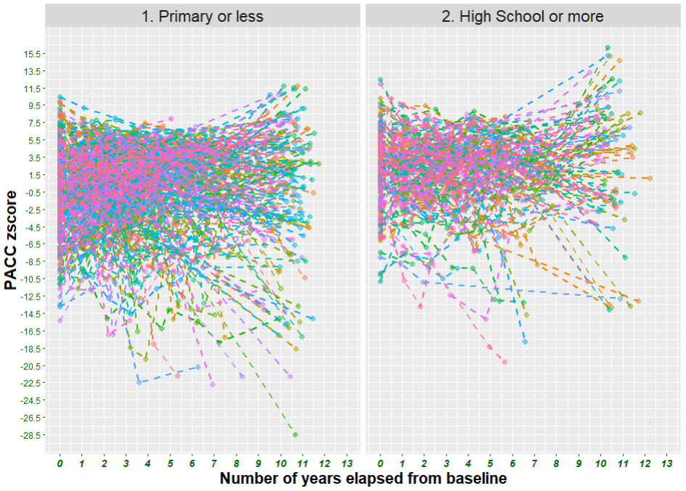
Baseline
P-tau 217
P-tau217 = Q4
P-tau217 = Q1, Q2-Q3
Level of
Education
High School
and University
Primary or less

Slide 12
Main goals of this study
Illustrates the application of SEMtrees to empirical data in the context of Alzheimer's disease and discusses the substantive interpretation of the results.
Analyses the performance of some of the most well-known goodness-of-fit indices for SEM models within each node, each latent class grouping.
Provide practical recommendations regarding advanced new methods for accurately tracking heterogeneity in longitudinal studies.

Slide 13
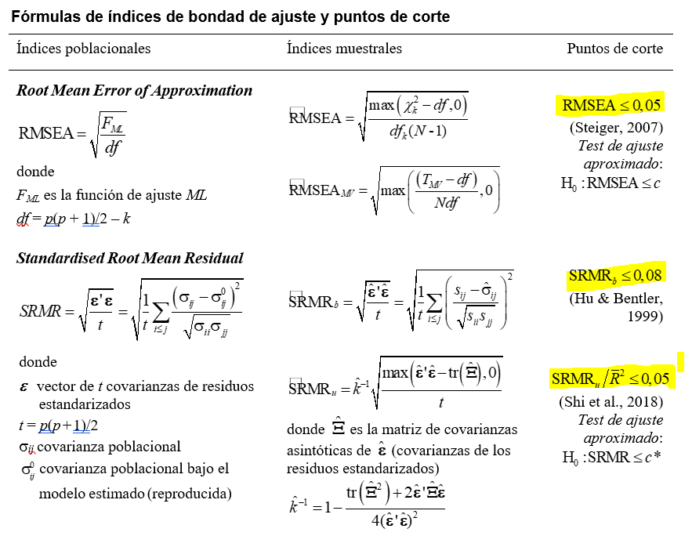

Slide 14
Interpreting fit indices in each node
SRMR = 0.120
SRMR_{u} [CI] = 0,066 [-0,021 – 0,153]
RMSEA = 0,107
RMSEA p-value ≤0.05 = 0,074
CFI = 0.925
TLI = 0.931

Slide 15
Interpreting fit indices in each node
SRMR = 0.265
SRMR_{u} [CI] = 0,222 [-0,084 – 0,527]
RMSEA = 0,261
RMSEA p-value ≤ 0.05 = 0,003
CFI = 0.785
TLI = 0.750

Slide 16
Interpreting fit indices in each node
SRMR = 0.107
SRMR_{u} [CI] = 0,055 [-0,020 – 0,129]
RMSEA = 0,061
RMSEA p-value ≤ 0.05 = 0,392
CFI = 0.982
TLI = 0.979

Slide 17
Main goals of this study
Illustrates the application of SEMtrees to empirical data in the context of Alzheimer's disease and discusses the substantive interpretation of the results.
Analyses the performance of some of the most well-known goodness-of-fit indices for SEM models within each latent class grouping.
Provides practical recommendations regarding advanced new methods for accurately tracking heterogeneity in longitudinal studies.

Slide 18
SEMtree
Strengths
Limitations
Flexibility to specify the model, growth factors, and covariates (independent variables)
Analyzes the pattern of change within each node and allows comparisons between nodes
Subpopulations are classified based on the distribution of covariates.
Longer computation time when the covariate is a continuous variable.
It is not possible to analyse a model when the observed variables are categorical.

Slide 19
Strategies to improve poor fit in nodes
Treat each SEMtree node like its own confirmatory model.
Interpret its CFI/TLI, RMSEA, SRMR and SRMR_{u} as measures of subgroup-model fit.
Watch for overfitting, limiting tree depth.
When fit worsens, examine invariance and consider freeing or constraining parameters used in the SEMtree’s template.

Slide 20
Strategies to improve poor fit in nodes
Be mindful that indices like SRMR and RMSEA may give biased signals in small nodes.
Simplify an overgrown tree.
Consider cross-validating the tree (using subsets of data) to ensure that node-specific fit improvements are not sample-specific.
Monitoring node-specific fit and kept only splits that did not cause unacceptable misfit.

Slide 21
SEMtree – Local fit indices
Fit indices such as RMSEA or SRMR can be used to evaluate the local fit of SEMs within each subgroup (terminal node) after splitting, but they are not the primary criterion for determining splits in SEM trees.
They are useful for post hoc validation, but not for guiding the construction of the tree itself.

Slide 22

Galadriel’s Mirror by JRR Tolkien
It shows things that were, things that are, and some things that may come to pass.
Its main purpose is to reveal possibilities and perspectives—not to predict the future with certainty.

Slide 23
Research Gaps
Consider fit indices, as an objective measure, used in selection among models with different numbers of classes
Choosing the correct number of factors
Considerations about the variety of reasons for emerging data patterns

Slide 24


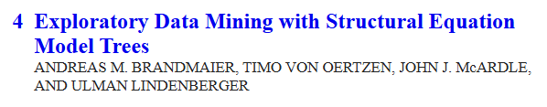

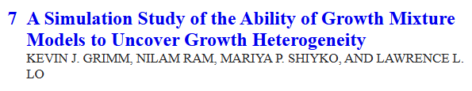

Computational tools - R

Slide 25













Acknowledgment
Prof. Carmen Ximénez Gómez
Autonomous University of Madrid
Department of Social Psychology and Methodology
This work was partially supported by grant PID2021-124885NB-I00 from the Ministerio de Ciencia e Innovación of Spain.
Scientific Director
FCIEN
Platform for Clinical Assessment
Biomarker Platform / Biochemistry and Molecular Genetics
The participants of the Vallecas Project - Madrid

