Slide 1
First steps in the construction of a new item pool to adaptively measure numerical reasoning in university students
Juan F. Luesia, María Dolores Nieto-Cañaveras, Ana Sanz-Cortés, Pilar Algaba-Cenizo, and Milagrosa Sánchez-Martín
Notes:
Good afternoon everyone.
My name is Juan Luesia, from Universidad Loyola in Spain.
Today I’m going to present this work on...
...the first steps...
...in the construction of a new item pool...
...designed to measure numerical reasoning in university students.

Slide 2




Work contextualization
ASSESSMENT OF KEY COMPETENCIES FOR ACADEMIC AND PROFESSIONAL SUCCESS IN HIGHER EDUCATION STUDENTS (KEY-COM) (PID2022-137067OB-I00)
...Provide instruments and procedures to measure academic competencies in college students.
...Transform cognitive abilities tests into computerized adaptive tests (CATs) to assess college students' level of competencies more accurately and efficiently.
Notes:
This is part of the broader project, with the objective of assessing key academic and professional competencies in higher education.
One of the main goals of this project is to create better tools and procedures for evaluating academic competencies.
In particular, we focus on transforming traditional cognitive tests into more flexible and accurate individual measures through computerized adaptive tests (or CAT).
We thing this tools help measure skills more efficiently, by adjusting the difficulty to each student’s level.

Slide 3
Introduction
Problem-solving abilities are reinforced through experiential learning approaches, such as case studies, project-based learning, and internships, which are common in modern higher education (National Research Council, 2012).
Cognitive gains from higher education have a lasting impact on professional performance and adaptability, particularly in dynamic environments that require critical and creative problem-solving (Pascarella and Terenzini, 2005).
This directly supports the development of core 21st-century skills. A framework that focus on cultivate learners’ ability to apply knowledge in real-world contexts, preparing them for complex, unpredictable challenges in modern work environment (Trilling and Fadel, 2009)
Union of Skills policy introduced in 2025 (March) emphasizes the integration of cognitive, technical, and interpersonal competencies to prepare learners for the complexities of the modern workforce (European Commission, 2025).
Notes:
Let’s begin with the broader context.
First, we know that problem-solving abilities (as part of project-based learning) is essential in higher education and play a crucial role in building real-world thinking skills.
These cognitive gains have an effect on professional performance especially in environments using critical and creative thinking.
This is aligned with the current educatioanal frameworks such as the 21st-century skills framework.
And a very recently Action Plan, the Union of Skills policy, introduced this year promotes integrating cognitive, technical, and interpersonal competencies, preparing students for the complex demands of today’s workforce.

Slide 4
Introduction
Numerical reasoning (NR) underpins higher-order problem-solving and analytical thinking, which are core components of both 21st-century skills and cognitive adaptability.
Essential for success in Science, Technology, Engineering, and Mathematics (STEM) and non-STEM fields alike (Aelenei et al., 2019; Steen, 2001).
When students learn to apply quantitative thinking across disciplines, they become better equipped to navigate dynamic, data-rich work environments and contribute meaningfully to problem-solving (Pascarella and Terenzini, 2005).
Numerical reasoning has become even more critical with the evolution of digital competence frameworks, which increasingly emphasize the capacity to interpret and use quantitative information in digital environments
  DigComp 2.2 (European Commission, 2022).
Notes:
More concretely...
We focus on Numerical reasoning as a fundamental cognitive skill in this context and essential in higher-order problem-solving and analytical thinking.

Slide 5
Justification and Objective
Is the assessment of numerical reasoning as a competence adapted to these new environments?
Is this competence evaluated from the early stages of university education in Spain?
...There is an absence of assessment tools adequately designed to address these emerging contexts and applicable to incoming university student
Computerized adaptive testing (CAT) offers an alternative to overcome some drawbacks of conventional testing methods
The purpose of this study is to present the characteristics of this instrument measuring NR that will form part of a larger bank currently under construction.
Notes:
So, we asked ourselves two main questions:
Is numerical reasoning being assessed in a way that reflects the current digital and professional demands?
Are these skills being evaluated early enough in university education in Spain?
Unfortunately, the answer is often no. Most existing tools are outdated, paper-based, and not aligned with today’s digital learning environments or competency frameworks.
Our goal was to address this gap.
In fact, we wanted to present the main preliminary psychometric properties of the tool.
However, the development and calibration process has been more time-consuming than expected, requiring greater resources and extending beyond the current academic year

Slide 6

In previous steps...
A pilot test was conducted (n=242) using a reasoning tool based on three reasoning patterns measured in a previous test (TOLT; Tobin and Capie, 1981; Acevedo and Oliva, 1995).
Within one of the numerical reasoning tasks (scales task), the item difficulty was found to be very high (p_{j} = .27; Perceived Difficulty = 4.03 (range: 1 to 5).
Possible reasons:
  Open Response format.
  No use of additional material (e.g., paper and pen).
A bank of items was designed using a scale task* to address the previously identified issues to support the implementation of a Computerized Adaptive Task (CAT).
-> Simulation study
In line with other study (Hofman et al., 2015) using scales task to measure NR.

Slide 7
Instrument Characteristics
An item bank consisting of 75 items was developed across two test versions (A and B) each comprising 45 items.
  15 anchor items in both test versions.
  60 specific items (30 per test version).
Nine items per difficulty level in each version, depending on:
  The number of figures.
  The quantity of distinct figures.
  The number of design variations in the figures.

Slide 8
Instrument Characteristics
Multiple-choice format (5 response options).
Support materials for responding (paper and pencil).
Notes:
DECIR: cuando se aplican TAIs, se pone un número más o menos "alto" de opciones de respuesta para que las discrimaciones de los ítems sean buenas, es decir, para que lo pusieras más bien en las modificaciones del nuevo formato.

Slide 9

Instrument Characteristics
Confidential
Multiple-choice format (5 response options).
Support materials for responding (paper and pencil).
  Each item includes:
    A written prompt.
Notes:
DECIR: cuando se aplican TAIs, se pone un número más o menos "alto" de opciones de respuesta para que las discrimaciones de los ítems sean buenas, es decir, para que lo pusieras más bien en las modificaciones del nuevo formato.

Slide 10
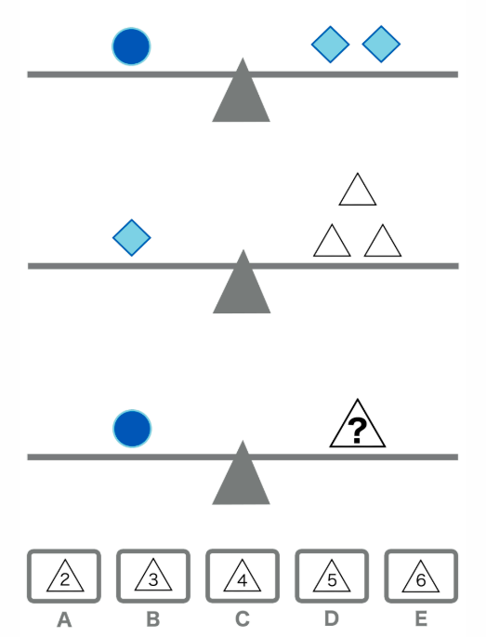
Instrument Characteristics
Confidential
Multiple-choice format (5 response options).
Support materials for responding (paper and pencil).
  Each item includes:
    A written prompt.
    An image displaying multiple scales in equilibrium.
Notes:
DECIR: cuando se aplican TAIs, se pone un número más o menos "alto" de opciones de respuesta para que las discrimaciones de los ítems sean buenas, es decir, para que lo pusieras más bien en las modificaciones del nuevo formato.

Slide 11
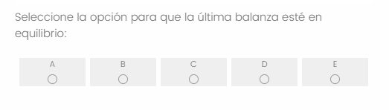
Instrument Characteristics
Confidential
Multiple-choice format (5 response options).
Support materials for responding (paper and pencil).
  Each item includes:
    A written prompt.
    An image displaying multiple scales in equilibrium.
    And five multiple-choice response options.
Notes:
DECIR: cuando se aplican TAIs, se pone un número más o menos "alto" de opciones de respuesta para que las discrimaciones de los ítems sean buenas, es decir, para que lo pusieras más bien en las modificaciones del nuevo formato.

Slide 12
Instructions Given
Confidential
  Choose the option that maintains equilibrium.
  The task allows for the use of pencil and paper, which are provided for support during the session...
  ...However, upon completion: All materials must be returned to the session supervisor.
  Enough time limit to respond the whole test.

Slide 13

Montecarlo Simulation Study
  Design:
  Item bank: 75 items, 2 test versions (15 anchor items, 3 per difficulty level).
  Parameters: a > uniform (0.7-1.5), b > (-2, 2).
  Theta: uniform between –2 and 2.
  Calibration: 2PL model.
  1000 participants (500 per test).

Slide 14
Montecarlo Simulation Study
Unidimensional CAT algorithm:
Scoring method: maximum a posteriori (MAP).
Starting rule: maximum Fisher information (θ=0).
Item selection criterion: maximum Fisher information.
  Stopping rule: 10, 15, 20, 25 items.
  Person scores recovery:
  Bias, accuracy, RMSE, and Mean SE.

Slide 15
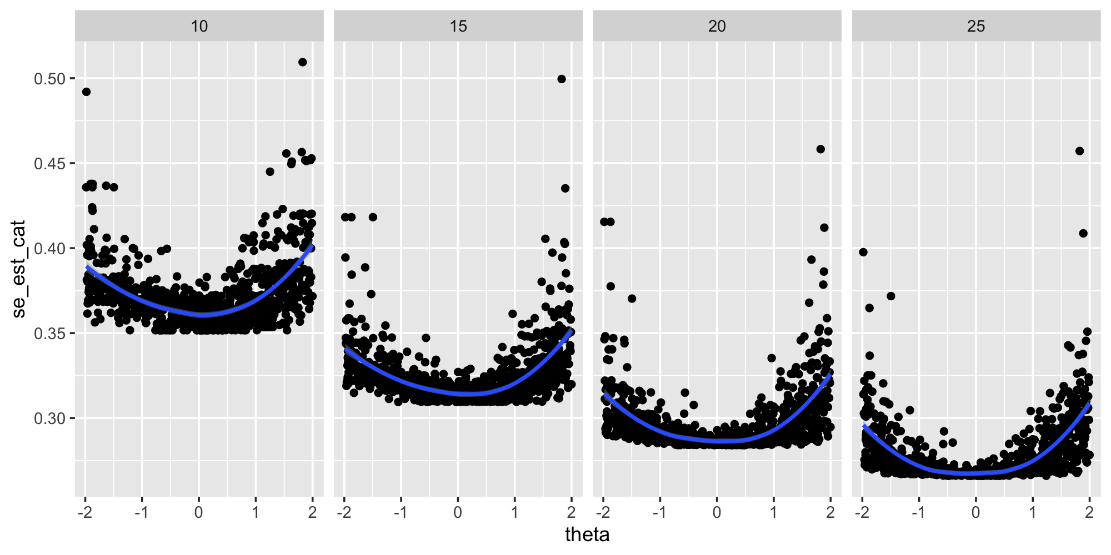
Simulation Results
Test length | 10 | 15 | 20 | 25
Bias | -0.087 | -0.089 | -0.084 | -0.085
Accuracy | 0.893 | 0.912 | 0.925 | 0.93
RMSE | 0.528 | 0.486 | 0.454 | 0.441
Mean SE | 0.372 | 0.324 | 0.296 | 0.277

Slide 16
Bilder, R. M., & Reise, S. P. (2018). Neuropsychological tests of the future: How do we get there from here? The Clinical Neuropsychologist, 33(2), 220–245. https://doi.org/10.1080/13854046.2018.1521993
Discussion
This CAT tool can enhances precision and efficiency (2PL) due to it adjusts item difficulty to match student proficiency, making this balance-scale item bank ideal for scalable, efficient assessment in higher education (Ebenbeck et al., 2024).
Aligns with Union of Skills new framework. The tool can support these policy priorities and contributes to EU targets for digital skills acquisition (European Commission, 2025).
Aligns with 21st-Century Skills framework in Problem-Solving. Embedding these tasks in a CAT ensures that higher-order thinking skills are assessed and developed in university students (Bennett, 2015; Bilder and Reise, 2018).
It promotes academic Success and Increases Graduate Employability. By diagnosing and strengthening NR early, the tool enhances academic performance and boosts readiness for the workforce (Chan et al., 2016).
To be continued:
  Bank calibration (and post-hoc simulation)
  Gradually expand the item bank.
Notes:
Nuestro objetivo es calibrar el banco, gradually expand the item bank.
Posteriormente, se harán las simulaciones post-hoc.

Slide 17
References
Acevedo, J. A., & Oliva, J. M. (1995). Validación y aplicación de un test de razonamiento lógico. Revista de psicología general y aplicada: Revista de la Federación Española de Asociaciones de Psicología, 48(3), 339-351.
Aelenei, C., Martinot, D., Sicard, A., & Darnon, C. (2019). When an academic culture based on self-enhancement values undermines female students’ sense of belonging, self-efficacy, and academic choices. The Journal of Social Psychology, 160(3), 373–389. https://doi.org/10.1080/00224545.2019.1675576
Bennett, R. E. (2015). The changing nature of educational assessment. Review of Research in Education, 39(1), 370–407. https://doi.org/10.3102/0091732x14554179
Bilder, R. M., & Reise, S. P. (2018). Neuropsychological tests of the future: How do we get there from here? The Clinical Neuropsychologist, 33(2), 220–245. https://doi.org/10.1080/13854046.2018.1521993
Chan, S. W., Ismail, Z., & Sumintono, B. (2016). A framework for assessing high school students’ statistical reasoning. PLoS ONE, 11(11), e0163846. https://doi.org/10.1371/journal.pone.0163846
Ebenbeck, N., Bastian, M., Mühling, A., & Gebhardt, M. (2024). Duration versus accuracy—what matters for computerised adaptive testing in schools? Journal of Computer Assisted Learning, 40(6), 3443–3453. https://doi.org/10.1111/jcal.13074
European Commission. (2022). The Digital Competence Framework 2.2 (DigComp 2.2): Examples of knowledge, skills and attitudes. https://publications.jrc.ec.europa.eu/repository/handle/JRC128415
European Commission. (2025, March 5). Union of Skills. https://employment-social-affairs.ec.europa.eu/policies-and-activities/skills-and-qualifications/union-skills_en
Hofman, A. D., Visser, I., Jansen, B. R. J., & Van Der Maas, H. L. J. (2015). The Balance-Scale task revisited: a comparison of statistical models for Rule-Based and Information-Integration theories of proportional reasoning. PLoS ONE, 10(10), e0136449. https://doi.org/10.1371/journal.pone.0136449
Karagianni, M., & Tsaousis, I. (2025). From Development to validation: Exploring the efficiency of Numetrive, a computerized adaptive assessment of numerical reasoning. Behavioral Sciences, 15(3), 268. https://doi.org/10.3390/bs15030268
National Research Council. (2012). Education for Life and Work: Developing Transferable Knowledge and Skills in the 21st Century. The National Academies Press. https://doi.org/10.17226/13398
Pascarella, E. T., & Terenzini, P. T. (2005). How College Affects Students: A Third Decade of Research. Jossey-Bass.
Steen, L. A. (2001). Mathematics and democracy: The case for quantitative literacy. National Council on Education and the Disciplines.
Tobin, K. G., & Capie, W. (1981). The development and validation of a group test of logical thinking. Educational and Psychological Measurement, 41(2), 413-423. https://doi.org/10.1177/00131644810410022
Trilling, B., & Fadel, C. (2009). 21st Century Skills: Learning for Life in Our Times. Jossey-Bass.

Slide 18
Thank you!
jfluesia@uloyola.es

