Slide 1

Mixture Three-Step Latent Vector Autoregression to Find Individuals With Similar Dynamic Processes
Manuel T. Rein¹², Leonie V.D.E. Vogelsmeier¹, Jeroen K. Vermunt¹, Kim De Roover²¹
¹Tilburg University, the Netherlands
²KU Leuven, Belgium
Notes:
- Talk about modeling between-group differences in dynamic processes

Slide 2
Within-person dynamics
Positive affect
Positive affect
Positive affect
Negative affect
Negative affect
Negative affect
Time
Notes:
Previous presentations dealt with cross-sectional research questions
But researchers are oftentimes interested in within-person processes
For example, how positive and negative affect carry over from one moment to the next and interact with each other
→ Analysis of intensive longitudinal data, where multiple observations (usually around 50 or more) are available for each individual

Slide 3
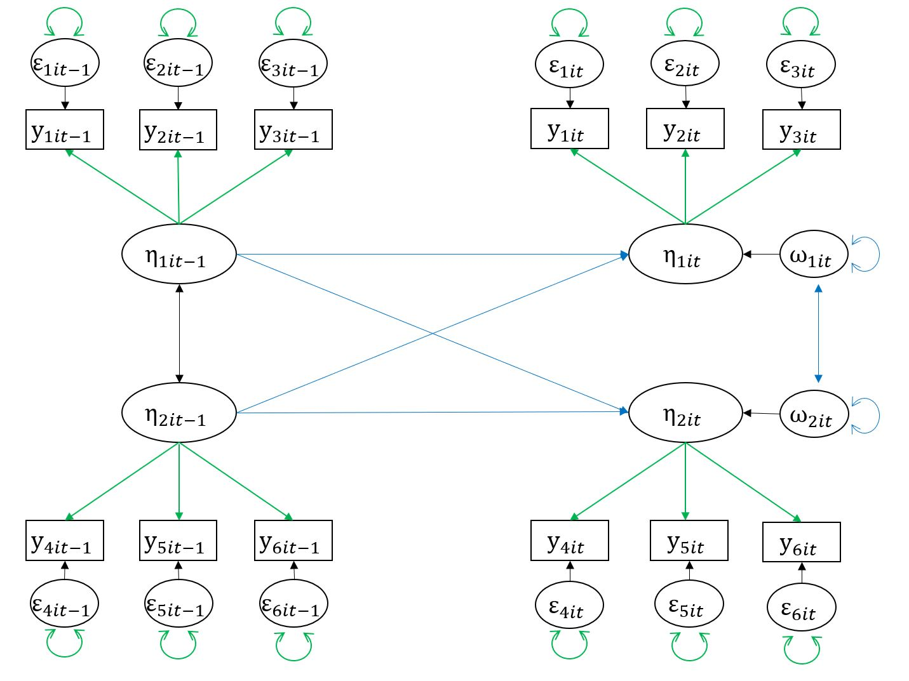
Latent Vector Autoregressive Model
Step 1
Step 2
Step 1
Notes:
(latent) vector autoregressive model is a popular model for dynamic processes
Y = observed scores of individual i at time-point t
Eta = true (latent) scores
Omega = innovations (residual of the latent variables)
When using MMG-SEM, we would first solve the MM in Step 1, and then estimate the SM in Step 2 (i.e., the dynamic relations of constructs across time-points)
Sounds easy, right? Spoiler alert: It’s not

Slide 4
The obstacles
Notes:
There are three major obstacles in extending MMG-SEM to intensive longitudinal data

Slide 5
Obstacle 1: missing data
ID | Time | excited | enthus | determ
1 | 1 | 3 | 7 | 3
1 | 2 | NA | NA | NA
1 | 3 | 3 | 7 | 6
… | … | … | … | …
2 | 1
2 | 2 | NA | NA | NA
2 | 3 | 4 | 5 | 3
… | … | … | … | …
3 | 1 | 4 | 3 | 5
… | … | … | … | …
(some) missing data are the norm instead of an exception in ILD
It is natural that participants miss beeps or are busy
Use of summary statistics (covariances) in MMG-SEM requires complete data

Slide 6
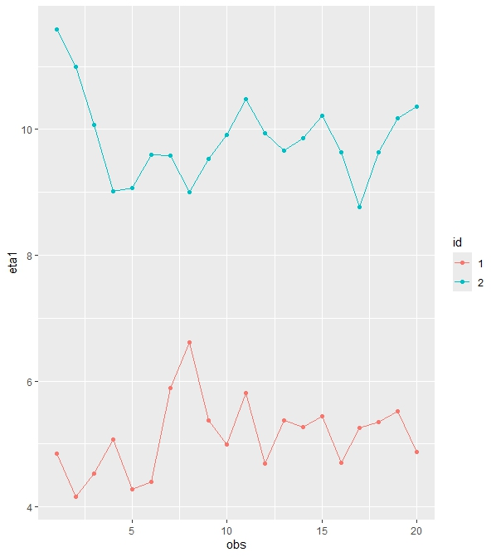
Obstacle 2: mean differences
Mean differences need to be addressed, or the regression estimates would conflate within-person processes with between-person differences
MMG-SEM mean-centers the data per group by default
This does not work in an LVAR model due to Nickell’s bias
Instead, add random intercept

Slide 7
Obstacle 3: estimation
SEM works in the “wide format” → every row refers to one individual
Wide format leads to large model and covariance matrices (T*Q x T*Q)
Estimation becomes unstable and unfeasible for T that is typical for ILD
ID | PAT1 | PAT2 | PAT3 | … | NAT1 | NAT2 | NAT3 | …
1 | 3 | 2 | 5 | … | 7 | 5 | 4 | …
2 | 2 | 4 | 4 | … | 4 | 3 | 2 | …
3 | 5 | 5 | 5 | … | 3 | 4 | 1 | …
4 | 6 | 3 | 1 | … | 5 | 5 | 4 | …
5 | 3 | 6 | 2 | … | 2 | 2 | 3 | …
6 | 6 | 3 | 4 | … | 1 | 3 | 2 | …
7 | 7 | 5 | 6 | … | 5 | 4 | 2 | …
8 | 2 | 5 | 2 | … | 4 | 3 | 1 | …
9 | 5 | 3 | 5 | … | 3 | 3 | 5 | …
… | … | … | … | … | … | … | … | …

Slide 8
Solution: Mixture Three-Step Latent Vector Autoregression
Step 1: Estimate the measurement model
(partially) person-specific parameters
Step 2: Compute factor scores and their reliability
account for measurement non-invariance across individuals
Step 3: estimate the structural model including a mixture
Cluster individuals based on their dynamic processes
Account for measurement error in the factor scores
Estimation: State Space Model with Kalman Filter
Notes:
to account for possible non-invariances when comparing groups of individuals in their dynamics, we propose multi-group three-step latent vector autoregression
Stepwise estimation method
Step 1: solely estimate the MM and investigate measurement non-invariance
Step 2: compute factor scores for the latent variables, and their uncertainty. use the factor scores as single indicators of the latent variables in step 3. by doing so, account for differences in the MM, as well as uncertainty in the factor scores
Step 3: estimate the SM using the factor scores as data.
avoid using summary statistics and can handle missing values
Use State Space Model: latent variable model that specifically handles time → allows including a random intercept and handles large number of time-points much better than wide-format SEM

Slide 9
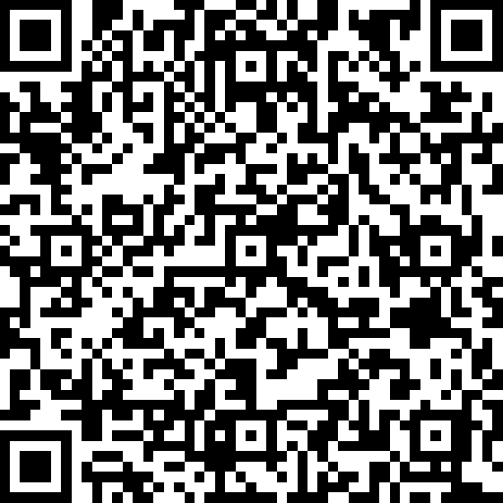
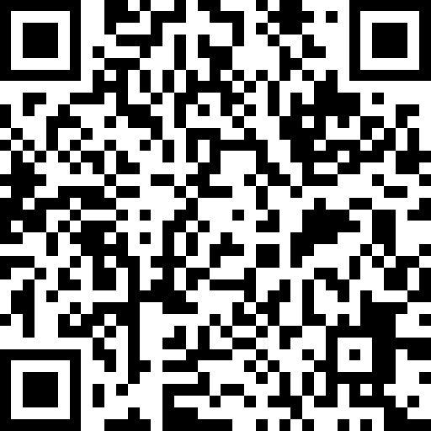
Thank you for your attention
☺
Latent Vector Autoregressive Modeling: A Stepwise Estimation Approach
https://github.com/mt-rein/ezLVAR

