Slide 1





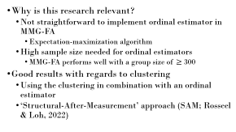
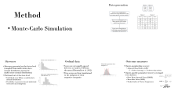
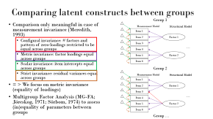


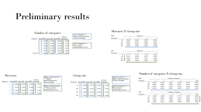
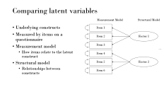
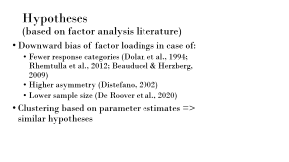
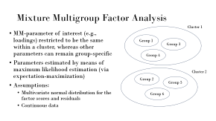
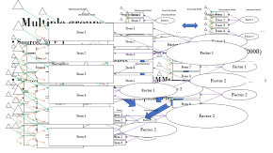
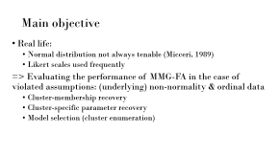


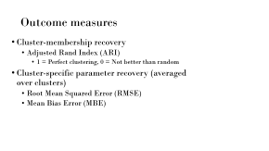
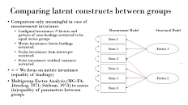
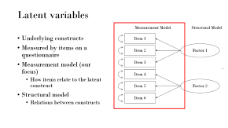
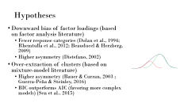
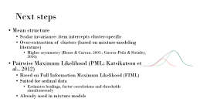
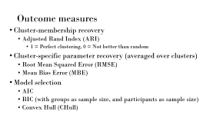
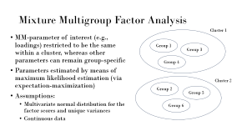
Evaluating the Efficacy of Mixture Multigroup Factor Analysis in Handling Non-Normal and Ordinal Data: A Simulation Study
Lucas Nowicki, Kim De Roover, Eva Ceulemans, Francis Tuerlinckx

Slide 2
Latent variables
Measurement Model
Structural Model
Underlying constructs
Measured by items on a questionnaire
Measurement model (our focus)
  How items relate to the latent construct
Structural model
  Relations between constructs
Item 1
Item 2
Factor 1
Item 3
…
Item 4
Item 5
Factor 2
Item 6

Slide 3
Comparing latent constructs between groups
Group 1
Comparison only meaningful in case of measurement invariance (Meredith, 1993)
  Configural invariance: # factors and pattern of zero-loadings restricted to be equal across groups
  Metric invariance: factor loadings equal across groups
  Scalar invariance: item intercepts equal across groups
  Strict invariance: residual variances equal across groups
= > We focus on metric invariance (equality of loadings)
Multigroup Factor Analysis (MG-FA; Jöreskog, 1971; Sörbom, 1974) to assess (in)equality of parameters between groups
Measurement Model
Structural Model
Item 1
Item 2
Factor 1
Item 3
…
Item 4
Item 5
Factor 2
Item 6
Group 2
Measurement Model
Structural Model
Item 1
Item 2
Factor 1
Item 3
…
Item 4
Item 5
Factor 2
Item 6
Group …

Slide 4
Multiple groups
Measurement Model
Structural Model
Measurement Model
Structural Model
Measurement Model
Structural Model
Measurement Model
Item 1
Measurement Model
Structural Model
Structural Model
Item 1
Item 2
Factor 1
Item 2
Factor 1
Item 1
Item 1
Item 3
Item 1
Item 3
…
Item 4
…
Item 4
Factor 2
Factor 1
Factor 2
Item 5
Item 5
Item 2
Factor 1
Sources of non-invariance?
  Can be of interest itself (intergroup differences in item interpretation; Chen, 2008)
  Pairwise comparison of parameters
  Not feasible when dealing with many groups
=> Mixture Multigroup Factor Analysis (MMG-FA; De Roover et al., 2020)
  Extension of MG-FA
  Mixture clustering based on certain MM-parameters
Measurement Model
Structural Model
Item 2
Item 6
Item 6
Factor 1
Item 1
Item 2
Measurement Model
Structural Model
Item 3
Factor 1
Item 2
Item 3
Item 1
…
Measurement Model
Item 4
Structural Model
…
Factor 1
Item 3
Item 3
Item 2
Item 4
…
Item 1
Item 3
Item 4
Factor 2
Measurement Model
Structural Model
Item 5
…
Factor 2
…
Item 1
Factor 2
Item 4
Item 5
Item 5
Factor 1
Item 2
Item 4
Item 6
Item 6
Factor 1
Item 5
Factor 2
Item 2
Item 3
Item 6
Item 6
Item 3
Factor 2
Item 5
Measurement Model
Structural Model
…
Item 4
Item 1
…
Item 4
Factor 1
Item 2
Factor 2
Factor 2
Item 5
Item 3
Item 5
Item 6
…
Item 4
Item 6
Item 5
Factor 2
Item 6
Item 6

Slide 5
Mixture Multigroup Factor Analysis
Cluster 1
MM-parameter of interest (e.g., loadings) restricted to be the same within a cluster, whereas other parameters can remain group-specific
Parameters estimated by means of maximum likelihood estimation (via expectation-maximization)
Assumptions:
  Multivariate normal distribution for the factor scores and residuals
  Continuous data
Group 1
Group 3
Group 4
Cluster 2
Group 2
Group 5
Group 6

Slide 6
Main objective
Real life:
  Normal distribution not always tenable (Micceri, 1989)
  Likert scales used frequently
=> Evaluating the performance of MMG-FA in the case of violated assumptions: (underlying) non-normality & ordinal data
  Cluster-membership recovery
  Cluster-specific parameter recovery
  Model selection (cluster enumeration)

Slide 7
Hypotheses
(based on factor analysis literature)
Downward bias of factor loadings in case of:
  Fewer response categories (Dolan et al., 1994; Rhemtulla et al., 2012; Beauducel & Herzberg, 2009)
  Higher asymmetry (Distefano, 2002)
  Lower sample size (De Roover et al., 2020)
Clustering based on parameter estimates => similar hypotheses

Slide 8
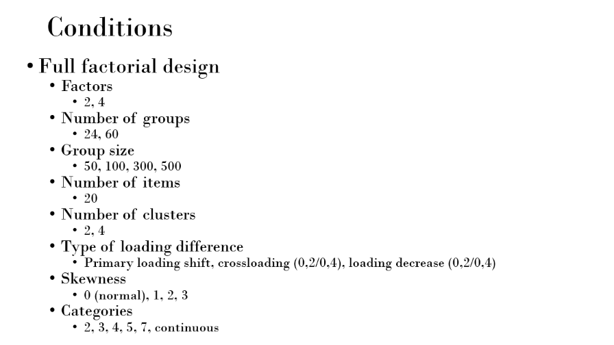
Method
Monte-Carlo Simulation

Slide 9
Conditions
Full factorial design
  Factors
    2, 4
  Number of groups
    24, 60
  Group size
    50, 100, 300, 500
  Number of items
    20
  Number of clusters
    2, 4
  Type of loading difference
    Primary loading shift, crossloading (0,2/0,4), loading decrease (0,2/0,4)
  Skewness
    0 (normal), 1, 2, 3
  Categories
    2, 3, 4, 5, 7, continuous

Slide 10
Outcome measures
Cluster-membership recovery
  Adjusted Rand Index (ARI)
    1 = Perfect clustering, 0 = Not better than random
Cluster-specific parameter recovery (averaged over clusters)
  Root Mean Squared Error (RMSE)
  Mean Bias Error (MBE)
Model selection
  AIC
  BIC (with groups as sample size, and participants as sample size)
  Convex Hull (CHull)
Notes:
Convex hull plots likelihood in function of free parameters

Slide 11
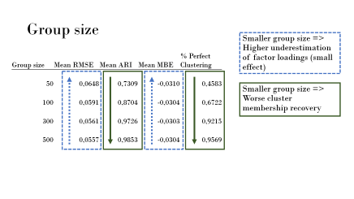
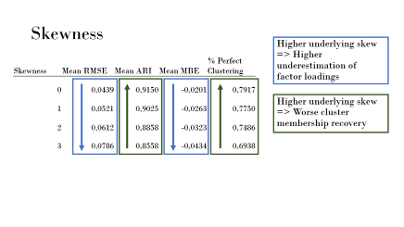
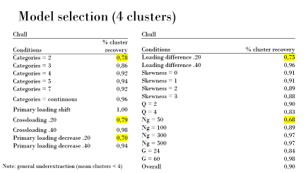
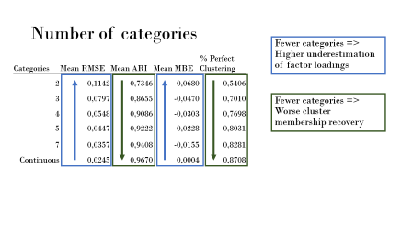
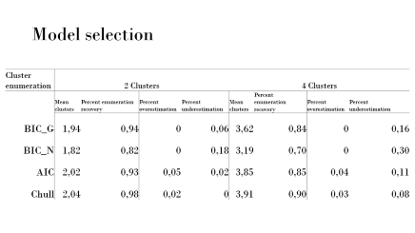
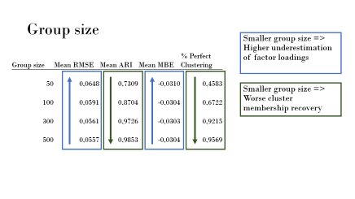
Preliminary results

Slide 12
Number of categories
Fewer categories => Higher underestimation of factor loadings
Categories | Mean RMSE | Mean ARI | Mean MBE | % Perfect Clustering
2 | 0,1142 | 0,7346 | -0,0680 | 0,5406
3 | 0,0797 | 0,8655 | -0,0470 | 0,7010
4 | 0,0548 | 0,9086 | -0,0303 | 0,7698
5 | 0,0447 | 0,9222 | -0,0228 | 0,8031
7 | 0,0357 | 0,9408 | -0,0155 | 0,8281
Continuous | 0,0245 | 0,9670 | 0,0004 | 0,8708
Fewer categories => Worse cluster membership recovery

Slide 13
Skewness
Higher underlying skew => Higher underestimation of factor loadings
Skewness | Mean RMSE | Mean ARI | Mean MBE | % Perfect Clustering
0 | 0,0439 | 0,9150 | -0,0201 | 0,7917
1 | 0,0521 | 0,9025 | -0,0263 | 0,7750
2 | 0,0612 | 0,8858 | -0,0323 | 0,7486
3 | 0,0786 | 0,8558 | -0,0434 | 0,6938
Higher underlying skew => Worse cluster membership recovery

Slide 14
Group size
Smaller group size => Higher underestimation of factor loadings (small effect)
Group size | Mean RMSE | Mean ARI | Mean MBE | % Perfect Clustering
50 | 0,0648 | 0,7309 | -0,0310 | 0,4583
100 | 0,0591 | 0,8704 | -0,0304 | 0,6722
300 | 0,0561 | 0,9726 | -0,0303 | 0,9215
500 | 0,0557 | 0,9853 | -0,0304 | 0,9569
Smaller group size => Worse cluster membership recovery

Slide 15
Model selection
Cluster enumeration |  | 2 Clusters |  |  |  | 4 Clusters
 |  | Mean clusters | Percent enumeration recovery | Percent overestimation | Percent underestimation | Mean clusters | Percent enumeration recovery | Percent overestimation | Percent underestimation
BIC_G |  | 1,94 | 0,94 | 0 | 0,06 | 3,62 | 0,84 | 0 | 0,16
BIC_N |  | 1,82 | 0,82 | 0 | 0,18 | 3,19 | 0,70 | 0 | 0,30
AIC |  | 2,02 | 0,93 | 0,05 | 0,02 | 3,85 | 0,85 | 0,04 | 0,11
Chull |  | 2,04 | 0,98 | 0,02 | 0 | 3,91 | 0,90 | 0,03 | 0,08

Slide 16
Model selection (4 clusters)
Chull
Conditions | % cluster recovery
Categories = 2 | 0,78
Categories = 3 | 0,86
Categories = 4 | 0,92
Categories = 5 | 0,94
Categories = 7 | 0,92
Categories = continuous | 0,96
Primary loading shift | 1,00
Crossloading .20 | 0,79
Crossloading .40 | 0,98
Primary loading decrease .20 | 0,70
Primary loading decrease .40 | 0,94
Chull
Conditions | % cluster recovery
Loading difference .20 | 0,75
Loading difference .40 | 0,96
Skewness = 0 | 0,91
Skewness = 1 | 0,91
Skewness = 2 | 0,89
Skewness = 3 | 0,88
Q = 2 | 0,90
Q = 4 | 0,83
Ng = 50 | 0,68
Ng = 100 | 0,89
Ng = 300 | 0,97
Ng = 500 | 0,97
G = 24 | 0,84
G = 60 | 0,98
Overall | 0,90
Note: general underextraction (mean clusters < 4)

Slide 17
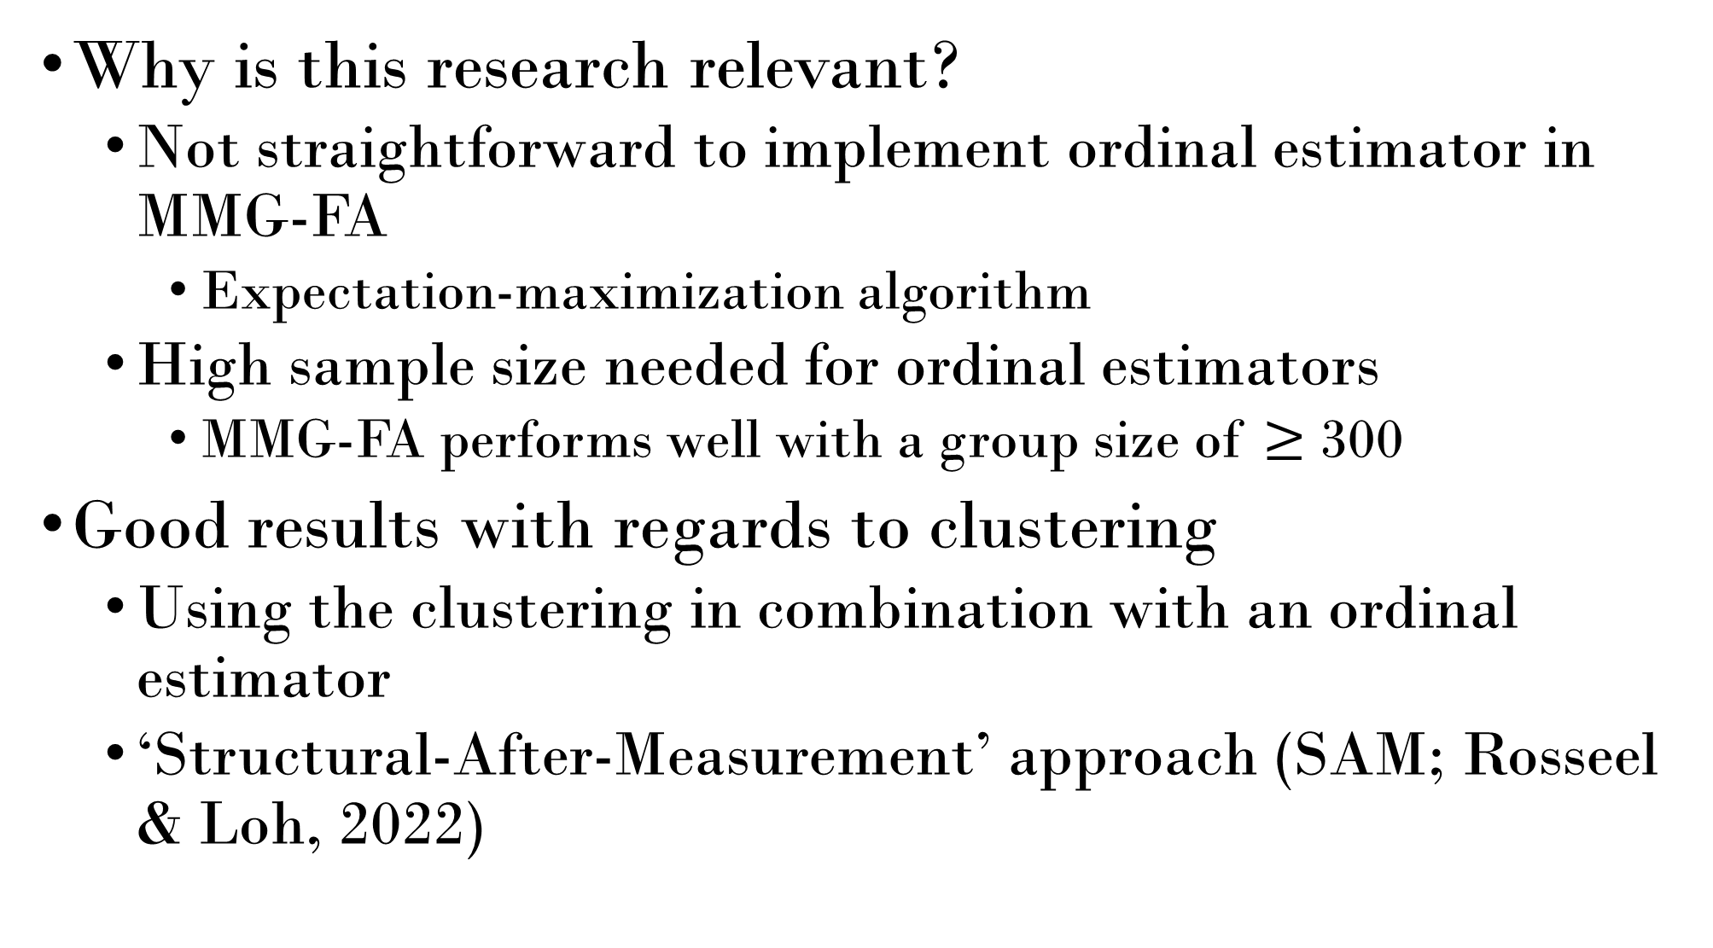
Why is this research relevant?
  Not straightforward to implement ordinal estimator in MMG-FA
    Expectation-maximization algorithm
  High sample size needed for ordinal estimators
    MMG-FA performs well with a group size of $≥$ 300
Good results with regards to clustering
  Using the clustering in combination with an ordinal estimator
  ‘Structural-After-Measurement’ approach (SAM; Rosseel & Loh, 2022)

Slide 18
Next steps
Mean structure
  Scalar invariance: item intercepts cluster-specific
  Over-extraction of clusters (based on mixture-modeling literature)
    Higher asymmetry (Bauer & Curran, 2003 ; Guerra-Peña & Steinley, 2016)
Pairwise Maximum Likelihood (PML; Katsikatsou et al., 2012)
  Based on Full Information Maximum Likelihood (FIML)
  Suited for ordinal data
    Estimates loadings, factor correlations and thresholds simultaneously
  Already used in mixture models

Slide 19
References
Bauer, D. J., & Curran, P. J. (2003). Distributional Assumptions of Growth Mixture Models: Implications for Overextraction of Latent Trajectory Classes. Psychological Methods, 8(3), 338–363. https://doi.org/10.1037/1082-989x.8.3.338
Chen, F. F. (2008). What happens if we compare chopsticks with forks? The impact of making inappropriate comparisons in cross-cultural research. Journal Of Personality And Social Psychology, 95(5), 1005–1018. https://doi.org/10.1037/a0013193
De Roover, K., Vermunt, J. K., & Ceulemans, E. (2022). Mixture multigroup factor analysis for unraveling factor loading noninvariance across many groups. Psychological Methods, 27(3), 281–306. https://doi.org/10.1037/met0000355
DiStefano, C. (2002). The Impact of Categorization With Confirmatory Factor Analysis. Structural Equation Modeling A Multidisciplinary Journal, 9(3), 327–346. https://doi.org/10.1207/s15328007sem0903_2
Dolan, C. V. (1994). Factor analysis of variables with 2, 3, 5 and 7 response categories: A comparison of categorical variable estimators using simulated data. British Journal Of Mathematical And Statistical Psychology, 47(2), 309–326. https://doi.org/10.1111/j.2044-8317.1994.tb01039.x
Guerra-Peña, K., & Steinley, D. (2016). Extracting spurious latent classes in growth mixture modeling with nonnormal errors. Educational And Psychological Measurement, 76(6), 933–953. https://doi.org/10.1177/0013164416633735
Jöreskog, K. G. (1971). Simultaneous factor analysis in several populations. Psychometrika, 36(4), 409–426. https://doi.org/10.1007/bf02291366
Li, C. (2015). Confirmatory factor analysis with ordinal data: Comparing robust maximum likelihood and diagonally weighted least squares. Behavior Research Methods, 48(3), 936–949. https://doi.org/10.3758/s13428-015-0619-7
Meredith, W. (1993). Measurement invariance, factor analysis and factorial invariance. Psychometrika, 58(4), 525–543. https://doi.org/10.1007/bf02294825
Micceri, T. (1989). The unicorn, the normal curve, and other improbable creatures. Psychological Bulletin, 105(1), 156–166. https://doi.org/10.1037/0033-2909.105.1.156
Rhemtulla, M., Brosseau-Liard, P. É., & Savalei, V. (2012). When can categorical variables be treated as continuous? A comparison of robust continuous and categorical SEM estimation methods under suboptimal conditions. Psychological Methods, 17(3), 354–373. https://doi.org/10.1037/a0029315
Sen, S., Cohen, A. S., & Kim, S. (2015). Robustness of Mixture IRT Models to Violations of Latent Normality. In Springer proceedings in mathematics & statistics (pp. 27–43). https://doi.org/10.1007/978-3-319-07503-7_3
Sörbom, D. (1974). A GENERAL METHOD FOR STUDYING DIFFERENCES IN FACTOR MEANS AND FACTOR STRUCTURE BETWEEN GROUPS. British Journal Of Mathematical And Statistical Psychology, 27(2), 229–239. https://doi.org/10.1111/j.2044-8317.1974.tb00543.x

Slide 20
Thank you for your attention!

