Slide 1
Using Cognitive Diagnostic Models for Criterion-Referenced Standard Setting in Legal Literacy Assessment
Daria Gracheva

Slide 2
Legal literacy is understood as a set of knowledge, skills and values ​​necessary to understand, interpret and apply legal norms in everyday life
Legal literacy usually discussed within broader civic constructs without targeted measurement of legal understanding or application and remains underexplored in international assessments
International Civic and Citizenship Education Study (ICCS 2022) reveal a declining trend in civic knowledge and engagement across participating countries (ICCS 2022 European Report, 2024).
The need for more granular, diagnostic assessment of legal literacy

Slide 3
“Traditional” assessment
IRT models with continuous latent trait
More simple structure: one or several latent constructs without much detail
Rank-ordering students
Proficiency levels for overall performance
Diagnostic assessment
Cognitive diagnostic models (CDMs) - performance is based on a binary latent attribute vector, such as 1,0,0,0
More detailed structure: Multiple skills (attributes) measured
Classify students: mastery or non-mastery of specific attribute

Slide 4
How CDMs can help to get more detailed results and feedback for Legal Literacy Assessment?
Combine detailed diagnostic feedback and three proficiency levels
This study aims to examine how well a CDM-based approach fits the structure of the Legal Literacy Assessment Tool in terms of providing both detailed diagnostic insights at the topic level and overall feedback aligned with proficiency levels
We use Legal Literacy Assessment Tool, designed specifically for 9th-grade students in a form of scenario-based tasks. Test development was guided by the Evidence-Centered Design (ECD) framework (Mislevy et al., 2003).

Slide 5
Legal literacy is as a system of competencies formed on the basis of legal knowledge and values, which are essential for the development of civic identity and for effective participation in all domains of social life.
*based on international conceptualizations of civic and legal competence (Council of Europe, 2016; OECD, 2019; Eurydice, 2017; Fraillon et al., 2023), recent empirical studies (Ozkaya & Colak, 2024; Habbig & Robeyns, 2022; Masesjans et al., 2022; Xu & An, 2024), and national education standards (Russian FGOS, 2021).
Three domains:
Social Values and Norms
  Interpersonal relationships and conflict resolution;
  Moral and social norms as regulators of behavior;
  The role of law in social cohesion.
Constitutional Foundations
  The Constitution as the fundamental law;
  Civil and human rights and responsibilities;
  Legal foundations of citizenship and state governance.
Legal Status and Responsibility of the Individual
  Legal capacity and liability;
  Understanding unlawful behavior and sanctions;

Slide 6
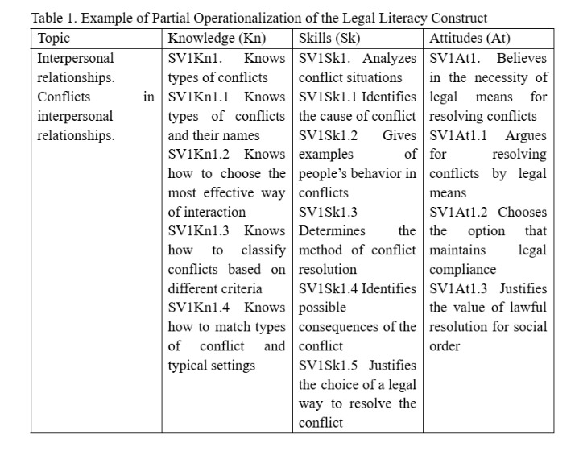
Observable indicators
Each domain was further articulated into specific observable indicators representing knowledge, skills, and attitudes.
Scenario tasks were designed to embed these indicators in a digital simulation.

Slide 7
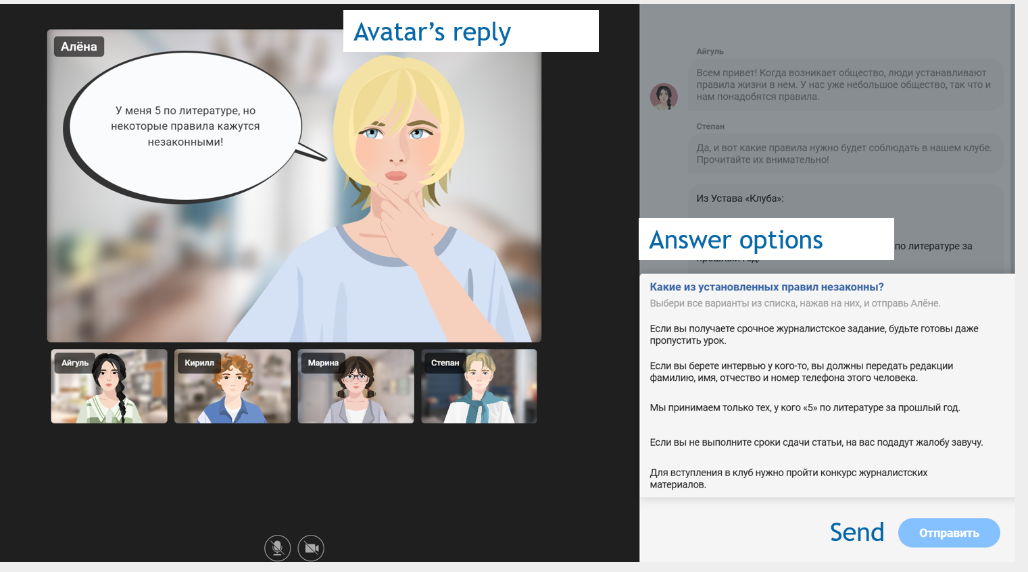
Instrument
Scenario-based tasks: chat with avatars with pre-defined answer options
Students choose answers and send to the chat
The test consists of 30 items, including 11 dichotomous and 19 polytomous items (from 2 to 7 items per topic).
Three proficiency levels: developing, basic, advanced

Slide 8
Previous studies explore how results from CDMs correspond to outcomes derived from traditional standard setting methods.
Compare CDM profiles with results from proficiency levels set by traditional standard setting methods (Angoff, Bookmark, etc).
Propose a new method of standard setting based on CDM diagnostic profiles
Skaggs, G., Hein, S. F., & Wilkins, J. L. (2016)
Min, S., & He, L. (2022)
Relative Diagnostic Profile (RDP)
Liu, R., Qian, H., Luo, X., & Woo, A. (2018)
Diagnostic Profile Method
Skaggs, G., Hein, S. F., & Wilkins, J. L. (2020)
Mastery profile method
Clark, A. K., Nash, B., Karvonen, M., & Kingston, N. (2017).

Slide 9
Current study: Combine detailed diagnostic profiles and three proficiency levels in Q matrix
Q-matrix was designed to reflect both the specific content domain (topics) assessed by each item and the expected proficiency level associated with each item category, based on expert judgment.
Item | Category | Topic 1 | Topic 2
1 | 1 | 1 | 0
2 | 1 | 0 | 1
3 | 1 | 1 | 0
3 | 2 | 1 | 0
Work with categories due to polytomous items
Some topics were combined due to small number of indicators = 7 topics overall
For example, in Item 3, both score categories (1 and 2) are associated with the same content topic (Topic 1).

Slide 10
Current study: Combine detailed diagnostic profiles and three proficiency levels in Q matrix
Item | Category | Topic 1 | Topic 2 | Threshold 1 | Threshold 2
1 | 1 | 1 | 0 | 1 | 0
2 | 1 | 0 | 1 | 0 | 1
3 | 1 | 1 | 0 | 1 | 0
3 | 2 | 1 | 0 | 0 | 1
Experts reviewed proficiency level descriptors and evaluated which items students at different proficiency levels would be likely to answer correctly
For polytomous items decision was made for each category
This information was used to create Q matrix
For item 3:
Category 1 indicates that the student has likely passed the threshold between the developing and basic levels but has not yet reached the advanced level.
Category 2 suggest that the student has likely passed both the basic and advanced thresholds.
Three proficiency levels = 2 thresholds

Slide 11
Methodology and sample
The sequential attribute CDM model (Ma & de la Torre, 2016) employed dichotomous attributes to represent different achievement levels
Multiple CDM models DINA, RRUM, LLM, ACDM, and GDINA were calibrated and compared using the GDINA package in R (Ma & de la Torre, 2020).
Model comparisons were based on Akaike Information Criterion (AIC) and Bayesian Information Criterion (BIC), with lower values indicating better model fit. Classification accuracy as a measure of reliability in CDM was calculated for each attribute.
The study sample included 767 9th grade students. Analysis was conducted in R software.

Slide 12
Choose best model
Model | Npar | AIC | BIC | chisq diff
GDINA | 691 | 35165 | 38373
ITEM-SP | 645 | 35153 | 38148 | 81
DINA | 609 | 35358 | 38185 | 357
DINO | 609 | 35435 | 38262 | 434
ACDM | 650 | 35200 | 38218 | 117
LLM | 650 | 35177 | 38195 | 95
RRUM | 650 | 35193 | 38211 | 110
ITEM-SP model – item-specific CDM
Linear logistic model was chosen

Slide 13
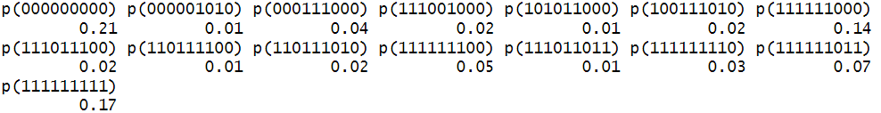
Reliability (Classification accuracy)
Topic 1 | Topic 2 | Topic 3 | Topic 4 | Topic 5 | Topic 6 | Topic 7 | Threshold 1 | Threshold 2
0,93 | 0,90 | 0,88 | 0,87 | 0,92 | 0,93 | 0,95 | 0,88 | 0,85
Profiles
In the model, we have 512 profiles. Profiles with 1% of sample or more:

Slide 14
Threshold results
The model determines the threshold level of legal literacy achieved by each test taker.
Based on the highest threshold passed, we classify the overall level of Legal Literacy:
if Threshold 1 is not mastered, the level is considered developing;
if Threshold 1 is mastered but Threshold 2 is not, the respondent is classified at the basic level;
if both Threshold 1 and Threshold 2 are mastered, the level is considered advanced.
Students at the same overall proficiency level may exhibit different profiles of mastered attributes. All information is used for feedback.

Slide 15
Compare with norm-referenced approach
Compare CDM-based proficiency levels with norm-referenced approach (factor scores from categorical CFA)
Standard setting approach | Developing, % | Basic, % | Advanced, %
Norm-reference (using mean and sd) -1 / + 1 sd | 19 | 66 | 15
Norm-reference (using mean and sd) -0.5 / + 0.5 sd | 30 | 36 | 34
Norm-reference (using mean and sd) -0.15 / 0.15 sd | 40 | 10 | 50
Criterion-referenced (CDM-based) | 56 | 10 | 32

Slide 16
Conclusion
CDMs allow to get more detailed feedback for Legal Literacy assessment and CDM can be used as measurement model for Legal Literacy construct
Proficiency levels for overall performance can be estimated using a Q-matrix with attributes for thresholds, which are defined based on achievement level descriptions and expert opinions
Compared to standard norm-reference approach based on distribution, criterion-referenced approach give differ results: percentage of students in each level
Detailed feedback CDMs are useful for decision making: learning and educational interventions, which is especially relevant in case of such construct as Legal Literacy.

Slide 17
Thank you for your attention
Daria Gracheva, HSE University
dgracheva@hse.ru

