Slide 1
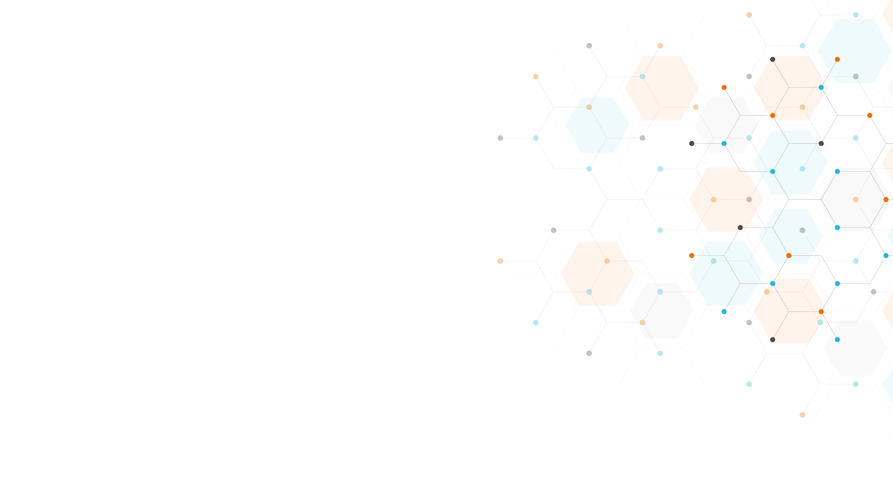

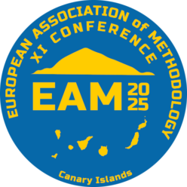

Person- or situation-specific? Factors explaining convergent validity and discrepancy between self-report and digital trace of smartphone use
Martin Tancoš, Michał Tkaczyk,
David Šmahel, Steriani Elavsky
The data described/study is from the project „Research of Excellence on Digital Technologies and Wellbeing CZ.02.01.01/00/22_008/0004583“ which is co-financed by the European Union.

Slide 2
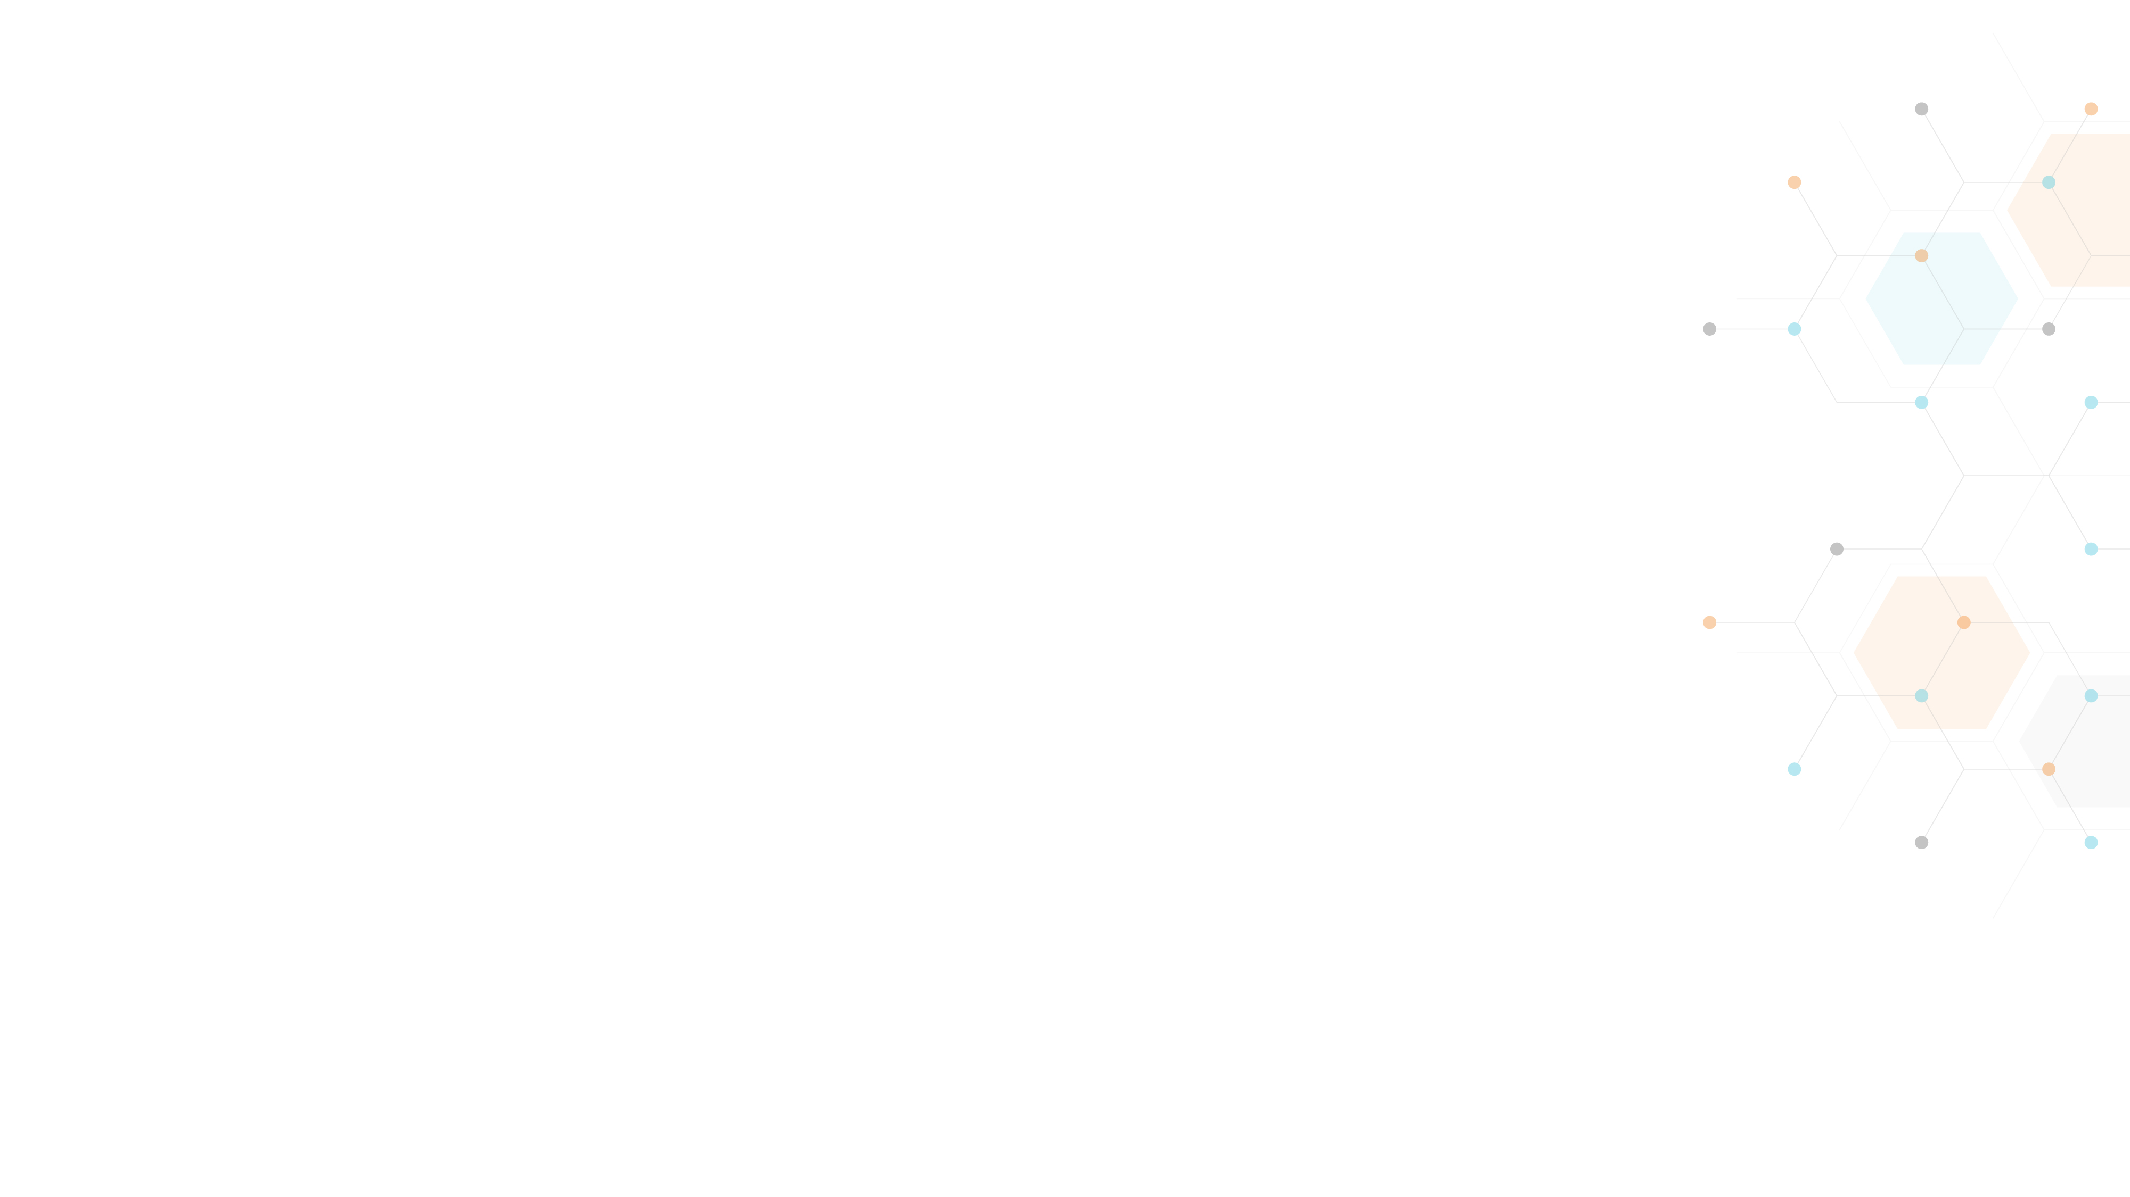

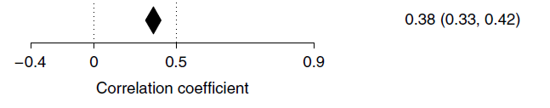
Introduction
Majority of digital media effects research has been based on self-reported estimates (Dienlin & Johannes, 2020)
Accuracy and validity of self-reported measures of digital media use has been recently questioned (Parry et al., 2021)
Innacuracy often related to central variables in question (e.g., media use itself, well-being) (Araujo et al., 2017; Sewall et al., 2020)

Slide 3
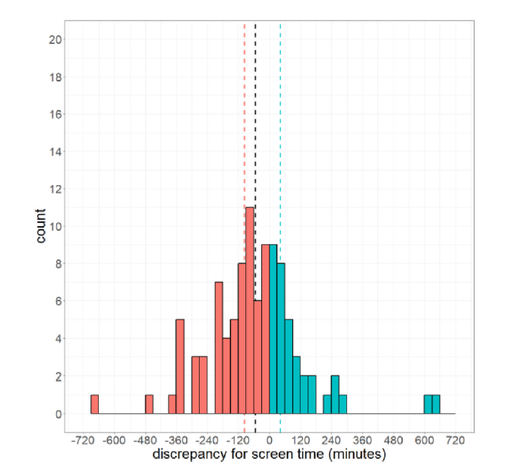
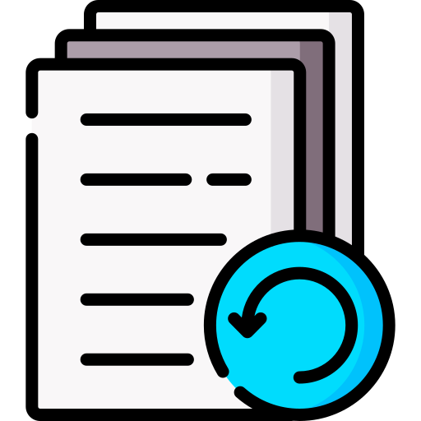
Introduction
Tkaczyk et al., 2024
Our recent study on adolescent
sample follows the trend
  between r = .40
  within r = .29
  mean discrepancy = −32 mins
  discrepancy ICC = .56

Slide 4

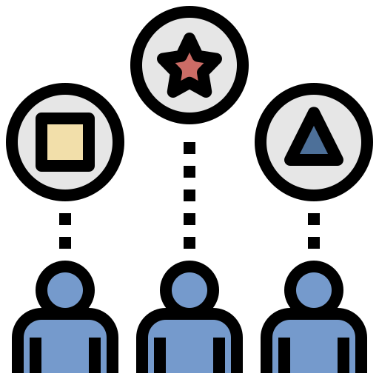
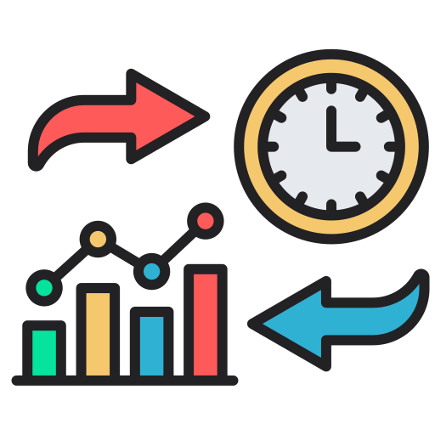
Introduction
To adress the limitations of prior research, we examined potentialy relevant factors that may affect:
  Convergent validity
  Discrepancy
Between-person | Within-person
Overall smartphone use
Mobile control self-efficacy
Screen time fragmentation | Screen time fragmentation
Overall compliance | Daily compliance
 | Weekend vs. weekdays
 | Day of study

Slide 5

Methods
Experience sampling method (ESM)
  14 days – 4 surveys per day
    Semi-random time frames
  Digital trace of smartphone use
  (every second)
  Custom built smarphone app
Self-reported smartphone use assessed in evening surveys:
    “For how long you were using your smartphone (including phone-calls, being-online, playing games, listening to music, etc.) during the day (up to this questionnaire). Enter the hours and minutes
    (e.g. enter 5.5 hours as 05:30).“
Morning Daily I Daily II Evening

Slide 6
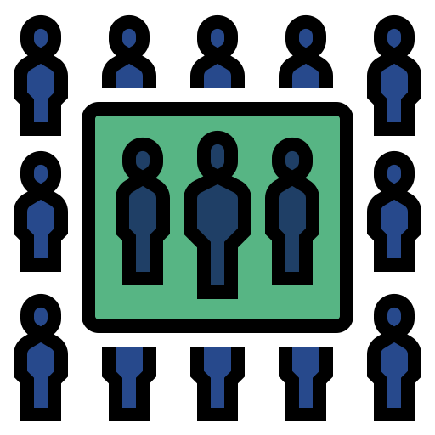
Methods
Sample – N = 132, 58 % boys, 13 to 17 y. o., Czech
  812 daily observations
  overall compliance rate: 72%
Study part of the larger research project (EXPRO) (Elavsky et al., 2022)
  four measurement bursts (per 14 days)
  we used data from the third burst

Slide 7

Analysis
We built two multilevel linear models:
  Convergent validity model
    Validity: digital trace → self-report
    Within-person level interactions
    Cross-level interactions: predictors → random slope (validity)
    Random intercept and random slope terms (with cov)
  Discrepancy model
    Discrepancy = | digital trace – self-report |
    Main effects without interactions
    Random intercept and random slope terms (with cov)
    Robustness check using complementary model with log-transformed discrepancy

Slide 8

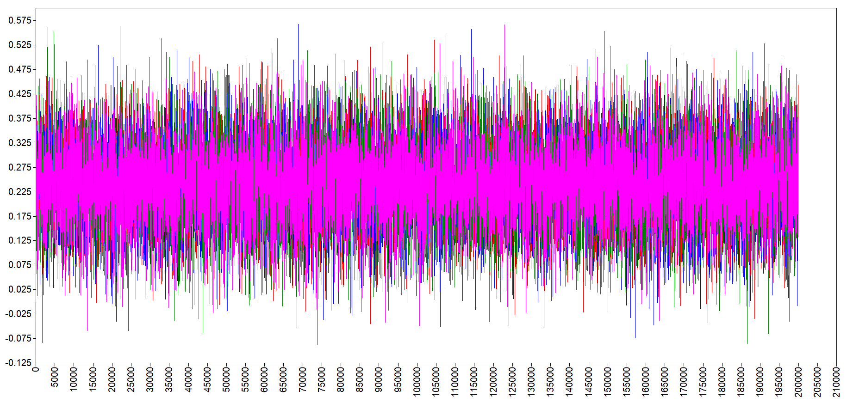
Analysis
Bayesian estimation in Mplus
  MCMC, Gibbs sampling
  4 chains, 200k iterations
  Default priors: β, τ ~ N(0, ∞); ψ ~ IW(0, −3) or IG(−1, 0)

Slide 9
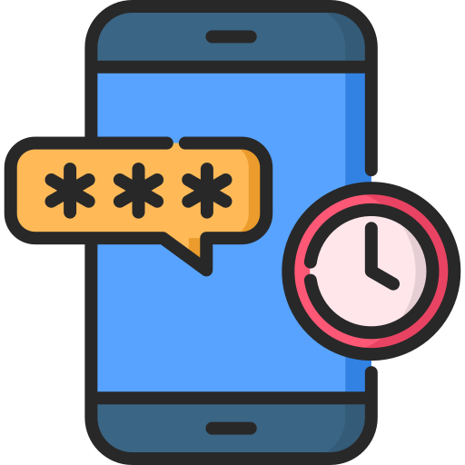
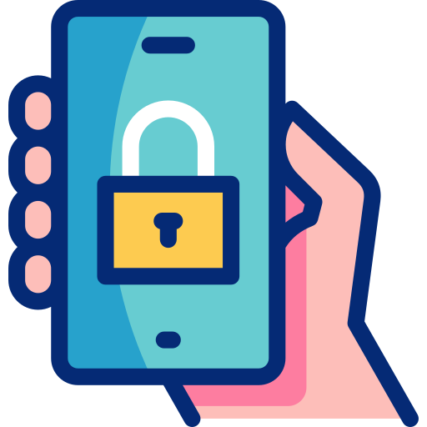
Results
Overall smartphone use
Positive relationship with discrepancy (β = .25)
Heavy smartphone users tend to underestimate their usage more severely than lighter users (Sewall et al., 2020)
Mobile control self-efficacy
No non-negligible effect

Slide 10


Results
Smartphone use fragmentation
Measured by time per interaction
  TPI = screen time / # interactions
Less within-person fragmentation related to more discrepancy (β = .18)
Opposite to our hypothesis and prior evidence
Compliance with the study protocol
Undirect measure of the motivation to participate
No non-negligible effects on either between or within-person level

Slide 11

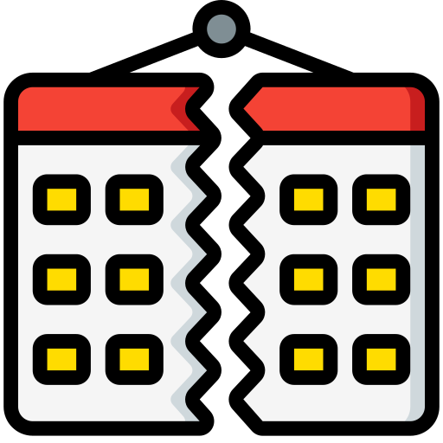
Results
Weekend vs. weekdays
No non-negligible effects
Day of study
Two concurrent hypotheses
  learning effect and fatigue effect (Verbeij et al., 2021)
Decreasing convergent validity with increasing days (β = −.07)
  Suggesting fatigue effect

Slide 12
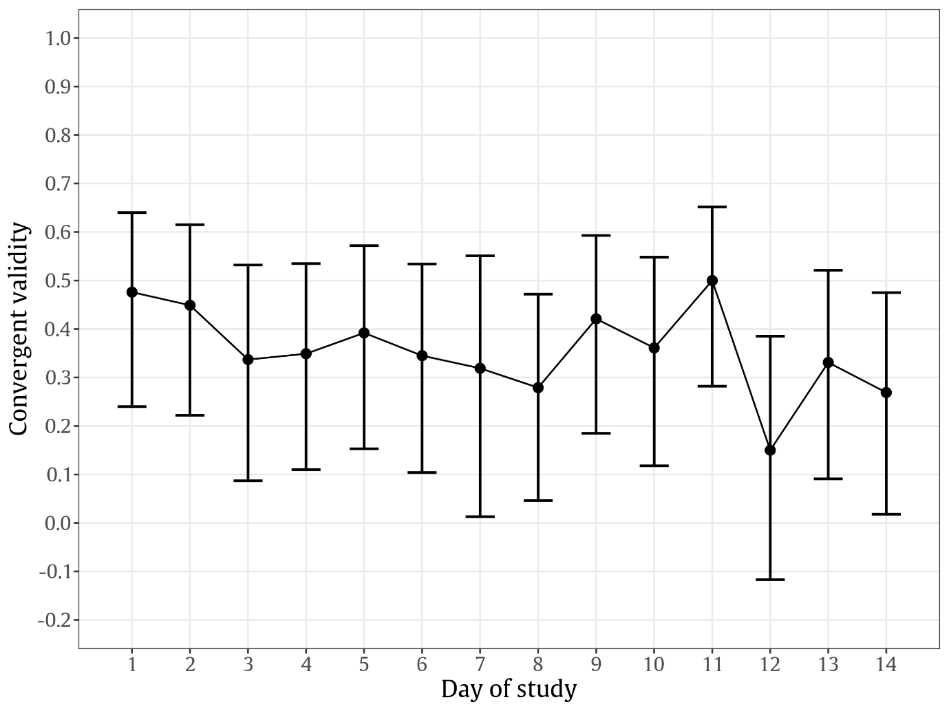
Results

Slide 13
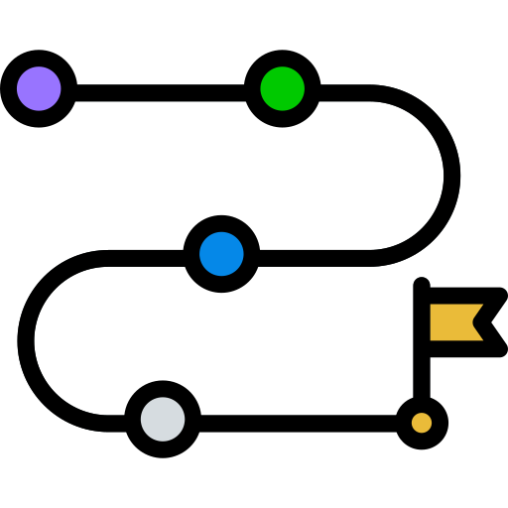

Conclusions
The nuanced daily variations underscore the complexity of measuring digital behavior
highlighting the importance of context in the understanding of self-reported smartphone use
These findings are particularly relevant for future research designs on the effects of digital media use
Limitations
Digital trace data are not „objective“ or exact measure of smarthphone use behavior – measurement error
Low power for between-person effects
Limited generalizability

Slide 14
References
Araujo, T., Wonneberger, A., Neijens, P., & De Vreese, C. (2017). How Much Time Do You Spend Online? Understanding and Improving the Accuracy of Self-Reported Measures of Internet Use. Communication Methods and Measures, 11(3), 173–190. https://doi.org/10.1080/19312458.2017.1317337
Dienlin, T., & Johannes, N. (2020). The impact of digital technology use on adolescent well-being. Dialogues in Clinical Neuroscience, 22(2), 135–142. https://doi.org/10.31887/DCNS.2020.22.2/tdienlin
Elavsky, S., Blahošová, J., Lebedíková, M., Tkaczyk, M., Tancoš, M., Plhák, J., Sotolář, O., & Šmahel, D. (2022). Researching the Links Between Smartphone Behavior and Adolescent Well-being With the FUTURE-WP4 (Modeling the Future: Understanding the Impact of Technology on Adolescent’s Well-being Work Package 4) Project: Protocol for an Ecological Momentary Assessment Study. JMIR Research Protocols, 11 (3), Article e35984. https://doi.org/10.2196/35984
Parry, D. A., Davidson, B. I., Sewall, C. J. R., Fisher, J. T., Mieczkowski, H., & Quintana, D. S. (2021). A systematic review and meta-analysis of discrepancies between logged and self-reported digital media use. Nature Human Behaviour, 5(11), 1535–1547. https://doi.org/10.1038/s41562-021-01117-5
Sewall, C. J. R., Bear, T. M., Merranko, J., & Rosen, D. (2020). How psychosocial well-being and usage amount predict inaccuracies in retrospective estimates of digital technology use. Mobile Media & Communication, 8(3), 379–399. https://doi.org/10.1177/2050157920902830
Tkaczyk, M., Tancoš, M., Smahel, D., Elavsky, S., & Plhák, J. (2024). (In)accuracy and convergent validity of daily end-of-day and single-time self-reported estimations of smartphone use among adolescents. Computers in Human Behavior, 158, 108281. https://doi.org/10.1016/j.chb.2024.108281
Verbeij, T., Pouwels, J. L., Beyens, I., & Valkenburg, P. M. (2021). The accuracy and validity of self-reported social media use measures among adolescents. Computers in Human Behavior Reports, 3, 100090. https://doi.org/10.1016/j.chbr.2021.100090

Slide 15
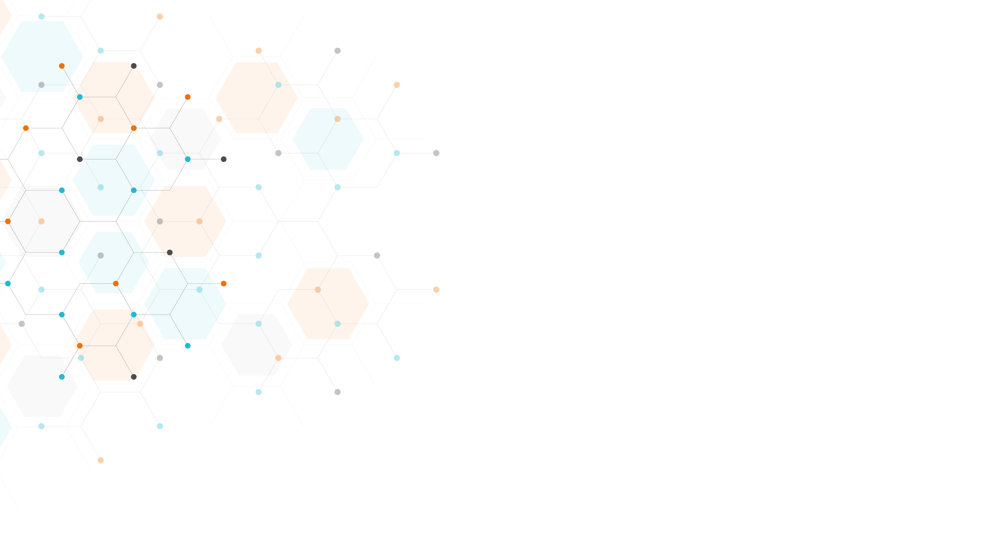
The data described/study is from the project „Research of Excellence on Digital Technologies and Wellbeing CZ.02.01.01/00/22_008/0004583“ which is co-financed by the European Union.

